Slide 1

2023.10.10
Malicious Code Analysis
Fangtian Zhong
CSCI 591
Gianforte School of Computing
Norm Asbjornson College of Engineering
E-mail: fangtian.zhong@montana.edu

Slide 2
Overview
DOS Header
01
NT Header
02

Slide 3

Part One
DOS Header
01

Slide 4
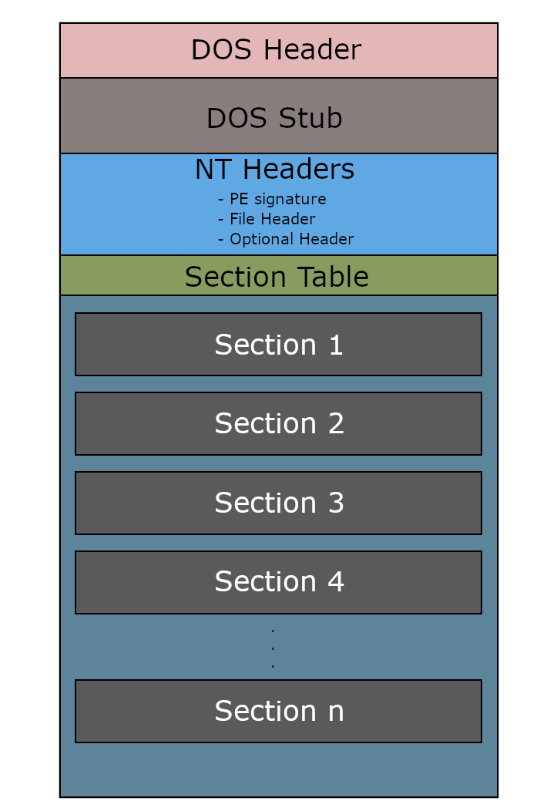
PE

Slide 5


DOS Header
The DOS header (also called the MS-DOS header) is a 64-byte-long structure that exists at the start of the PE file.

Slide 6
DOS Header
typedef struct _IMAGE_DOS_HEADER { // DOS .EXE header
WORD e_magic; // Magic number
WORD e_cblp; // Bytes on last page of file
WORD e_cp; // Pages in file
WORD e_crlc; // Relocations
WORD e_cparhdr; // Size of header in paragraphs
WORD e_minalloc; // Minimum extra paragraphs needed
WORD e_maxalloc; // Maximum extra paragraphs needed
WORD e_ss; // Initial (relative) SS value
WORD e_sp; // Initial SP value
WORD e_csum; // Checksum
WORD e_ip; // Initial IP value
WORD e_cs; // Initial (relative) CS value
WORD e_lfarlc; // File address of relocation table
WORD e_ovno; // Overlay number
WORD e_res[4]; // Reserved words
WORD e_oemid; // OEM identifier (for e_oeminfo)
WORD e_oeminfo; // OEM information; e_oemid specific
WORD e_res2[10]; // Reserved words
LONG e_lfanew; // File address of new exe header
} IMAGE_DOS_HEADER, *PIMAGE_DOS_HEADER;

Slide 7
Fields
e_magic
e_lfanew
This is the last member of the DOS header structure, it’s located at offset 0x3C into the DOS header and it holds an offset to the start of the NT headers. This member is important to the PE loader on Windows systems because it tells the loader where to look for the file header.
This is the first member of the DOS Header, it’s a WORD so it occupies 2 bytes, it’s usually called the magic number. It has a fixed value of 0x5A4D or MZ in ASCII, and it serves as a signature that marks the file as an MS-DOS executable.

Slide 8
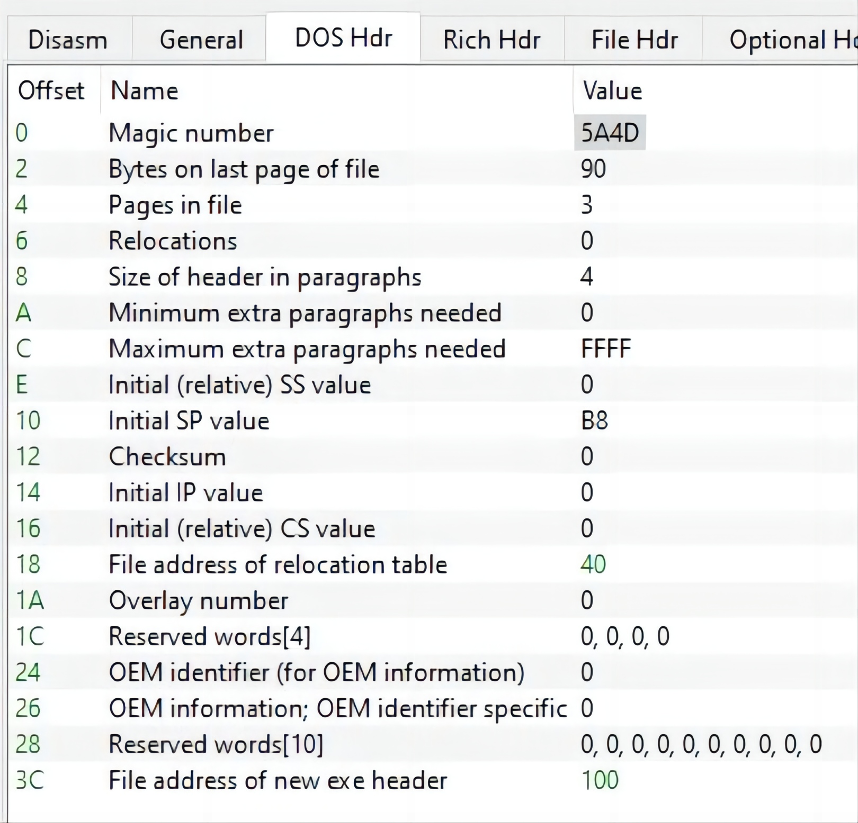

Examples

Slide 9
Explanations
As you can see, the first member of the header is the magic number with the fixed value we talked about which was 5A4D.
The last member of the header (at offset 0x3C) is given the name “File address of new exe header”, it has the value 100, we can follow to that offset and we’ll find the start of the NT headers as expected:
 | 0 | 1 | 2 | 3 | 4 | 5 | 6 | 7 | 8 | 9 | A | B | C | D | E | F
100 | 50 | 45 | 00 | 00 | 64 | 86 | 06 | 00 | 03 | DE | 59 | 61 | 00 | 00 | 00 | 00
110 | 00 | 00 | 00 | 00 | F0 | 00 | 22 | 00 | 0B | 02 | 0E | 1A | 00 | 0E | 00 | 00
0 | 1 | 2 | 3 | 4 | 5 | 6 | 7 | 8 | 9 | A | B | C | D | E | F
P | E | . | . | d | . | . | . | . | & | Y | a | . | . | . | .
. | . | . | . | a | . | ” | . | . | . | . | . | . | . | . | .

Slide 10

DOS Stub
This is a small segment of code at the beginning of the file that is executed by the MS-DOS operating system to display an error message if the file is not compatible with the operating system.
This is what gets executed when the program is loaded in MS-DOS, the default error message is “This program cannot be run in DOS mode.”, however this message can be changed by the user during compile time.

Slide 11
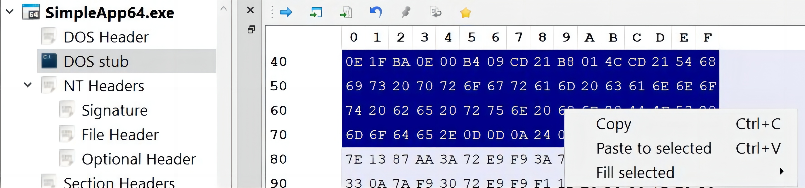
DOS Stub
To be able to disassemble the machine code of the DOS stub, I copied the code of the stub from PE-bear, then I created a new file with the stub contents using a hex editor (HxD).

Slide 12
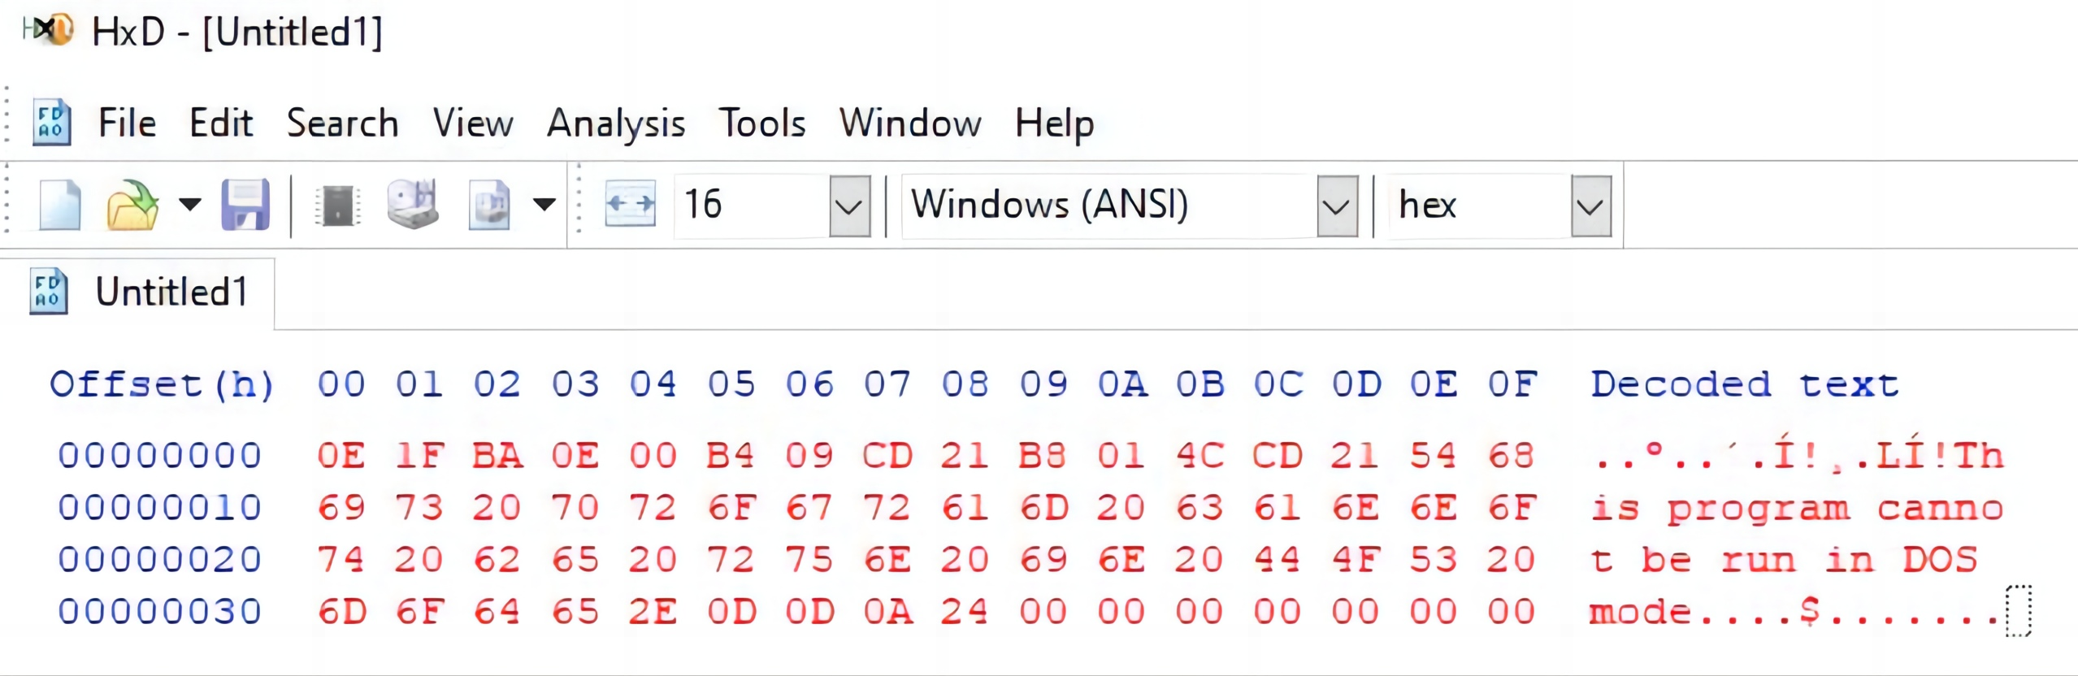
DOS Stub

Slide 13
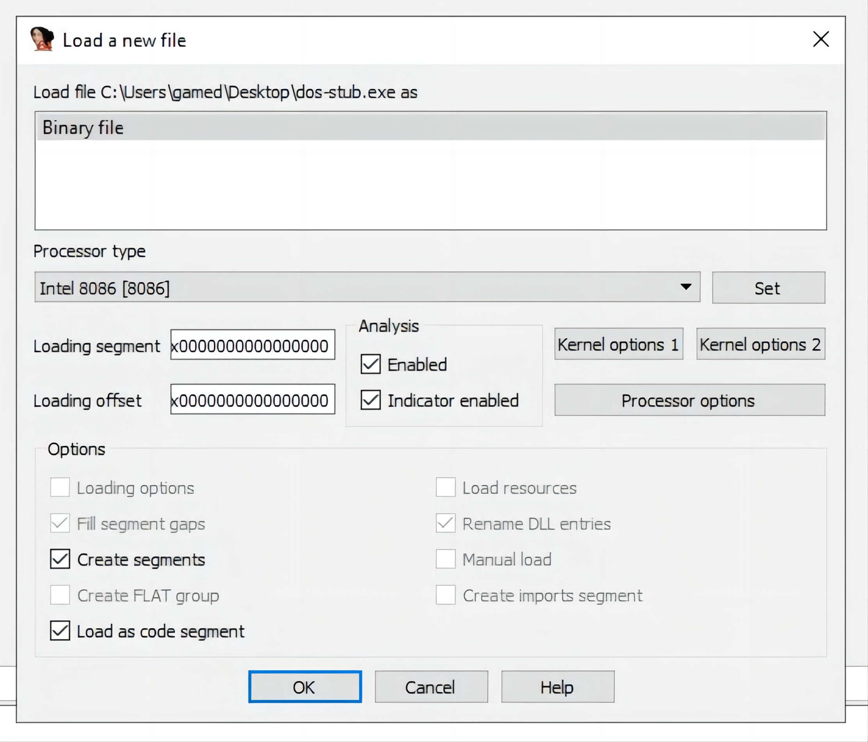
Assembly
After that I used IDA to disassemble the executable, MS-DOS programs are 16-bit programs, so I chose the intel 8086 processor type and the 16-bit disassembly mode.

Slide 14
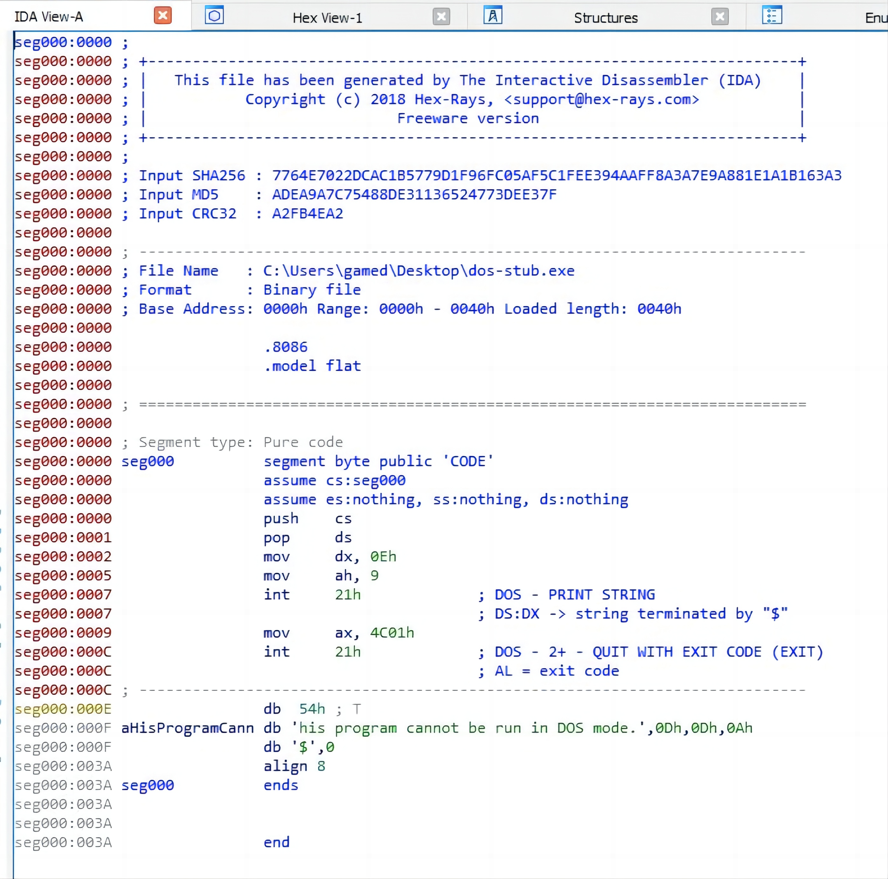
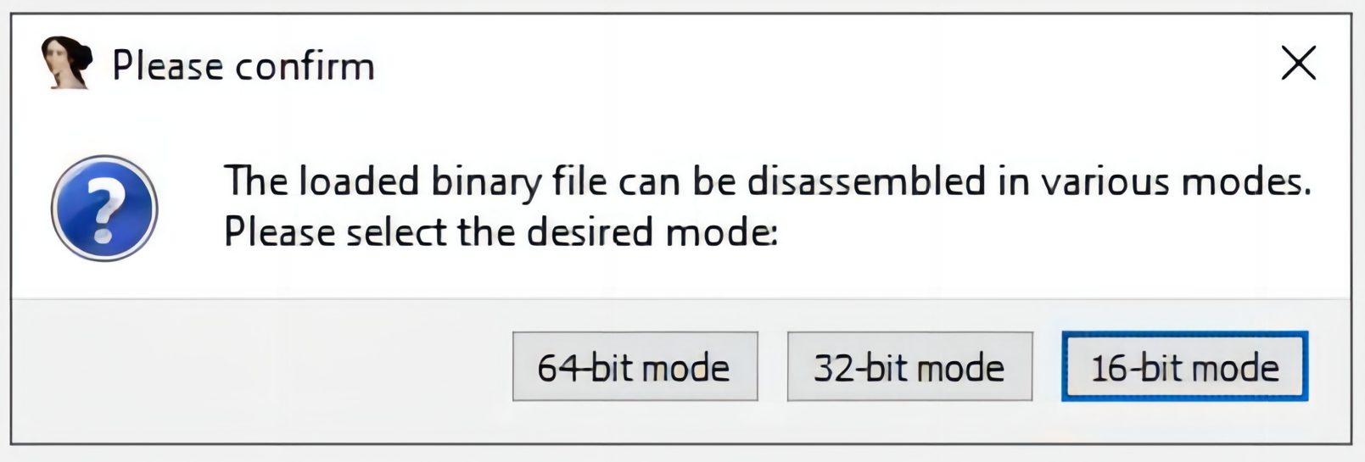
Assembly

Slide 15
Assembly
seg000:0000 | push | cs
seg000:0001 | pop | ds
First line pushes the value of cs onto the stack and the second line pops that value from the top of stack into ds. This is just a way of setting the value of the data segment to the same value as the code segment.

Slide 16
Assembly
seg000:0002 mov dx, 0Eh
seg000:0005 mov ah, 9
seg000:0007 int 21h ; DOS - PRINT STRING
seg000:0007 ; DS:DX -> string terminated by "$"
These three lines are responsible for printing the error message, first line sets dx to the address of the string “This program cannot be run in DOS mode.” (0xe), second line sets ah to 9 and the last line invokes interrupt 21h.
Interrupt 21h is a DOS interrupt (API call) that can do a lot of things, it takes a parameter that determines what function to execute and that parameter is passed in the ah register. We see here that the value 9 is given to the interrupt, 9 is the code of the function that prints a string to the screen, that function takes a parameter which is the address of the string to print, that parameter is passed in the dx register as we can see in the code.

Slide 17
Assembly
seg000:0009 mov ax, 4C01h
seg000:000C int 21h ; DOS - 2+ - QUIT WITH EXIT CODE (EXIT)
seg000:000C ; AL = exit code
The last three lines of the program are again an interrupt 21h call. There’s a mov instruction that puts 0X4C01 into ax. This sets al to 0x01 and ah to 0x4c.
0x4c is the function code of the function that exits with an error code, it takes the error code from al, which in this case is 1.
In summary, all the DOS stub is doing is print the error message then exit with code 1.

Slide 18
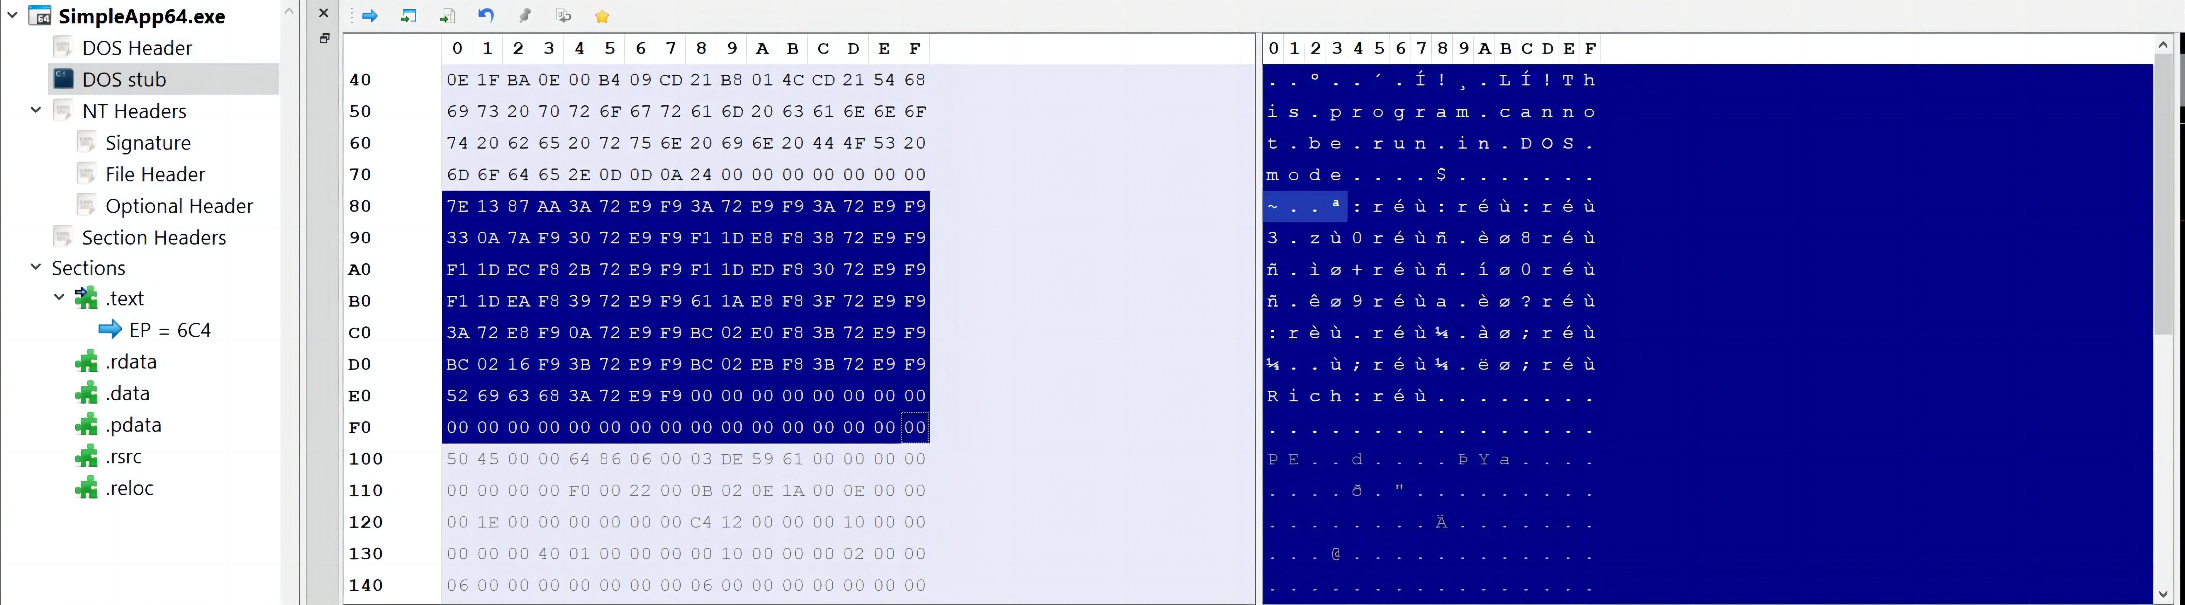
Rich Header
We’ve seen the DOS Header and the DOS Stub, however there’s still a chunk of data we haven’t talked about lying between the DOS Stub and the start of the NT Headers.

Slide 19

Rich Header
That’s only present in executables built using the Microsoft Visual Studio toolset.
This structure holds some metadata about the tools used to build the executable like their names or types and their specific versions and build numbers.
The Rich Header consists of a chunk of XORed data followed by a signature (Rich) and a 32-bit checksum value that is the XOR key.

Slide 20

Rich Header
The encrypted data consists of a DWORD signature DanS, 3 zeroed-out DWORDs for padding, then pairs of DWORDS each pair representing an entry, and each entry holds a tool name, its build number and the number of times it’s been used.
In each DWORD pair the first pair holds the type ID or the product ID in the high WORD and the build ID in the low WORD, the second pair holds the use count.

Slide 21
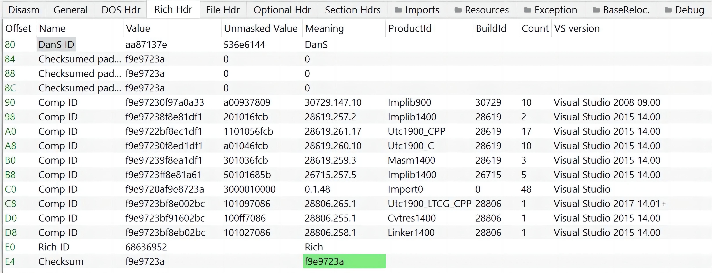
Rich Header

Slide 22
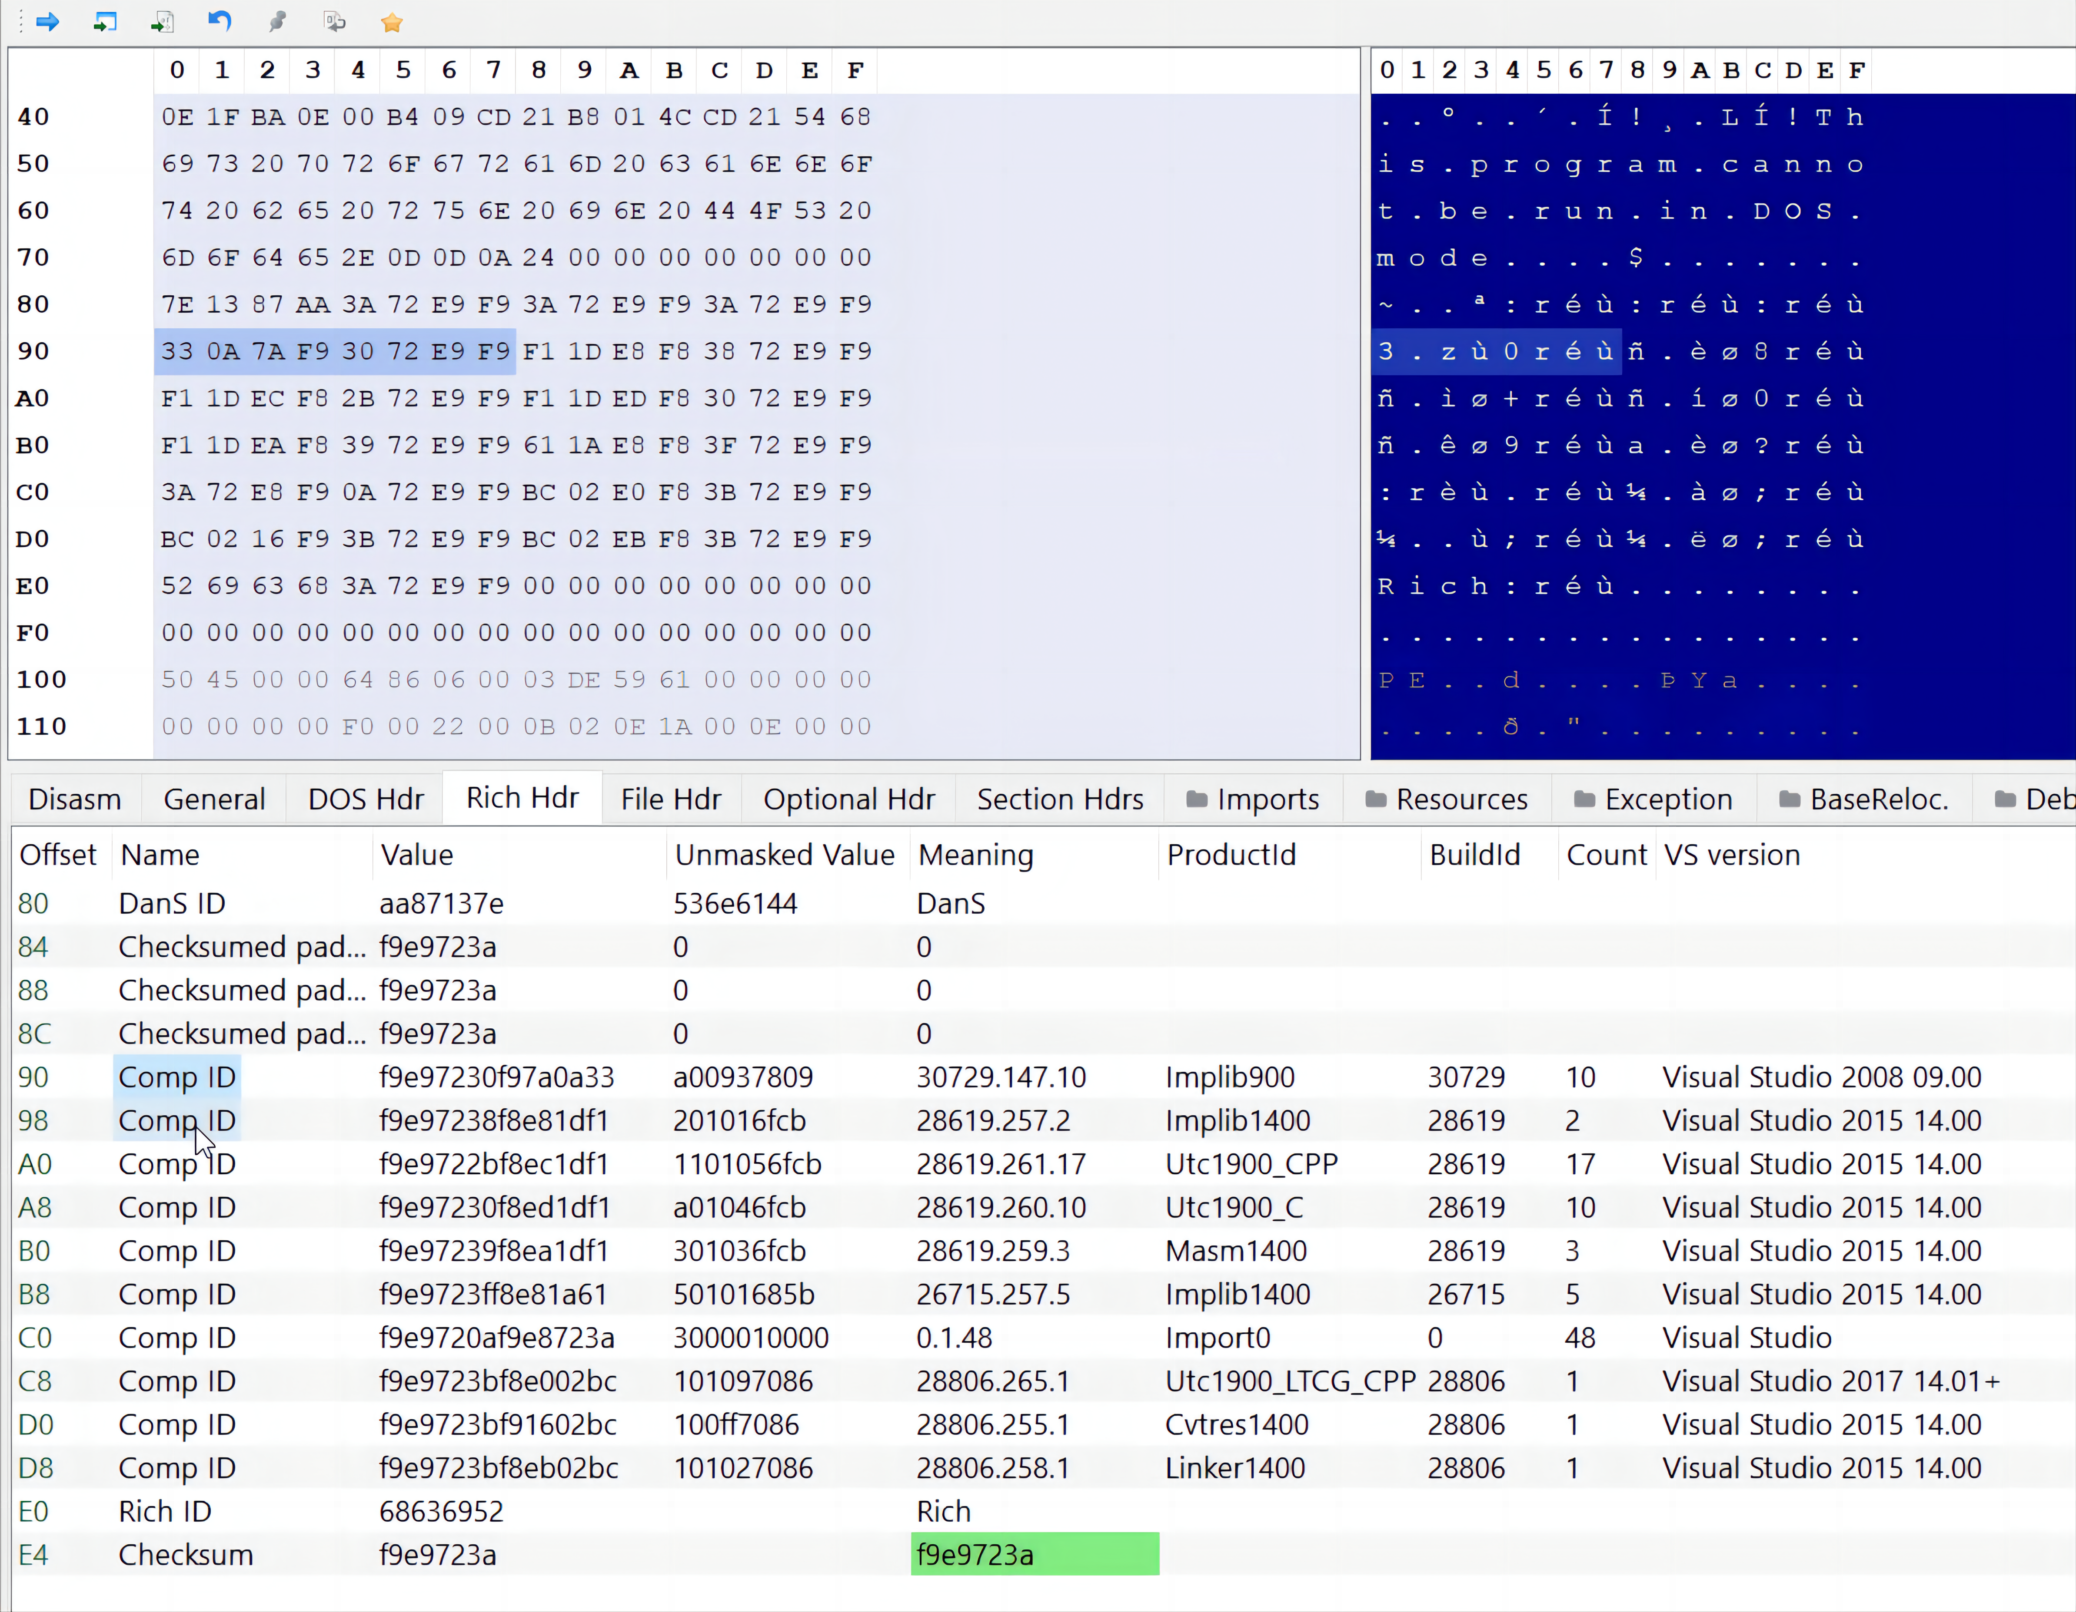
Rich Header

Slide 23
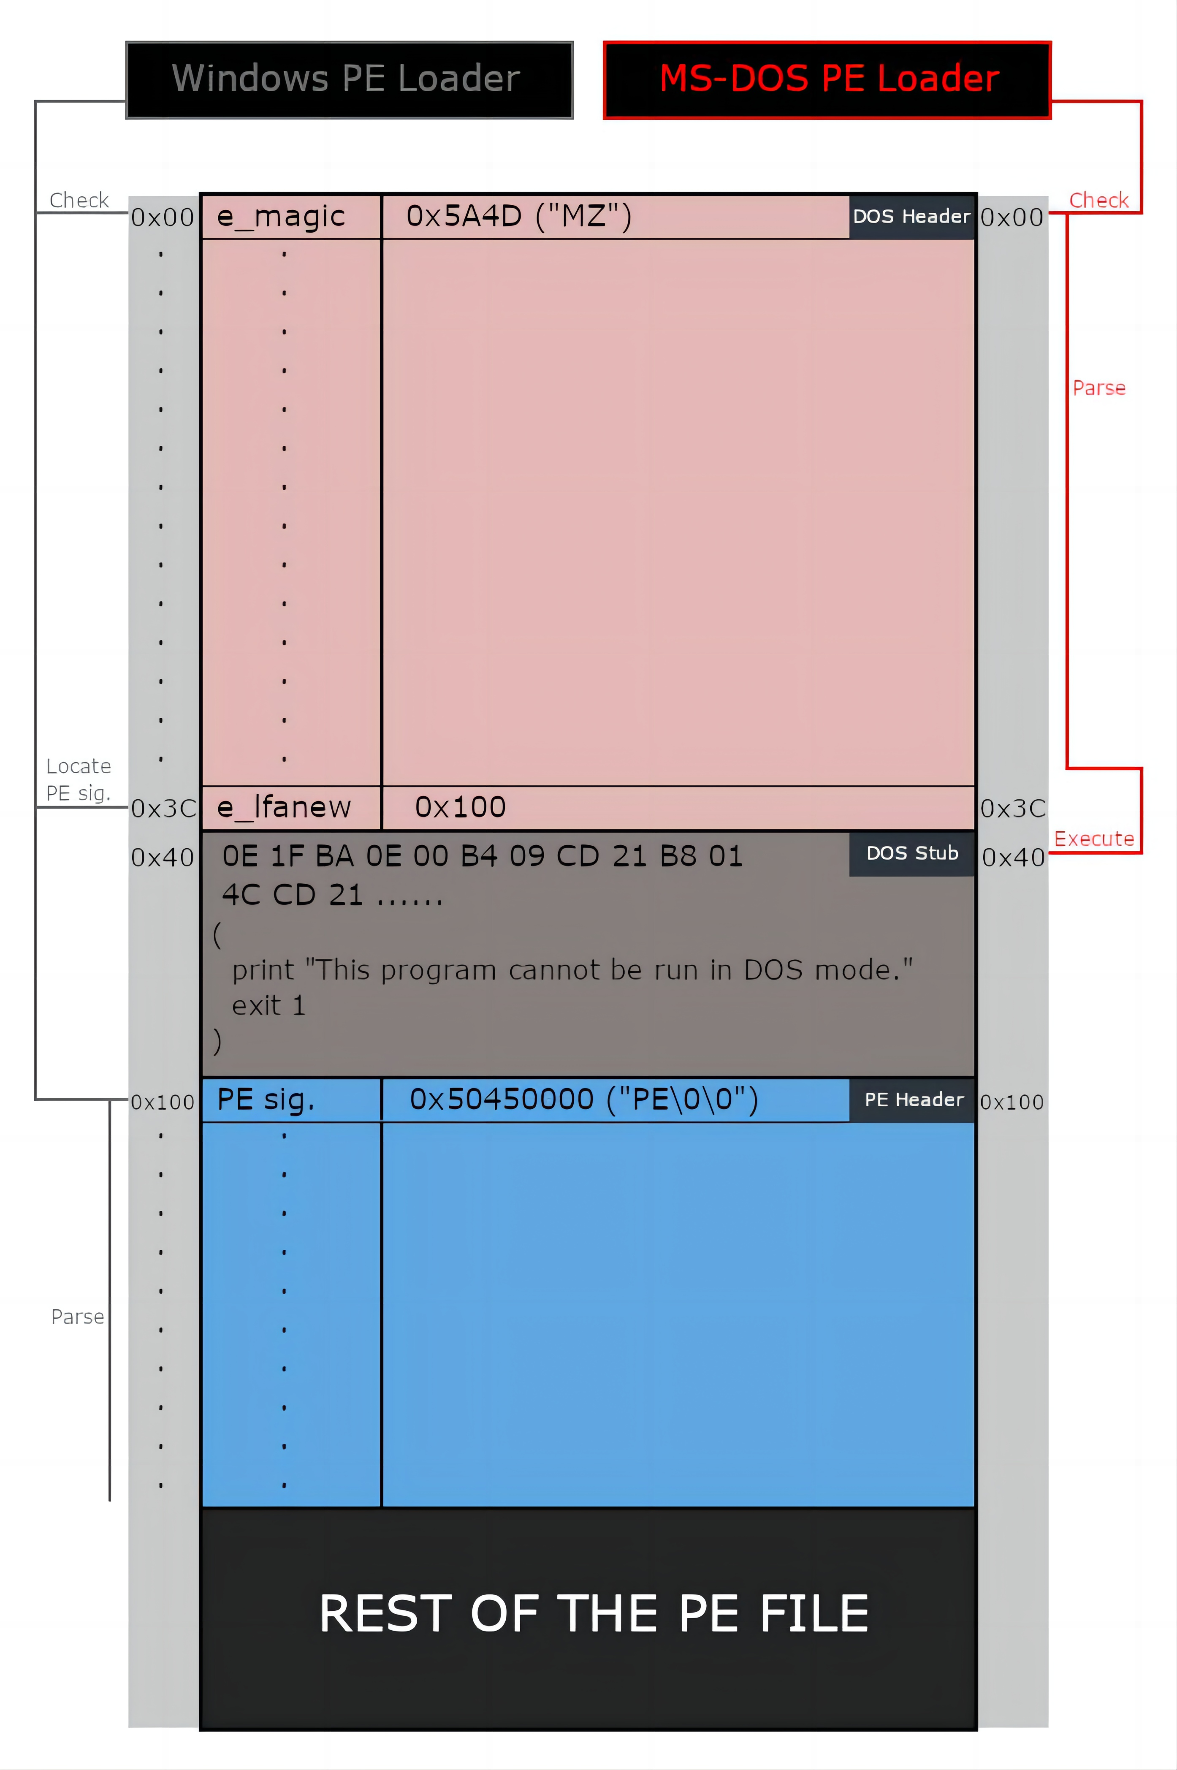
PE Structure

Slide 24
Part Two
NT Header
02

Slide 25
NT Header
typedef struct _IMAGE_NT_HEADERS64 {
DWORD Signature;
IMAGE_FILE_HEADER FileHeader;
IMAGE_OPTIONAL_HEADER64 OptionalHeader;
} IMAGE_NT_HEADERS64, *PIMAGE_NT_HEADERS64;
typedef struct _IMAGE_NT_HEADERS {
DWORD Signature;
IMAGE_FILE_HEADER FileHeader;
IMAGE_OPTIONAL_HEADER32 OptionalHeader;
} IMAGE_NT_HEADERS32, *PIMAGE_NT_HEADERS32;

Slide 26

Signature
This is a 4-byte signature that identifies the file as a PE file.
It always has a fixed value of 0x50450000 which translates to PE\0\0 in ASCII.

Slide 27
COFF (Common Object File Format) Header
This header contains information about the file's format, including the size of the code and data sections, the number of sections, and the size of the optional header.

Slide 28
COFF Header
typedef struct _IMAGE_FILE_HEADER {
WORD Machine;
WORD NumberOfSections;
DWORD TimeDateStamp;
DWORD PointerToSymbolTable;
DWORD NumberOfSymbols;
WORD SizeOfOptionalHeader;
WORD Characteristics;
} IMAGE_FILE_HEADER, *PIMAGE_FILE_HEADER;

Slide 29
Fields
Machine: This is a number that indicates the type of machine (CPU Architecture) the executable is targeting, this field can have a lot of values, but we’re only interested in two of them, 0x8864 for AMD64 and 0x14c for i386.
Constant | Value | Description
IMAGE_FILE_MACHINE_UNKNOWN | 0x0 | The content of this field is assumed to be applicable to any machine type
IMAGE_FILE_MACHINE_ALPHA | 0x184 | Alpha AXP, 32-bit address space
IMAGE_FILE_MACHINE_ALPHA64 | 0x284 | Alpha 64, 64-bit address space
IMAGE_FILE_MACHINE_AM33 | 0x1d3 | Matsushita AM33
IMAGE_FILE_MACHINE_AMD64 | 0x8664 | x64
IMAGE_FILE_MACHINE_ARM | 0x1c0 | ARM little endian
IMAGE_FILE_MACHINE_ARM64 | 0xaa64 | ARM64 little endian
IMAGE_FILE_MACHINE_ARMNT | 0x1cd | ARM Thumb-2 little endian
IMAGE_FILE_MACHINE_AXP64 | 0x284 | AXP 64 (Same as Alpha 64)
IMAGE_FILE_MACHINE_EBC | 0xebc | EFI byte code
IMAGE_FILE_MACHINE_I386 | 0x14c | Intel 386 or later processors and compatible processors

Slide 30
Fields
Machine: This is a number that indicates the type of machine (CPU Architecture) the executable is targeting, this field can have a lot of values, but we’re only interested in two of them, 0x8864 for AMD64 and 0x14c for i386.
Constant | Value | Description
IMAGE_FILE_MACHINE_IA64 | 0x200 | Intel Itanium processor family
IMAGE_FILE_MACHINE_LOONGARCH32 | 0x6232 | LoongArch 32-bit processor family
IMAGE_FILE_MACHINE_LOONGARCH64 | 0x6264 | LoongArch 64-bit processor family
IMAGE_FILE_MACHINE_M32R | 0x9041 | Mitsubishi M32R little endian
IMAGE_FILE_MACHINE_MIPS16 | 0x266 | MIPS16
IMAGE_FILE_MACHINE_MIPSFPU | 0x366 | MIPS with FPU
IMAGE_FILE_MACHINE_MIPSFPU16 | 0x466 | MIPS 16 with FPU
IMAGE_FILE_MACHINE_POWERPC | 0x1f0 | Power PC little endian
IMAGE_FILE_MACHINE_POWERPCFP | 0x1f1 | Power PC with floating point support
IMAGE_FILE_MACHINE_R4000 | 0x166 | MIPS little endian
IMAGE_FILE_MACHINE_RISCV32 | 0x5032 | RISC-V 32-bit address space
IMAGE_FILE_MACHINE_RISCV64 | 0x5064 | RISC-V 64-bit address space
IMAGE_FILE_MACHINE_RISCV128 | 0x5128 | RISC-V 128-bit address space

Slide 31
Fields
Machine: This is a number that indicates the type of machine (CPU Architecture) the executable is targeting, this field can have a lot of values, but we’re only interested in two of them, 0x8864 for AMD64 and 0x14c for i386.
Constant | Value | Description
IMAGE_FILE_MACHINE_SH3 | 0x1a2 | Hitachi SH3
IMAGE_FILE_MACHINE_SH3DSP | 0x1a3 | Hitachi SH3 DSP
IMAGE_FILE_MACHINE_SH4 | 0x1a6 | Hitachi SH4
IMAGE_FILE_MACHINE_SH5 | 0x1a8 | Hitachi SH5
IMAGE_FILE_MACHINE_THUMB | 0x1c2 | Thumb
IMAGE_FILE_MACHINE_WCEMIPSV2 | 0x169 | MIPS little-endian WCE v2

Slide 32
Fields
NumberOfSections: This field holds the number of sections (or the number of section headers. the size of the section table.)
TimeDateStamp: A unix timestamp that indicates when the file was created.
PointerToSymbolTable and NumberOfSymbols: These two fields hold the file offset to the COFF symbol table and the number of entries in that symbol table, however they get set to 0 which means that no COFF symbol table is present, this is done because the COFF debugging information is deprecated.

Slide 33
Fields
SizeOfOptionalHeader: The size of the Optional Header.
Characteristics: A flag that indicates the attributes of the file, these attributes can be things like the file being executable, the file being a system file and not a user program, and a lot of other things.

Slide 34
Characteristics
Flag | Value | Description
IMAGE_FILE_RELOCS_STRIPPED | 0x0001 | Image only, Windows CE, and Microsoft Windows NT and later. This indicates that the file does not contain base relocations and must therefore be loaded at its preferred base address. If the base address is not available, the loader reports an error. The default behavior of the linker is to strip base relocations from executable (EXE) files.
IMAGE_FILE_EXECUTABLE_IMAGE | 0x0002 | Image only.This indicates that the image file is valid and can be run. If this flag is not set, it indicates a linker error.
IMAGE_FILE_LINE_NUMS_STRIPPED | 0x0004 | COFF line numbers have been removed.This flag is deprecated and should be zero.
IMAGE_FILE_LOCAL_SYMS_STRIPPED | 0x0008 | COFF symbol table entries for local symbols have been removed. This flag is deprecated and should be zero.

Slide 35
Characteristics
Constant | Value | Description
IMAGE_FILE_AGGRESSIVE_WS_TRIM | 0x0010 | Obsolete.Aggressively trim working set.This flag is deprecated for Windows 2000 and later and must be zero.
IMAGE_FILE_LARGE_ADDRESS_AWARE | 0x0020 | Application can handle>2-GB addresses.
 | 0x0040 | This flag is reserved for future use.
IMAGE_FILE_BYTES_REVERSED_LO | 0x0080 | Little endian: the least significant bit (LSB)precedes the most significant bit (MSB) in memory. This flag is deprecated and should be zero.
IMAGE_FILE_32BIT_MACHINE | 0x0100 | Machine is based on a 32-bit-word architecture.
IMAGE_FILE_DEBUG_STRIPPED | 0x0200 | Debugging information is removed from the image file.
IMAGE_FILE_REMOVABLE_RUN_FROM_SWAP | 0x0400 | If the image is on removable media,fully load it and copy it to the swap file.
IMAGE_FILE_NET_RUN_FROM_SWAP | 0x0800 | If the image is on network media,fully load it and copy it to the swap file.

Slide 36
Characteristics
Constant | Value | Description
IMAGE_FILE_SYSTEM | 0x1000 | The image file is a system file,not a user program.
IMAGE_FILE_DLL | 0x2000 | The image file is a dynamic-link library (DLL). Such files are considered executable files for almost all purposes, although they cannot be directly run.
IMAGE_FILE_UP_SYSTEM_ONLY | 0x4000 | The file should be run only on a uniprocessor machine.
IMAGE_FILE_BYTES_REVERSED_HI | 0x8000 | Big endian:the MSB precedes the LSB in memory. This flag is deprecated and should be zero.

Slide 37
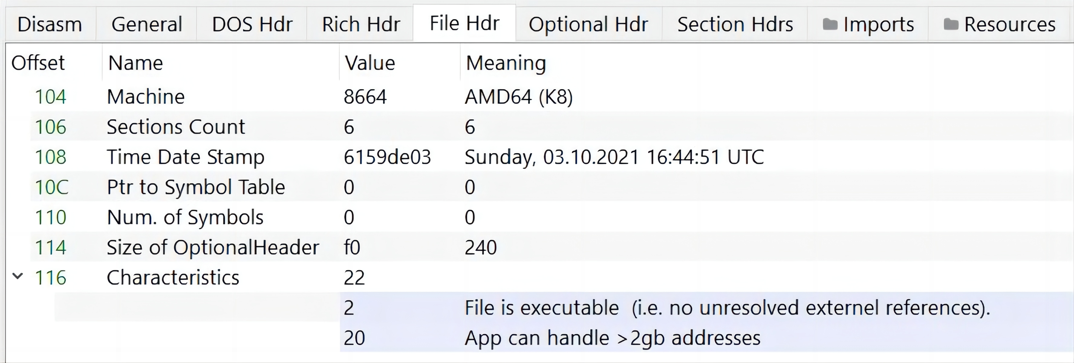

COFF Header

Slide 38
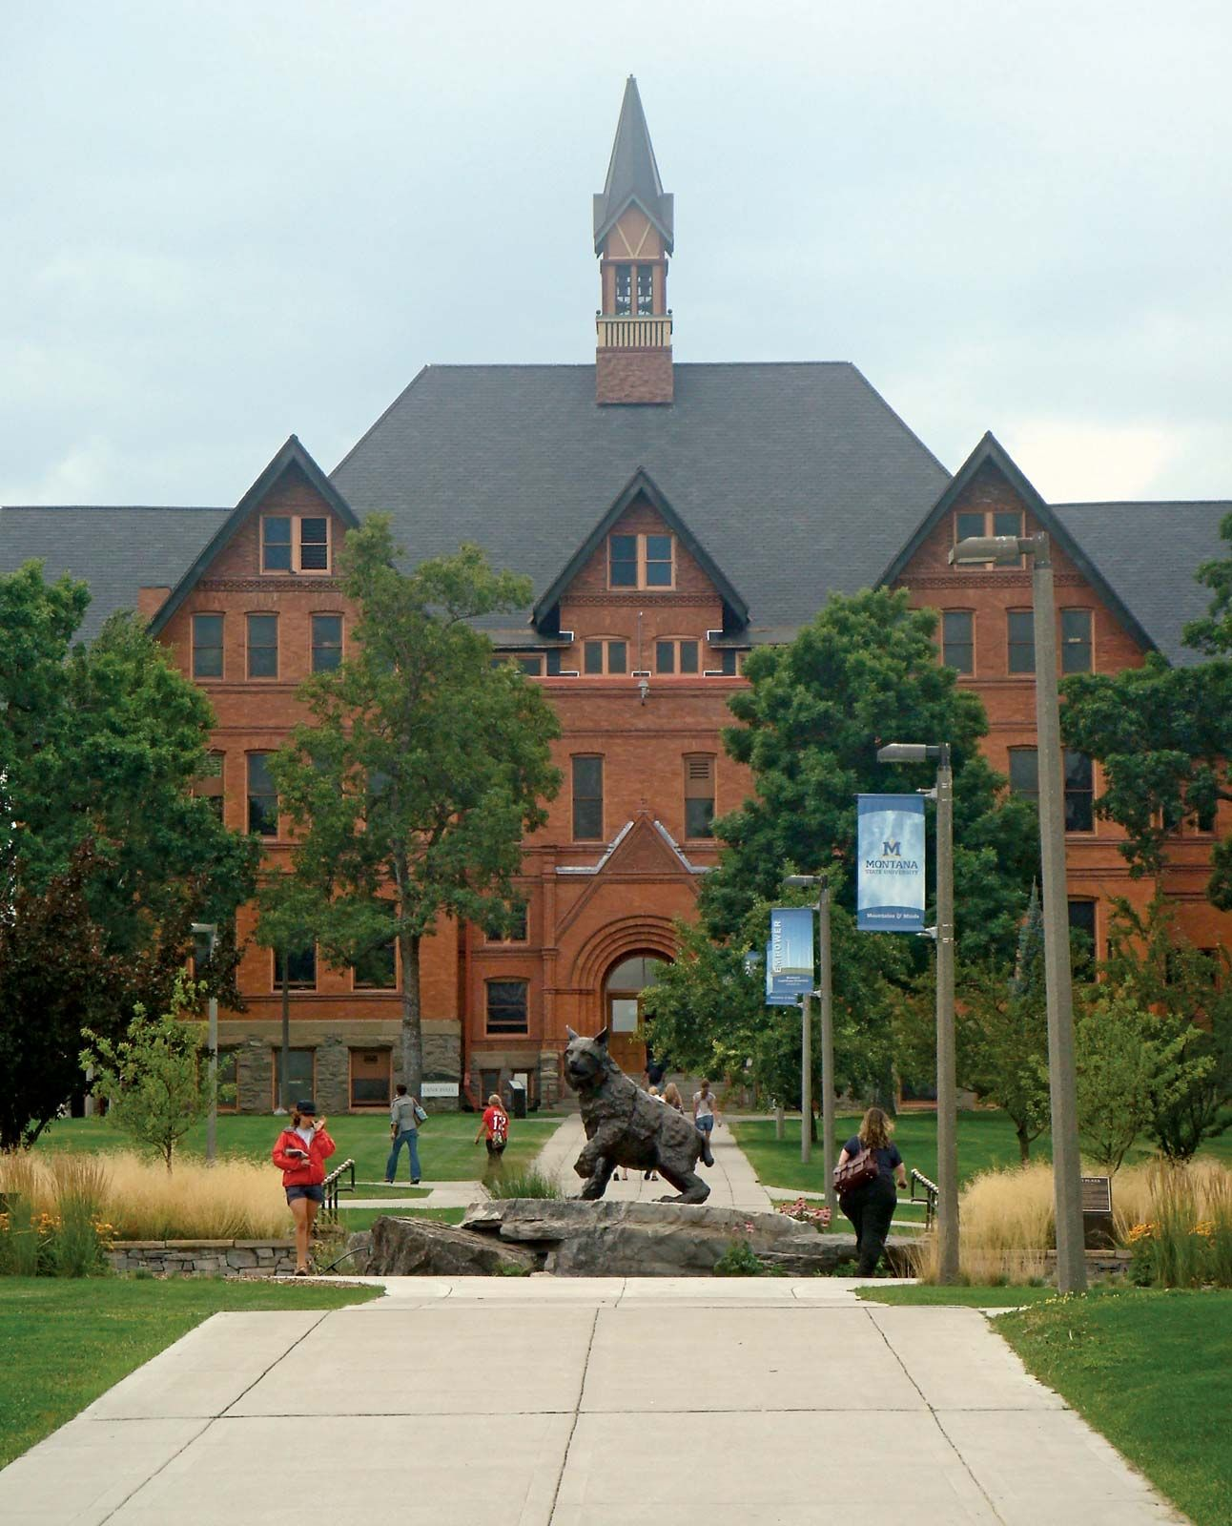
THE END
Fangtian Zhong
CSCI 591
Gianforte School of Computing
Norm Asbjornson College of Engineering
E-mail: fangtian.zhong@montana.edu
2023.10.10

