Slide 1

2023.10.12
Malicious Code Analysis
Fangtian Zhong
CSCI 591
Gianforte School of Computing
Norm Asbjornson College of Engineering
E-mail: fangtian.zhong@montana.edu

Slide 2
Overview
Optional Header
01
Section Headers
02

Slide 3

Part One
Optional Header
01

Slide 4


Optional Header
This header contains information about the file's preferred load address, the size of the image, and the size of the stack required to run the file.

Slide 5

Optional Header
there are two versions of the Optional Header, one for 32-bit executables and one for 64-bit executables.
The size of the structure itself (or the number of members defined within the structure): IMAGE_OPTIONAL_HEADER32 has 31 members while IMAGE_OPTIONAL_HEADER64 only has 30 members, that additional member in the 32-bit version is a DWORD named BaseOfData which holds an RVA of the beginning of the data section.
The data type of some of the members: The following 5 members of the Optional Header structure are defined as DWORD in the 32-bit version and as ULONGLONG in the 64-bit version:
ImageBase
SizeOfStackReserve
SizeOfStackCommit
SizeOfHeapReserve
SizeOfHeapCommit

Slide 6
Optional Header-64 bit
typedef struct _IMAGE_OPTIONAL_HEADER64 {
WORD Magic;
BYTE MajorLinkerVersion;
BYTE MinorLinkerVersion;
DWORD SizeOfCode;
DWORD SizeOfInitializedData;
DWORD SizeOfUninitializedData;
DWORD AddressOfEntryPoint;
DWORD BaseOfCode;
ULONGLONG ImageBase;
DWORD SectionAlignment;
DWORD FileAlignment;
WORD MajorOperatingSystemVersion;
WORD MinorOperatingSystemVersion;
WORD MajorImageVersion;
WORD MinorImageVersion;
WORD MajorSubsystemVersion;
WORD MinorSubsystemVersion;
DWORD Win32VersionValue;
DWORD SizeOfImage;
DWORD SizeOfHeaders;
DWORD CheckSum;
WORD Subsystem;
WORD DllCharacteristics;
ULONGLONG SizeOfStackReserve;
ULONGLONG SizeOfStackCommit;
ULONGLONG SizeOfHeapReserve;
ULONGLONG SizeOfHeapCommit;
DWORD LoaderFlags;
DWORD NumberOfRvaAndSizes;
IMAGE_DATA_DIRECTORY DataDirectory[IMAGE_NUMBEROF_DIRECTORY_ENTRIES];
} IMAGE_OPTIONAL_HEADER64, *PIMAGE_OPTIONAL_HEADER64;

Slide 7
Fields
Magic: Microsoft documentation describes this field as an integer that identifies the state of the image, the documentation mentions three common values:
0x10B: Identifies the image as a PE32 executable.
0x20B: Identifies the image as a PE64 executable.
0x107: Identifies the image as a ROM image.
The value of this field is what determines whether the executable is 32-bit or 64-bit.

Slide 8

Fields
MajorLinkerVersion and MinorLinkerVersion: The linker major and minor version numbers.
SizeOfCode: This field holds the size of the code (.text) section, or the sum of all code sections if there are multiple sections.
SizeOfInitializedData: This field holds the size of the initialized data (.data) section, or the sum of all initialized data sections if there are multiple sections.

Slide 9
Fields
SizeOfUninitializedData: This field holds the size of the uninitialized data (.bss) section, or the sum of all uninitialized data sections if there are multiple sections.
AddressOfEntryPoint: A pointer to the entry point function, relative to the image base address. The documentation states that for program images this relative address points to the starting address and for device drivers it points to initialization function. For DLLs an entry point is optional, and in the case of entry point absence the AddressOfEntryPoint field is set to 0.
BaseOfCode: A pointer to the beginning of the code section, relative to the image base.

Slide 10
Fields
BaseOfData (PE32 Only): A pointer to the beginning of the data section, relative to the image base..
ImageBase: The preferred address of the first byte of the image when it is loaded in memory. this value must be a multiple of 64K. Due to memory protections like ASLR, and a lot of other reasons, the address specified by this field is almost never used, in this case the PE loader chooses an unused memory range to load the image into, after loading the image into that address the loader goes into a process called the relocating where it fixes the constant addresses within the image to work with the new image base, there’s a special section that holds information about places that will need fixing if relocation is needed, that section is called the relocation section (.reloc), more on that in the upcoming posts.

Slide 11
Fields
SectionAlignment: The alignment of sections loaded in memory, in bytes. Sections are aligned in memory boundaries that are multiples of this value. The documentation states that this value defaults to the page size for the architecture and it can’t be less than the value of FileAlignment.
FileAlignment: The alignment of the raw data of sections in the image file, in bytes. if the size of the actual data in a section is less than the FileAlignment value, the rest of the chunk gets padded with zeroes to keep the alignment boundaries. The documentation states that this value should be a power of 2 between 512 and 64K, and if the value of SectionAlignment is less than the architecture’s page size then the sizes of FileAlignment and SectionAlignment must match.

Slide 12
Fields
MajorOperatingSystemVersion, MinorOperatingSystemVersion, MajorImageVersion, MinorImageVersion, MajorSubsystemVersion and MinorSubsystemVersion: These members of the structure specify the major version number of the required operating system, the minor version number of the required operating system, the major version number of the image, the minor version number of the image, the major version number of the subsystem and the minor version number of the subsystem respectively.
Win32VersionValue: A reserved field that the documentation says should be set to 0.
SizeOfImage: The size of the image file (in bytes), including all headers. It gets rounded up to a multiple of SectionAlignment because this value is used when loading the image into memory.

Slide 13
Fields
SizeOfHeaders: The combined size of the e_lfanew member of IMAGE_DOS_HEADER, NT Headers, and section headers, rounded up to a multiple of FileAlignment.
CheckSum: A checksum of the image file, it’s used to validate the image at load time.
Subsystem: This field specifies the Windows subsystem (if any) that is required to run the image.

Slide 14
Subsystem
Constant | Value | Description
IMAGE_SUBSYSTEM_UNKNOWN | 0 | An unknown subsystem
IMAGE_SUBSYSTEM_NATIVE | 2 | Device drivers and native Windows processes
IMAGE_SUBSYSTEM_WINDOWS_GUI | 3 | The Windows graphical user interface (GUI) subsystem
IMAGE_SUBSYSTEM_WINDOWS_CUI | 4 | The Windows character subsystem
IMAGE_SUBSYSTEM_OS2_CUI | 5 | The OS/2 character subsystem
IMAGE_SUBSYSTEM_POSIX_CUI | 7 | The Posix character subsystem
IMAGE_SUBSYSTEM_NATIVE_WINDOWS | 8 | Native Win9x driver
IMAGE_SUBSYSTEM_WINDOWS_CE_GUI | 9 | Windows CE
IMAGE_SUBSYSTEM_EFI_APPLICATION | 10 | An Extensible Firmware Interface (EFI) application
IMAGE_SUBSYSTEM_EFI_RUNTIME_DRIVER | 12 | An EFI driver with run-time services
IMAGE_SUBSYSTEM_EFI_ROM | 13 | An EFI ROM image
IMAGE_SUBSYSTEM_XBOX | 14 | XBOX
IMAGE_SUBSYSTEM_WINDOWS_BOOT_APPLICATION | 16 | Windows boot application.

Slide 15
Fields
DLLCharacteristics: This field defines some characteristics of the executable image file, like if it’s NX compatible and if it can be relocated at run time. It exists within normal executable image files and it defines characteristics that can apply to normal executable files.
SizeOfStackReserve, SizeOfStackCommit, SizeOfHeapReserve and SizeOfHeapCommit: These fields specify the size of the stack to reserve, the size of the stack to commit, the size of the local heap space to reserve and the size of the local heap space to commit respectively.

Slide 16
DLLCharacteristics
Constant | Value | Description
 | 0x0001 | Reserved,must be zero.
 | 0x0002 | Reserved,must be zero.
 | 0x0004 | Reserved,must be zero.
 | 0x0008 | Reserved, must be zero.
IMAGE_DLLCHARACTERISTICS_HIGH_ENTROPY_VA | 0x0020 | Image can handle a high entropy 64-bit virtual address space.
IMAGE_DLLCHARACTERISTICS_DYNAMIC_BASE | 0x0040 | DLL can be relocated at load time.
IMAGE_DLLCHARACTERISTICS_FORCE_INTEGRITY | 0x0080 | Code Integrity checks are enforced.
IMAGE_DLLCHARACTERISTICS_NX_COMPAT | 0x0100 | Image is NX compatible.
IMAGE_DLLCHARACTERISTICS_NO_ISOLATION | 0x0200 | Isolation aware,but do not isolate the image.

Slide 17
DLLCharacteristics
Constant | Value | Description
IMAGE_DLLCHARACTERISTICS_NO_SEH | 0x0400 | Does not use structured exception (SE) handling. No SE handler may be called in this image.
IMAGE_DLLCHARACTERISTICS_NO_BIND | 0x0800 | Do not bind the image.
IMAGE_DLLCHARACTERISTICS_APPCONTAINER | 0x1000 | Image must execute in an AppContainer.
IMAGE_DLLCHARACTERISTICS_WDM_DRIVER | 0×2000 | A WDM driver.
IMAGE_DLLCHARACTERISTICS_GUARD_CF | 0x4000 | Image supports Control Flow Guard.
IMAGE_DLLCHARACTERISTICS_TERMINAL_SERVER_AWARE | 0x8000 | Terminal Server aware.

Slide 18
Fields
LoaderFlags: A reserved field that the documentation says should be set to 0.
NumberOfRvaAndSizes: Size of the DataDirectory array.
DataDirectory: An array of IMAGE_DATA_DIRECTORY structures. We will talk about this in the next post.

Slide 19
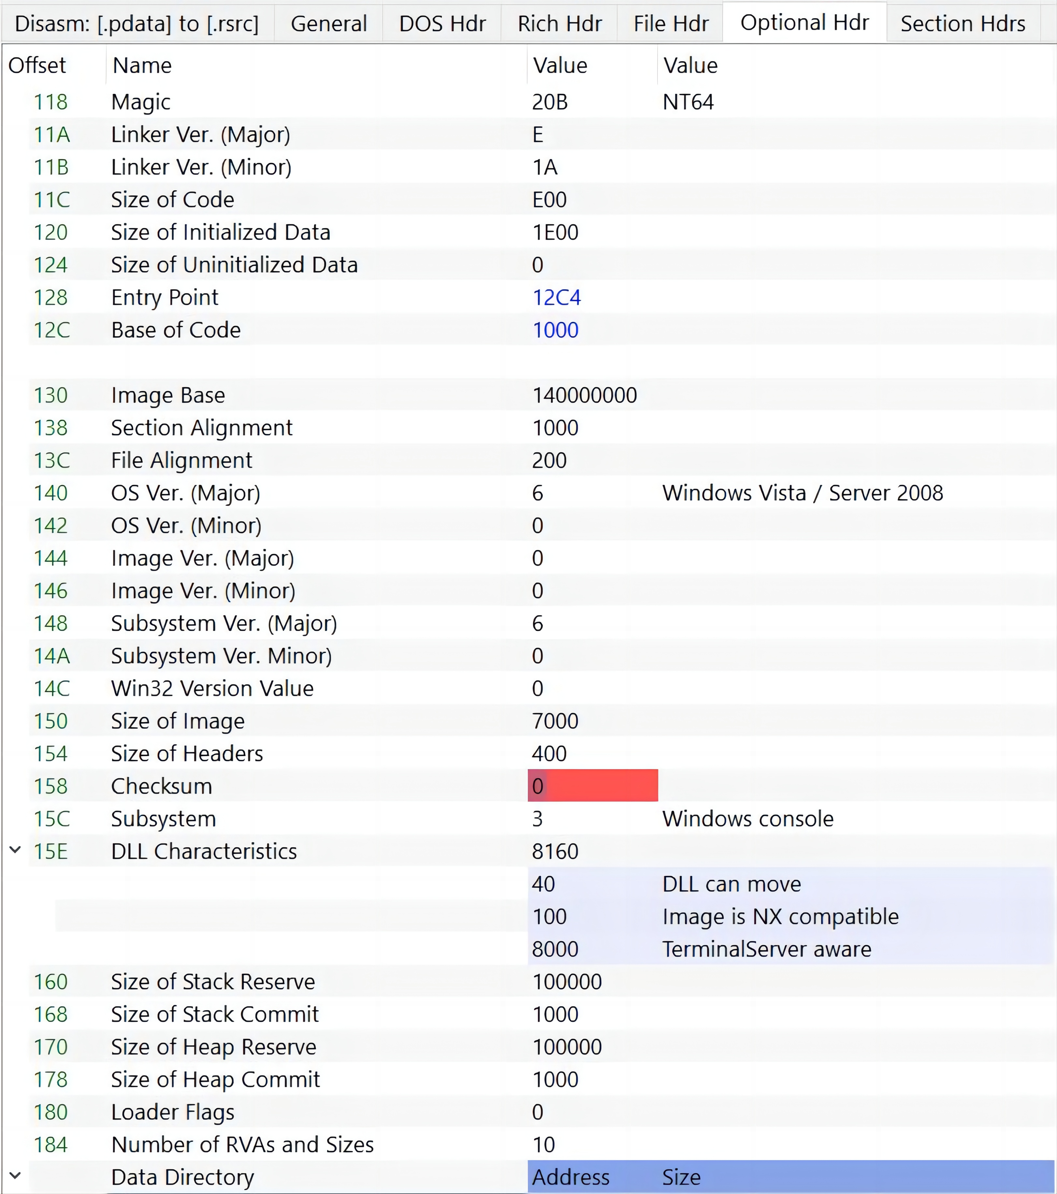
Optional Header

Slide 20
Fields
We can talk about some of these fields, first one being the Magic field at the start of the header, it has the value 0x20B meaning that this is a PE64 executable.
We can see that the entry point RVA is 0x12C4 and the code section start RVA is 0x1000, it follows the alignment defined by the SectionAlignment field which has the value of 0x1000.
File alignment is set to 0x200, and we can verify this by looking at any of the sections, for example the data section:

Slide 21
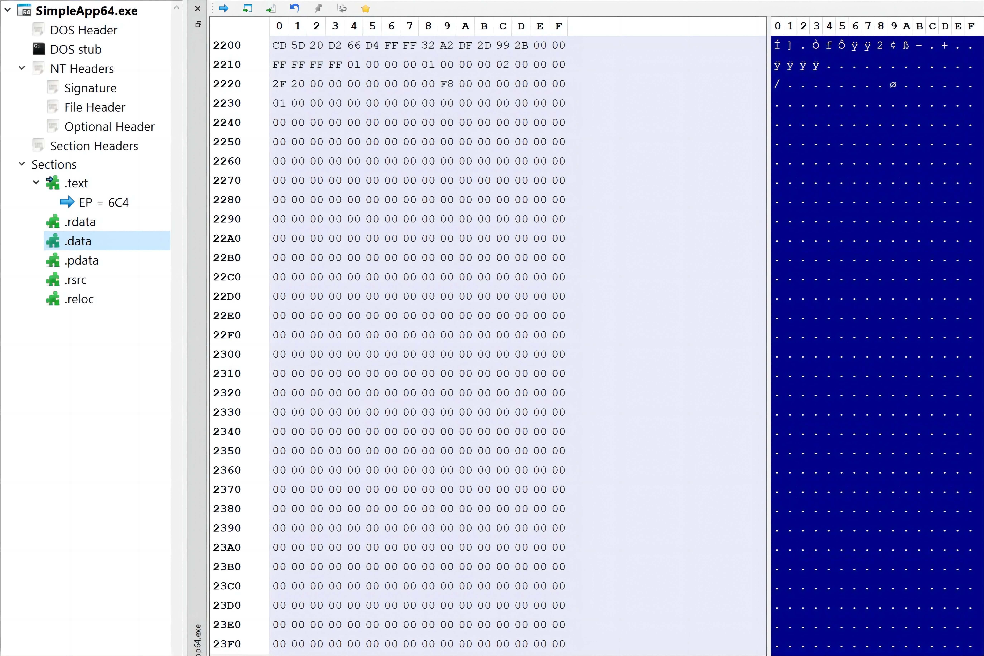
Optional Header

Slide 22
Part Two
Section Headers
02

Slide 23

Section Headers
This section contains information about each section of the file, including the section's name, size, and location in the file.

Slide 24

Sections
Sections are the containers of the actual data of the executable file, they occupy the rest of the PE file after the headers, precisely after the section headers.
.text: Contains the executable code of the program.
.data: Contains the initialized data.
.bss: Contains uninitialized data.
.rdata: Contains read-only initialized data.
.edata: Contains the export tables.
.idata: Contains the import tables.
.reloc: Contains image relocation information.
.rsrc: Contains resources used by the program, these include images, icons or even embedded binaries.
.tls: (Thread Local Storage), provides storage for every executing thread of the program.

Slide 25
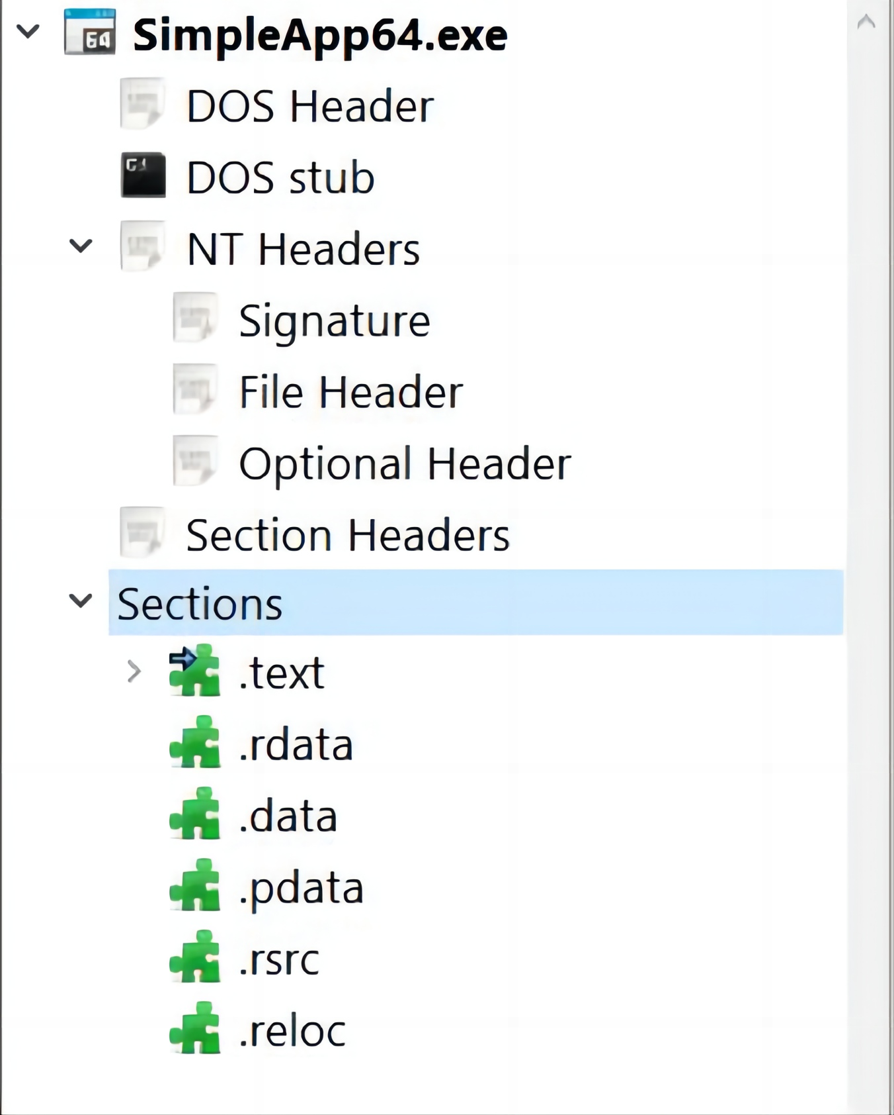

Sections

Slide 26
Section Headers
typedef struct _IMAGE_SECTION_HEADER {
BYTE Name[IMAGE_SIZEOF_SHORT_NAME];
union {
DWORD PhysicalAddress;
DWORD VirtualSize;
} Misc;
DWORD VirtualAddress;
DWORD SizeOfRawData;
DWORD PointerToRawData;
DWORD PointerToRelocations;
DWORD PointerToLinenumbers;
WORD NumberOfRelocations;
WORD NumberOfLinenumbers;
DWORD Characteristics;
} IMAGE_SECTION_HEADER, *PIMAGE_SECTION_HEADER;

Slide 27

Fields
Name: First field of the Section Header, a byte array of the size IMAGE_SIZEOF_SHORT_NAME that holds the name of the section. IMAGE_SIZEOF_SHORT_NAME has the value of 8 meaning that a section name can’t be longer than 8 characters. For longer names the official documentation mentions a work-around by filling this field with an offset in the string table, however executable images do not use a string table so this limitation of 8 characters holds for executable images.

Slide 28
Fields
PhysicalAddress or VirtualSize: A union defines multiple names for the same thing, this field contains the total size of the section when it’s loaded in memory.
VirtualAddress: The address of the first byte of the section when loaded into memory, relative to the image base, and for object files it holds the address of the first byte of the section before relocation is applied.
SizeOfRawData: The size of the initialized data on disk, in bytes. It must be a multiple of IMAGE_OPTIONAL_HEADER.FileAlignment. SizeOfRawData and VirtualSize can be different.

Slide 29
Fields
PointerToRawData: A pointer to the first page of the section within the file, for executable images it must be a multiple of IMAGE_OPTIONAL_HEADER.FileAlignment.
PointerToRelocations: A file pointer to the beginning of relocation entries for the section. It’s set to 0 for executable files.
PointerToLineNumbers: A file pointer to the beginning of COFF line-number entries for the section. It’s set to 0 because COFF debugging information is deprecated.
NumberOfRelocations: The number of relocation entries for the section, it’s set to 0 for executable images.

Slide 30

Fields
NumberOfLinenumbers: The number of COFF line-number entries for the section, it’s set to 0 because COFF debugging information is deprecated.
Characteristics: Flags that describe the characteristics of the section. These characteristics are things like if the section contains executable code, contains initialized/uninitialized data, can be shared in memory.

Slide 31
Characteristics
Flag | Value | Description
 | 0x00000000 | Reserved for future use.
 | 0x00000001 | Reserved for future use.
 | 0x00000002 | Reserved for future use.
 | 0x00000004 | Reserved for future use.
IMAGE_SCN_TYPE_NO_PAD | 0x00000008 | The section should not be padded to the next boundary. This flag is obsolete and is replaced by IMAGE_SCN_ALIGN_1BYTES. This is valid only for object files.
 | 0x00000010 | Reserved for future use.
IMAGE_SCN_CNT_CODE | 0x00000020 | The section contains executable code.
IMAGE_SCN_CNT_INITIALIZED_DATA | 0x00000040 | The section contains initialized data.
IMAGE_SCN_CNT_UNINITIALIZED_DATA | 0x00000080 | The section contains uninitialized data.
IMAGE_SCN_LNK_OTHER | 0x00000100 | Reserved for future use.

Slide 32
Characteristics
Flag | Value | Description
IMAGE_SCN_LNK_INFO | 0x00000200 | The section contains comments or other information. The .drectve section has this type. This is valid for object files only.
 | 0x00000400 | Reserved for future use.
IMAGE_SCN_LNK_REMOVE | 0x00000800 | The section will not become part of the image. This is valid only for object files.
IMAGE_SCN_LNK_COMDAT | 0x00001000 | The section contains COMDAT data.For more information,see COMDAT Sections (Object Only). This is valid only for object files.
IMAGE_SCN_GPREL | 0x00008000 | The section contains data referenced through the global pointer (GP).
IMAGE_SCN_MEM_PURGEABLE | 0x00020000 | Reserved for future use.
IMAGE_SCN_MEM_16BIT | 0x00020000 | Reserved for future use.
IMAGE_SCN_MEM_LOCKED | 0x00040000 | Reserved for future use.
IMAGE_SCN_MEM_PRELOAD | 0x00080000 | Reserved for future use.

Slide 33
Characteristics
Flag | Value | Description
IMAGE_SCN_ALIGN_1BYTES | 0x00100000 | Align data on a 1-byte boundary.Valid only for object files.
IMAGE_SCN_ALIGN_2BYTES | 0x00200000 | Align data on a 2-byte boundary.Valid only for object files.
IMAGE_SCN_ALIGN_4BYTES | 0x00300000 | Align data on a 4-byte boundary.Valid only for object files.
IMAGE_SCN_ALIGN_8BYTES | 0x00400000 | Align data on an 8-byte boundary. Valid only for object files.
IMAGE_SCN_ALIGN_16BYTES | 0x00500000 | Align data on a 16-byte boundary.Valid only for object files.
IMAGE_SCN_ALIGN_32BYTES | 0x00600000 | Align data on a 32-byte boundary.Valid only for object files.
IMAGE_SCN_ALIGN_64BYTES | 0x00700000 | Align data on a 64-byte boundary.Valid only for object files.
IMAGE_SCN_ALIGN_128BYTES | 0x00080000 | Align data on a 128-byte boundary. Valid only for object files.

Slide 34
Characteristics
Flag | Value | Description
IMAGE_SCN_ALIGN_512BYTES | 0x00A00000 | Align data on a 512-byte boundary. Valid only for object files.
IMAGE_SCN_ALIGN_1024BYTES | 0x00B00000 | Align data on a 1024-byte boundary. Valid only for object files.
IMAGE_SCN_ALIGN_2048BYTES | 0x00C00000 | Align data on a 2048-byte boundary.Valid only for object files.
IMAGE_SCN_ALIGN_4096BYTES | 0x00D00000 | Align data on a 4096-byte boundary.Valid only for object files.
IMAGE_SCN_ALIGN_8192BYTES | 0x00E00000 | Align data on an 8192-byte boundary. Valid only for object files.
IMAGE_SCN_LNK_NRELOC_OVFL | 0x01000000 | The section contains extended relocations.
IMAGE_SCN_MEM_DISCARDABLE | 0x02000000 | The section can be discarded as needed.
IMAGE_SCN_MEM_NOT_CACHED | 0x04000000 | The section cannot be cached.
IMAGE_SCN_MEM_NOT_PAGED | 0x08000000 | The section is not pageable.
IMAGE_SCN_MEM_SHARED | 0x10000000 | The section can be shared in memory.

Slide 35
Characteristics
Flag | Value | Description
IMAGE_SCN_MEM_SHARED | 0x10000000 | The section can be shared in memory.
IMAGE_SCN_MEM_EXECUTE | 0x20000000 | The section can be executed as code.
IMAGE_SCN_MEM_READ | 0x40000000 | The section can be read.
IMAGE_SCN_MEM_WRITE | 0x80000000 | The section can be written to.

Slide 36
Reminder
SizeOfRawData and VirtualSize can be different, and this can happen for multiple of reasons.
SizeOfRawData must be a multiple of IMAGE_OPTIONAL_HEADER.FileAlignment, so if the section size is less than that value the rest gets padded and SizeOfRawData gets rounded to the nearest multiple of IMAGE_OPTIONAL_HEADER.FileAlignment.
However when the section is loaded into memory it doesn’t follow that alignment and only the actual size of the section is occupied. In this case SizeOfRawData will be greater than VirtualSize.

Slide 37
Reminder
If the section contains uninitialized data, these data won’t be accounted for on disk, but when the section gets mapped into memory, the section will expand to reserve memory space for when the uninitialized data gets later initialized and used.
This means that the section on disk will occupy less than it will do in memory, in this case VirtualSize will be greater than SizeOfRawData.

Slide 38
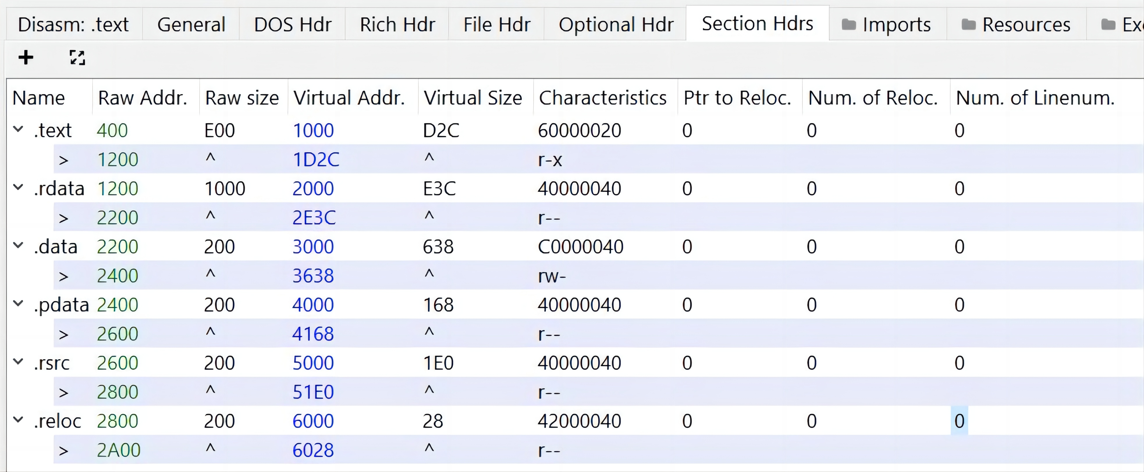
Section Headers

Slide 39

Example
For example if we take the .text section, it has a raw address of 0x400 and a raw size of 0xE00, if we add them together we get 0x1200 which is displayed as the section end on disk.
Similarly we can do the same with virtual size and address, virtual address is 0x1000 and virtual size is 0xD2C, if we add them together we get 0x1D2C.

Slide 40

THE END
Fangtian Zhong
CSCI 591
Gianforte School of Computing
Norm Asbjornson College of Engineering
E-mail: fangtian.zhong@montana.edu
2023.10.12

