Slide 1

2023.10.19
Malicious Code Analysis
Fangtian Zhong
CSCI 591
Gianforte School of Computing
Norm Asbjornson College of Engineering
E-mail: fangtian.zhong@montana.edu

Slide 2
Overview
Export
01
Relocation
02
Retrofitting
03

Slide 3

Part One
Export
01

Slide 4
Data Directories
#define IMAGE_DIRECTORY_ENTRY_EXPORT 0 // Export Directory
#define IMAGE_DIRECTORY_ENTRY_IMPORT 1 // Import Directory
#define IMAGE_DIRECTORY_ENTRY_RESOURCE 2 // Resource Directory
#define IMAGE_DIRECTORY_ENTRY_EXCEPTION 3 // Exception Directory
#define IMAGE_DIRECTORY_ENTRY_SECURITY 4 // Security Directory
#define IMAGE_DIRECTORY_ENTRY_BASERELOC 5 // Base Relocation Table
#define IMAGE_DIRECTORY_ENTRY_DEBUG 6 // Debug Directory
// IMAGE_DIRECTORY_ENTRY_COPYRIGHT 7 // (X86 usage)
#define IMAGE_DIRECTORY_ENTRY_ARCHITECTURE 7 // Architecture Specific Data
#define IMAGE_DIRECTORY_ENTRY_GLOBALPTR 8 // RVA of GP
#define IMAGE_DIRECTORY_ENTRY_TLS 9 // TLS Directory
#define IMAGE_DIRECTORY_ENTRY_LOAD_CONFIG 10 // Load Configuration Directory
#define IMAGE_DIRECTORY_ENTRY_BOUND_IMPORT 11 // Bound Import Directory in headers
#define IMAGE_DIRECTORY_ENTRY_IAT 12 // Import Address Table
#define IMAGE_DIRECTORY_ENTRY_DELAY_IMPORT 13 // Delay Load Import Descriptors
#define IMAGE_DIRECTORY_ENTRY_COM_DESCRIPTOR 14 // COM Runtime descriptor

Slide 5

Data Directories
typedef struct _IMAGE_DATA_DIRECTORY {
DWORD VirtualAddress;
DWORD Size;
} IMAGE_DATA_DIRECTORY, *PIMAGE_DATA_DIRECTORY;

Slide 6
Export Directory Table
typedef struct _IMAGE_EXPORT_DIRECTORY {
DWORD Characteristics; // Reserved, must be 0.
DWORD TimeDateStamp; //The time and date that the export data was created.
WORD MajorVersion; //The major version number.
WORD MinorVersion; //The minor version number.
DWORD Name; //The address of the ASCII string that contains the name of the DLL.
DWORD Base; //The starting ordinal number for exports in this image.
//It is usually set to 1.
DWORD NumberOfFunctions; //The number of entries in the export address table.
DWORD NumberOfNames; //The number of entries in the name pointer table.
DWORD AddressOfFunctions; //The address of the export address table.
DWORD AddressOfNames; //The address of the export name pointer table.
DWORD AddressOfNameOrdinals; //The address of the ordinal table, relative to the image base.
} IMAGE_EXPORT_DIRECTORY, *PIMAGE_EXPORT_DIRECTORY;

Slide 7
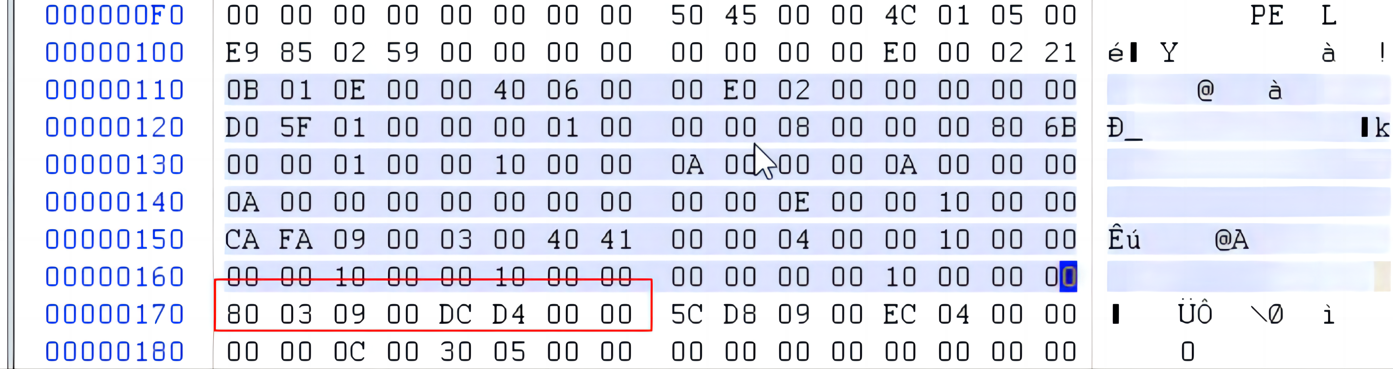
Export Directory Table
Virtual Address== 0x90380 Size == D4DC

Slide 8
Section Headers
typedef struct _IMAGE_SECTION_HEADER {
BYTE Name[IMAGE_SIZEOF_SHORT_NAME];
union {
DWORD PhysicalAddress;
DWORD VirtualSize;
} Misc;
DWORD VirtualAddress;
DWORD SizeOfRawData;
DWORD PointerToRawData;
DWORD PointerToRelocations;
DWORD PointerToLinenumbers;
WORD NumberOfRelocations;
WORD NumberOfLinenumbers;
DWORD Characteristics;
} IMAGE_SECTION_HEADER, *PIMAGE_SECTION_HEADER;

Slide 9
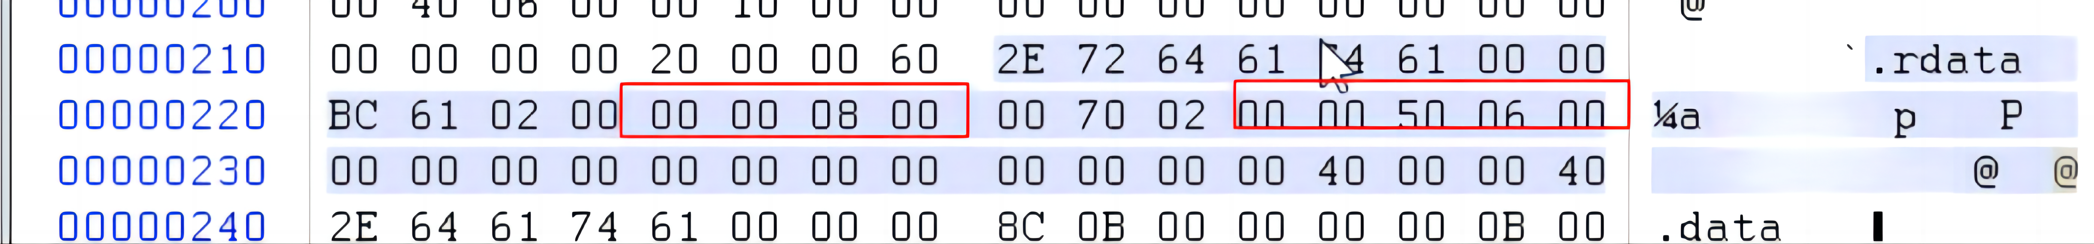

Export Directory Table
Because we don’t run the program, we should convert the Virtual Address (RVA) to File Address (FOA).
In this case, 00080000 (Section VirtualAddress) < 90380 <00080000+ 000261BC(Virtual Size).
Therefore, it exists in .rdata section. PointerToRawData == 0x65000.
FOA = 0x90380 - 0x80000 + 0x65000 == 0x75380

Slide 10
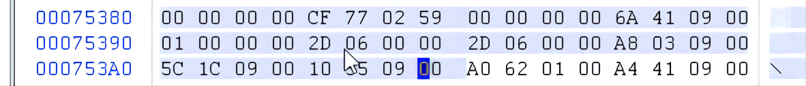

Export Directory Table
Name: starting at 13th bytes with value 0x9416A, which is a RVA. Its FOA == 7916A

Slide 11
Export Directory Table
typedef struct _IMAGE_EXPORT_DIRECTORY {
DWORD Characteristics; // Reserved, must be 0.
DWORD TimeDateStamp; //The time and date that the export data was created.
WORD MajorVersion; //The major version number.
WORD MinorVersion; //The minor version number.
DWORD Name; //The address of the ASCII string that contains the name of the DLL.
DWORD Base; //The starting ordinal number for exports in this image.
//It is usually set to 1.
DWORD NumberOfFunctions; //The number of entries in the export address table.
DWORD NumberOfNames; //The number of entries in the name pointer table.
DWORD AddressOfFunctions; //The address of the export address table.
DWORD AddressOfNames; //The address of the export name pointer table.
DWORD AddressOfNameOrdinals; //The address of the ordinal table, relative to the image base.
} IMAGE_EXPORT_DIRECTORY, *PIMAGE_EXPORT_DIRECTORY;

Slide 12
NumberOfFunctions and NumberOfNames
In this case, the number of all exported functions is 62d. The number of exported functions by name is 62d.
The number of all exported functions - The number of exported functions by name == the number of differences.
That means other functions may not be exported or exported by ordinal number.

Slide 13
Export Directory Table
Similarly, AddressOfFunctions FOA == 0x753A8
AddressOfNames FOA == 0x76c5c
AddressOfNameOrdinals FOA == 0x78510

Slide 14
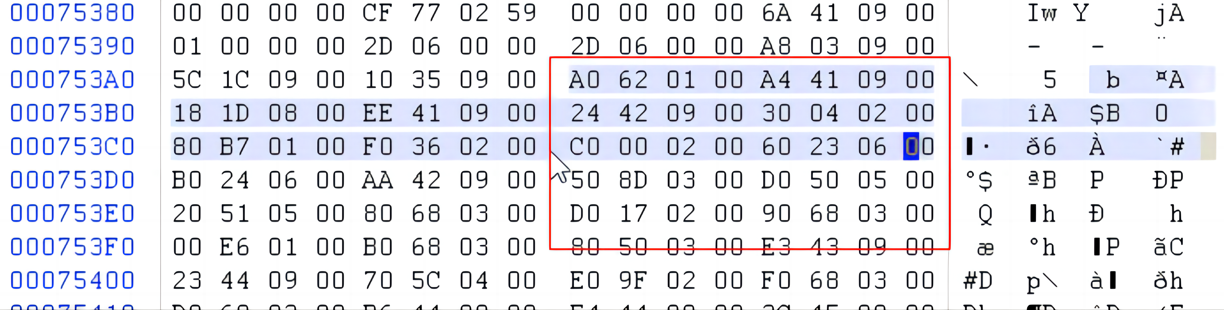
AddressOfFunctions
AddressOfFunctions FOA == 0x753A8
In function address table, each entry is 4 bytes. The number of entries is determined by NumberOfFunctions.

Slide 15
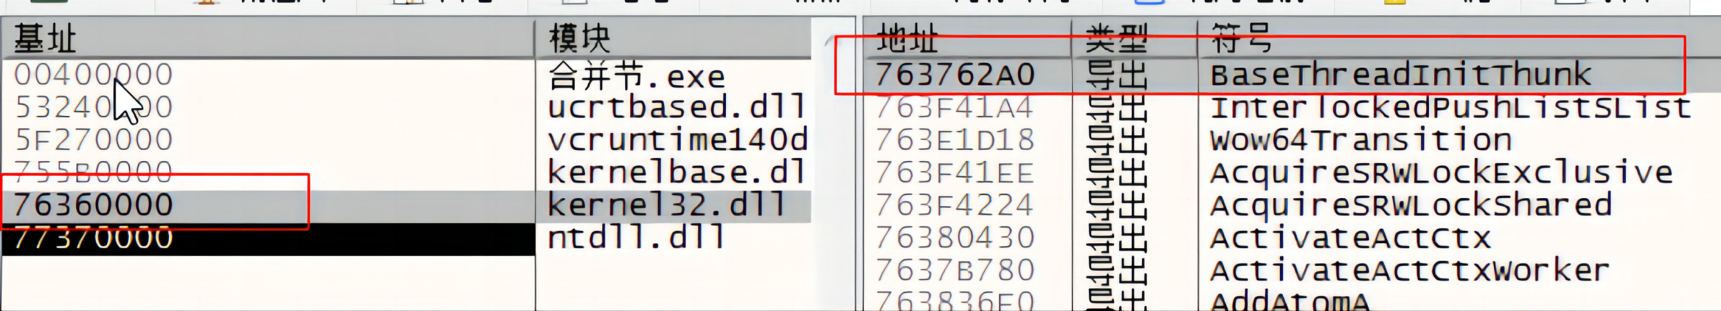
Export Directory Table
For example, the RVA of the first entry is 0x0162A0.
We use the RVA of the first entry + ImageBase is the function address.
Base address
Module
Address
Type
Symbol
merged section. exe
export
export
export
export
export
export
export
export
ucrtbased.dll

Slide 16
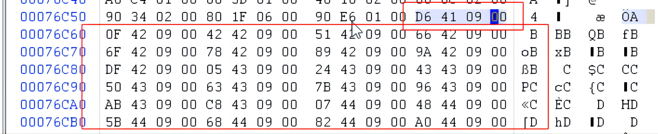
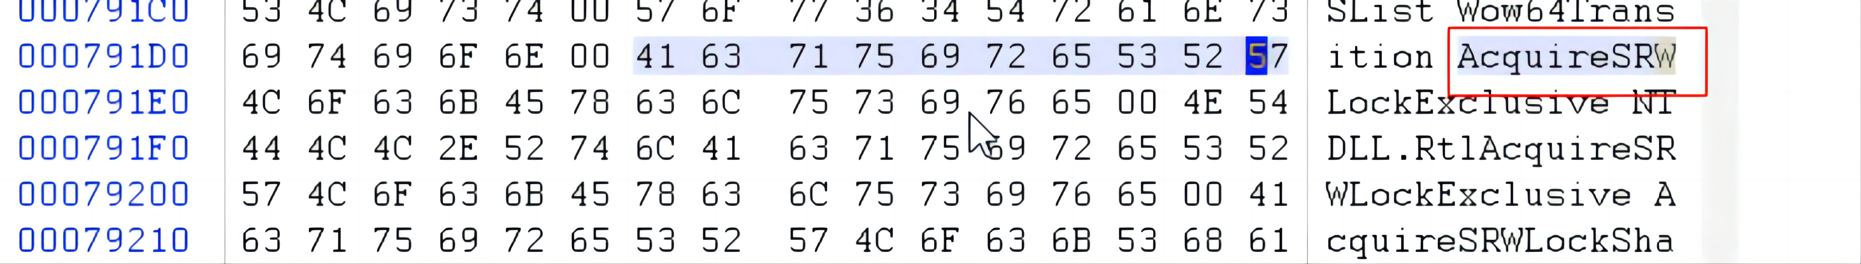
AddressOfNames
AddressOfNames FOA == 0x76c5c
FOA = 0x941D6 - 0x80000 + 0x65000 = 0x791D6

Slide 17
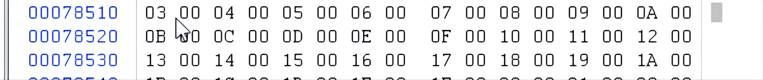
AddressOfNameOrdinals
AddressOfNameOrdinals FOA == 0x78510

Slide 18

Example
AddressOfFunctions | AddressOfNameOrdinals | AddressOfNames
0 0x1010 Sub | 0 0x0100 | 0 Add
1 0x2020 Add | 1 0x0000 | 1 Sub
2 0x3030 Div | 2 0x0200 | 2 Div

Slide 19
Part Two
Relocation
02

Slide 20
Relocation Table
Typedef struct _IMAGE_BASE_RELOCATION{
DWORD VirtualAddress
DWORD SizeOfBlock
}IMAGE_BASE_RELOCATION,*PIMAGE_BASE_RELOCATION;

Slide 21
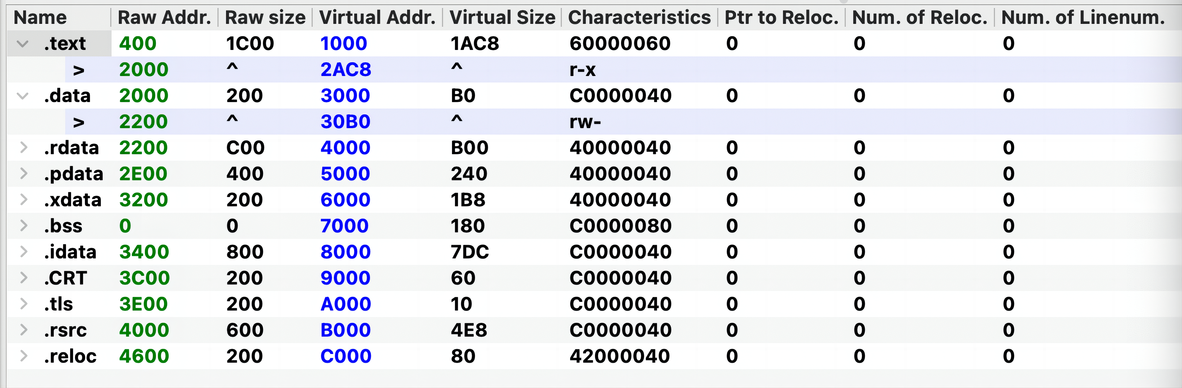
PE
Typedef struct _IMAGE_BASE_RELOCATION{
DWORD VirtualAddress
DWORD SizeOfBlock
}IMAGE_BASE_RELOCATION,*PIMAGE_BASE_RELOCATION;
IMAGE_DIRECTORY_ENTRY_BASERELOC
DWORD VirtualAddress:0000 C000
DWORD Size:0000 0080
C000 – C000(VA of section)+4600(FOA of section)=4600

Slide 22
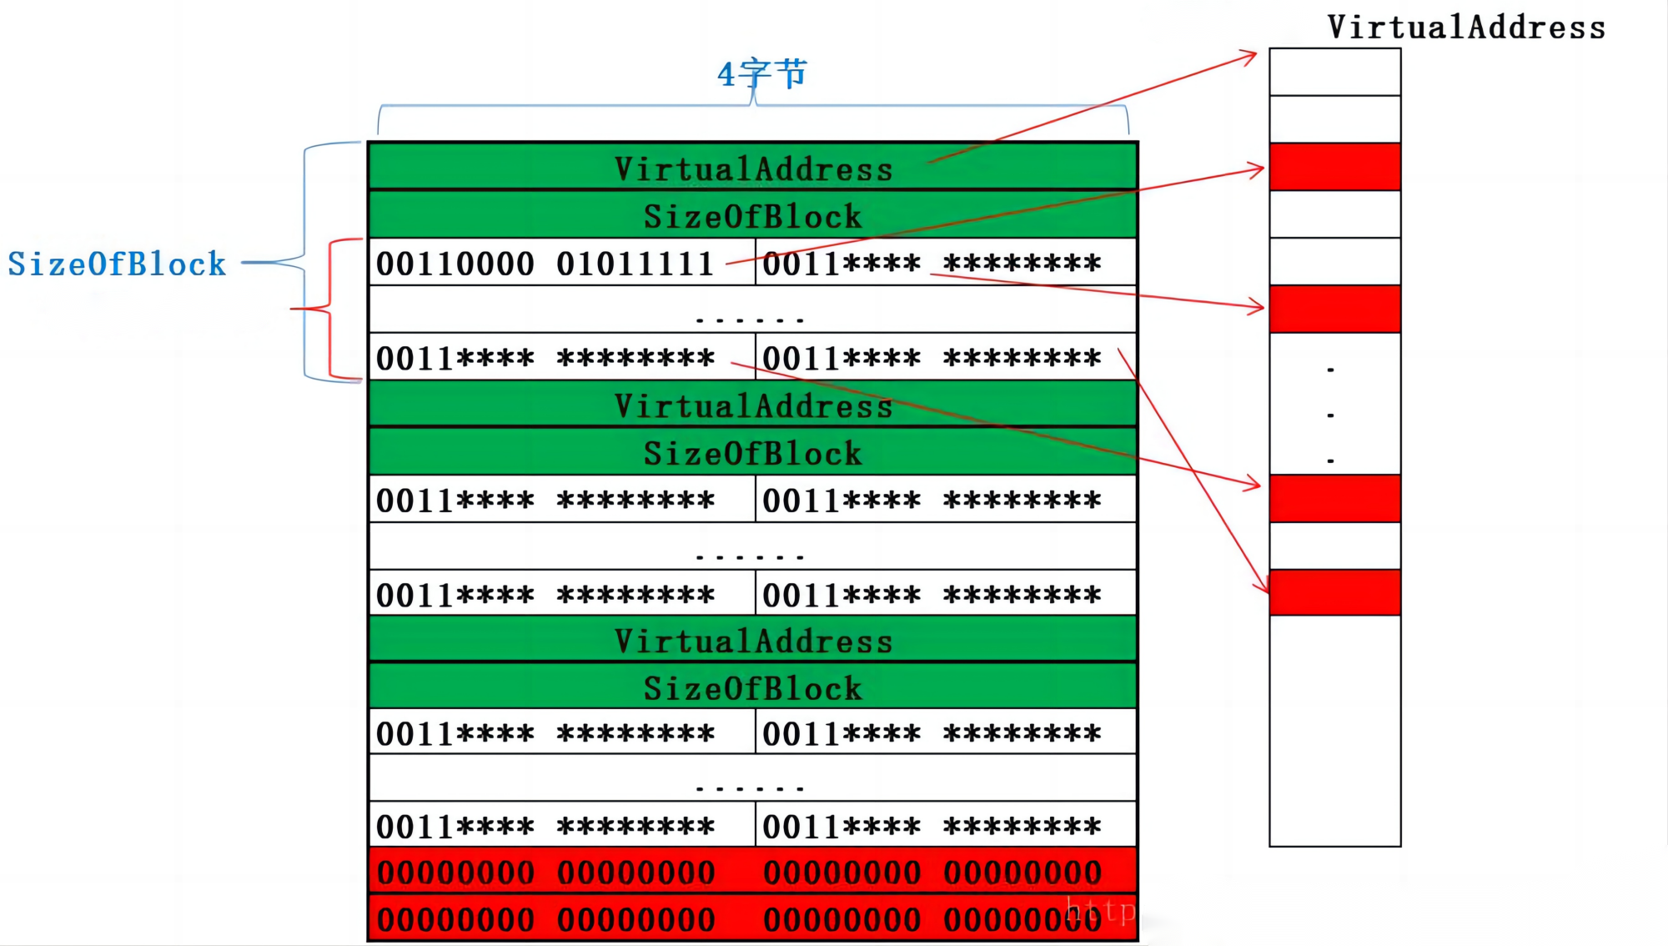
PE
Base address: VirtualAddress
4 bytes
SizeOfBlock
RVA

Slide 23
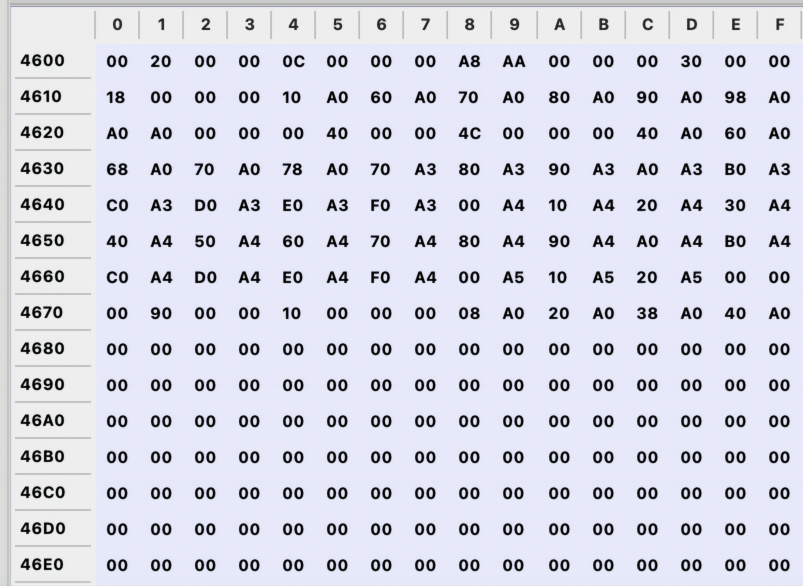
PE
C000 – C000(VA of section)+4600(FOA of section)=4600
DWORD VirtualAddress: 0000 4000
A4A0
A480
A470
A390
A420
A3C0
A078
DWORD VirtualAddress: 0000 3000
DWORD Size: 0000 0018
DWORD Size: 0000 000C
0000
A040
A060
A060
A380
A070
A090
DWORD VirtualAddress: 0000 2000
DWORD VirtualAddress: 0000 9000
AAA8
A010
A080
A098
DWORD Size: 0000 004C
DWORD Size: 0000 0010
A490
A068
A3B0
A070
A3F0
A040
A020
A038
A008
A4B0
A3A0
A440
A3D0
A3E0
A4F0
A0A0
A370
A430
A450
A520
A400
0000
A510
A4D0
A460
0000
A410
A500
A4C0
A4E0

Slide 24
Retrofitting
Part Three
03

Slide 25
Retrofiting
Malware retrofitting refers to the process of modifying or updating existing malware to enhance its functionality, stealthiness, or evasion capabilities. This practice is typically carried out by cybercriminals or hackers to adapt their malicious code to changing security measures, making it more difficult for antivirus products to detect and remove the malware.

Slide 26
Retrofiting Technique
Here are some common objectives and techniques associated with malware retrofitting:
Evasion of Antivirus and Security Software: Malware authors often retrofit their code to evade detection by antivirus and security software. This may involve altering the code's structure, changing its signatures, or using polymorphic techniques to generate new variants that appear different to security scanners.
Persistence: Malware often seeks to maintain a persistent presence on an infected system. Retrofitting may involve enhancing the malware's ability to survive system reboots, updates, or antivirus scans.

Slide 27
Retrofiting Technique
Here are some common objectives and techniques associated with malware retrofitting:
Payload Delivery: Malware may be retrofitted to deliver additional payloads or modules. For example, a Trojan horse may be updated to download and execute other malicious software, such as ransomware or keyloggers.
Data Exfiltration: Retrofitting can add data exfiltration capabilities to malware. This enables it to steal sensitive information from infected systems and transmit it to command and control servers controlled by cybercriminals.

Slide 28
Retrofiting Technique
Here are some common objectives and techniques associated with malware retrofitting:
Evasion of Sandboxing and Analysis: Malware retrofitting may include techniques to detect if it is running in a sandbox or virtualized environment used for security analysis. If detected, the malware may behave differently or remain dormant to avoid detection.
Dynamic Command and Control: Retrofitting can enhance the malware's ability to communicate with command and control servers dynamically. This makes it harder for security researchers to track and disrupt malicious networks.

Slide 29
Retrofiting Technique
Here are some common objectives and techniques associated with malware retrofitting:
Rootkit Functionality: Some malware is retrofitted to include rootkit capabilities, allowing it to gain elevated privileges and hide from system monitoring tools.
Obfuscation: Code obfuscation techniques may be applied during retrofitting to make the malware's code more challenging to analyze and reverse-engineer.

Slide 30
Conclusion
It's important to note that malware retrofitting is an ongoing arms race between cybercriminals and cybersecurity professionals. As security measures improve, malware authors adapt their code to counteract these defenses.
Consequently, cybersecurity experts continuously work to develop better detection and prevention techniques to combat evolving malware threats.

Slide 31
Project3
You should develop program2.c that has to be implemented with the following functionality:
print a string "hello program2".
Read encrypted program1 at the last section of program2.exe.
Decrypt it to get the original program1.exe.
Create the process in suspended form by using API "CreateProcess", the process to be created is program2.exe.
Get the context of the program2.exe (ImageBase and OEP).
Uninstaller (NtUnmapViewOfSection).
Allocate space (by using API "VirtualAllocEx") at the specified location which is "ImageBase" of program1.exe, and the size is the SizeOfImage of program1.exe.
If the application space is successful, stretch the program1.exe and copy it to the space (by using WriteProcessMemory).
If the application space fails, but there is a relocation table, apply for space at any position, then stretch, copy, and repair the relocation table of the program1.exe.
Modify the Context of the program. Change the ImageBase of the Context of the program2.exe to the ImageBase of program1.exe and change the OEP of the Context of the program2.exe to the OEP of program1.exe.
Set the Context and restore the main thread
The replacement is successful

Slide 32
Project3
The source code of program1.exe is to print a string "hello program1".
You have to develop program1.c that print the string.
Compile program1.c to produce program1.exe.
We have to develop a program3.c that first encrypt the virus (in our case, it is program1.exe) by XORing it with 0x40 and then attached the encrypted virus to the end of program2.exe. After it is compiled, producing program3.exe.
After running program3.exe, you will get the new program2.exe that has the encrypted program1.exe at its last section.
If we run the new program2.exe, it first prints "hello program2" and then prints "hello program1".

Slide 33
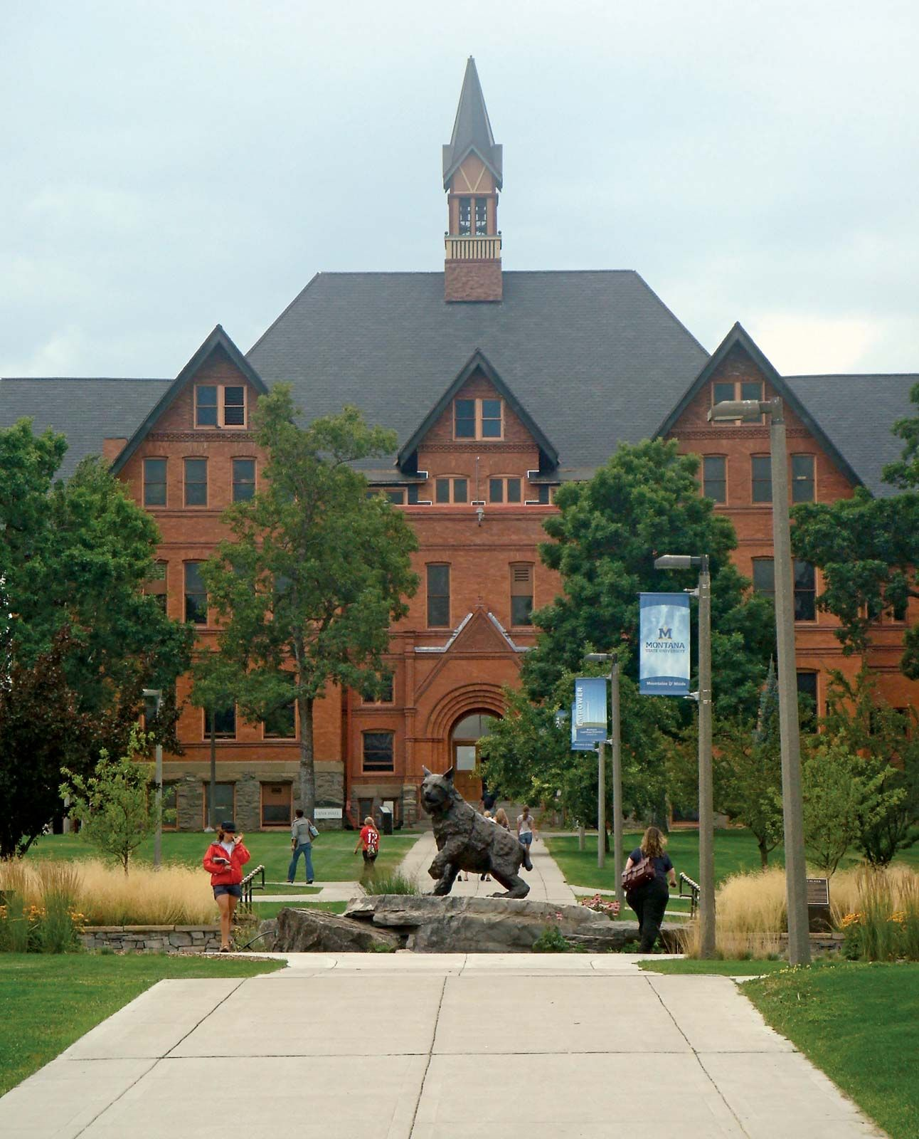
THE END
Fangtian Zhong
CSCI 591
Gianforte School of Computing
Norm Asbjornson College of Engineering
E-mail: fangtian.zhong@montana.edu
2023.10.19

