Slide 1

2023.11.09
Malicious Code Analysis
Fangtian Zhong
CSCI 591
Gianforte School of Computing
Norm Asbjornson College of Engineering
E-mail: fangtian.zhong@montana.edu

Slide 2
Overview
Factory
01
Analysis
02
User Mode Debugging
03

Slide 3

Part One
Factory
01

Slide 4

Factory
“””
factory
“””
block = proj.factory.block(proj.entry)
print(block.pp())
print(block.instructions)
print(block.instruction_addrs)
print(block.size)
block.capstone.pp()
block.vex.pp()

Slide 5
Break Type
#get our state
s = proj.factory.entry_state()
“””
on the other hand, we can have a breakpoint trigger right *after* a memory write happens.
we can also have a callback function run instead of opening ipdb
“””
def debug_func(state):
print(“State %s is about to do a syscall!”)
s.inspect.b(‘syscall’, when=angr.BP_BEFORE, action=debug_func)
#or, you can have it drop you in an embedded IPython!
s.inspect.b(‘syscall’, when=angr.BP_BEFORE, action=angr.BP_IPYTHON)

Slide 6
Break Type
def track_reads(state):
print(‘Read’, state.inspect.mem_read_expr, ‘from’, state.inspect.mem_read_address)
s.inspect.b(‘mem_read’, when=angr.BP_AFTER, action=track_reads)
“””
This will break before a memory write if 0x1000 is a possible
value of its target expression
“””
s.inspect.b(‘mem_write’, mem_write_address=0x1000)
“””
This will break before a memory write if 0x1000 is the only
value of its target expression
“””
s.inspect.b(‘mem_write’, mem_write_address=0x1000, mem_write_address_unique=true)
“””
This will break after instruction 0x8000, but only 0x1000 is possible value of the last expression
was read from memory
“””
s.inspect.b(‘instruction’, when=angr.BP_AFTER, instruction=0x8000, mem_read_expr=0x1000)

Slide 7
Break Type
“””
this is a comple condition that could do anything! In this case, it makes sure that
RAX is 0x41414141 and that the basic block starting at 0x8004 was executed
sometime in this path’s history
“””
def cond(state):
return state.eval(state.regs.rax, cast_to=str)==’AAAA’ and 0x8004 in state.inspect.backtrace
s.inspect.b(‘mem_write’, condition=cond)

Slide 8
Analysis
Part Two
02

Slide 9

Analyses
angr provides a number of analyses:
>> p.analyses.[TAB]
p.analyses.BackwardSlice p.analyses.CFGFast p.analyses.Reassembler
p.analyses.BinaryOptimizer p.analyses.CongruencyCheck p.analyses.reload_analyses
p.analyses.BinDiff p.analyses.DDG p.analyses.StaticHooker
p.analyses.BoyScout p.analyses.DFG p.analyses.VariableRecovery
p.analyses.CalleeCleanupFinder p.analyses.Disassembly p.analyses.VariableRecoveryFast
p.analyses.CDG p.analyses.GirlScout p.analyses.Veritesting
p.analyses.CFG p.analyses.Identifier p.analyses.VFG
p.analyses.CFGAccurate p.analyses.LoopFinder p.analyses.VSA_DDG
The details about the analysis can be found in the API documentation

Slide 10
CFG
“””
analysis
“””
cfg = proj.analysis.CFGFast()
graph = cfg.graph
print(len(graph.nodes()))
entry_node = cfg.get_any_node(proj.entry)
print(len(list(cfg.graph.successors(entry_node))))

Slide 11
CFG
cfg = proj.analysis.CFGEmulated()
graph = cfg.graph
print(len(graph.edges))
entry_node = cfg.get_any_node(proj.entry)
print(len(list(cfg.graph.successors(entry_node))))

Slide 12
User Mode Debugging
Part Three
03

Slide 13
install dependencies
git clone https://github.com/axt/bingraphvis
pip install -e ./bingraphvis
git clone https://github.com/axt/angr-utils
pip install -e ./angr-utils

Slide 14
CG
def analyze(b, addr, name=None):
start_state = b.factory.blank_state(addr=addr)
start_state.stack_push(0x0)
plot_cg(b.kb, "%s_callgraph" % name, format="pdf")
plot_cg(b.kb, "%s_callgraph_verbose" % name, format="pdf", verbose=True)
proj = angr.Project('backdoor1', auto_load_libs=False)
analyze(proj, proj.entry, "backdoor")

Slide 15
Source Code
char *sneaky = "SOSNEAKY";
int authenticate(char *username, char *password)
{
char stored_pw[9];
stored_pw[8] = 0;
int pwfile;
// evil back d00r
if (strcmp(password, sneaky) == 0) return 1;
pwfile = open(username, O_RDONLY);
read(pwfile, stored_pw, 8);
if (strcmp(password, stored_pw) == 0) return 1;
return 0;
}
int accepted()
{
printf("Welcome to the admin console, trusted user!\n");
}
int rejected()
{
printf("Go away!");
exit(1);
}
int main(int argc, char **argv)
{
char username[9];
char password[9];
int authed;
username[8] = 0;
password[8] = 0;
printf("Username: \n");
read(0, username, 8);
read(0, &authed, 1);
printf("Password: \n");
read(0, password, 8);
read(0, &authed, 1);
authed = authenticate(username, password);
if (authed) accepted();
else rejected();
}

Slide 16
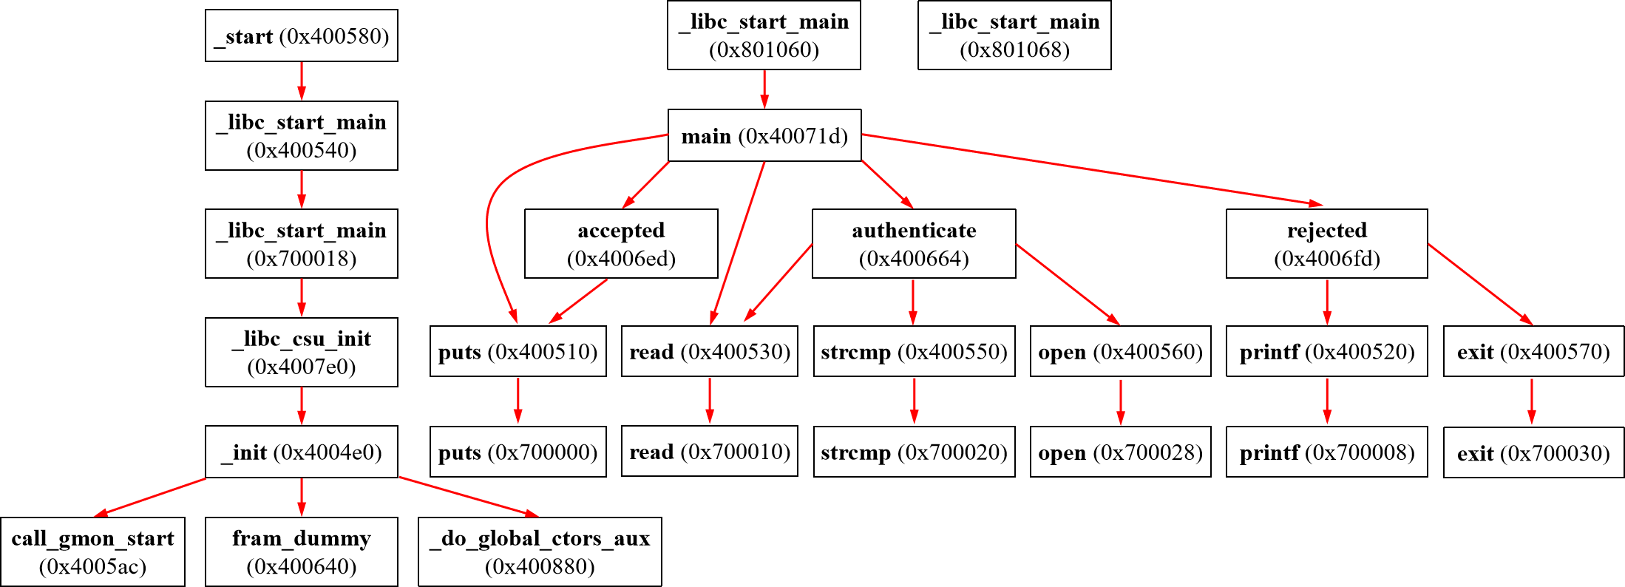
CG
_start (0x400580)
_libc_start_main (0x801060)
_libc_start_main (0x801068)
_libc_start_main (0x400540)
main (0x40071d)
_libc_start_main (0x700018)
accepted (0x4006ed)
authenticate (0x400664)
rejected (0x4006fd)
_libc_csu_init (0x4007e0)
puts (0x400510)
read (0x400530)
strcmp (0x400550)
open (0x400560)
printf (0x400520)
exit (0x400570)
_init (0x4004e0)
puts (0x700000)
read (0x700010)
strcmp (0x700020)
open (0x700028)
printf (0x700008)
exit (0x700030)
call_gmon_start (0x4005ac)
fram_dummy (0x400640)
_do_global_ctors_aux (0x400880)

Slide 17
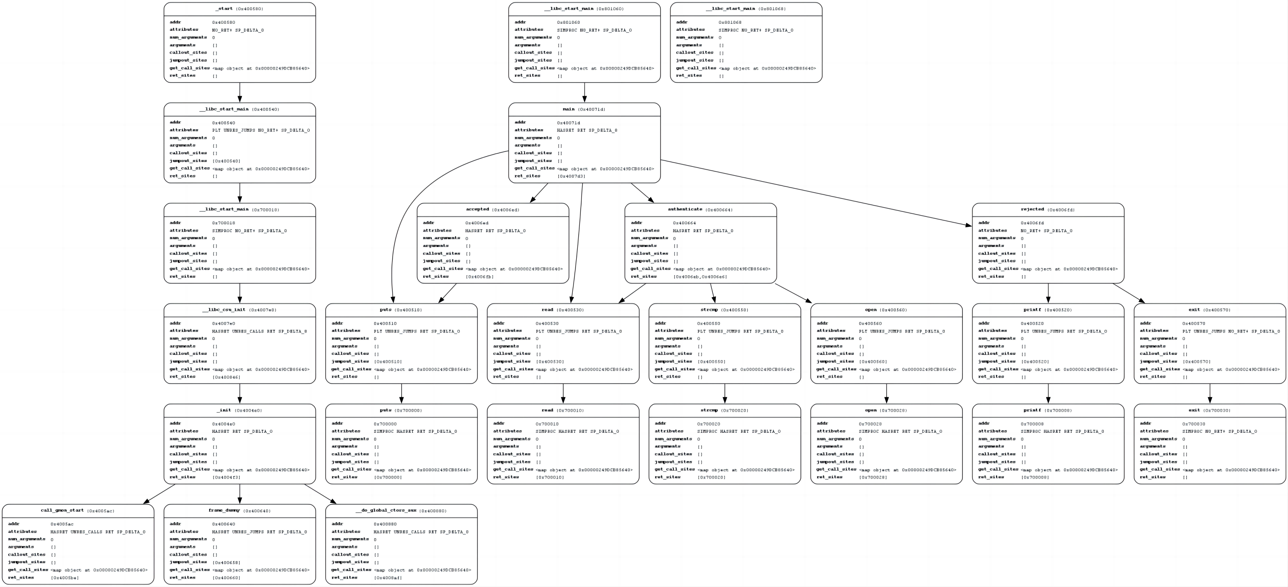
Call Graph (CG)

Slide 18
CFG-function
def analyze(b, name):
for func in proj.kb.functions.values():
if func.name.find(name) == 0:
plot_func_graph(b, func.transition_graph, "%s_%s_cfg" % (name, func.name), asminst=True, vexinst=False)
proj = angr.Project('backdoor1', auto_load_libs=False)
analyze(proj, "authenticate")

Slide 19
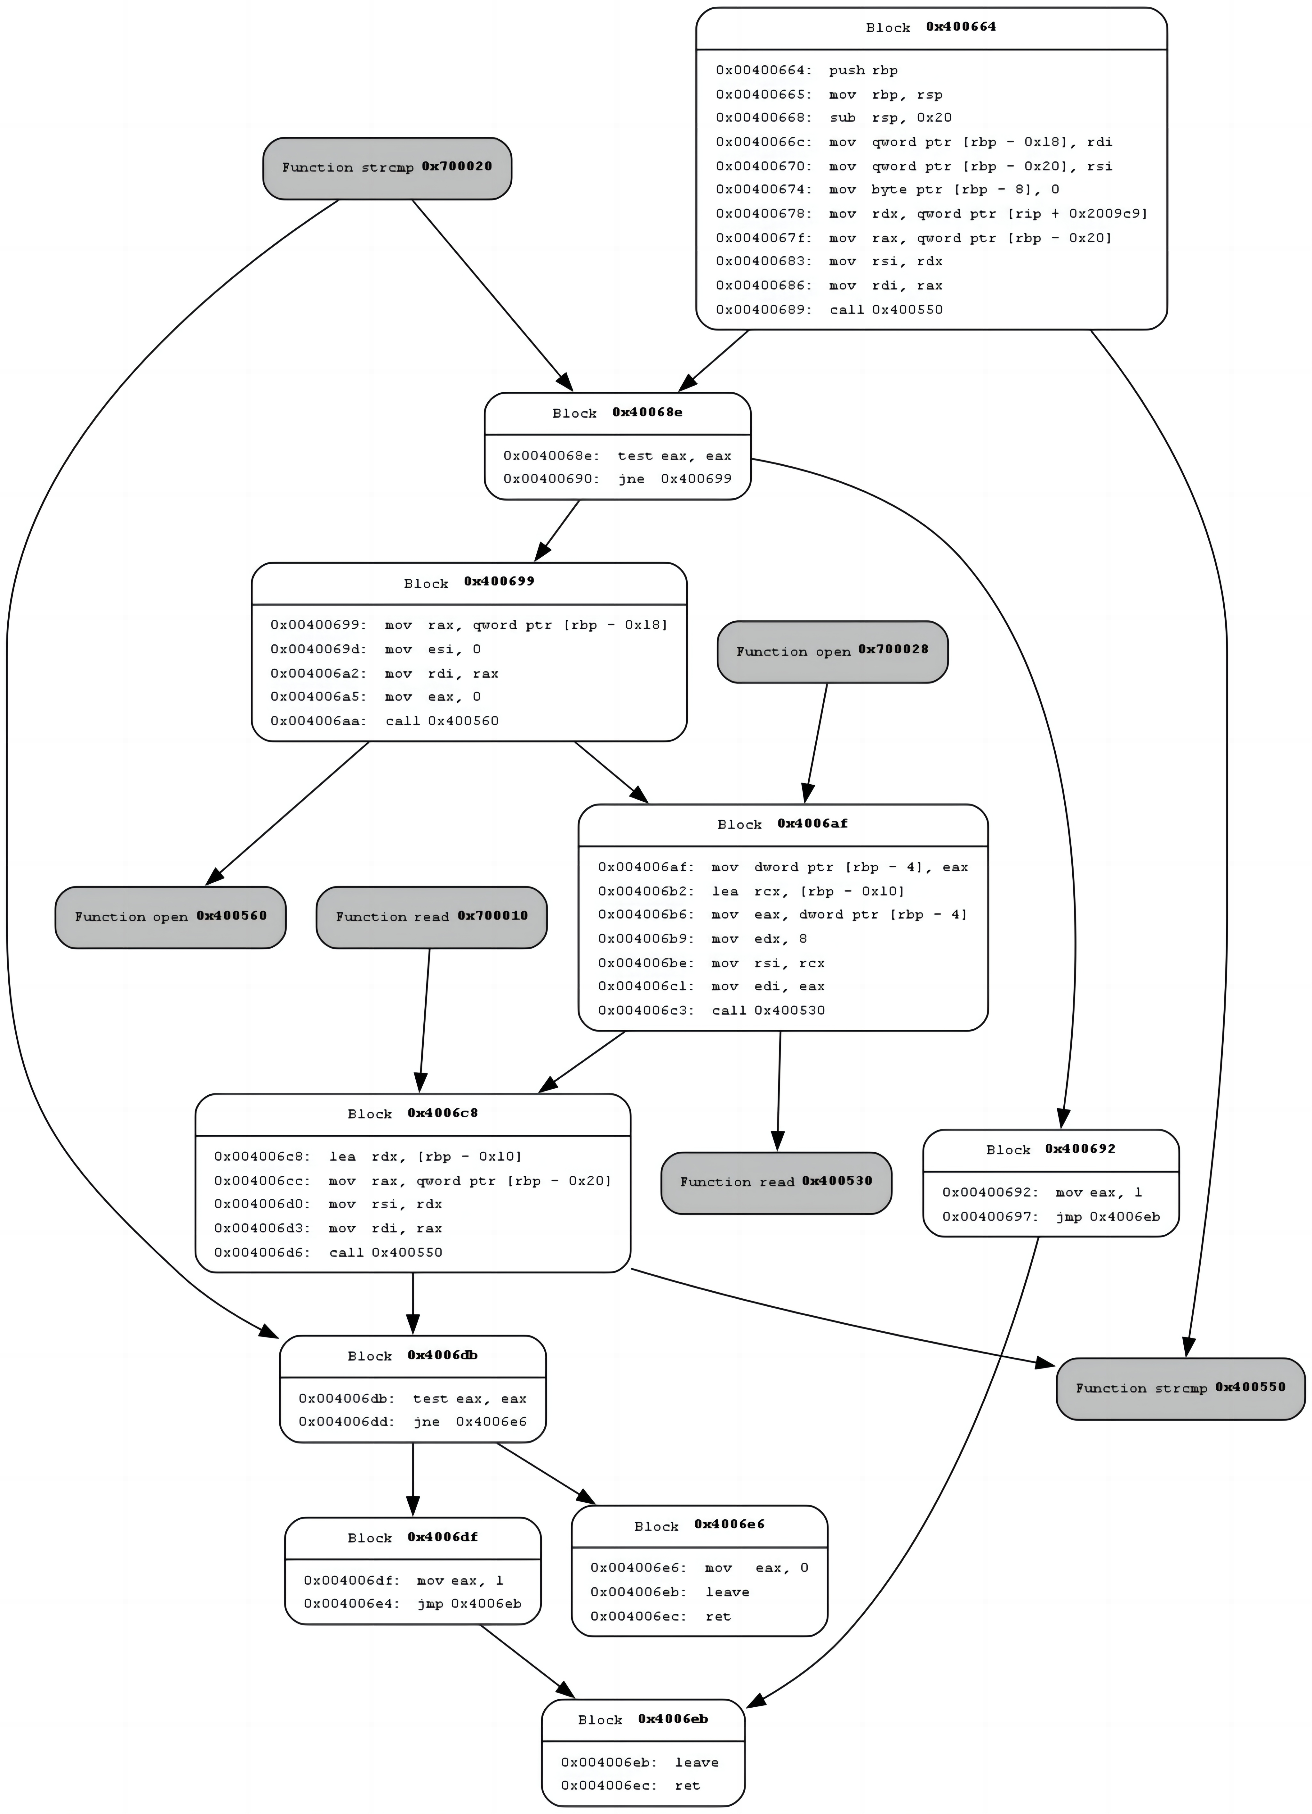
CFG-authenticate

Slide 20
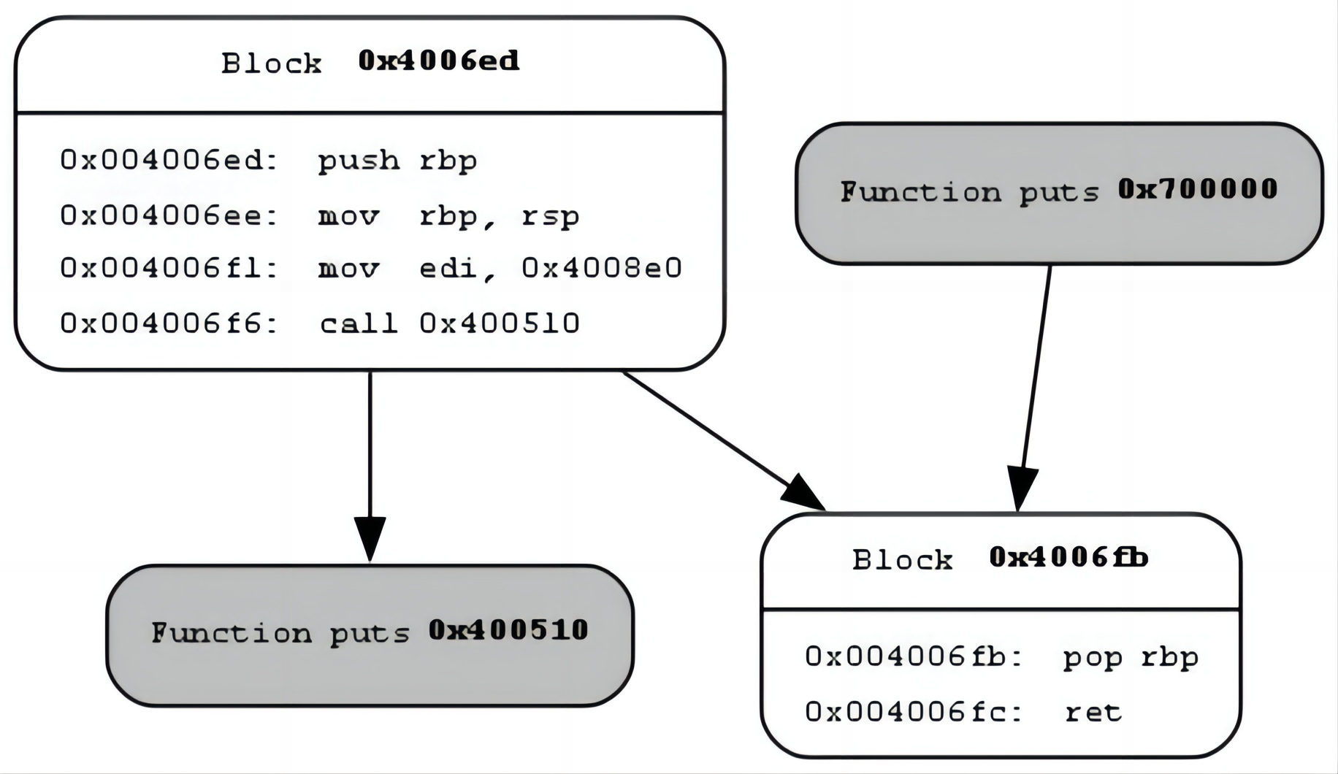
CFG-accepted

Slide 21
CFG-binary
  def analyze(b, name, func_name):
  main = b.loader.main_object.get_symbol(func_name)
start_state = b.factory.blank_state(addr=main.rebased_addr)
cfg = b.analyses.CFGEmulated(fail_fast=True, starts=[main.rebased_addr], initial_state=start_state)
plot_cfg(cfg, "name", asminst=True, remove_imports=True, remove_path_terminator=True)
proj = angr.Project('backdoor1', auto_load_libs=False)
analyze(proj, “backdoor_cfg”, “main”)

Slide 22
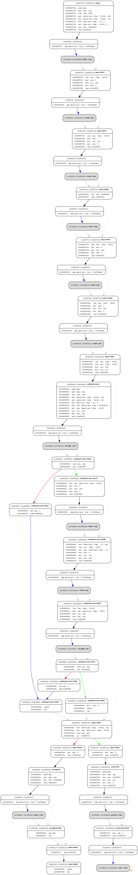
CFG

Slide 23

angr-management
installation:
pip install angr-management
This tool is designed to support interactive CFGs

Slide 24
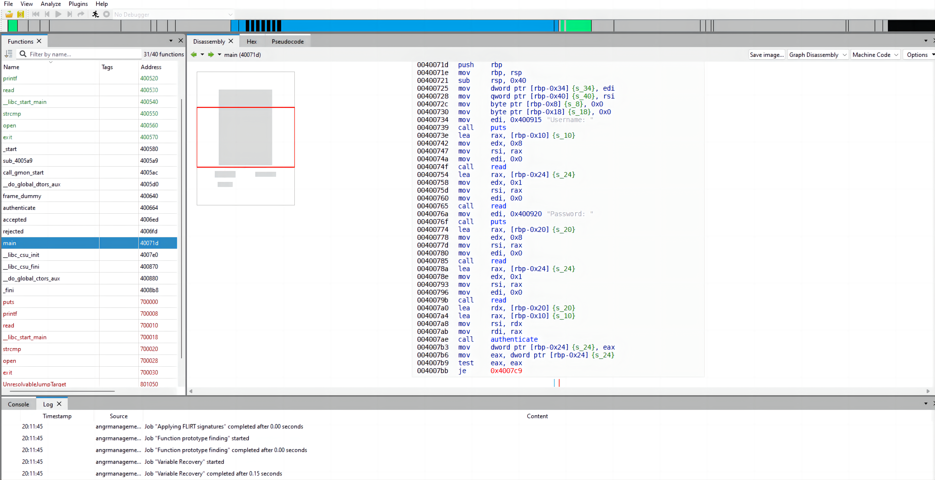
angr-management

Slide 25
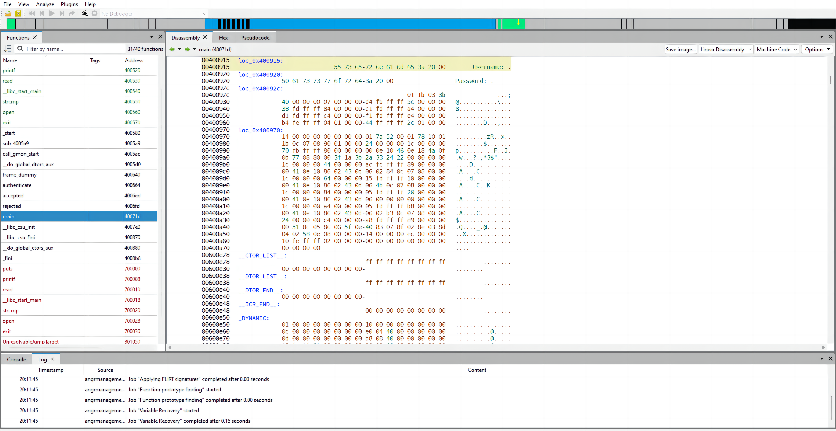
angr-management

Slide 26
CFG-accepted

Slide 27
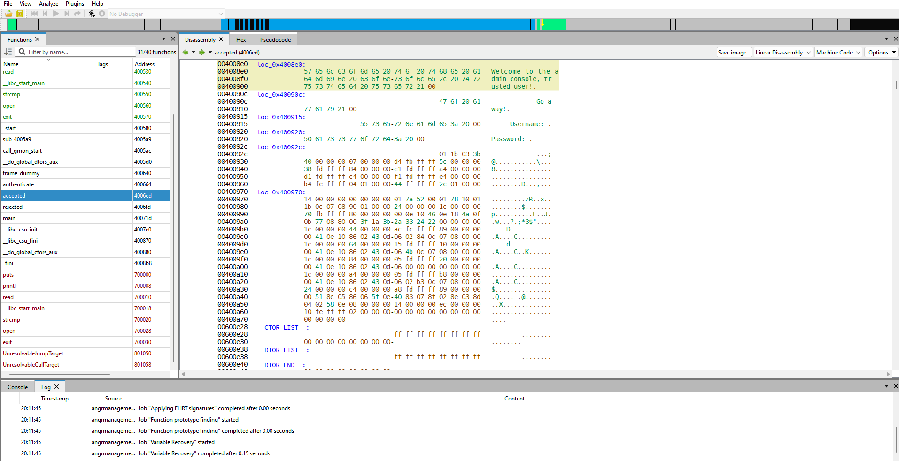
debug

Slide 28
debug
proj = angr.Project('backdoor1', auto_load_libs=False)
simgr = proj.factory.simgr()
simgr.explore(find=lambda s: b"Welcome" in s.posix.dumps(1))
s = simgr.found[0]
print(s.posix.dumps(1))
flag = s.posix.dumps(0)
print(flag)
#output:
b'Username: \nPassword: \nWelcome to the admin console, trusted user!\n'
b'\x00\x00\x00\x00\x00\x00\x00\x00\x00SOSNEAKY\x00'

Slide 29
CFG-authenticate

Slide 30
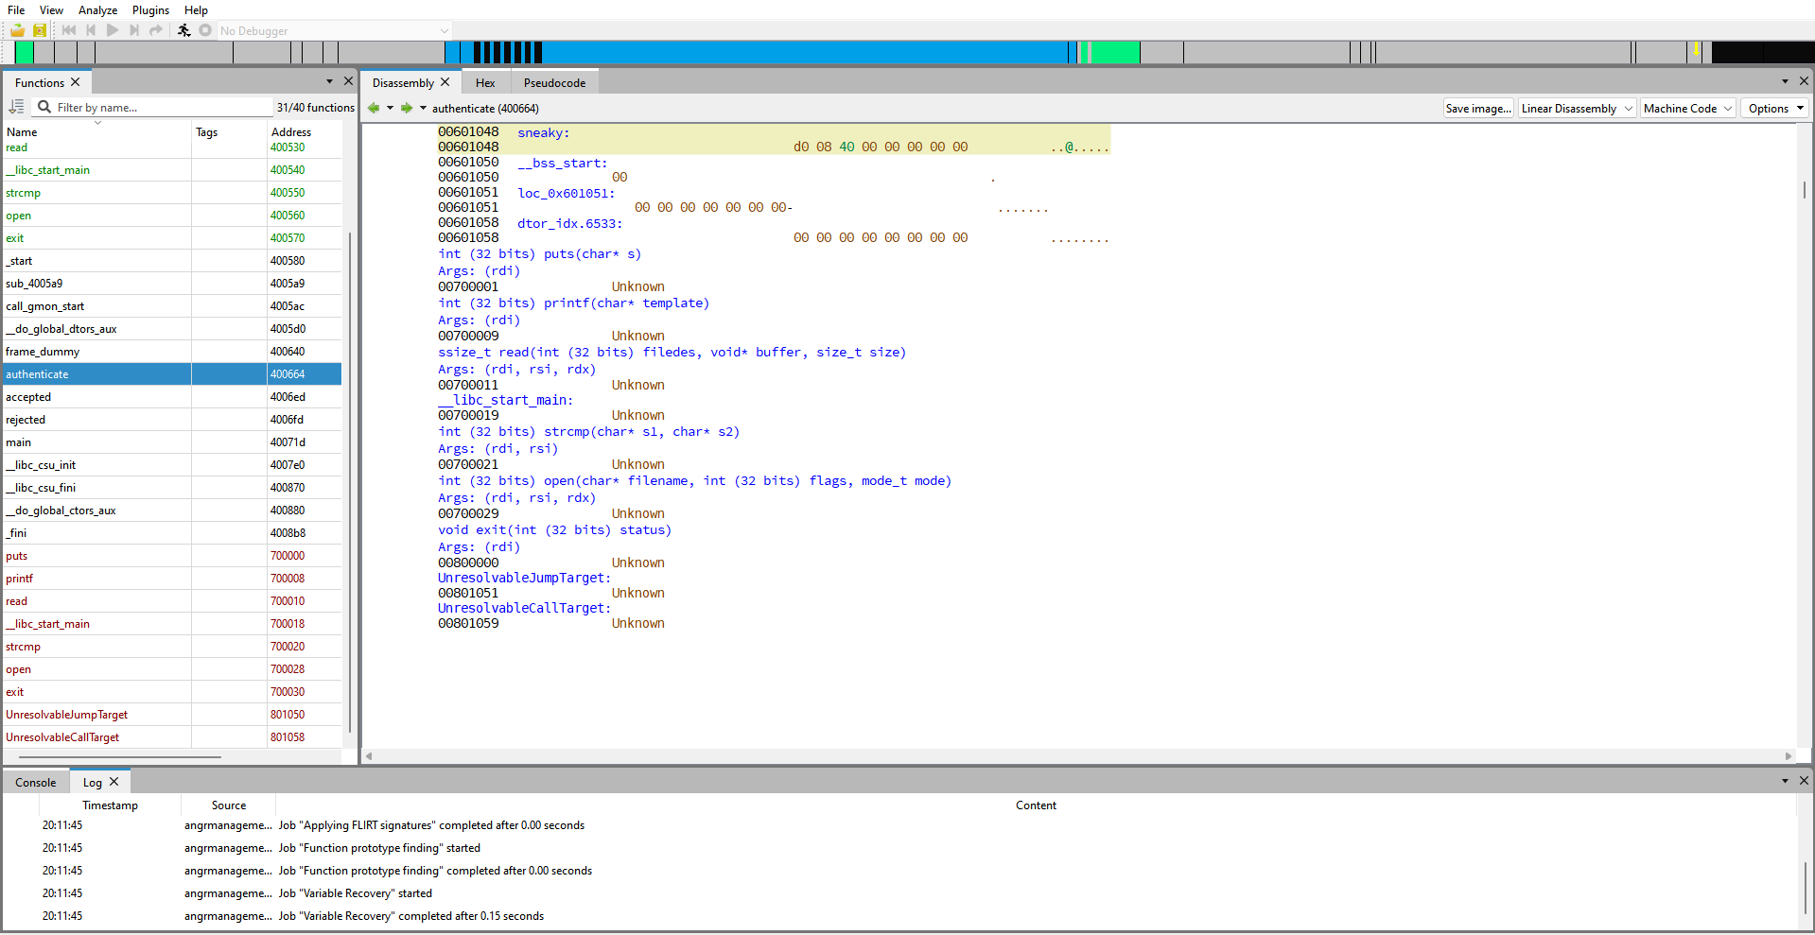
debug

Slide 31
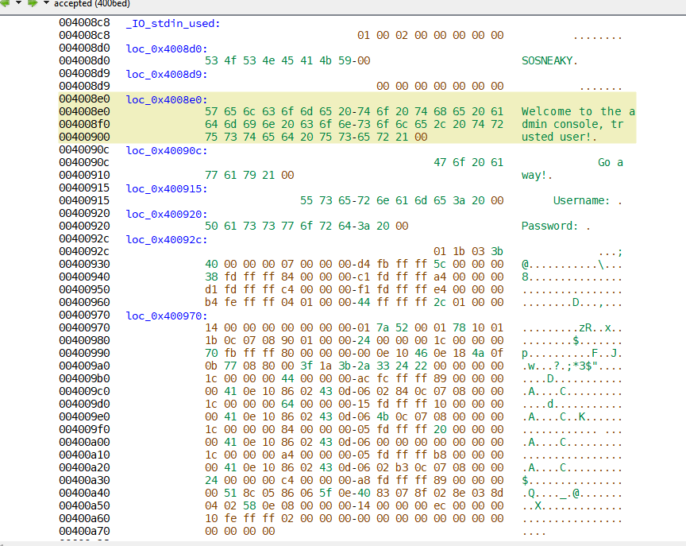
debug

Slide 32
CG
_start (0x400580)
_libc_start_main (0x801060)
_libc_start_main (0x801068)
_libc_start_main (0x400540)
main (0x40071d)
_libc_start_main (0x700018)
accepted (0x4006ed)
authenticate (0x400664)
rejected (0x4006fd)
_libc_csu_init (0x4007e0)
puts (0x400510)
read (0x400530)
strcmp (0x400550)
open (0x400560)
printf (0x400520)
exit (0x400570)
_init (0x4004e0)
puts (0x700000)
read (0x700010)
strcmp (0x700020)
open (0x700028)
printf (0x700008)
exit (0x700030)
call_gmon_start (0x4005ac)
fram_dummy (0x400640)
_do_global_ctors_aux (0x400880)

Slide 33
Alternative
proj = angr.Project('backdoor1', auto_load_libs=False)
state = proj.factory.entry_state(stdin=angr.SimFile)
while True:
succ = state.step()
if len(succ.successors)==2:
break
state = succ.successors[0]
state1, state2 = succ.successors
input_data = state1.posix.stdin.load(0, state1.posix.stdin.size)
print(state1.solver.eval(input_data, cast_to=bytes))
#output:
b'\x00\x00\x00\x00\x00\x00\x00\x00\x00SOSNEAKY\x00'

Slide 34
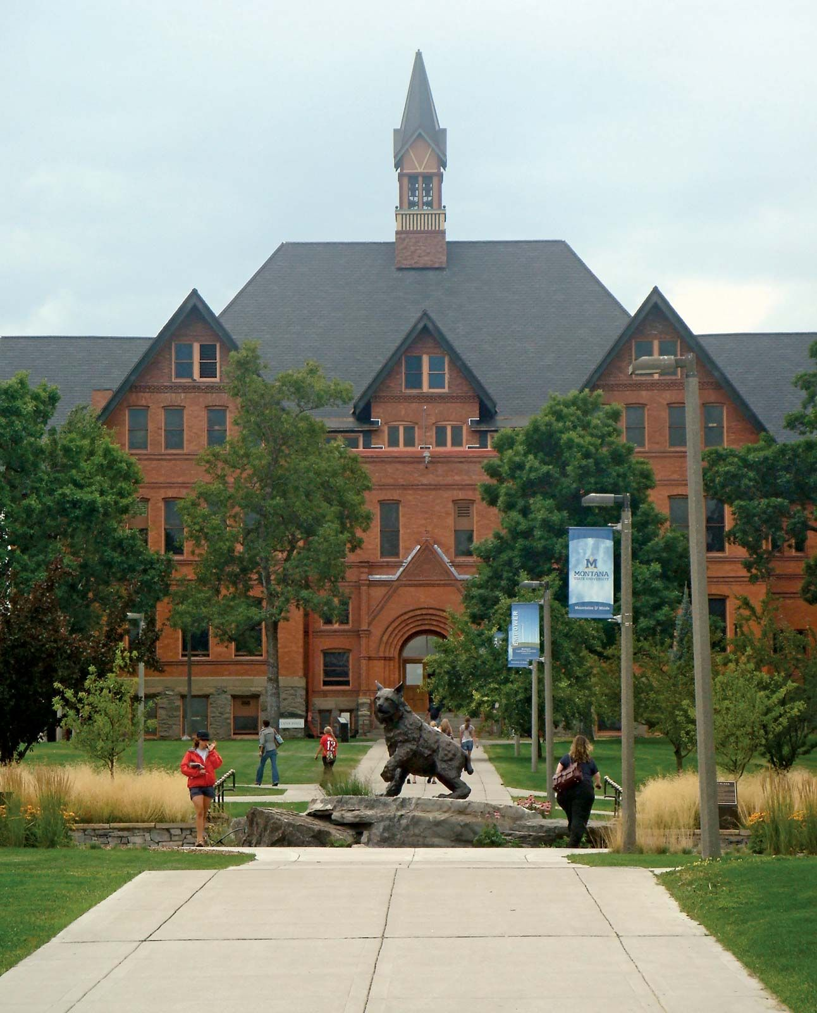
THE END
Fangtian Zhong
CSCI 591
Gianforte School of Computing
Norm Asbjornson College of Engineering
E-mail: fangtian.zhong@montana.edu
2023.11.09

