Slide 1

2023.11.14
Malicious Code Analysis
Fangtian Zhong
CSCI 591
Gianforte School of Computing
Norm Asbjornson College of Engineering
E-mail: fangtian.zhong@montana.edu

Slide 2
Overview
Debugger Overview
01
WinDbg Preview
02

Slide 3

Debugger Overview
Part One
01

Slide 4

Documentation
Read the documentation
  Installed in the debugger root directory
Reading the docs is key to using the debugger efficiently
  Ever-increasing number of commands and command parameters
  Very large number of debugging topics
  No presentation or class can cover all the debugger features you care about
Use the index for any topic you need more information on
  Use search if the index does not list the topic
New features are also listed on their website

Slide 5
Types of Debuggers
Command line debuggers
  kd.exe: kernel debugger
  cdb.exe, ntsd.exe: user mode debugger
WinDbg
  GUI on top of kd.exe and cdb.exe
  Identical extensions and command interface
  Much more efficient for source debugging
  Can be slower because of extra data displayed
Dbgrsv.exe, kdsrv.exe, dbengprx.exe
  Debugger protocol remoting tools
  Discussed later as part of debugger remoting

Slide 6
What Do the Debuggers Support?
Processor architectures:
  x86, Itanium, x64
OS versions:
  Windows NT 4 and later
  No Win9x kernel debugging
  Debugging the newest OS requires using the latest debugger
Protocols
  COM, 1394, EXDI, USB 2.0 in beta
Can debug a Windows OS running inside the Virtual PC or VMware virtual machines

Slide 7
Common Issues
Local variable issues
  Turn off compiler optimizations
  razzle no_opt
Breakpoint issues
  Use the “bu” command to deal with unloading modules
1394 debugging won’t connect (firewall)
  Disable 1394 host controller on the target
COM port debugging won’t connect
  Disable legacy USB support in the BIOS
If all else fails, you may have hit a debugger bug
  Report it! We don’t release until all known bugs are fixed.

Slide 8
Part Two
WinDbg Preview
02

Slide 9

Installing
Installing WinDbg Preview
If you are using the Windows 10 or above, WinDbg Preview is already installed.
If you are using some other machine, follow the steps below to install it.
On Windows 10, at the lower left of the desktop, click the magnifing glass. Type STORE
Open Microsoft Store.
In Microsoft Store, search for WinDbg, as shown below.

Slide 10
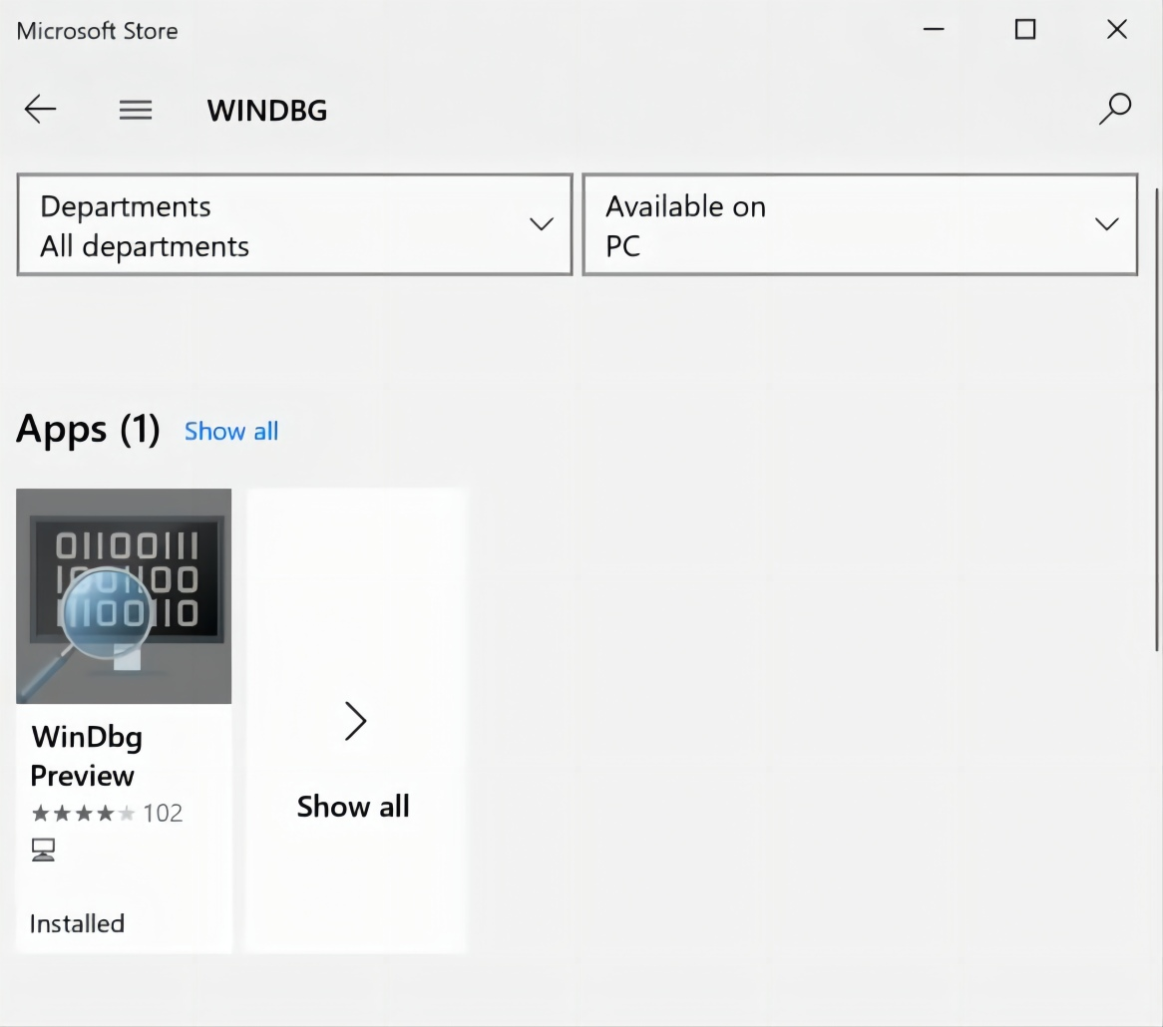
Installing
When it finds "WinDbg Preview", click the blue Get button.
A "Use across your devices" box pops up. Click "No, thanks".
Click Launch.

Slide 11

Launching
Close WinDbg.
Click the Start button and type WINDBG. Right-click "WinDbg Preview" and click "Run as Administrator".
Approve the privilege escalation.

Slide 12

Debugging Notepad
In WinDbg, click File, "Launch executable".
Navigate to:
C:\Windows\System32\notepad.exe
and open it.

Slide 13
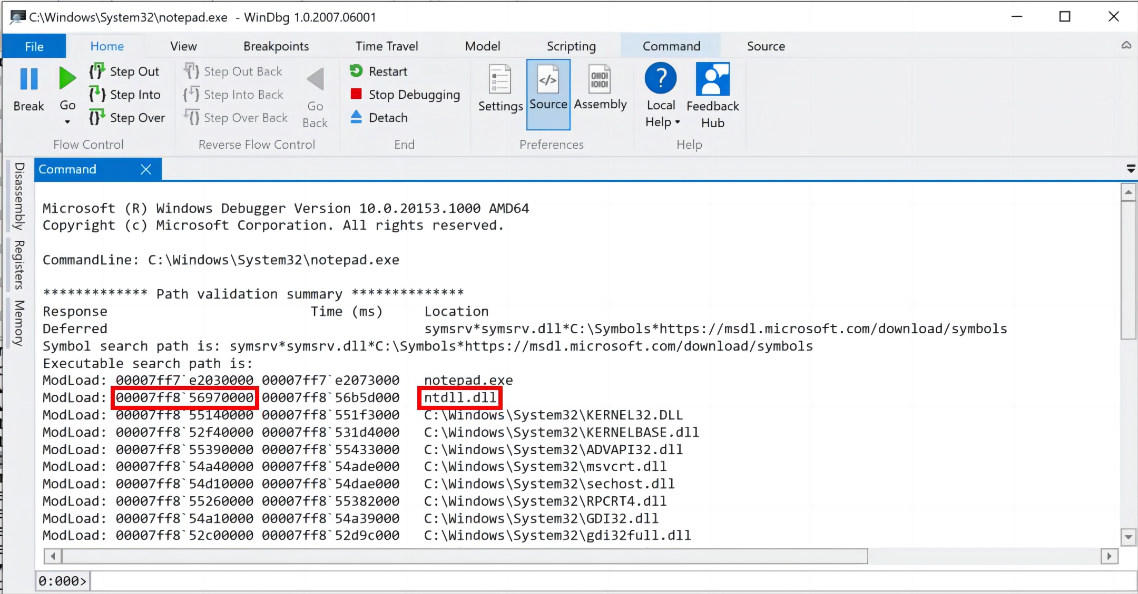
Loading Dlls
In WinDbg Preview, in the center pane, scroll up to the start.
Here you see Notepad loading the DLLs it uses.
Notice the address shown for ntdll, the user-mode face of the Windows kernel, outlined in red in the image below.

Slide 14
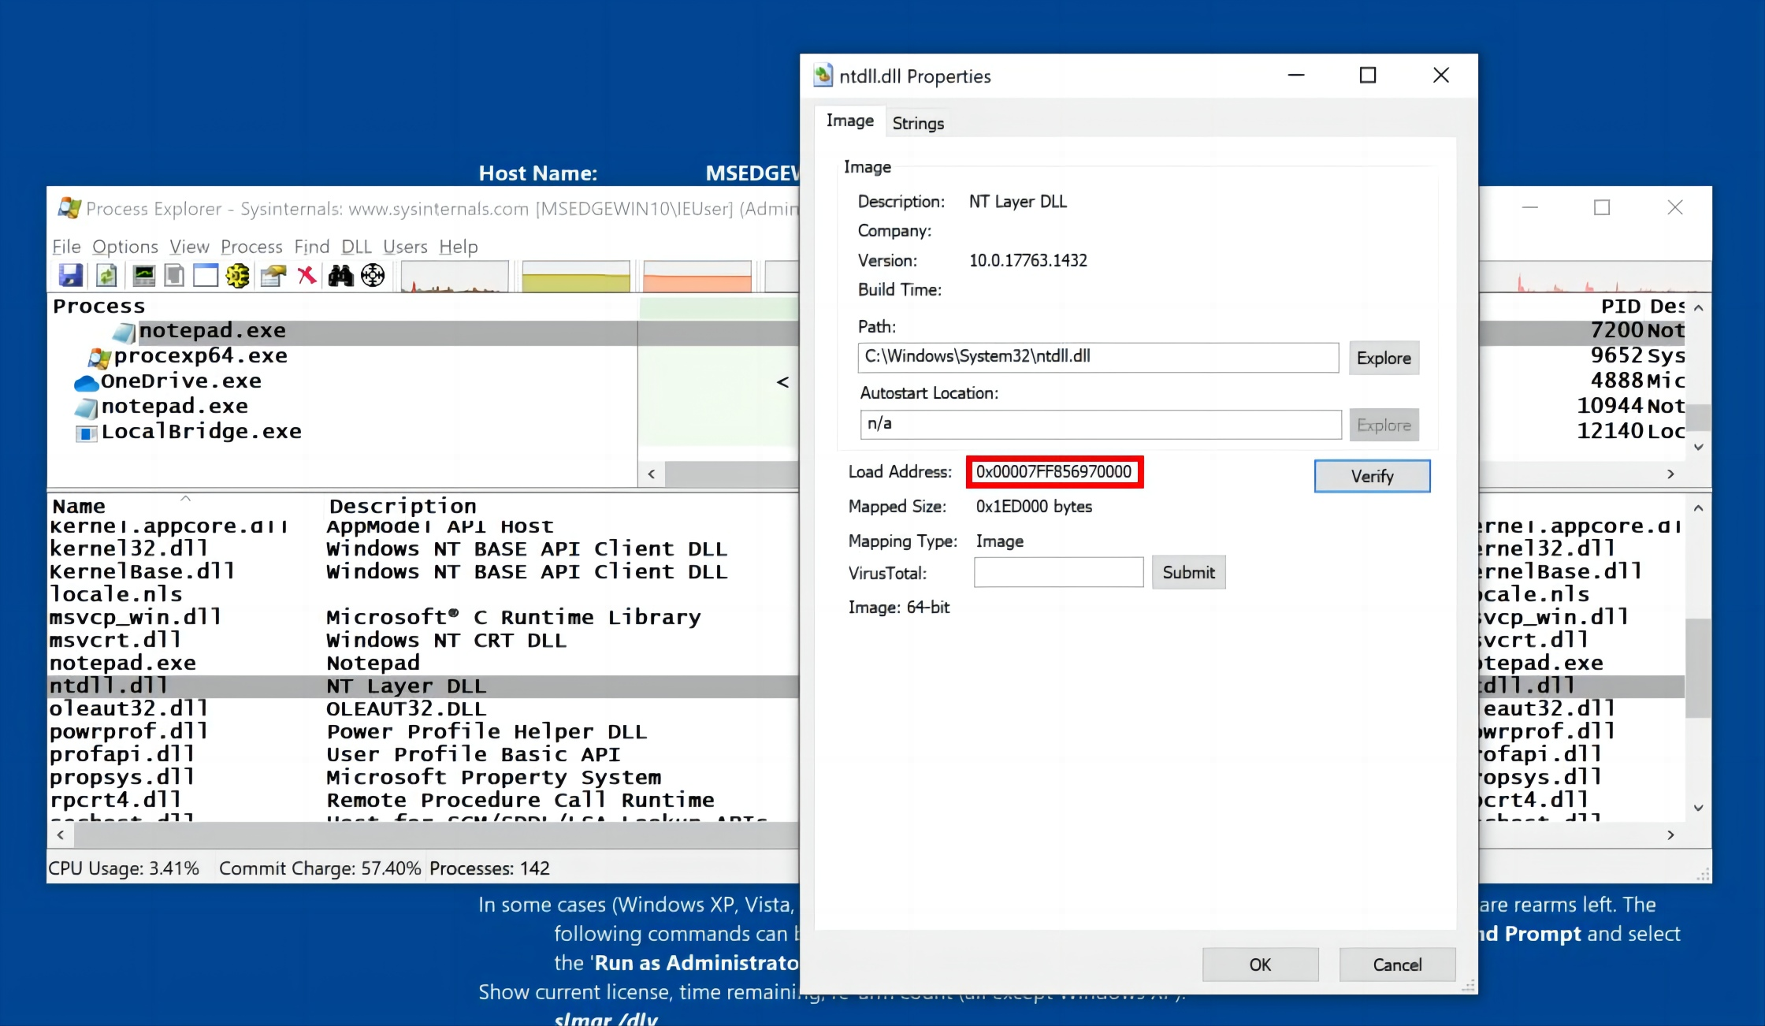
Loading Dlls
Launch Process Explorer as Administrator and click notepad.exe
Click View, "Show Lower Pane".
Click View, "Lower Pane View", DLLs.
In the lower pane, right-click ntdll and click Properties.
As shown below, the load address shown here matches the first address shown in WinDbg.

Slide 15
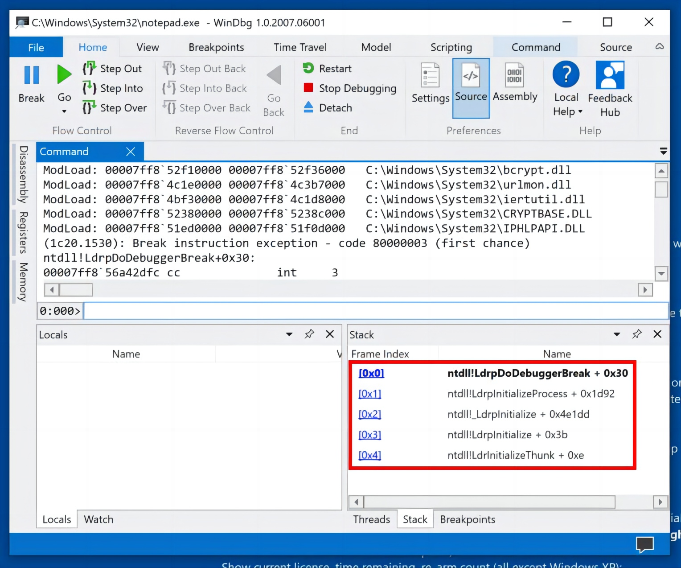
Stack
In WinDbg Preview, in the center pane, scroll down to the bottom.
Here you can see that the program has stopped at a break instruction inside the ntdll module, as shown below.
From the menu bar, click View, Stack.
The lower right pane shows the stack frames, indicating that we are five calls deep, all within ntdll.

Slide 16
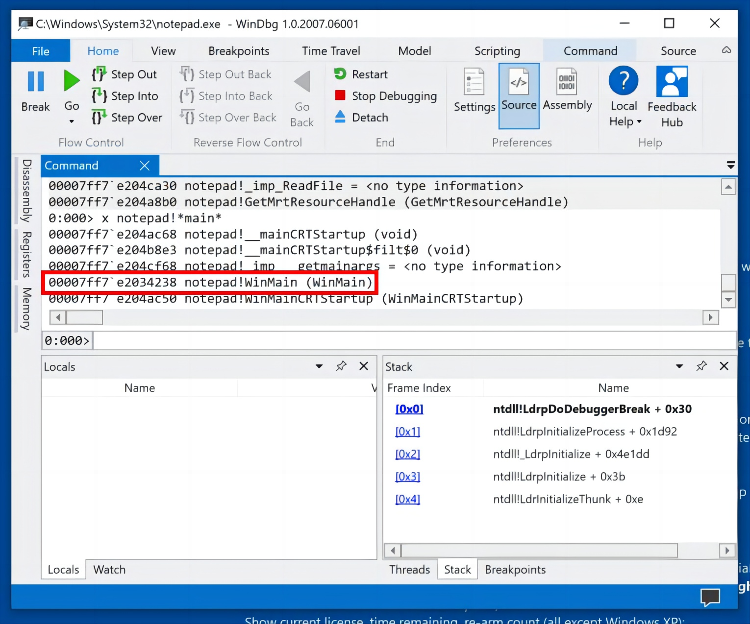
Viewing Symbols
In the lower center command-line (to the right of 0:00>), execute this command:
x notepad!*
You see a long list of symbols used by Notepad.
To see the symbols containing the word main, execute this command:
x notepad!*main*
You see a few symbols, including the entry point WinMain, as shown below.

Slide 17
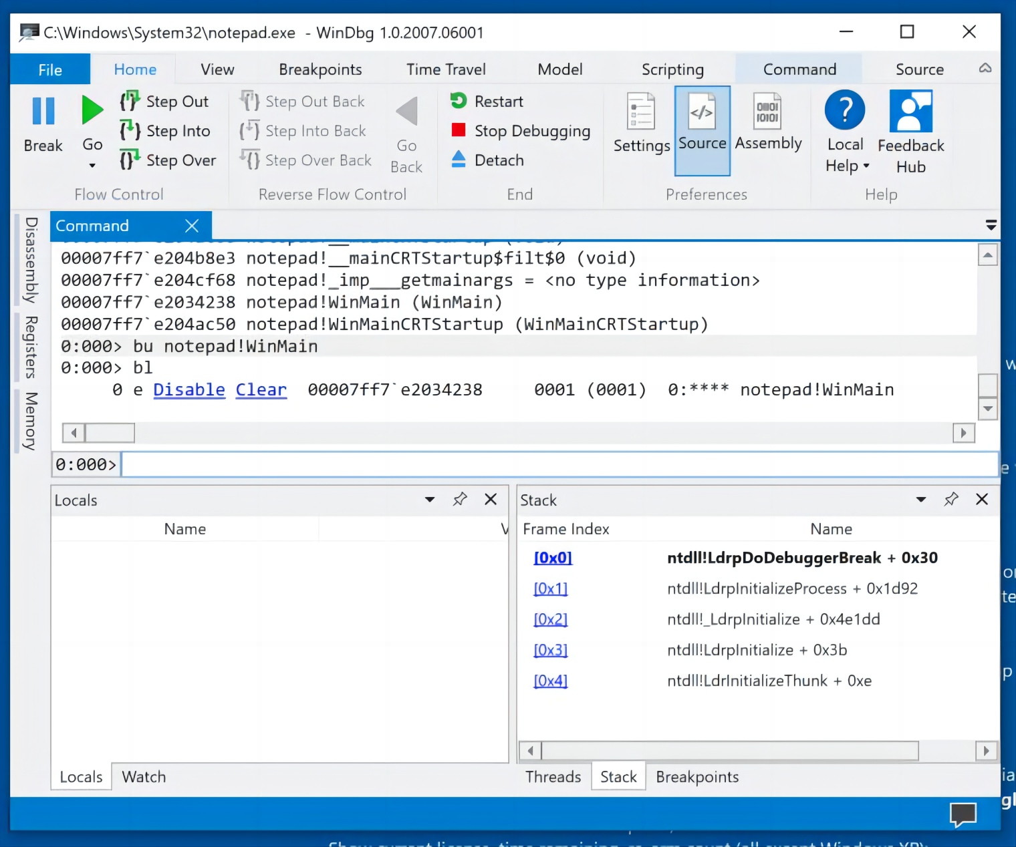
Setting a Breakpoint
Execute these commands to set a breakpoint at WinMain, and display breakpoints:
bu notepad!WinMain
bl
The breakpoint is set, as shown below.

Slide 18
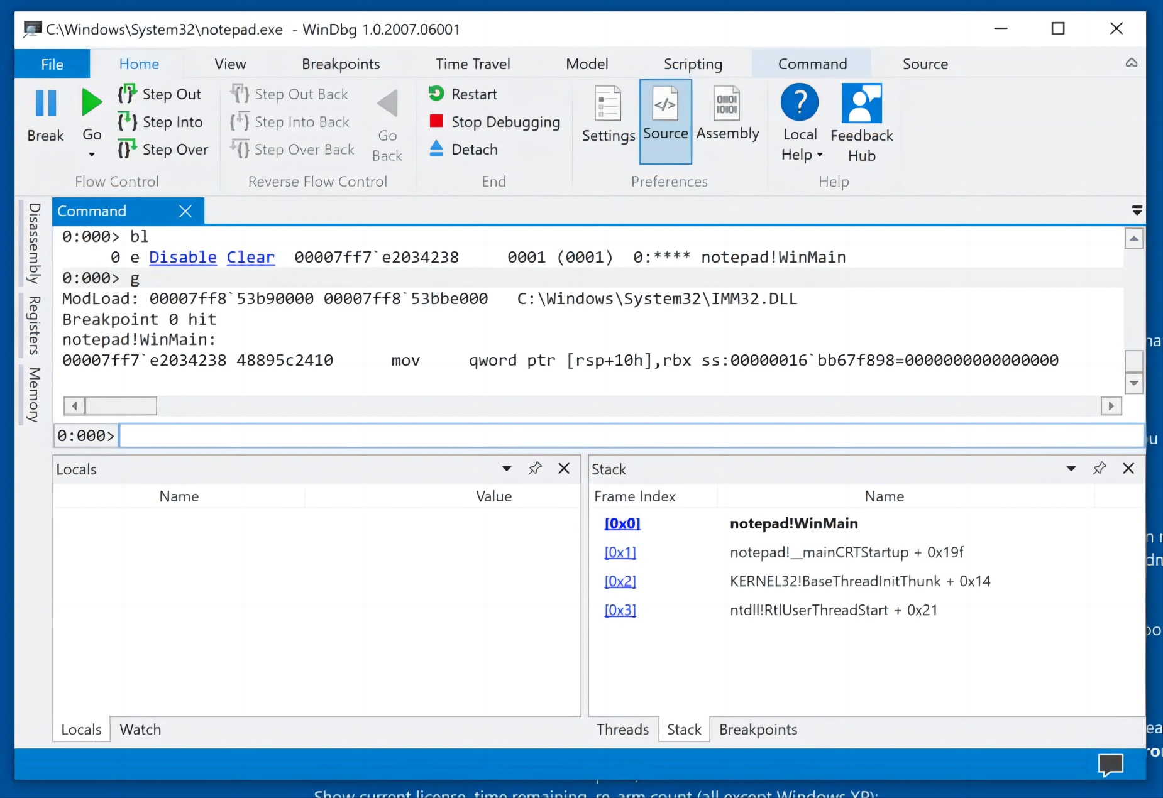
Setting a Breakpoint
Running to the Breakoint
g
The program stops at the WinMain breakpoint, as shown below.

Slide 19
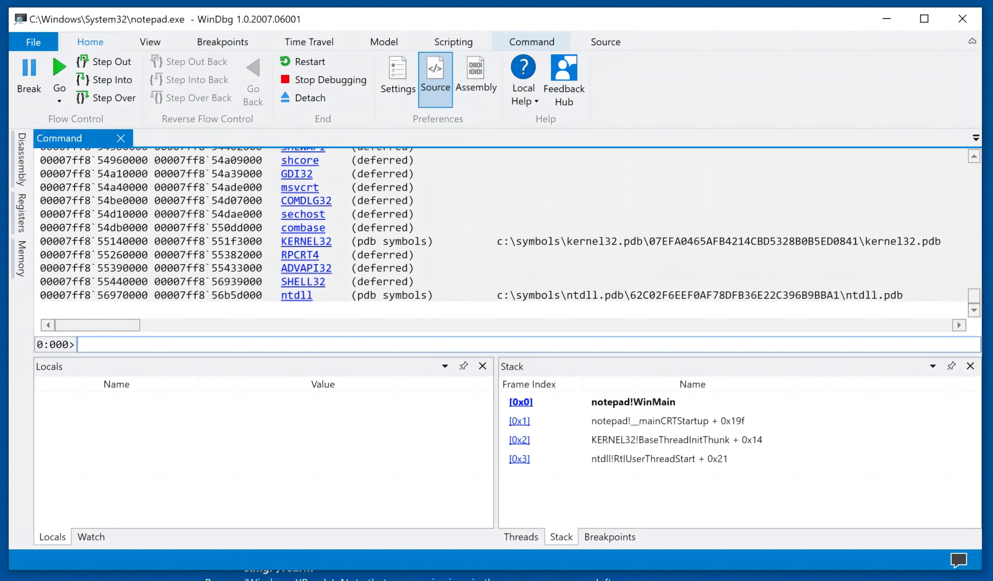
Viewing Loaded Modules
To view the loaded modules for Notepad (the process WinDbg is attached to), execute this command:
lm
You see a list of loaded modules. Some of them have .pdb files shown on the right, including ntdll, as shown below. Those are symbol files that make debugging easier.

Slide 20
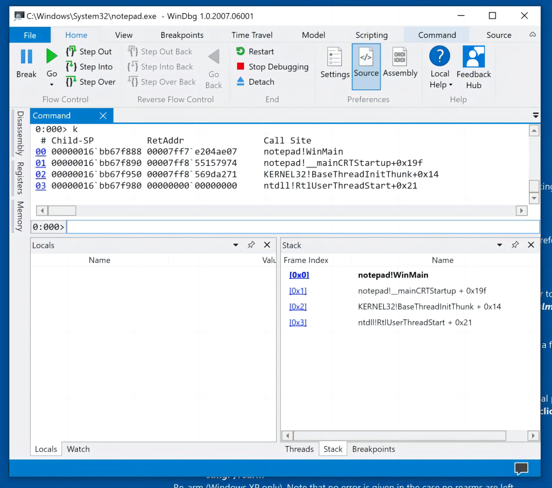
Stack Trace
To see a stack trace, execute this command:
k
You see a list of the functions that are in progress at this point, as shown below.
This is the same list as the one that appears in the lower right pane, with more detail.

Slide 21
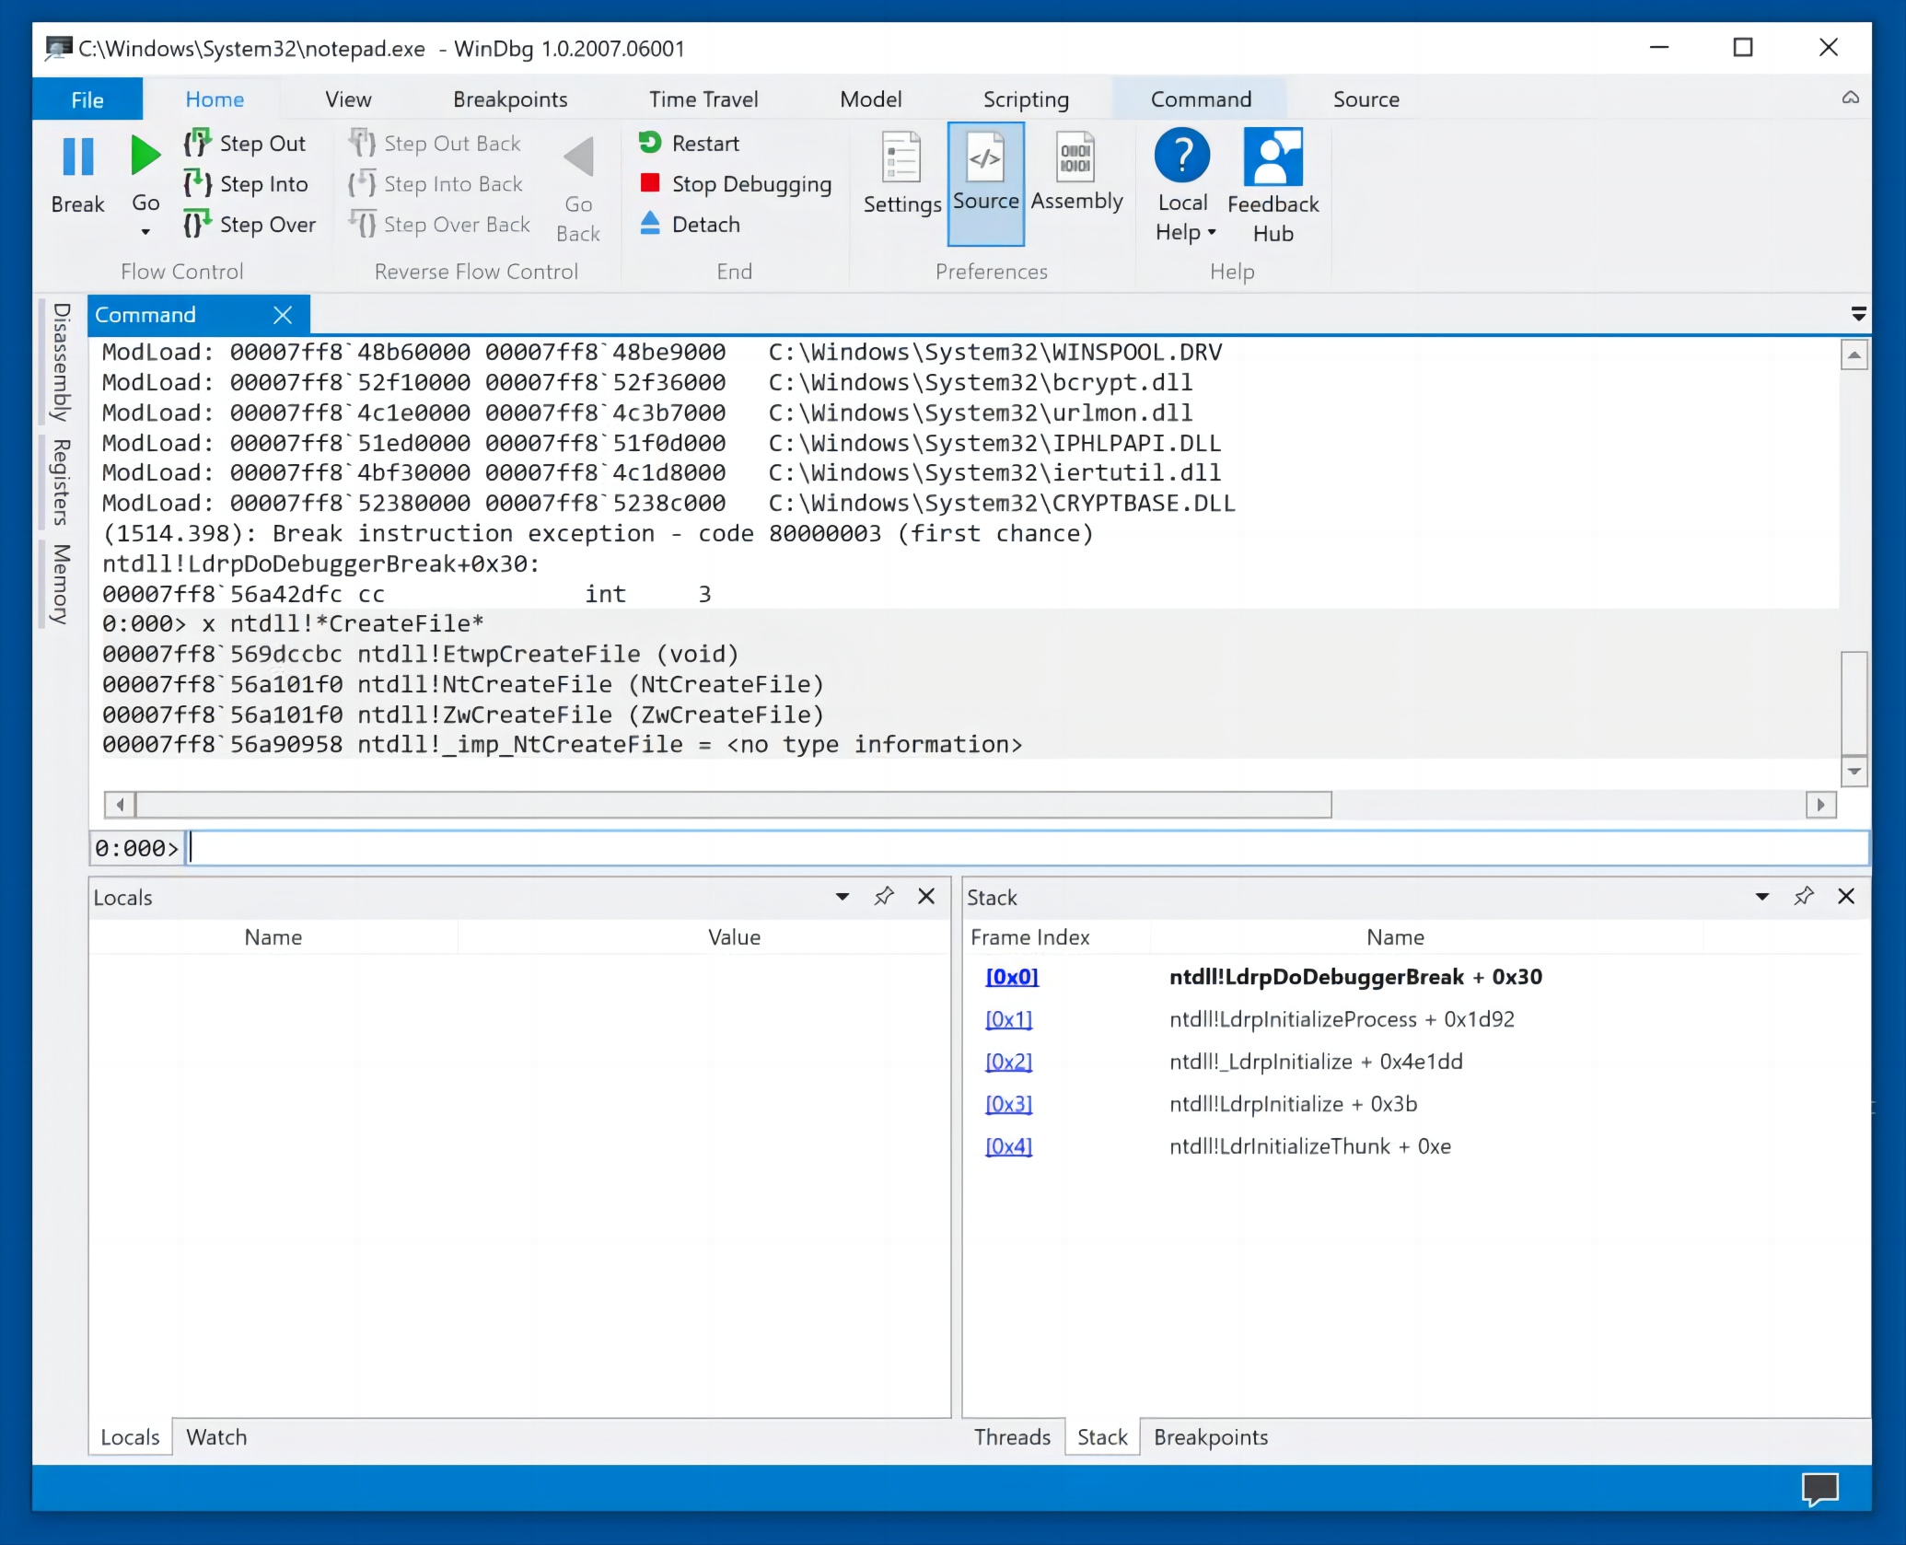
Finding API Calls that Create Files
Let's find the start of the ZwWriteFile method in the ntdll module execute this command:
x ntdll!*CreateFile*
You see a few symbols, including ntdll!ZwCreateFile, as shown below.

Slide 22
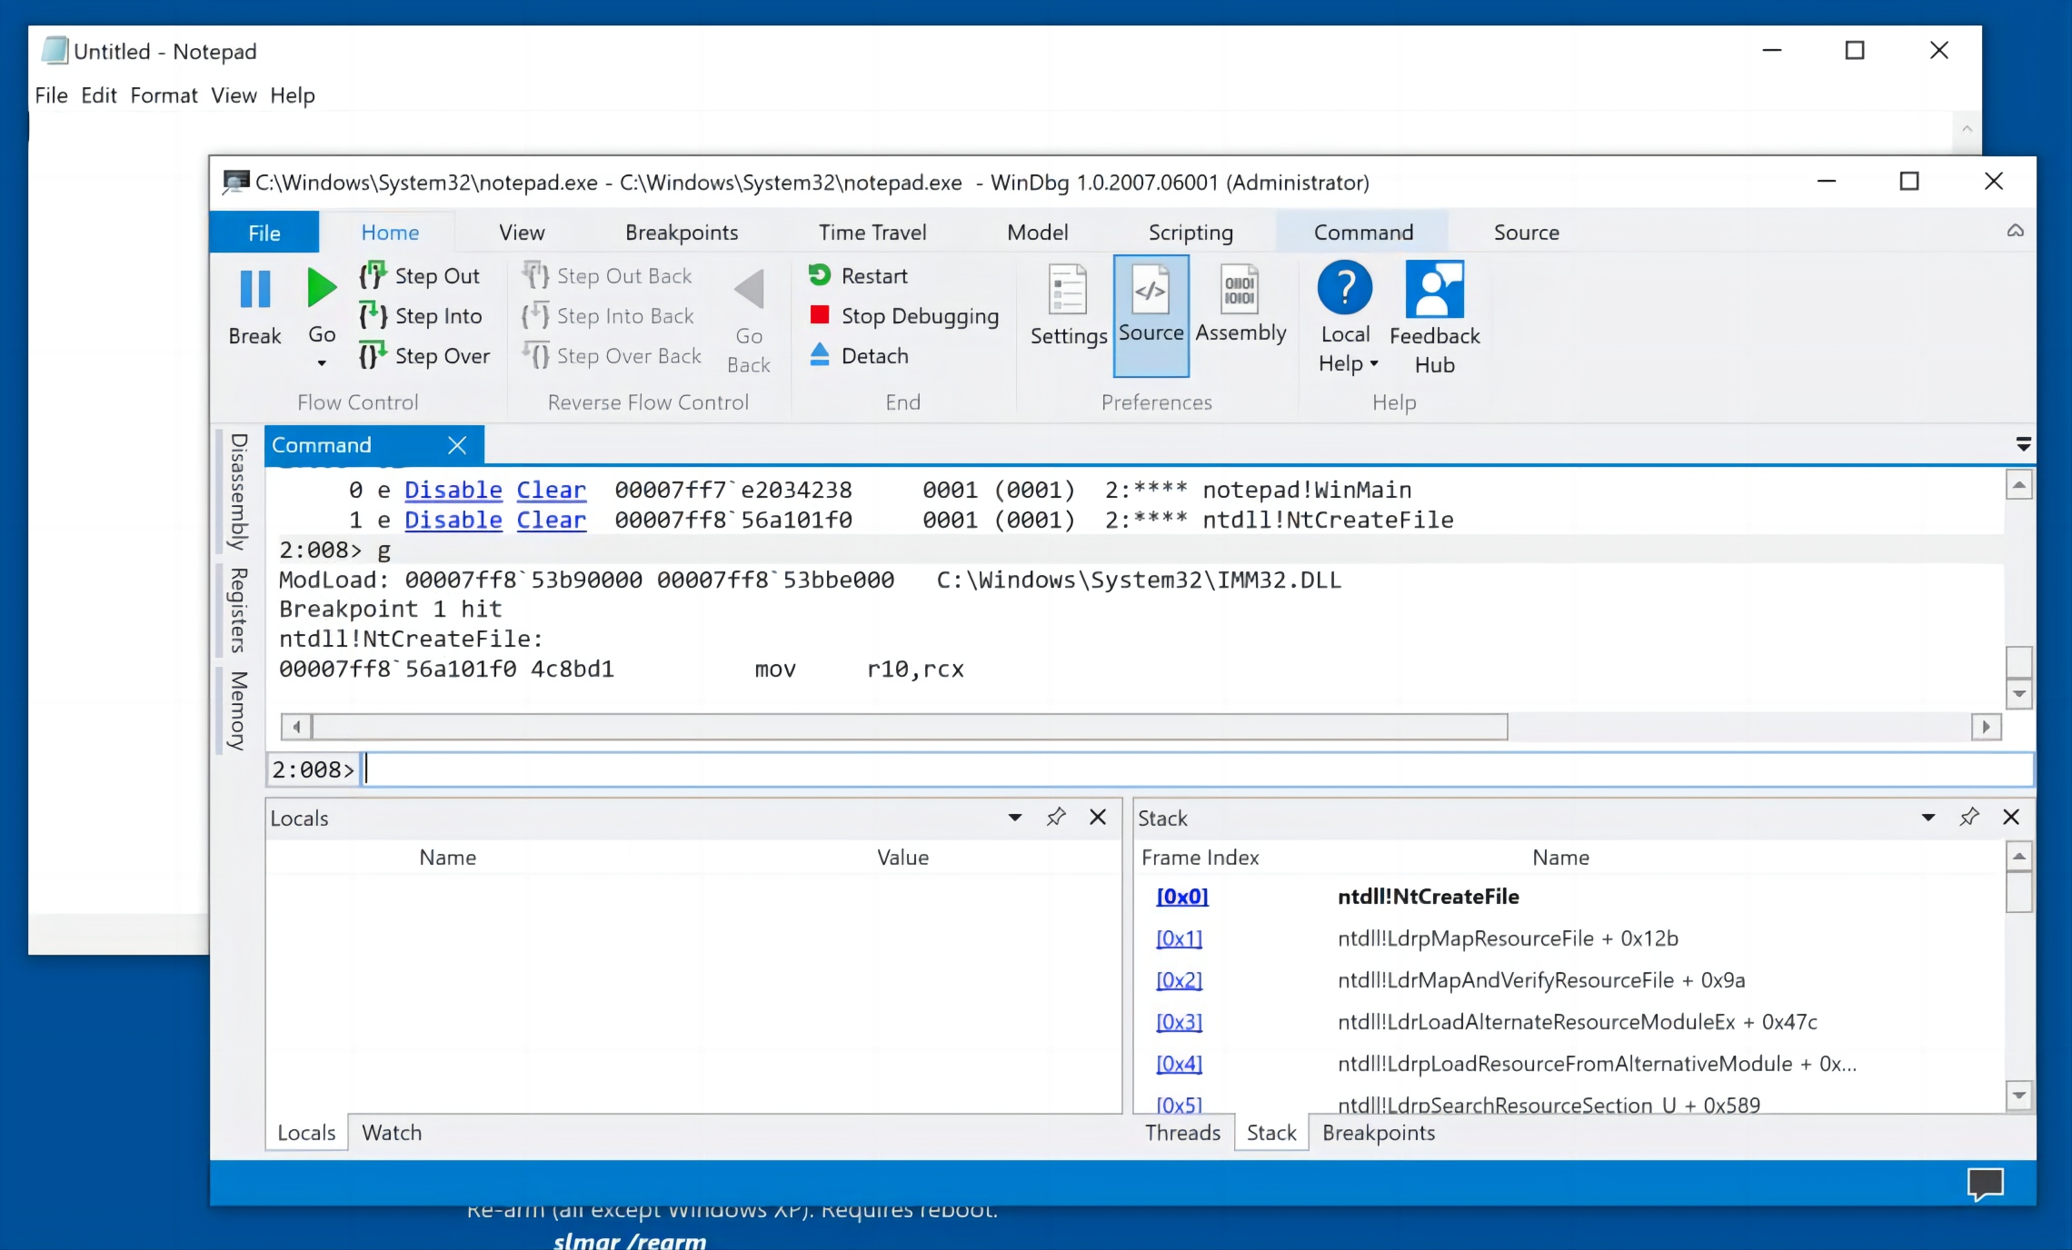
Setting a Breakpoint and Resuming
Execute these commands to set a breakpoint atntdll!NtCreateFile and resume execution.
bu ntdll!NtCreateFile
g
Notepad hits the breakpoint, as shown below.

Slide 23
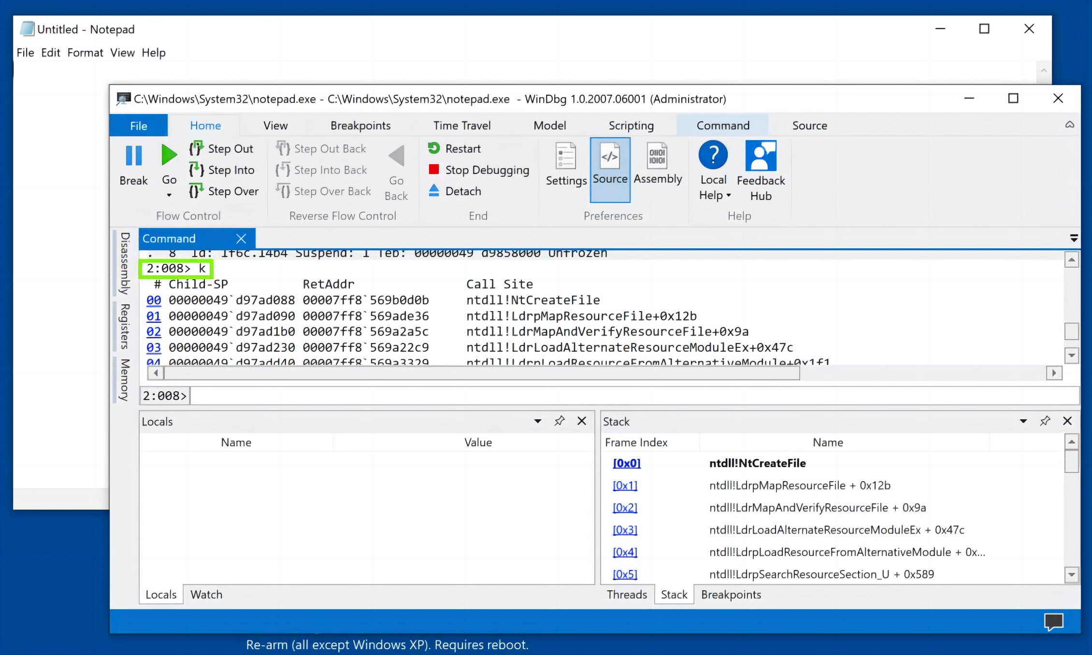
Stack Trace
Execute this command to see the stack trace:
k
Notepad hits the breakpoint.
Scroll back up to see the start of the k output, as shown below.

Slide 24
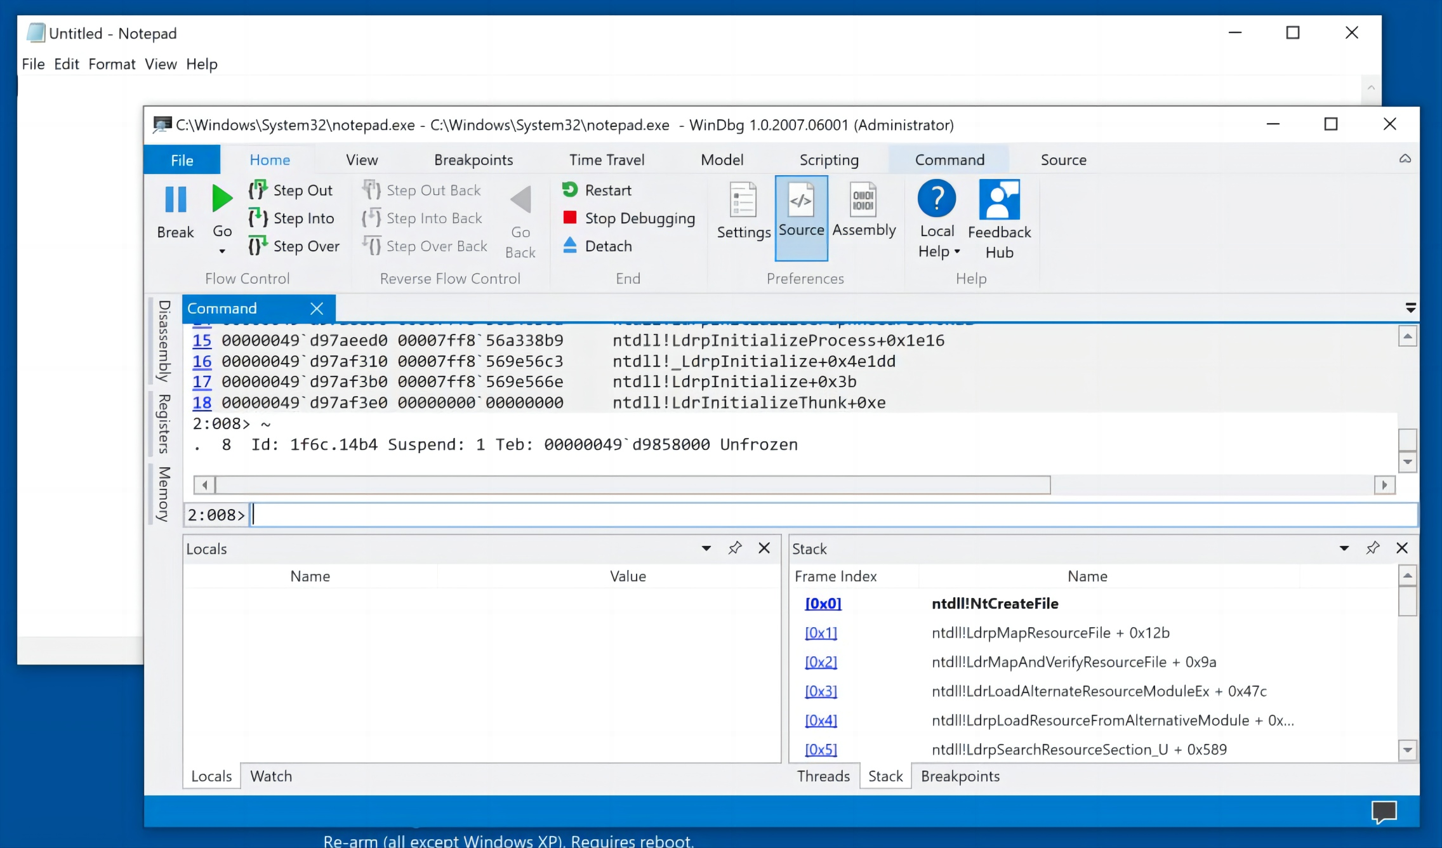
Viewing Threads
Notice the numbers before the k, outlined in green in the image above.
The first number is the processor number, and the second is the thread number.
When I did it, the breakpoint was hit by thread 8, running on processor 2. Your numbers may be different.
To see all the threads in the Notepad process, execute this command (the tilde character, a Shift+Backtick):
~
On my system, only one thread was running, as shown below.

Slide 25
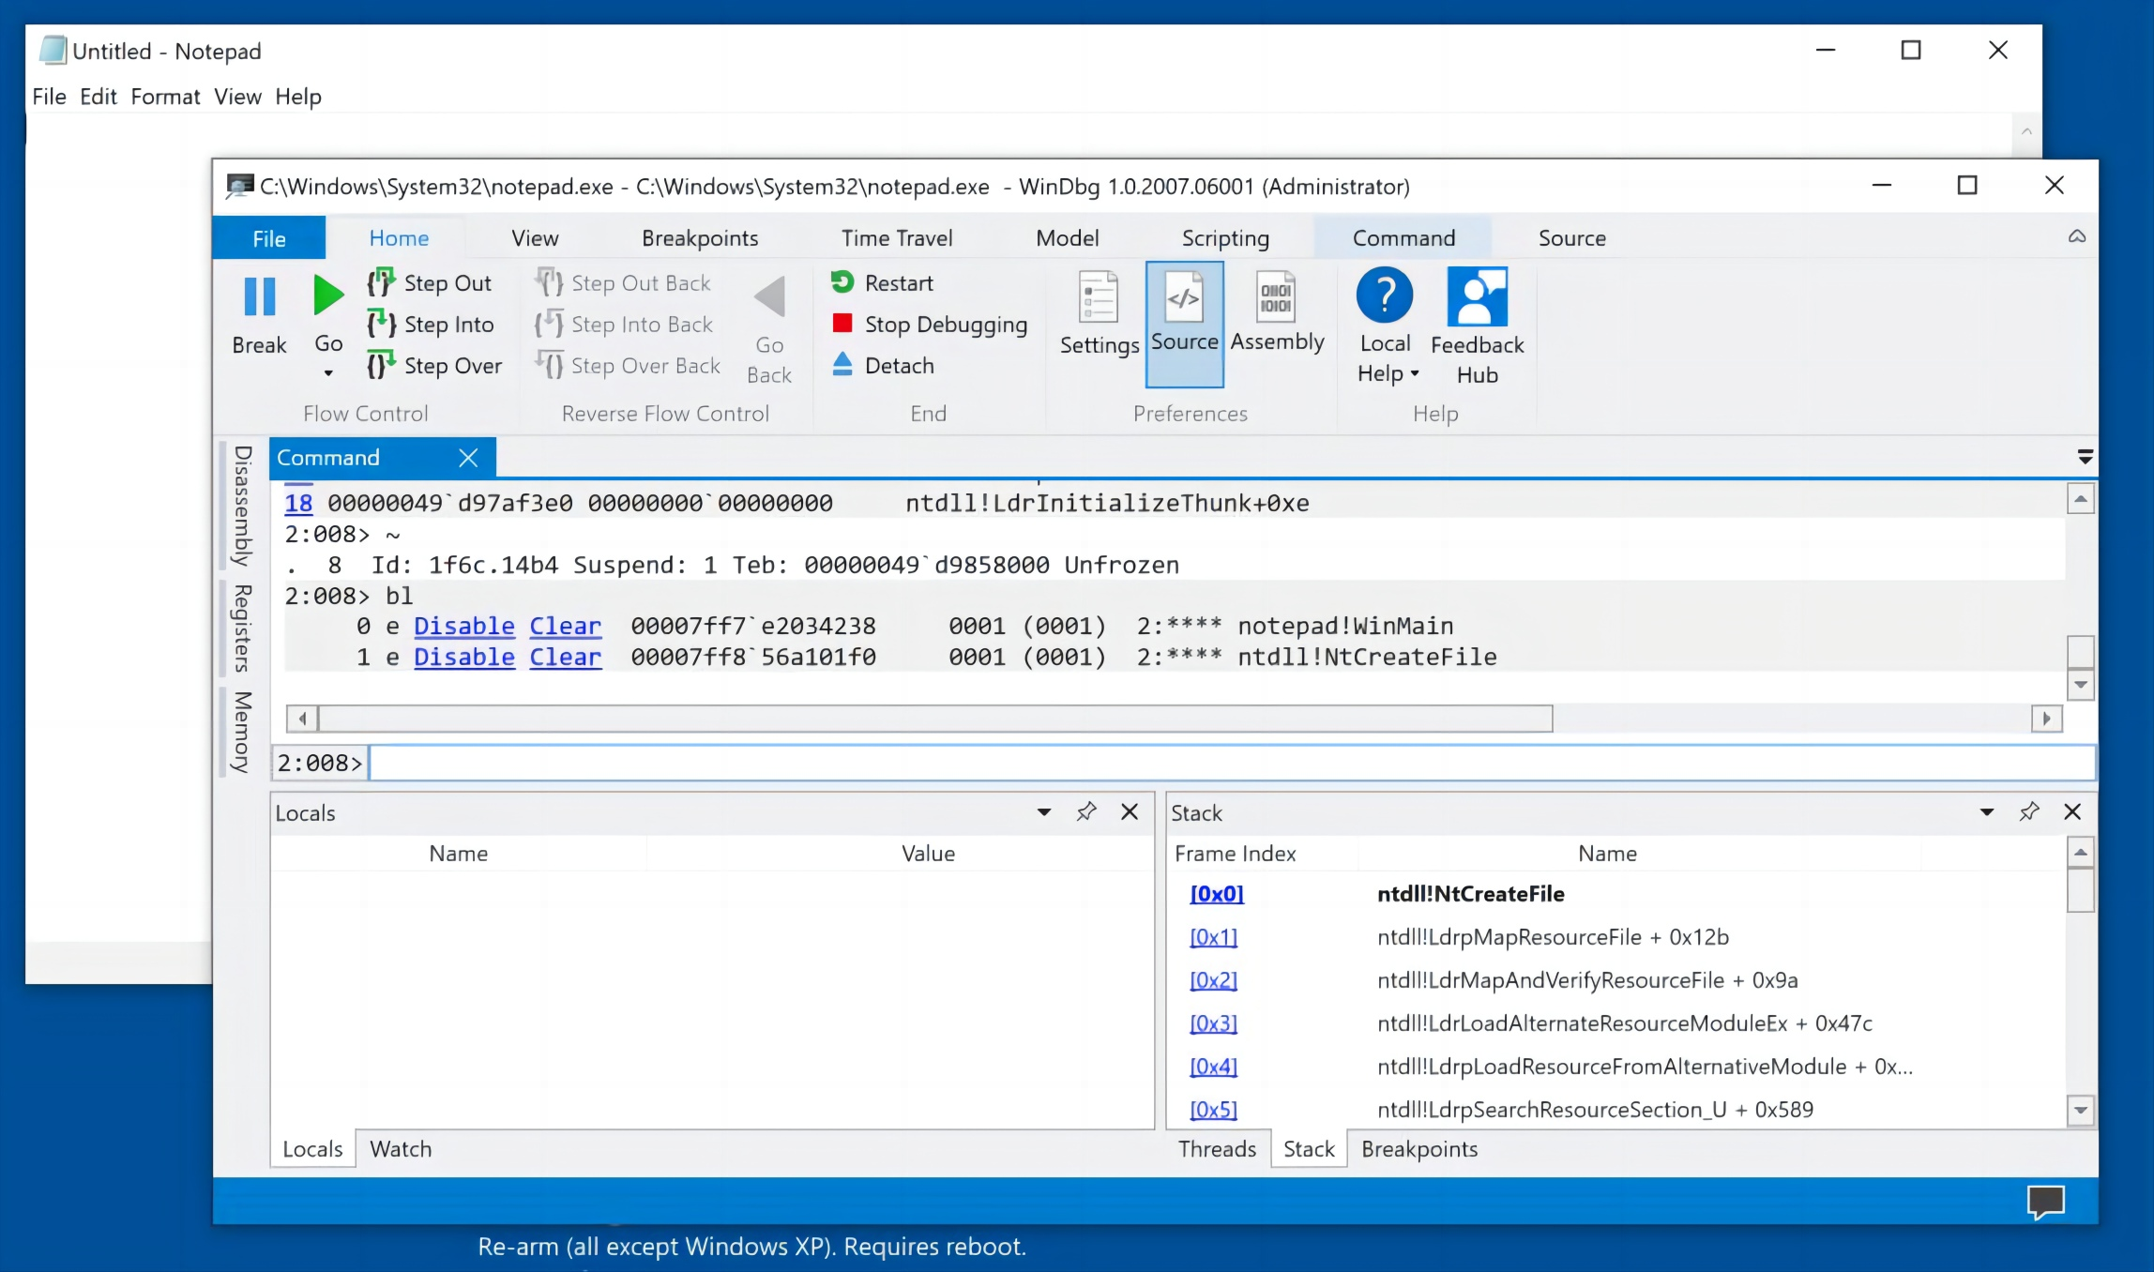
Deleting Breakpoints
To see all the breakpoints, execute this command:
bl
There are two breakpoints, as shown below.

Slide 26
Deleting Breakpoints
In the line for breakpoint 1, click Clear.
The system executes the bc 1 command for you.
Repeat the process to delete breakpoint 0.

Slide 27

THE END
Fangtian Zhong
CSCI 591
Gianforte School of Computing
Norm Asbjornson College of Engineering
E-mail: fangtian.zhong@montana.edu
2023.11.14

