Slide 1

2023.11.16
Malicious Code Analysis
Fangtian Zhong
CSCI 591
Gianforte School of Computing
Norm Asbjornson College of Engineering
E-mail: fangtian.zhong@montana.edu

Slide 2
Overview
Source Level Debugging
03
Kernel Debugging
04
Packer and Shellcode
05

Slide 3

Source-Level Debugging
Part Three
03

Slide 4


Installing Visual Studio 2022
Download it from https://visualstudio.microsoft.com/vs/older-downloads/

Slide 5
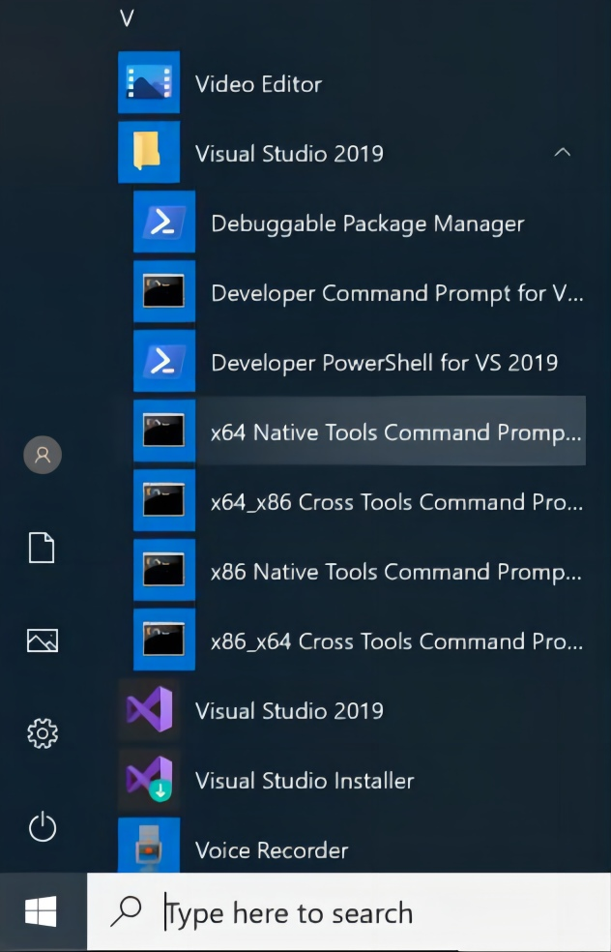
Preparing to Compile C++ Code
Click Start. Scroll down to the programs starting with V. Expand the "Visual Studio 2022" section.
Click "x64 Native Tools Command Prompt", as shown below.

Slide 6
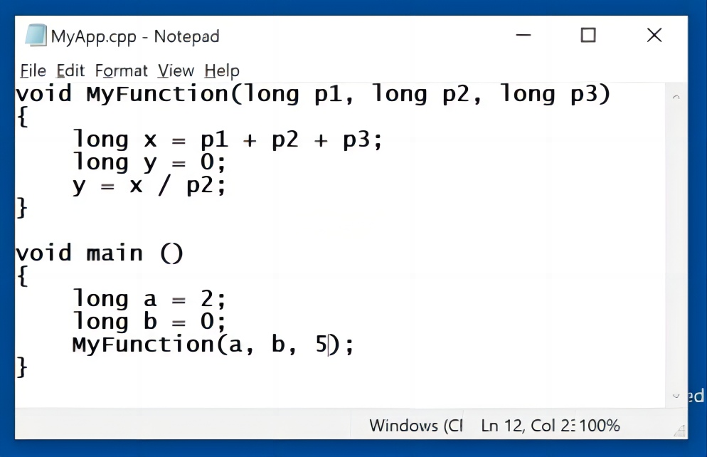
Creating a C++ Program
In the "x64 Native Tools Command Prompt" window, execute these commands:
mkdir c:\MyApp
cd c:\MyApp
notepad MyApp.cpp
Click Yes to create a new file.
Paste in this code, as shown below.
void MyFunction(long p1, long p2, long p3)
{
long x = p1 + p2 + p3;
long y = 0;
y = x / p2;
}
void main ()
{
long a = 2;
long b = 0;
MyFunction(a, b, 5);
}
In Notepad, save the file.

Slide 7
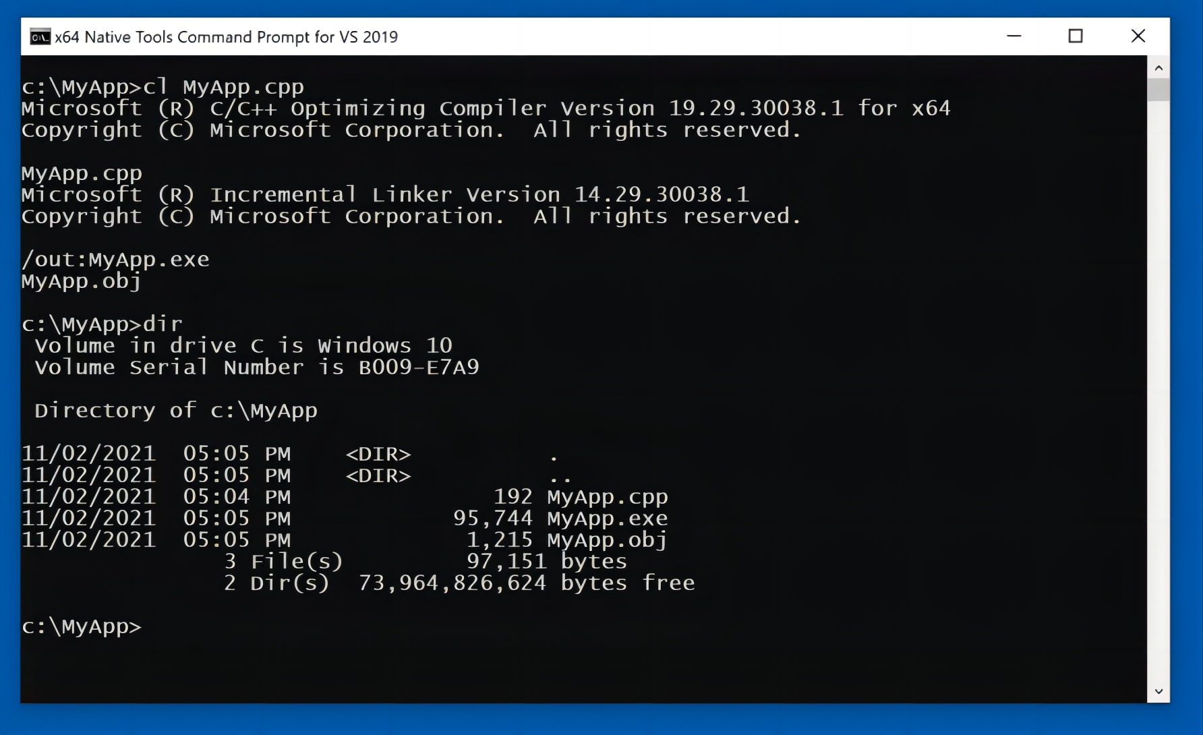
Compiling a C++ Program Without Symbols
In the "x64 Native Tools Command Prompt" window, execute these commands:
cl MyApp.cpp
dir
As shown below, the compilation process created an .exe file and an .obj files, but no .pdb file.

Slide 8
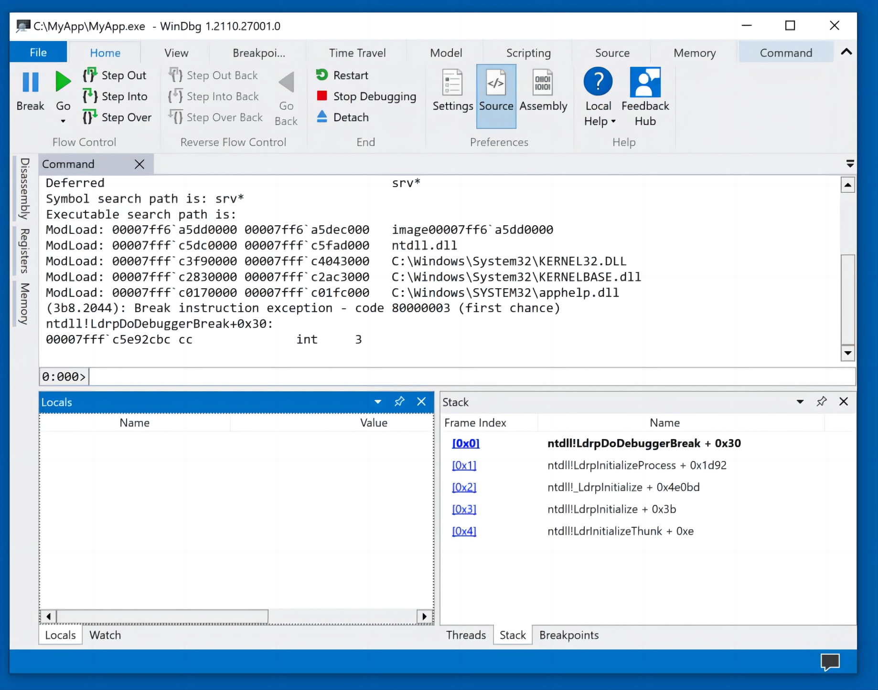

Launching WinDbg Preview and Loading MyApp
Click the Start button and type WIN. Click "WinDbg Preview".
In WinDbg, click File, "Launch executable".
Navigate to:
C:\MyApp\MyApp.exe
and double-click it.
The app loads, and stops inside ntdll, as shown below.

Slide 9
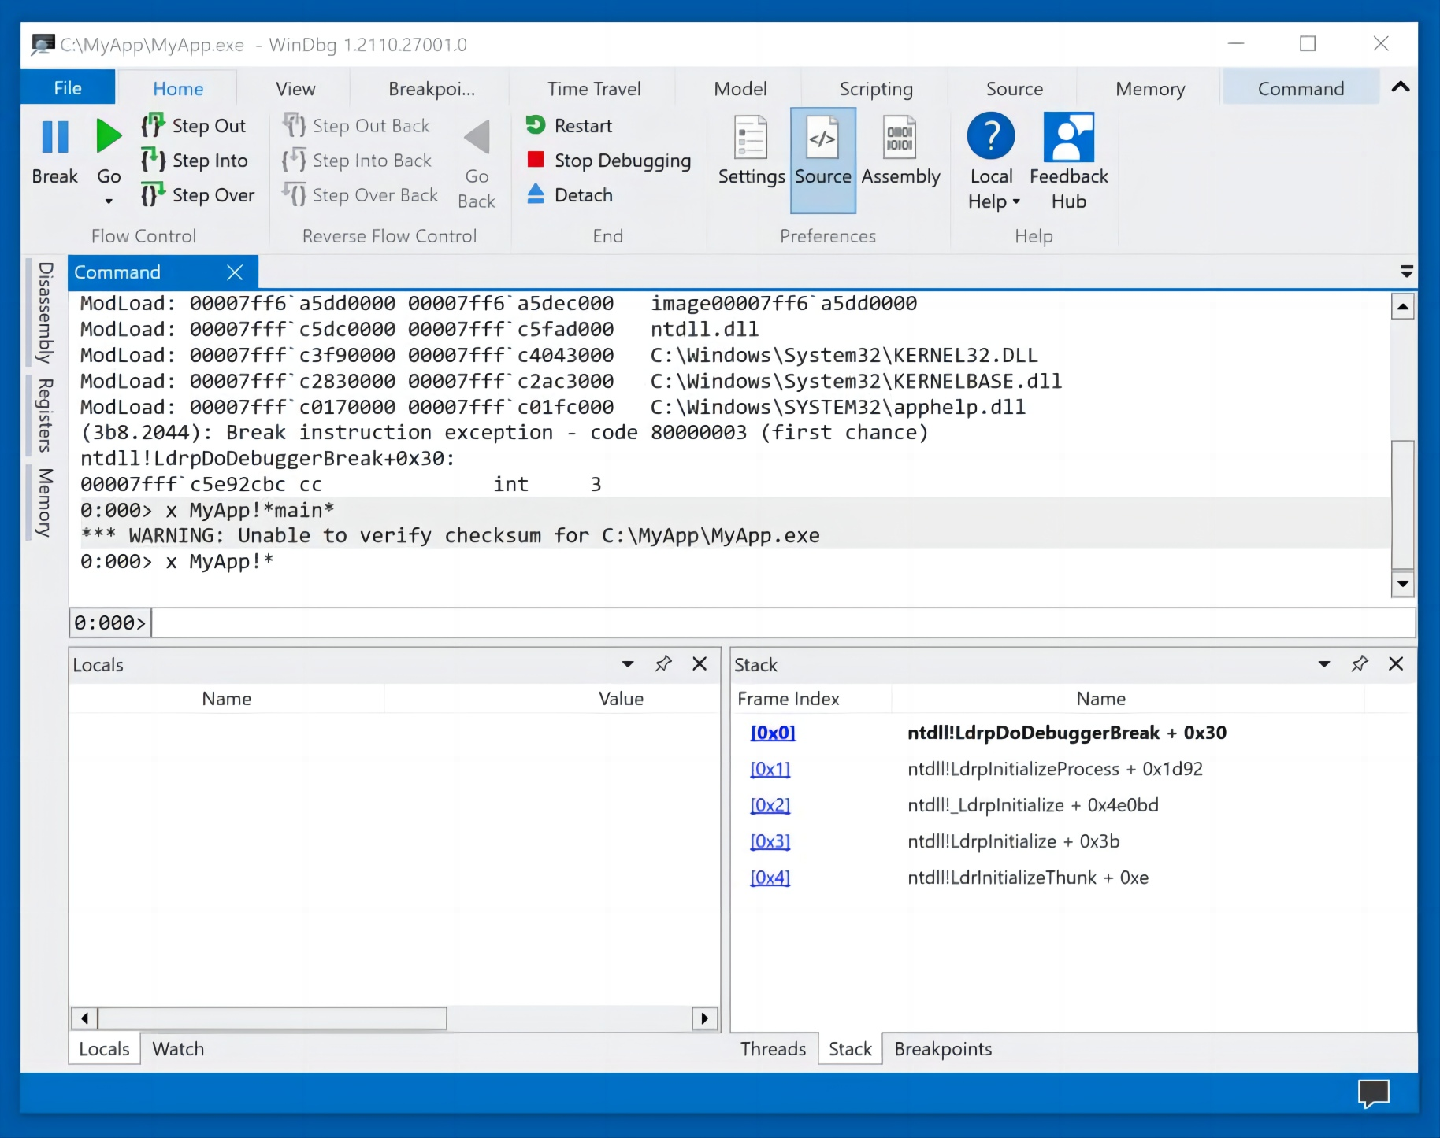
Finding "main" symbols in MyApp
In the lower center of WinDbg, execute these commands:
x MyApp!*main*
x MyApp!*
There are no results, as shown below.

Slide 10
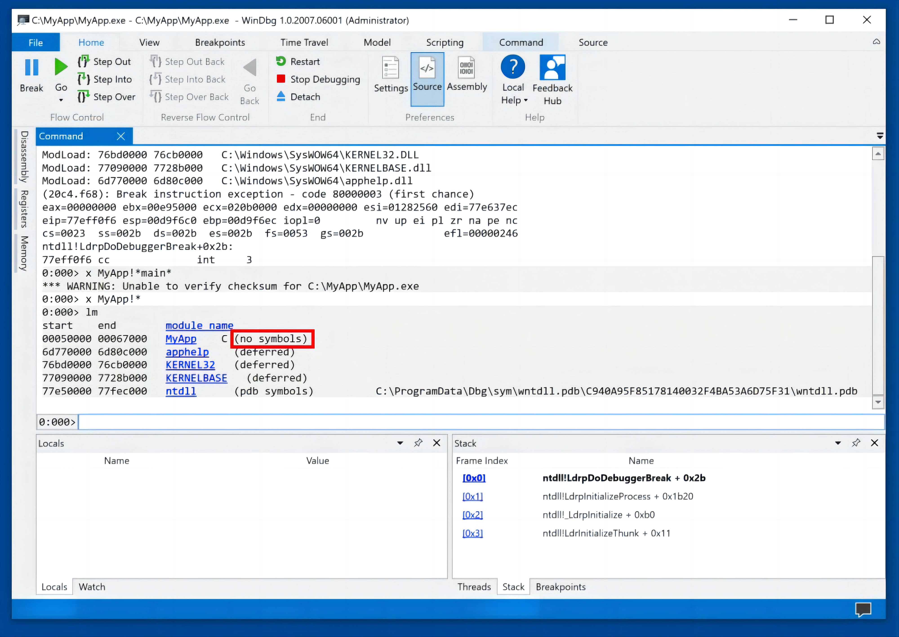
Show loaded modules
To see the problem, execute this command:
lm
The "MyApp" module is loaded, but it has no symbols, as shown below.
This makes it difficult to find the MyApp code. Finally, Close WinDbg.
This is necessary because it locks the MyApp.exe file.

Slide 11
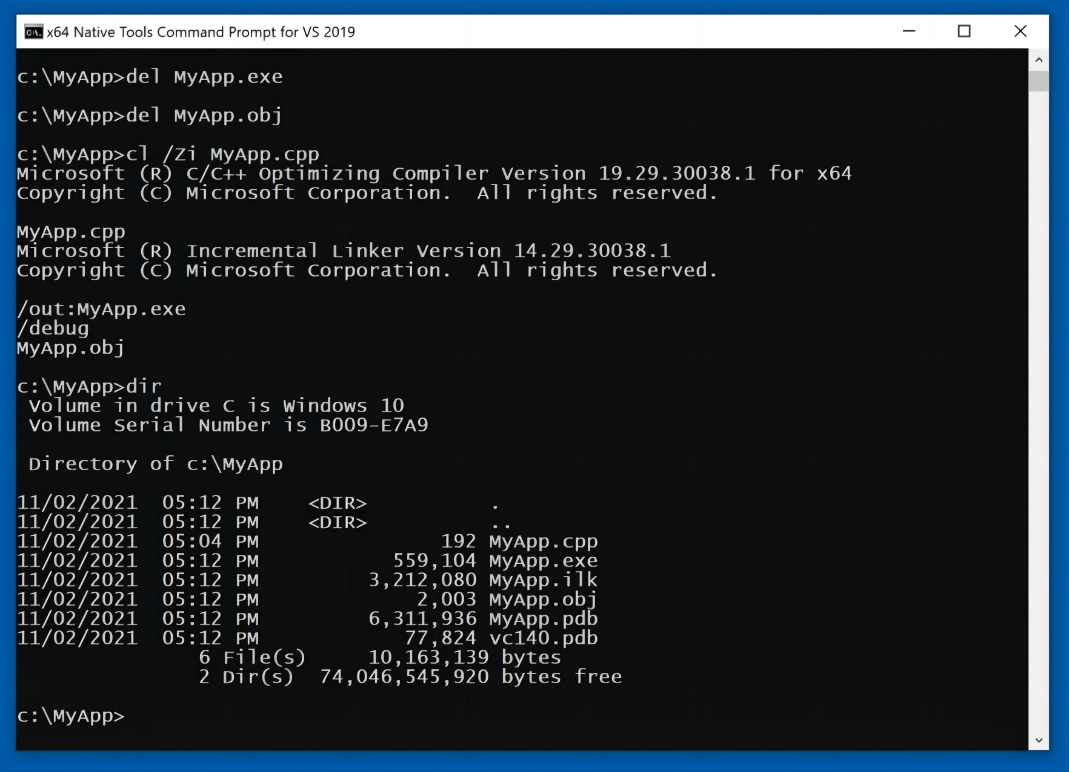
Compiling a C++ Program with Symbols
In the "x64 Native Tools Command Prompt" window, execute these commands:
del MyApp.obj
del MyApp.exe
cl /Zi MyApp.cpp
dir
As shown below, the compilation process created an .exe file and two .pdb files, which contain debugging symbols.

Slide 12
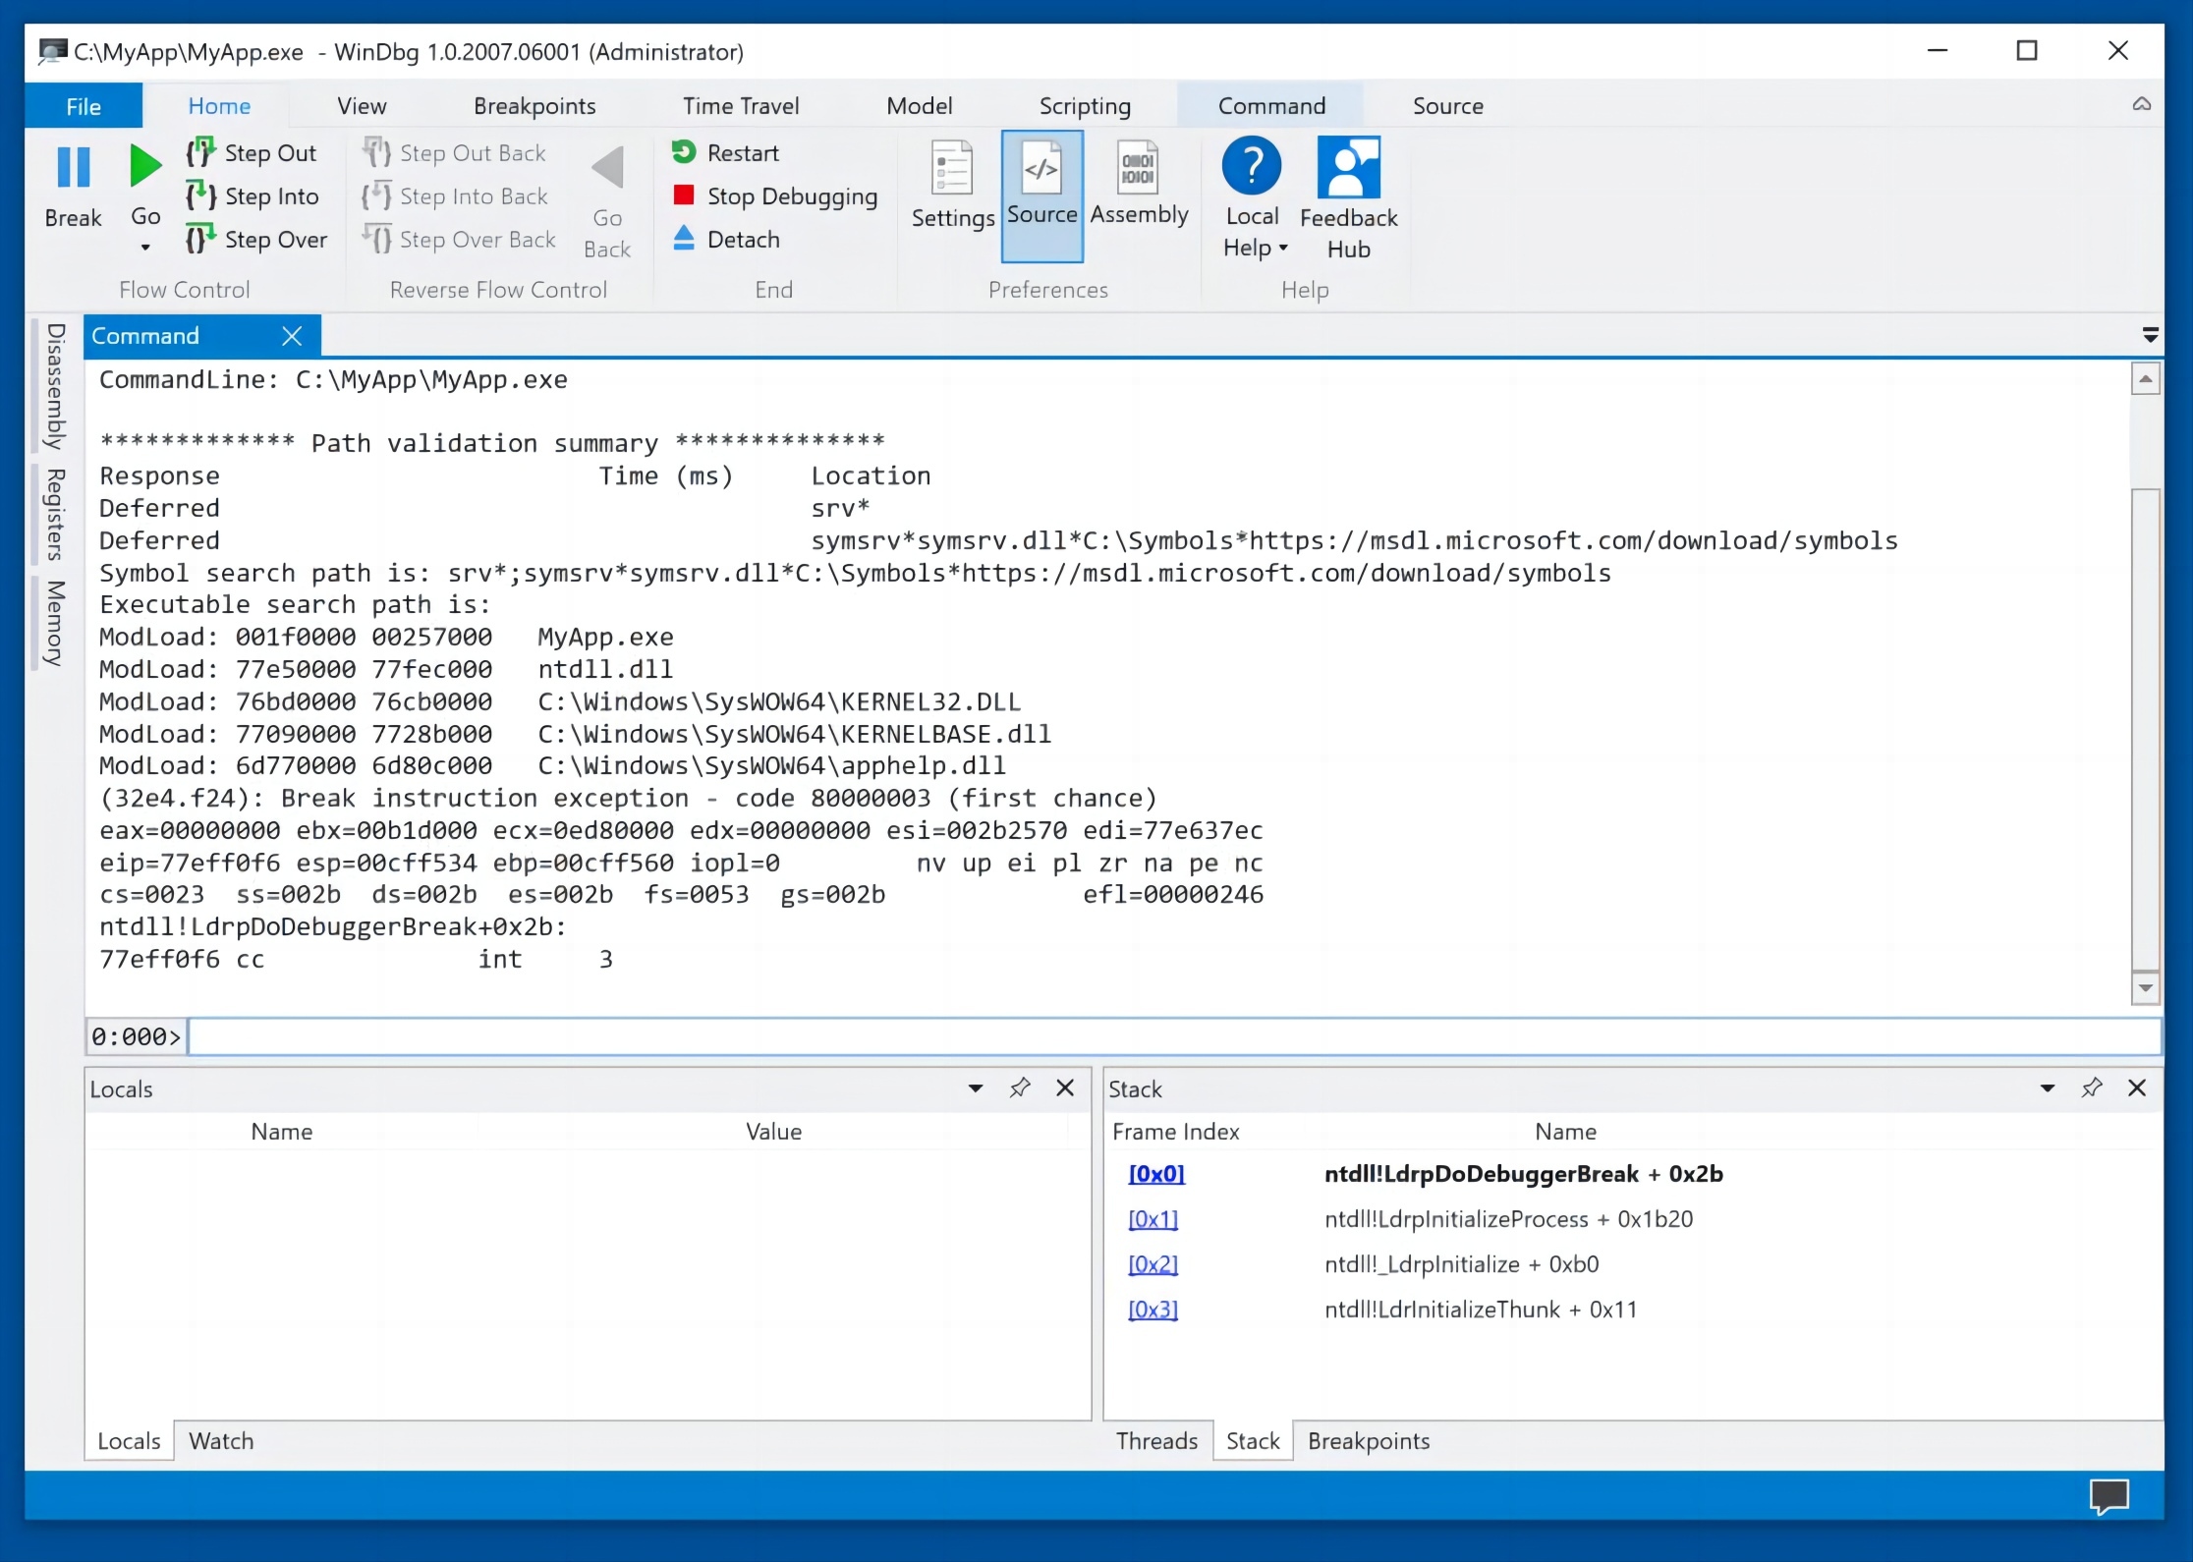
Launching WinDbg Preview and Loading MyApp
In WinDbg, click File, "Launch executable".
Navigate to:
C:\MyApp\MyApp.exe
and double-click it.
The app loads, and stops inside ntdll, as shown below.

Slide 13
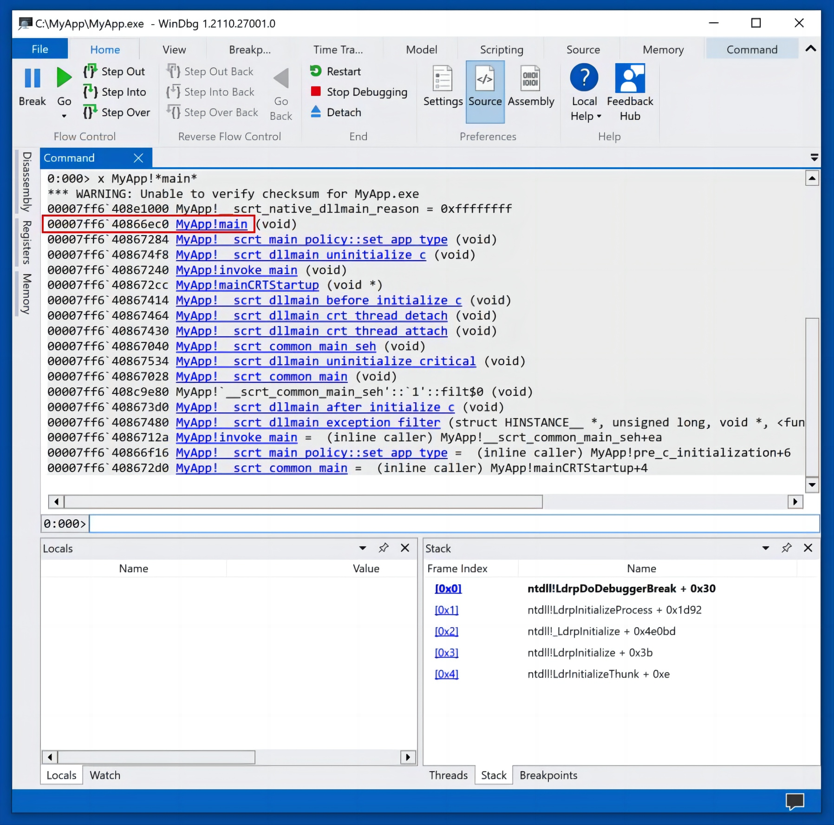
Finding "main" symbols in MyApp
In the lower center of WinDbg, execute this command:
x MyApp!*main*
Now it finds symbols, including MyApp!main, as shown below.

Slide 14
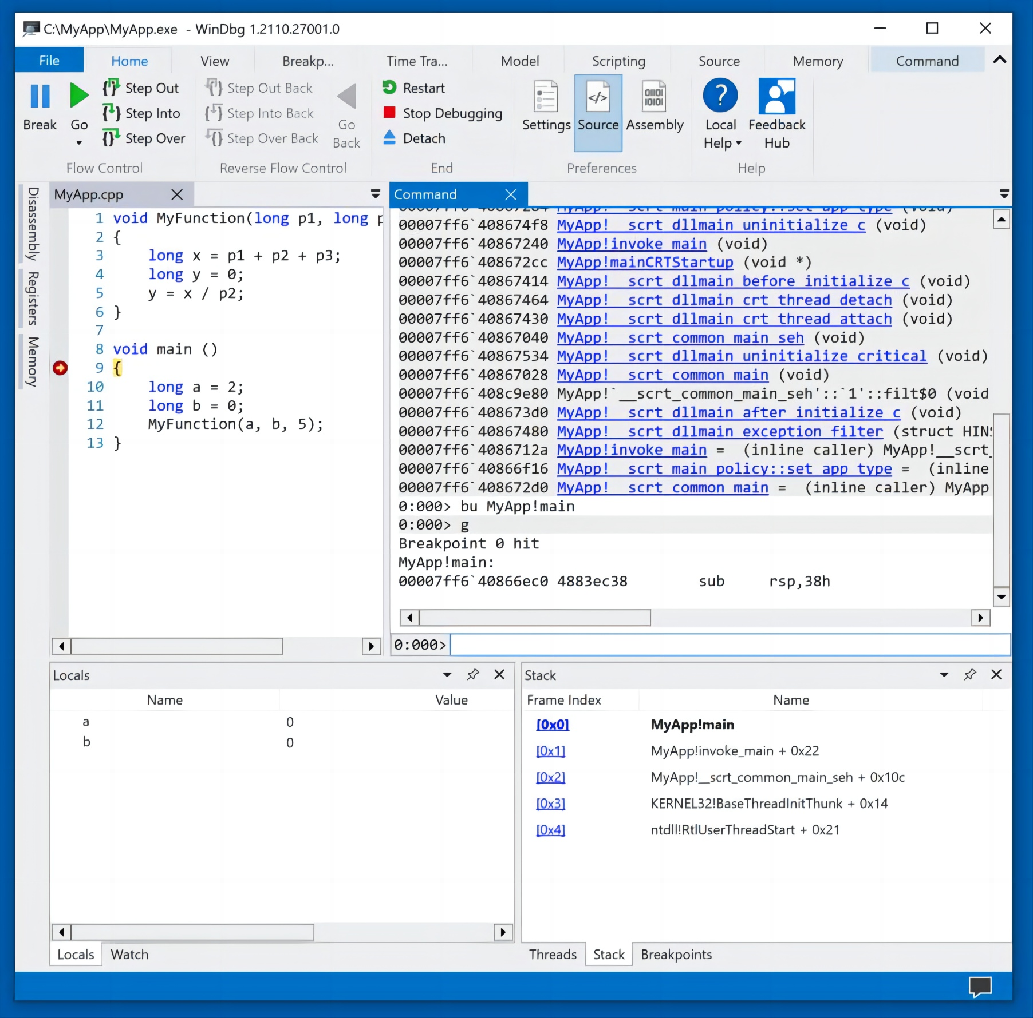
Setting a Breakpoint and Running To It
In the lower center of WinDbg, execute this command:
bu MyApp!main
In WinDbg, at the top left, click Go.
The app runs to the start of main(), and the top left pane shows the C++ source code, with the breakpoint and current instruction highlighted, as shown below.
At the lower left, notice the "Locals" pane. This shows the local variables. Right now they contain zeroes.

Slide 15
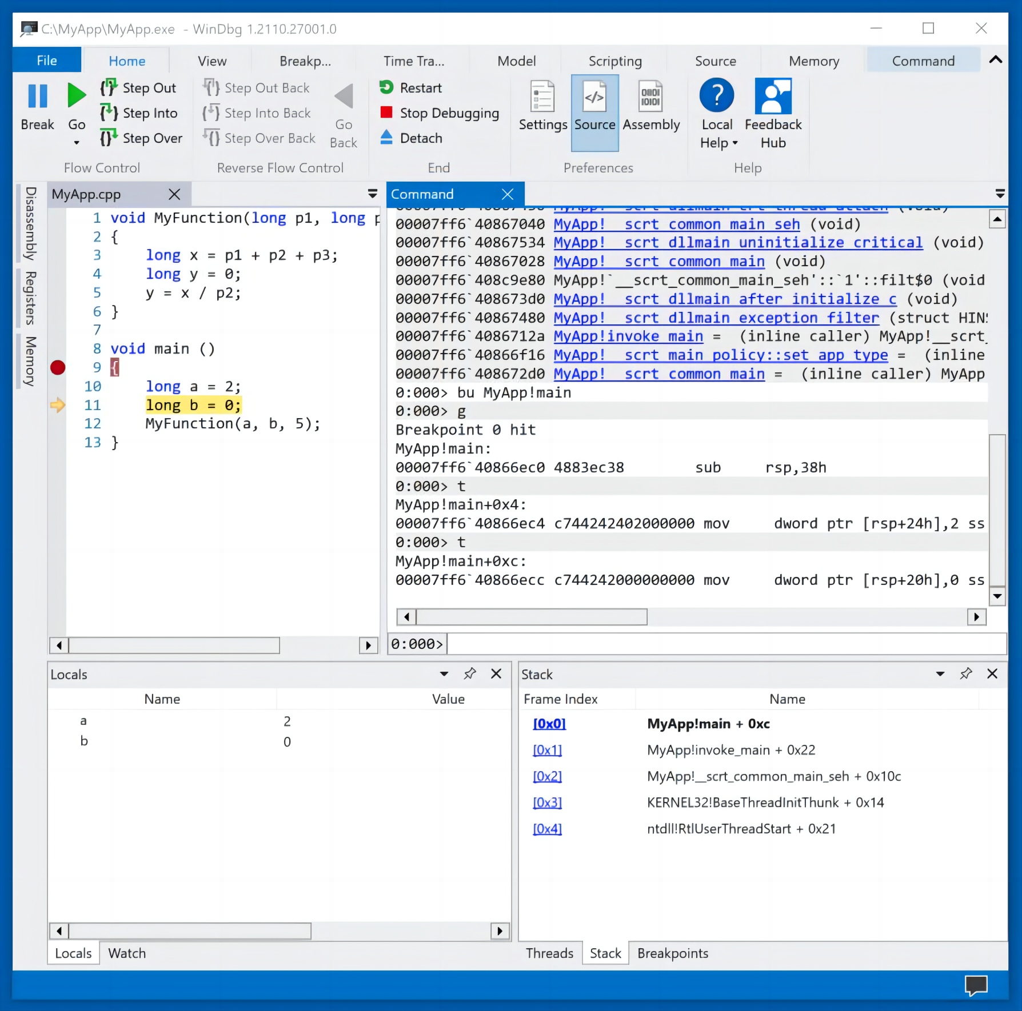
Stepping Through the Code
In WinDbg, at the top left, click "Step Into" twice.
As shown below, the program proceeds to line 11 of the source code. The variable a is now set to 2.

Slide 16
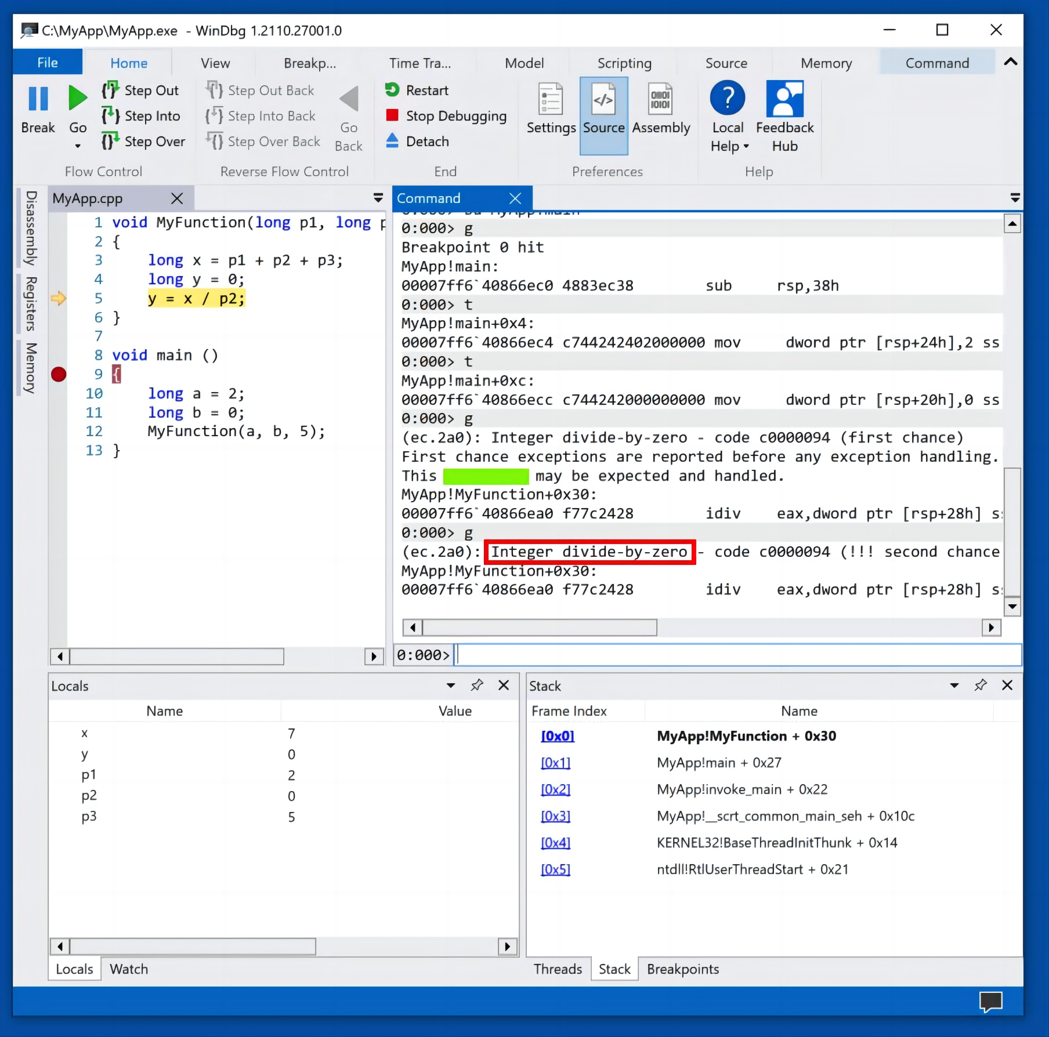
Stepping Through the Code
In WinDbg, at the top left, click "Step Into" several more times, until the program executes source line 5.
The program cannot execute this instruction because of a divide-by-zero error, as shown below.

Slide 17
Kernel Debugging
Part Four
04

Slide 18
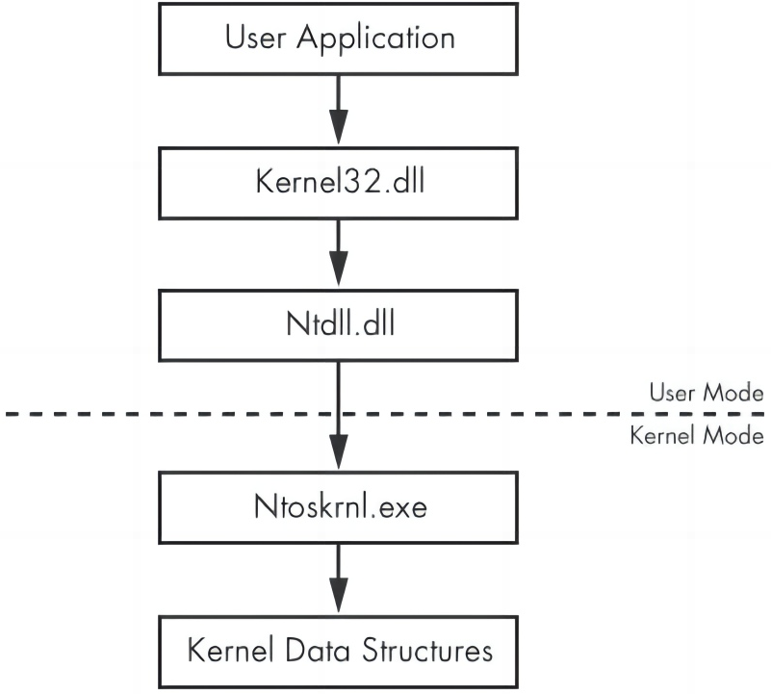

User Mode and Kernel Mode
To use WinDbg Preview for kernel debugging.
The kernel is the heart of the operating system, and it resides in the file ntoskrnl.exe, as shown in the figure below, from the "Practical Malware Analysis" book.
User mode and kernel mode

Slide 19
Installing CFF Explorer
If you are using the "Windows 10 w Tools" VM, CFF Explorer is already installed.
If you are using some other machine, go to this URL and install "Explorer Suite":
https://ntcore.com/?page_id=388

Slide 20
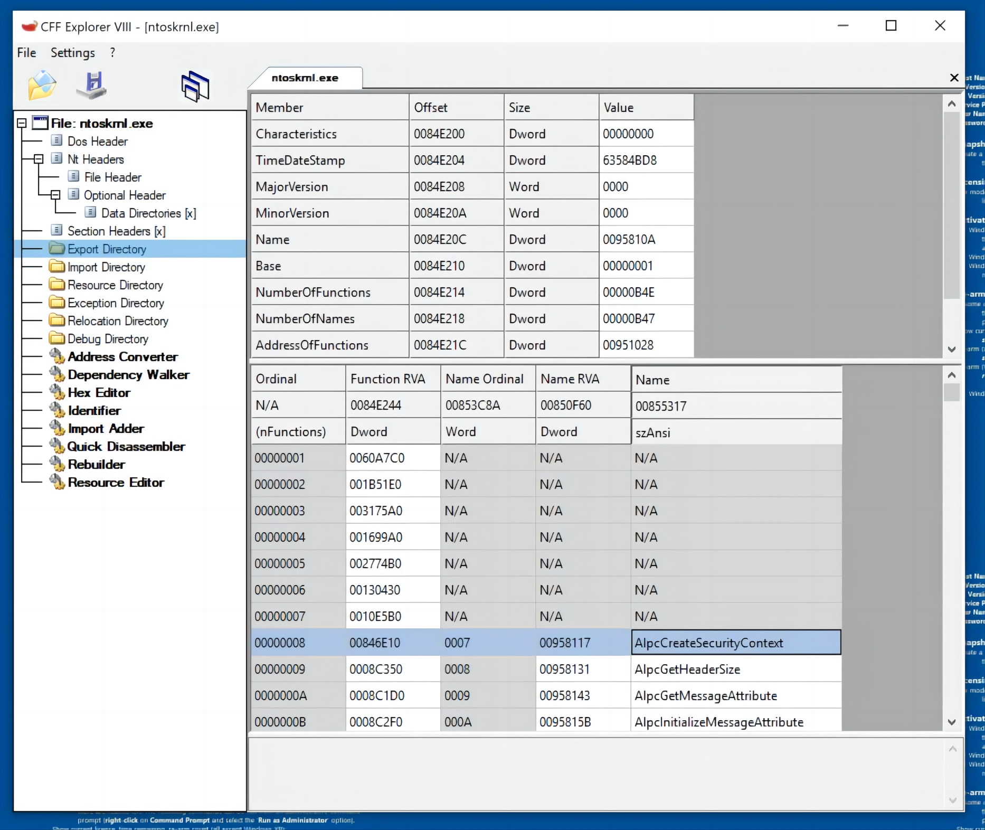
Examining ntoskrnl.exe with CFF Explorer
Launch File Explorer and navigate to C:\Windows\System32.
Right-click ntoskrnl.exe and click "Open with CFF Explorer".
In CFF Explorer, in the left pane, click "Export Directory".
As shown below, there are a lot of functions exported by ntoskrnl.exe, including AlpcCreateSecurityContext.

Slide 21
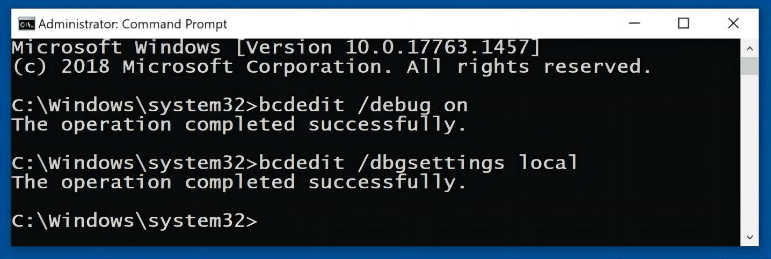
Using BCDEdit for Local Debugging
This process enables "local" kernel-mode debugging, so you can observe kernel routines and data but you cannot use breakpoints.
Click the Start button and type CMD. Right-click "Command Prompt" and click "Run as administrator". Click Yes.
Execute these commands:
bcdedit /debug on
bcdedit /dbgsettings local
Restart your Windows machine.

Slide 22
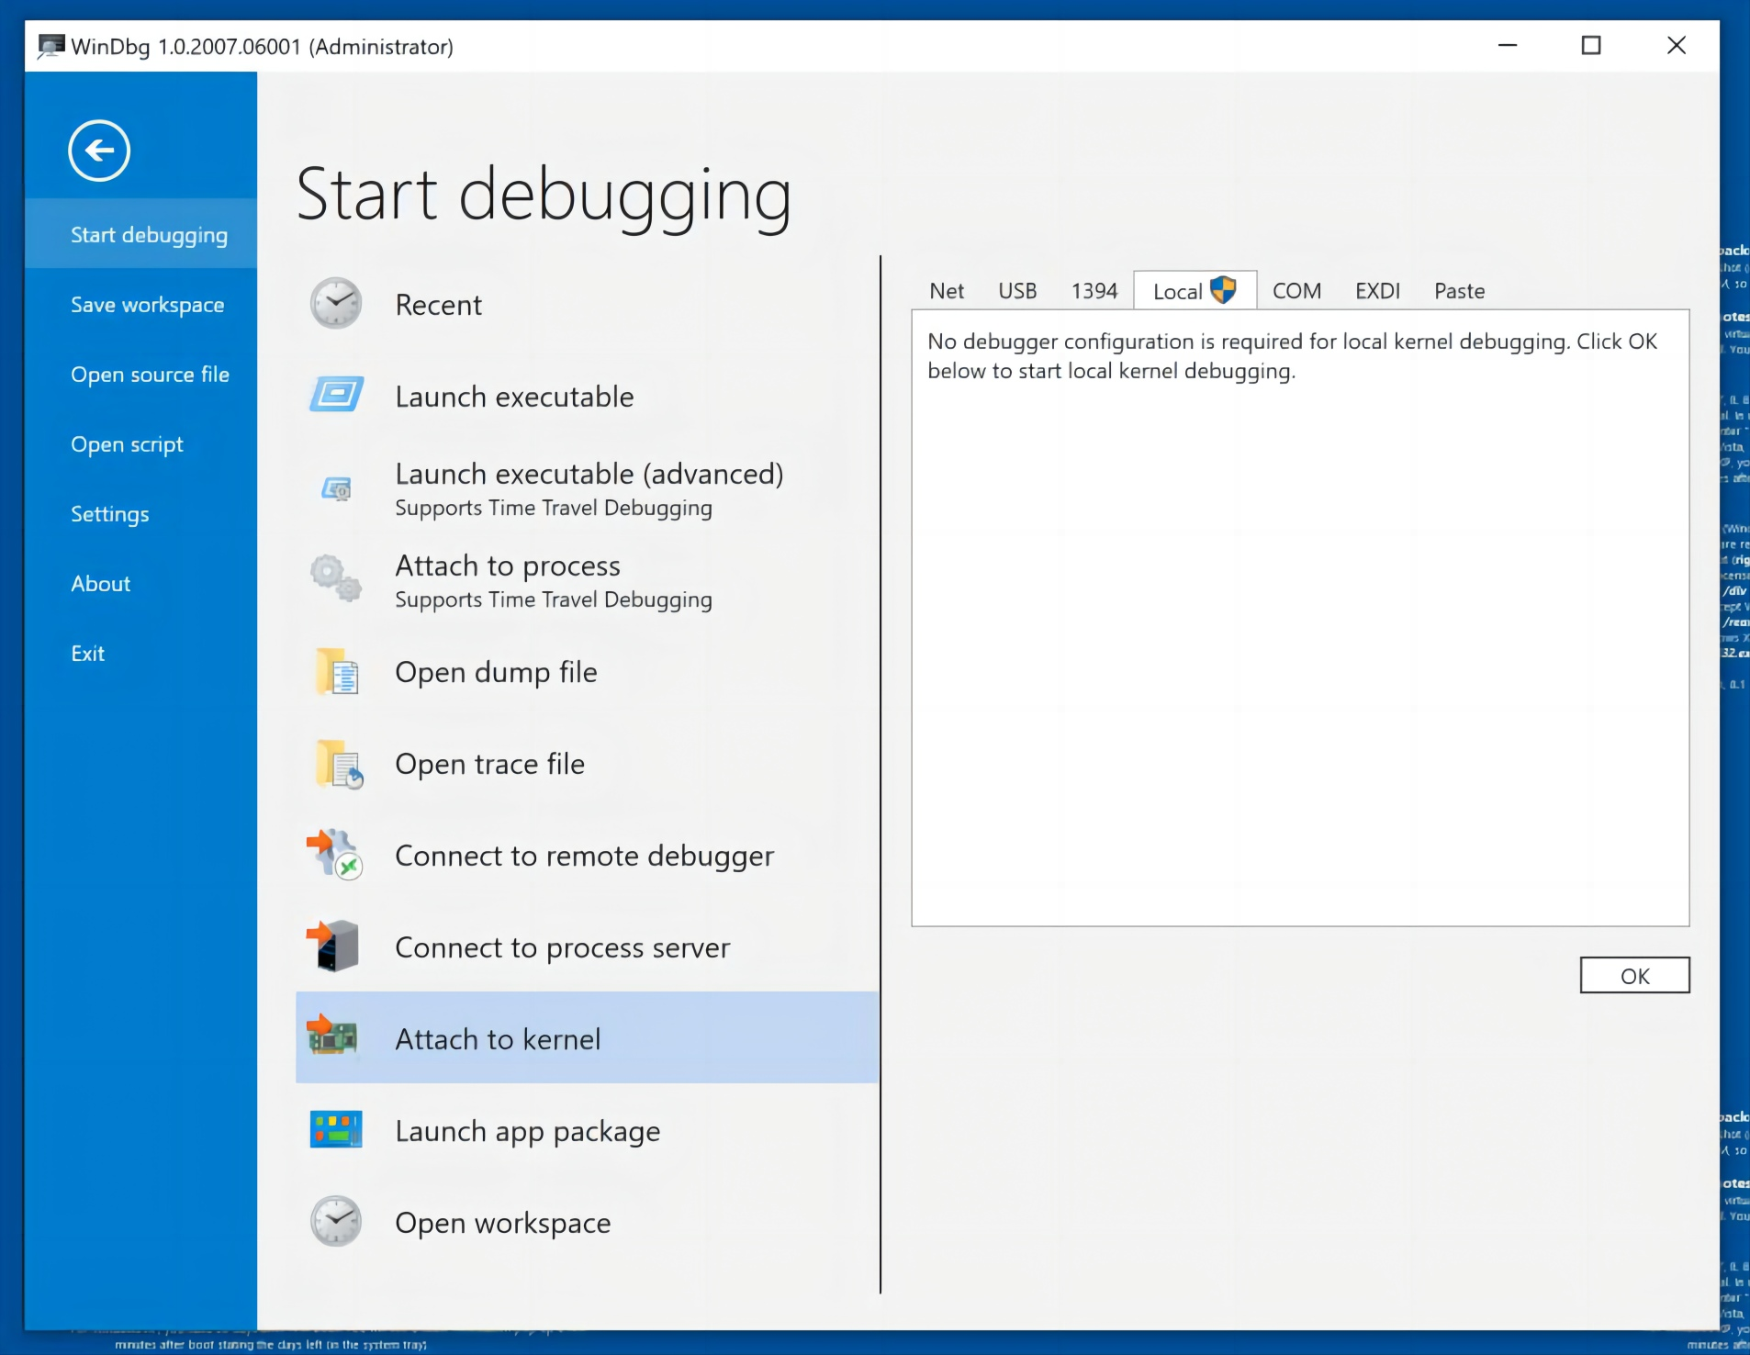
Starting Kernel Debugging
Click the Start button and type WIN. Right-click "WinDbg Preview" and click "Run as administrator". Click Yes.
In WinDbg, click File, "Attach to kernel".
In the right pane, click the Local tab, as shown below.
At the lower right, click the OK button.

Slide 23
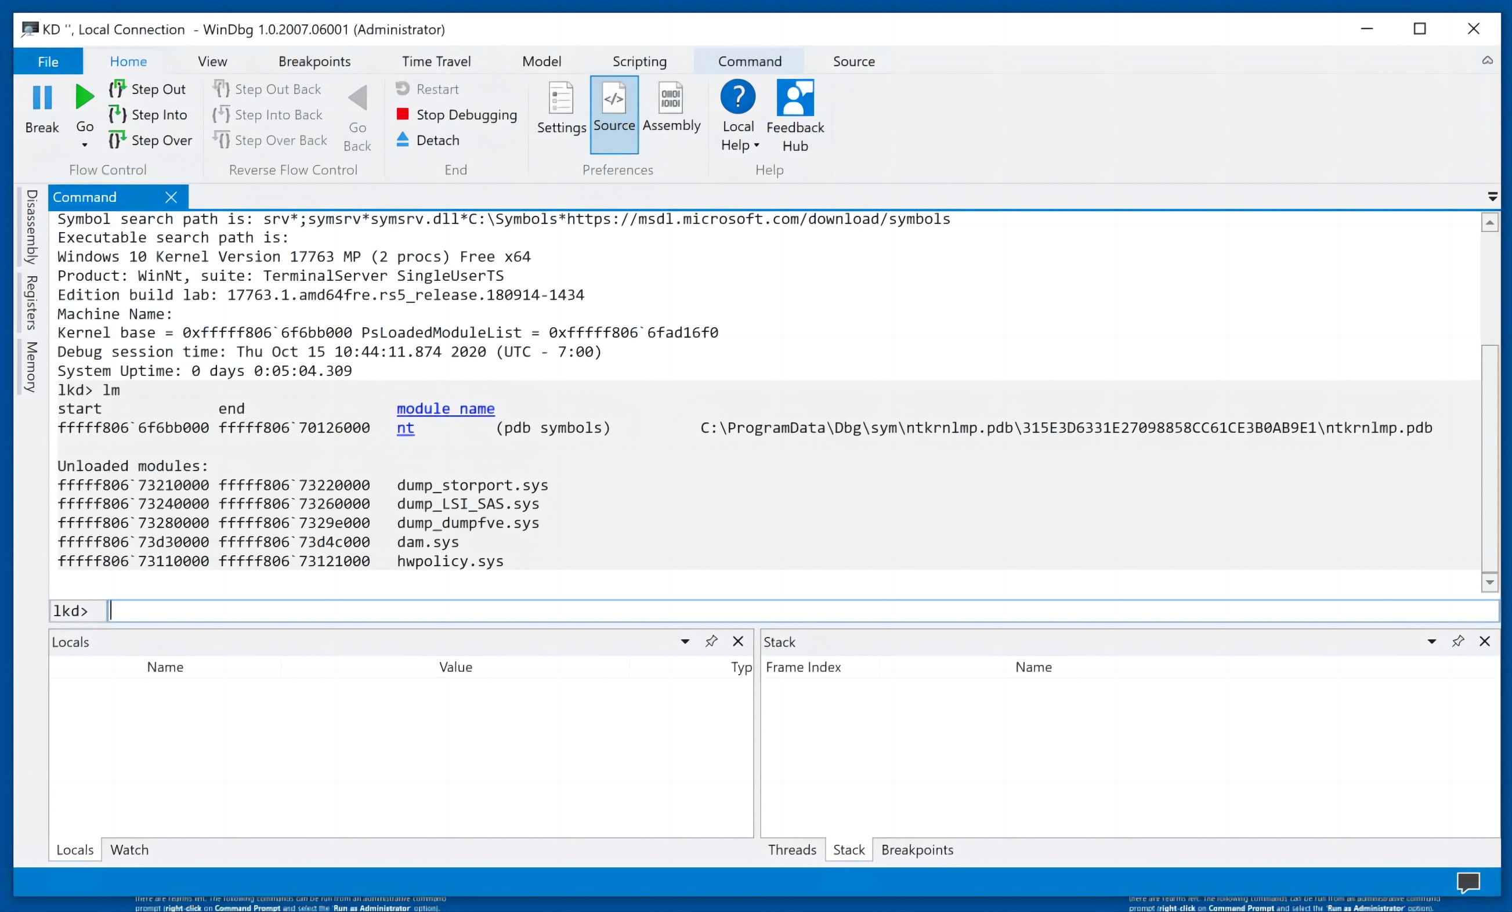
Viewing Loaded Modules
In the lower center of WinDbg, execute this command:
lm
There are several modules loaded, starting with nt, as shown below.
nt is the kernel, a short name for "ntoskrnl.exe".

Slide 24
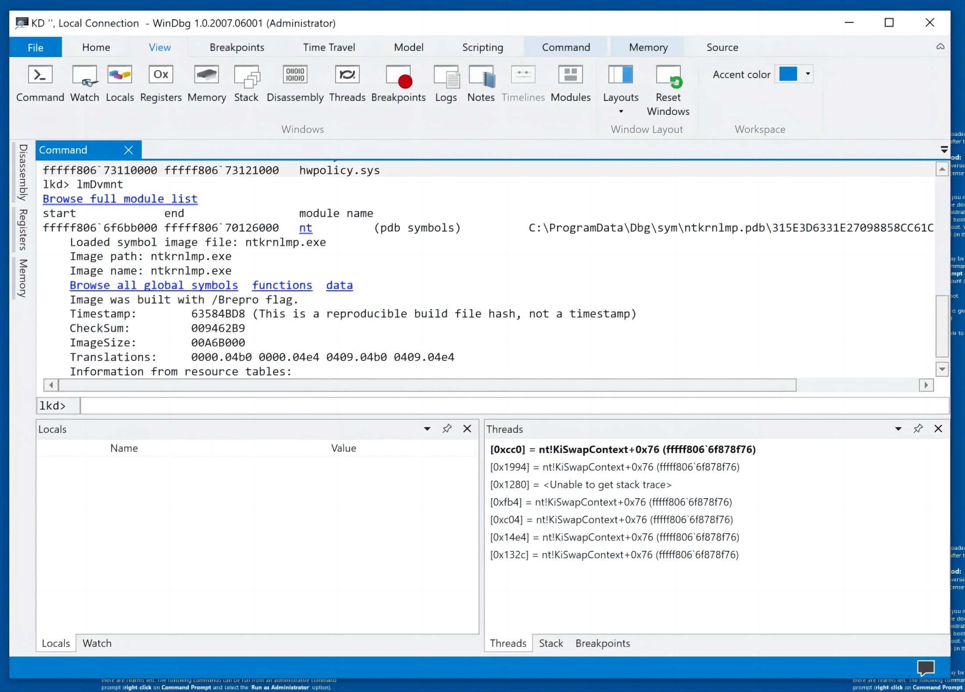
Viewing Loaded Modules
Click the blue nt link.
Now several more blue links appear, as shown below.

Slide 25
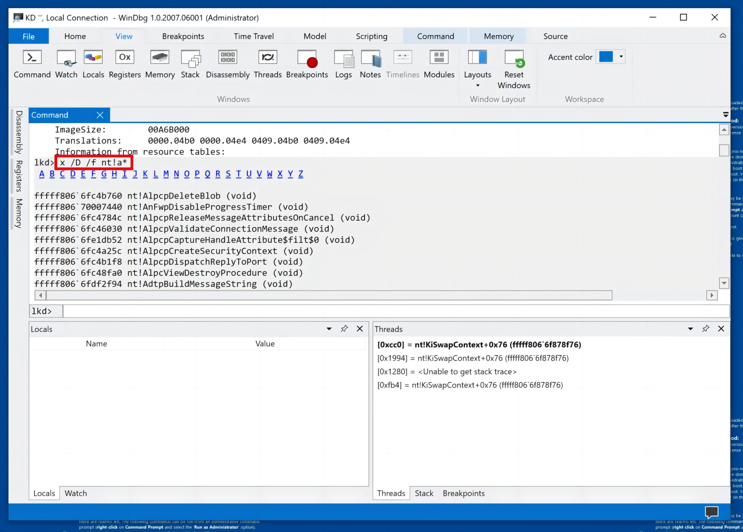
Viewing Loaded Modules
Click functions. Scroll back to the start of the list, as shown below.
There are links for each letter of the alphabet, to make it somewhat less clumsy to sort through the vast number of functions in the kernel.
You see the functions starting with "A", including AlpcCreateSecurityContext. Notice the command executed to
produce these list of functions in the nt module starting with "A", as shown below.
x /D /f nt!a*

Slide 26
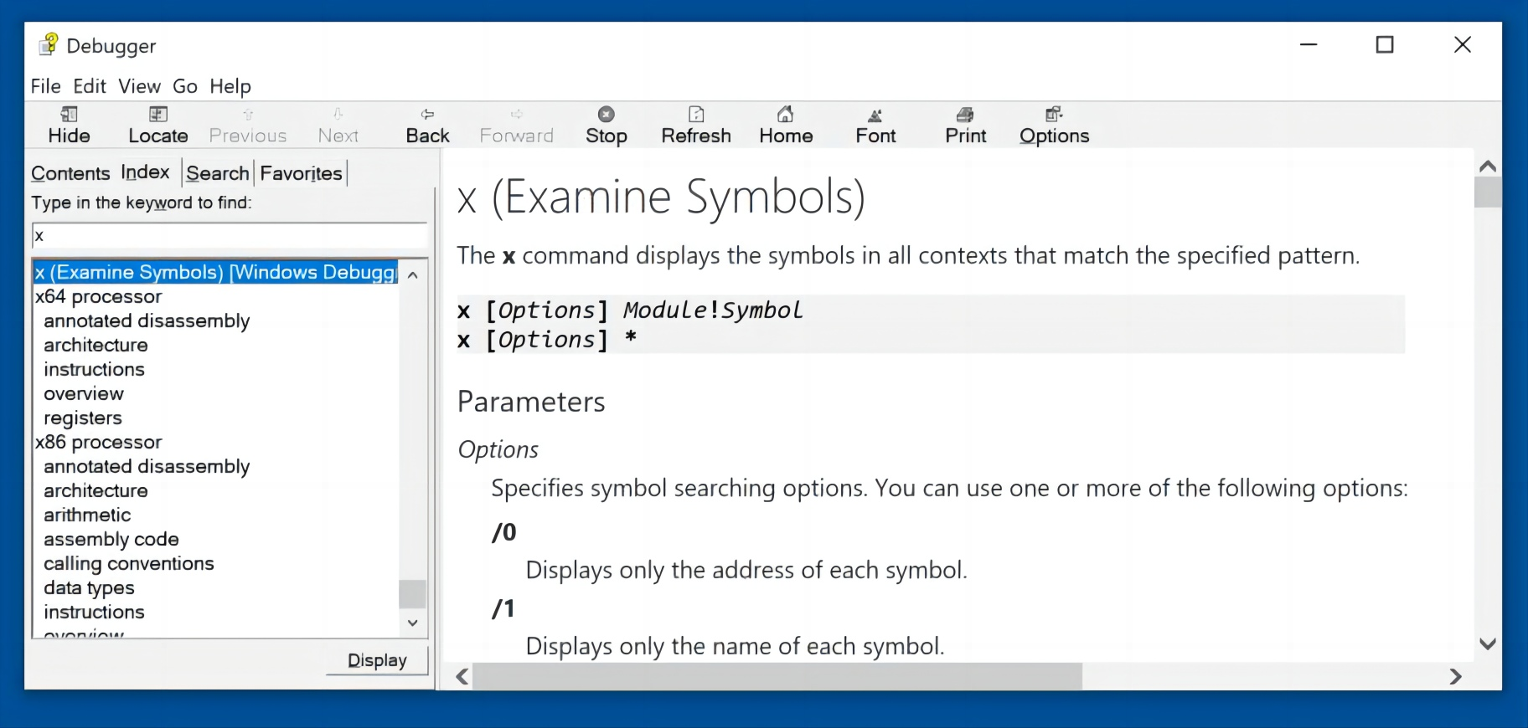
Using Help
In WinDbg, in the Ribbon, on the Home tab, on the right, click "Local Help".
In the Debugger window, enter a keyword of x.
Double-click the first result: "x (Examine Symbols), as shown below.
This is a good place to learn how to use the command-line commands.

Slide 27
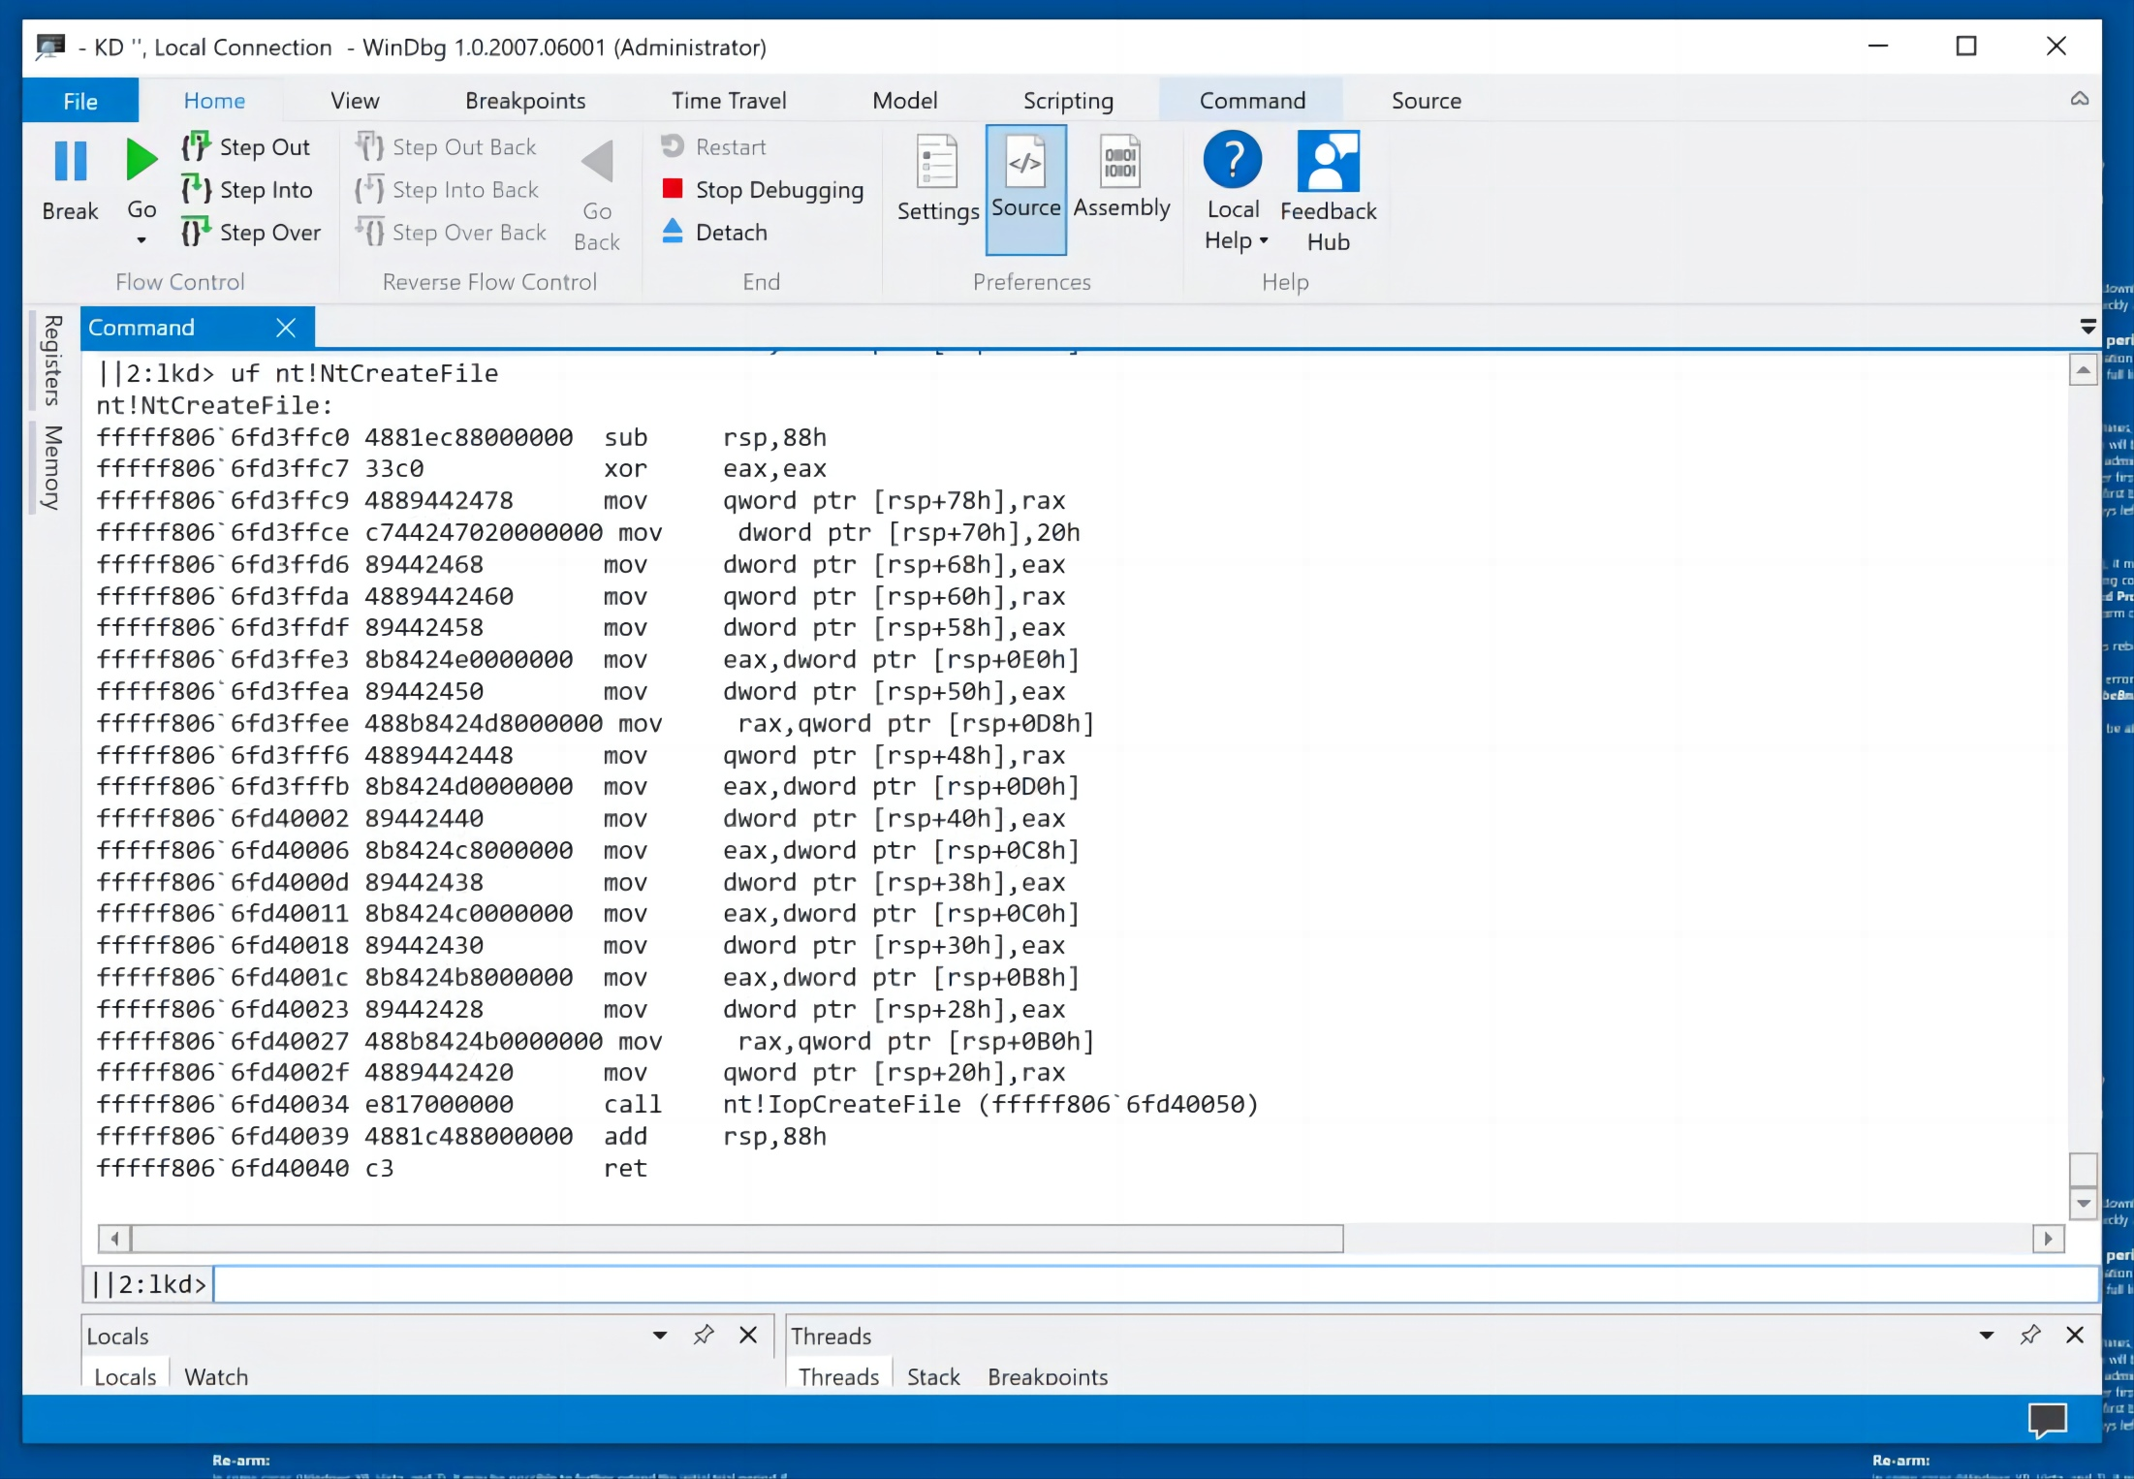
Disassembling a Function
In the lower center of WinDbg, execute this command:
uf nt!NtCreateFile
The assembly code is shown, including the addresses and raw hex bytes, as shown below.

Slide 28
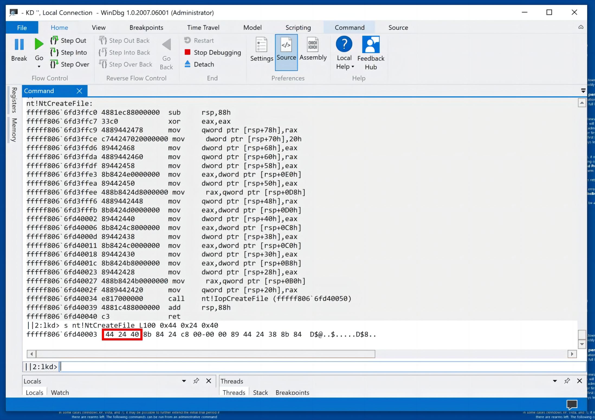
Searching Memory
In the lower center of WinDbg, execute this command:
s nt!NtCreateFile L100 0x44 0x24 0x40
The pattern is found once, as shown below.

Slide 29
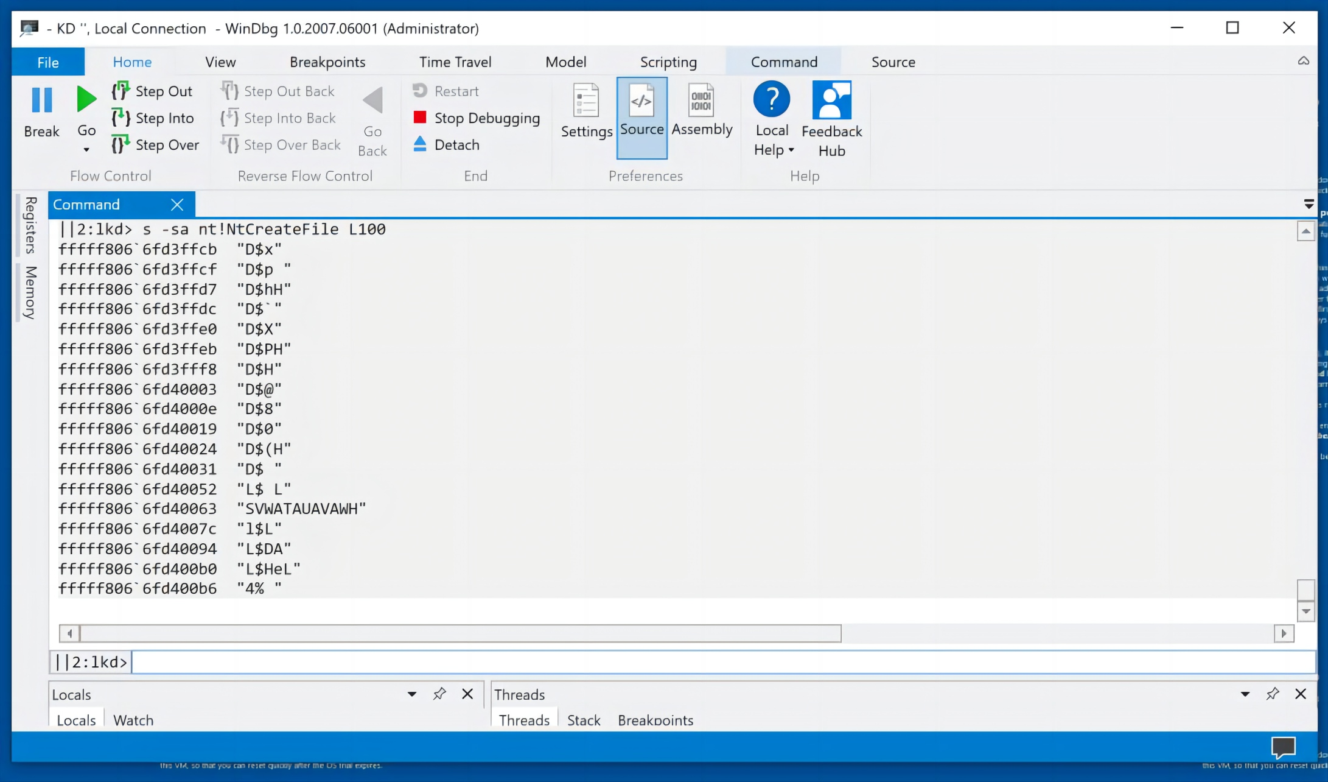
Finding Strings
In the lower center of WinDbg, execute this command:
s -sa nt!NtCreateFile L100
You see all ASCII strings of length three or more, as shown below.

Slide 30
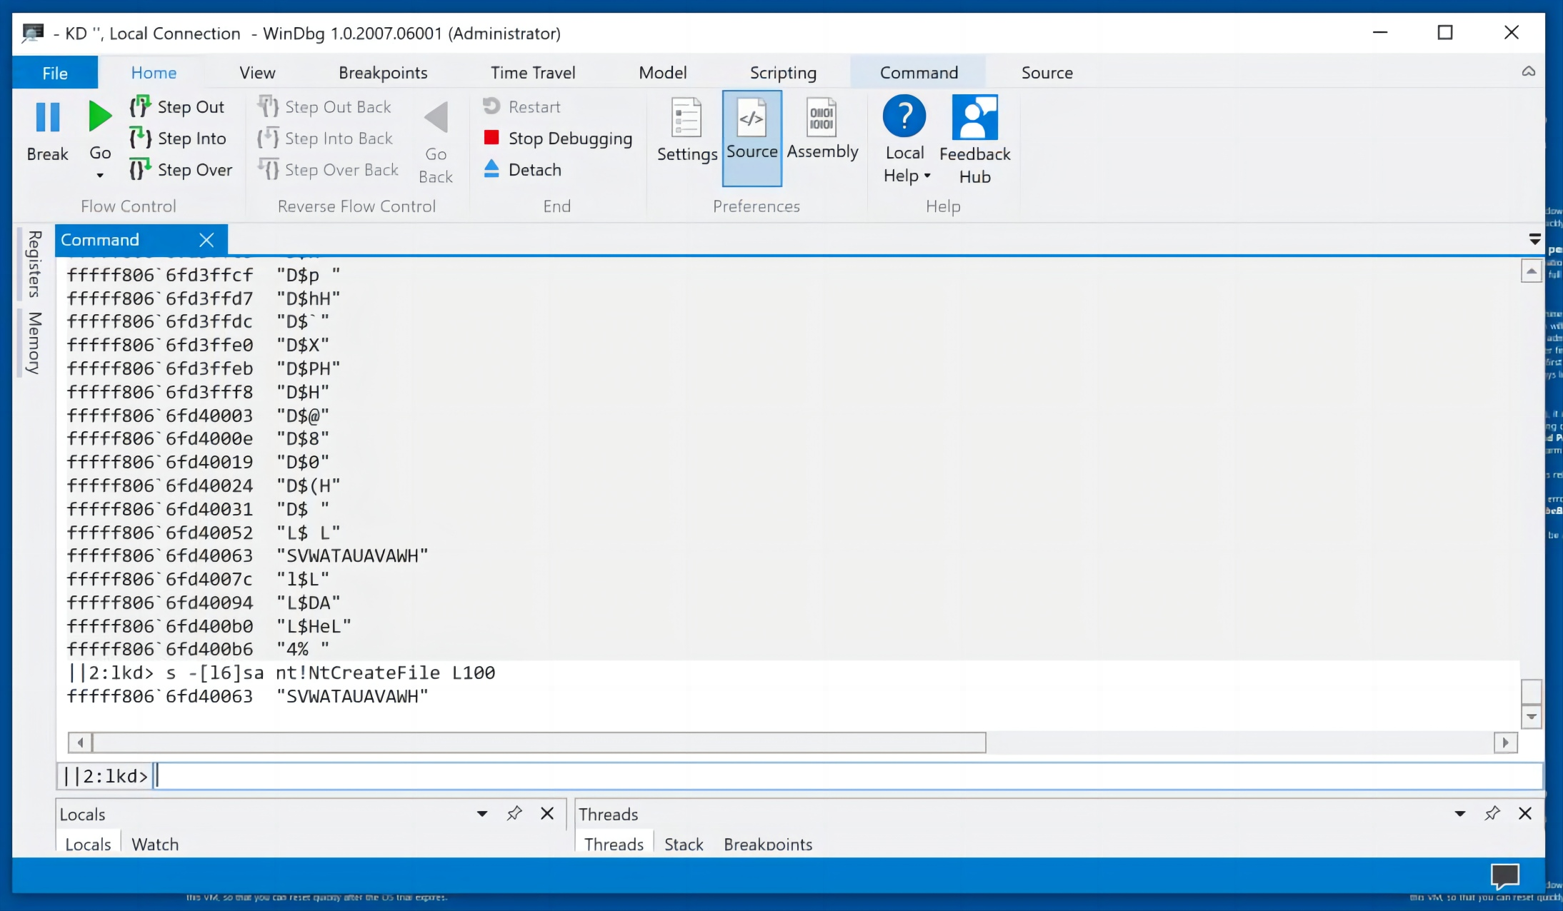
Finding Strings
In the lower center of WinDbg, execute this command:
s -[l6]sa nt!NtCreateFile L100
You see the one ASCII string with length six or more, as shown below.

Slide 31
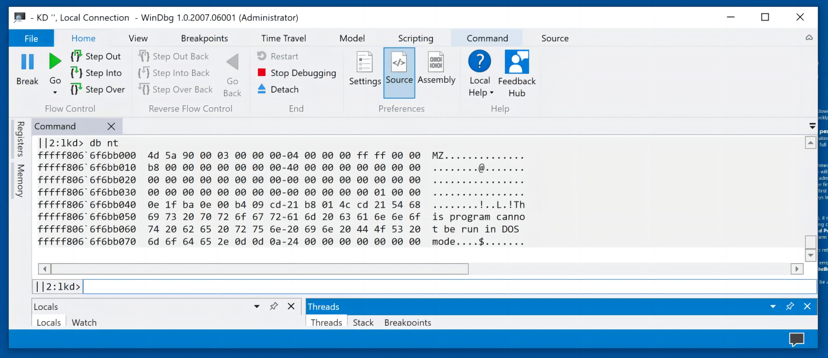
Display Memory
In the lower center of WinDbg, execute this command:
db nt
This shows memory contents in hexadecimal and ASCII, as shown below.

Slide 32
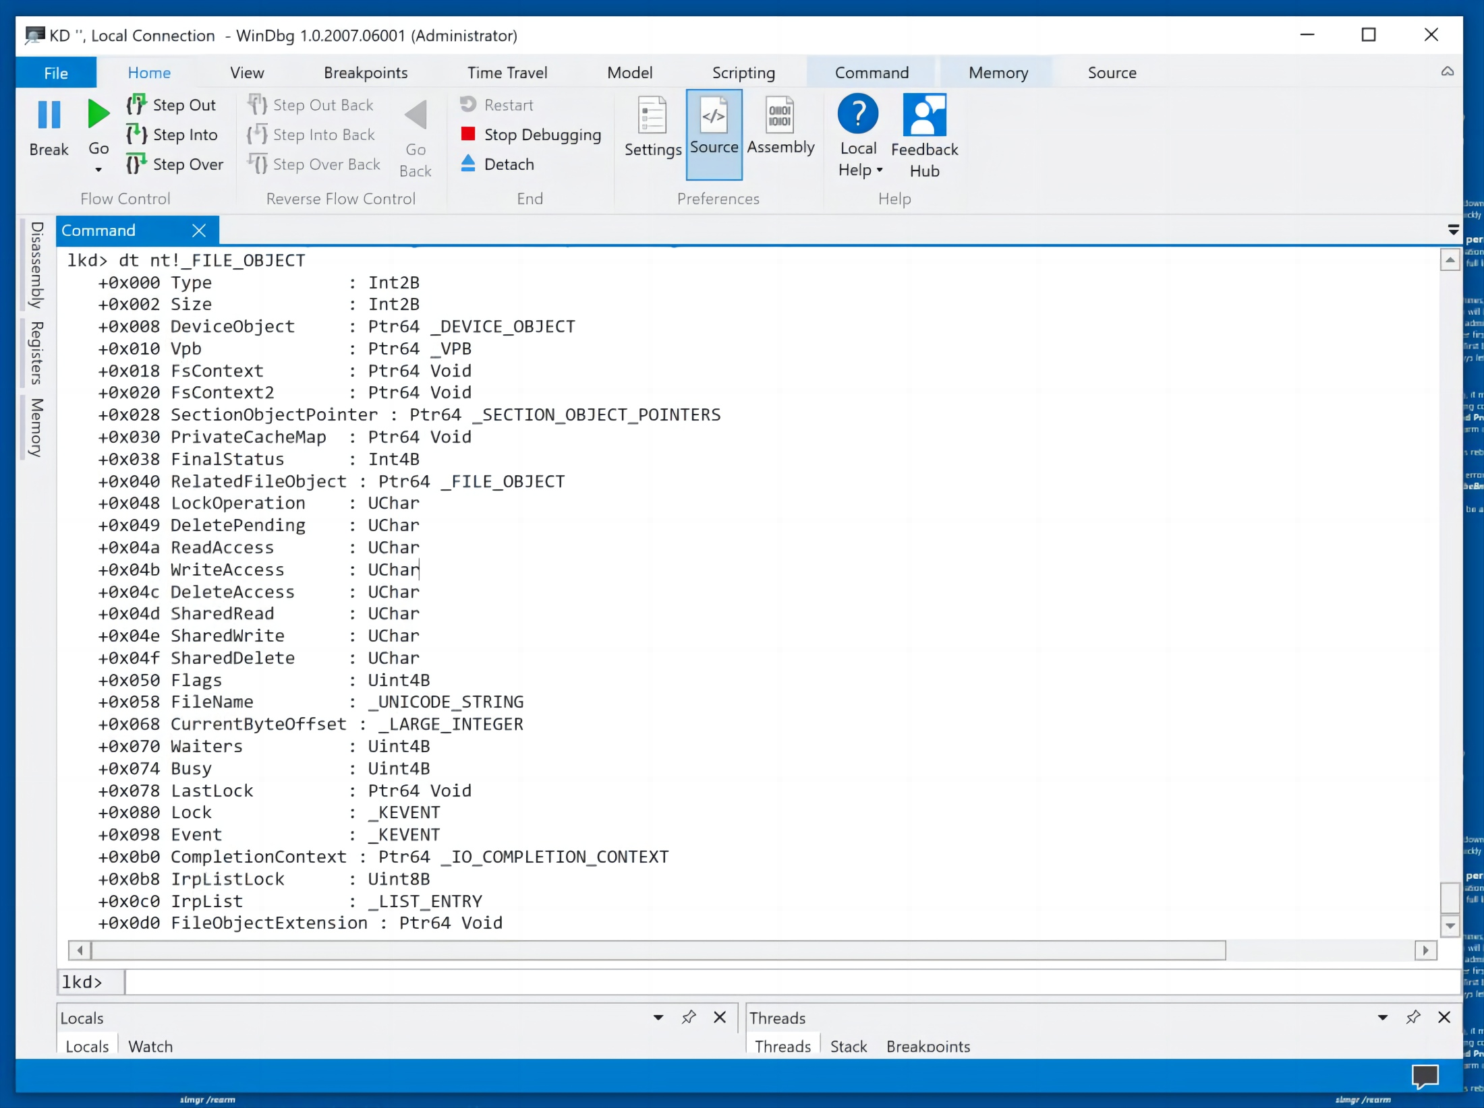
Examining a Data Structure
In the lower center of WinDbg, execute this command:
dt nt!_FILE_OBJECT
This shows the syntax of the _FILE_OBJECT data structure used to represent an open file.
Notice the permission bytes, such as ReadAccess, and the FileName string, as shown below.
For a more complete explanation of the _FILE_OBJECT structure, see: FILE_OBJECT structure (wdm.h).

Slide 33
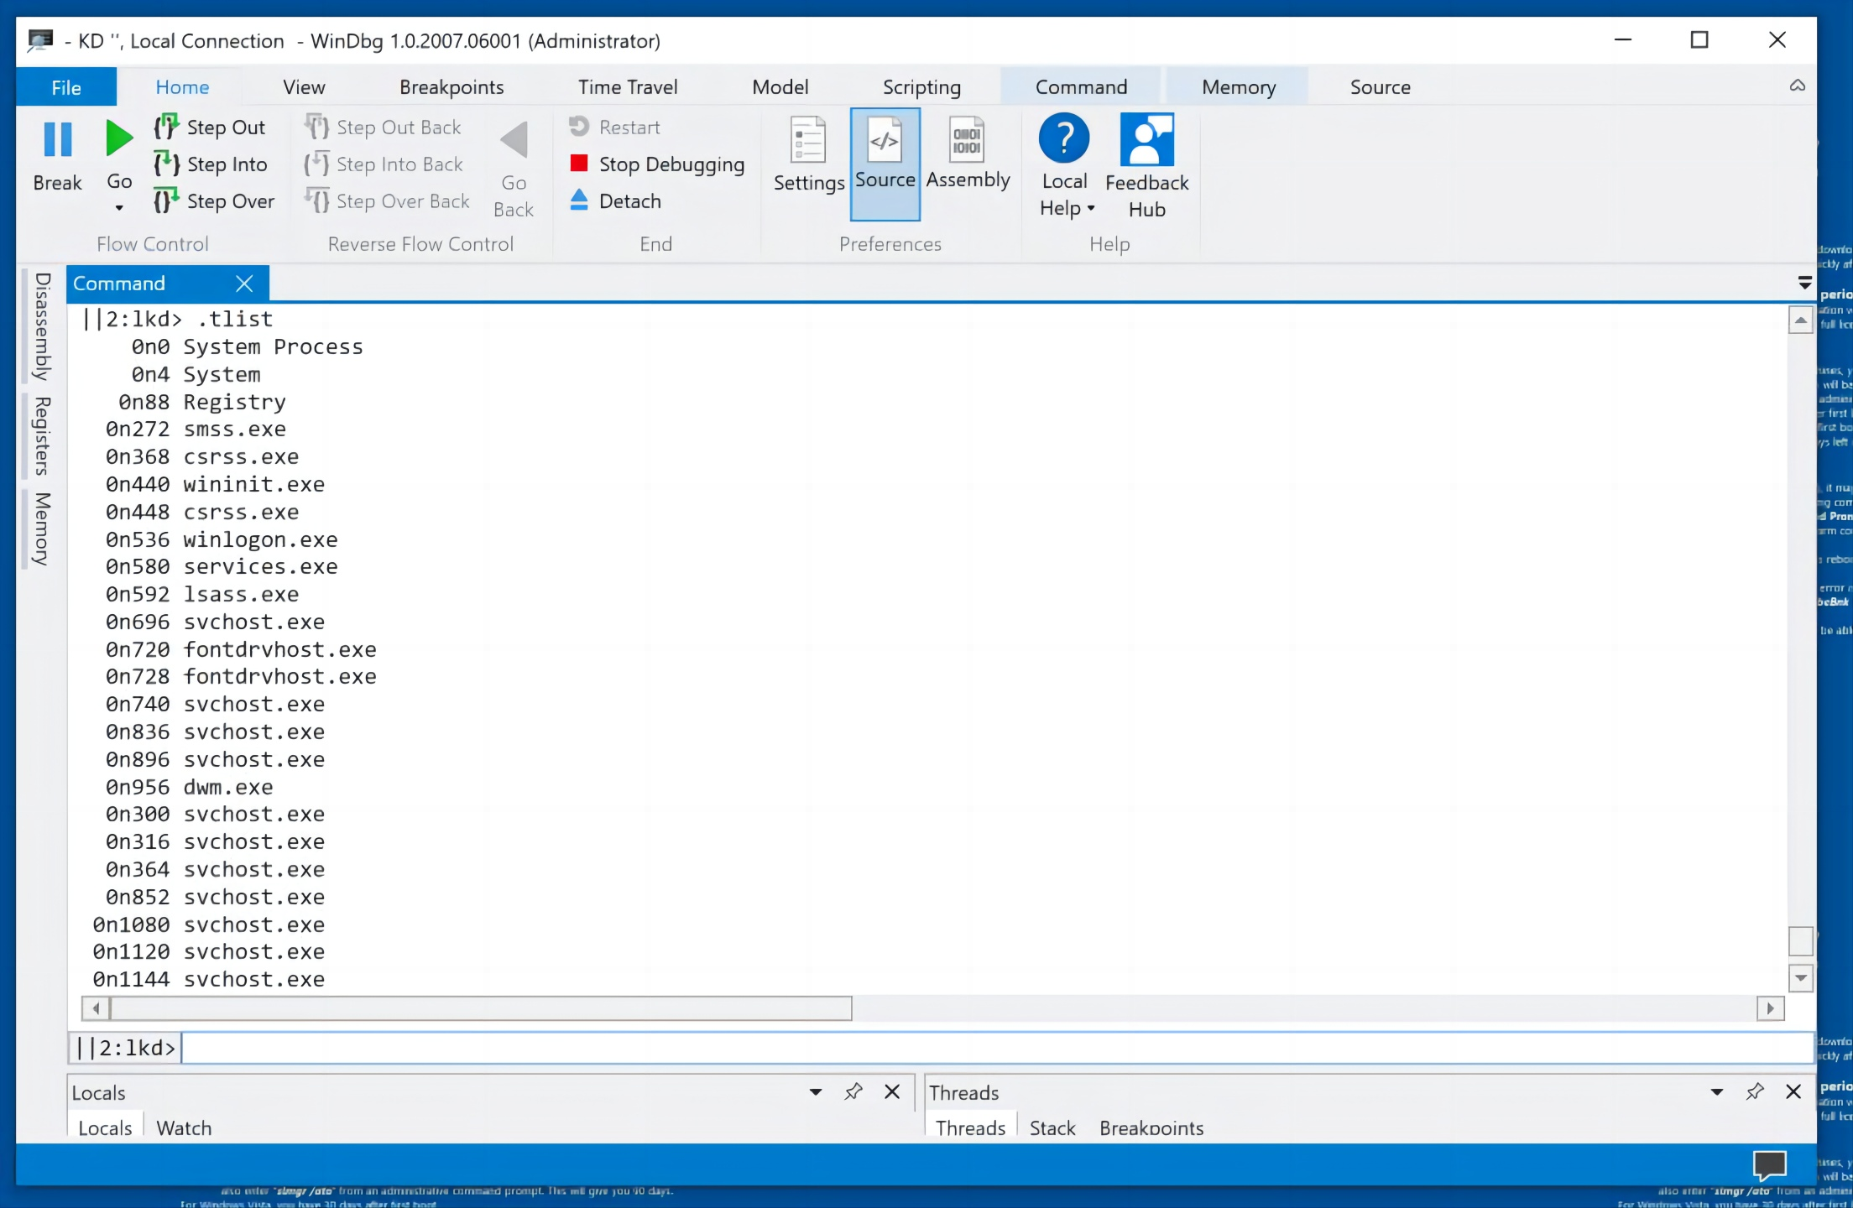
Viewing Processes
In the lower center of WinDbg, execute this command:
.tlist
You see a list of running processes, as shown below.

Slide 34
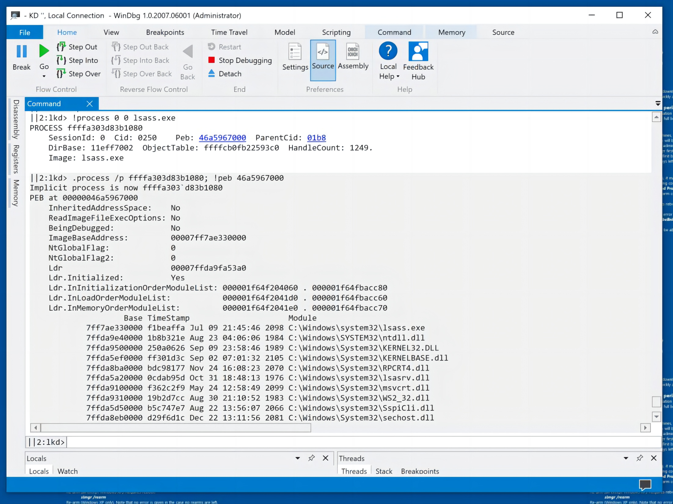
Viewing Processes
For more details about the "lsass.exe" process, execute this command:
!process 0 0 lsass.exe
You see a few lines of data, incluing a blue address for the "peb"--the Process Environment Block.
Click that blue address for far more information, as shown below.

Slide 35
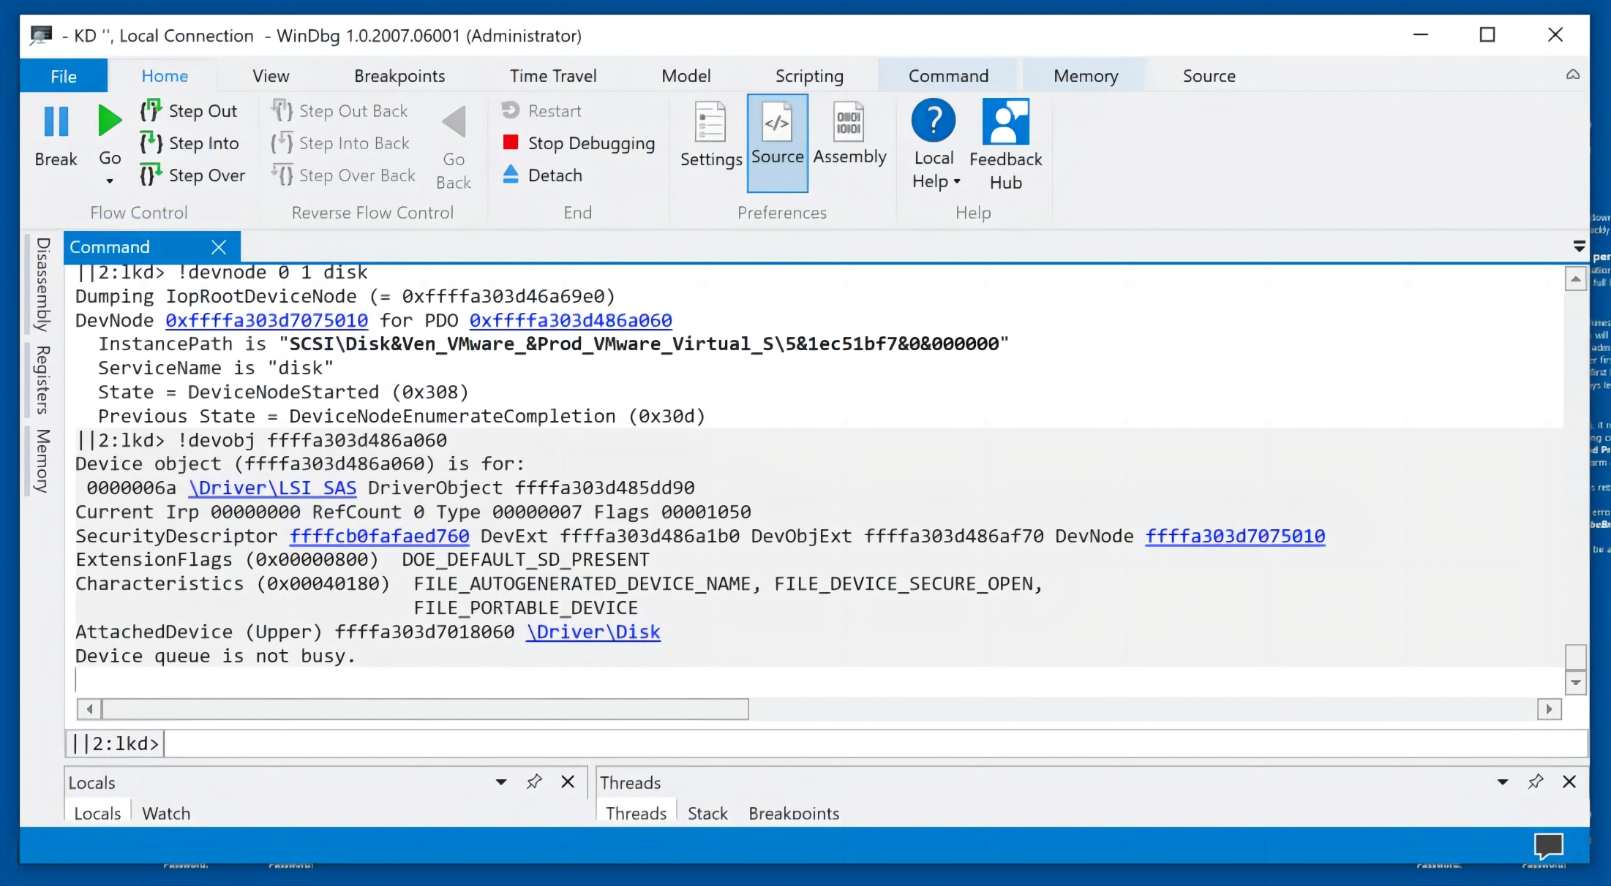
Viewing Devices and Drivers
In the lower center of WinDbg, execute this command:
!devnode 0 1 disk
You see a few lines of data, incluing a blue address for the "PDO"--the Physical Device Object.
Click that blue address for more information, including the InstancePath, which shows that I am using a VMware disk, as shown below.

Slide 36
Disabling Debugging
Click the Start button and type CMD. Right-click "Command Prompt" and click "Run as administrator". Click Yes.
Execute this command:
bcdedit /debug off
Restart your Windows machine.

Slide 37

THE END
Fangtian Zhong
CSCI 591
Gianforte School of Computing
Norm Asbjornson College of Engineerin
E-mail: fzhong@montana.edu
2023.11.16

