Slide 1

2023.11.28
Malicious Code Analysis
Fangtian Zhong
CSCI 591
Gianforte School of Computing
Norm Asbjornson College of Engineering
E-mail: fangtian.zhong@montana.edu

Slide 2
Overview
Malware Binary Analysis
01
Static Malware Analysis I
02

Slide 3

Malware Binary Analysis
Part One
01

Slide 4



Malware Binary Analysis
01001010100101010
10101010011010101
01001010100101010
10101010011010101
01001010100101010
10101010011010101
01001010100101010
10101010011010101
10101010011010101
01001010100101010
10101010011010101
What does the malware do
How does it do it
identify triggers
What is the purpose of the malware
Is this an instance of a known threat or a new malware
who is the author
…
.exe
Typically a stripped binary with no debugging information.
In the case of malicious code, it is often obfuscated and packed.
Often has embedded suicide logic and anti-analysis logic.
Challenges:
lack of automation
time-critical analysis
labor intensive
requires a human in the loop

Slide 5
Malware Analysis Systems
Malware analysis involves dissecting malware to understand how it works, and determine its functionality, origin, and potential impact
  Malware analysis is essential for any business and infrastructure that responds to cybersecurity incidents
Malware analysis systems can be classified into two broad categories
  Static analysis systems (pre-execution analysis)
    Process malware without running it, and extract features to be used for malware detection and classification
  Dynamic analysis systems (post-execution analysis)
    It involves running the malware either in a physical or virtual environment, and searching for indicators of malicious activities
Some references also add a class of hybrid analysis systems, that combine static and dynamic analysis

Slide 6
Static Analysis VS Dynamic Analysis
Static Analysis
The process of analyzing a malware sample without actually executing it.
Tools: VirusTotal, strings, a disassembler like angr, IDA Pro, etc.
Dynamic Analysis
The process of analyzing malware by executing it in a controlled environment to observe its behavior and identify its functionality. Use a virtual machine and take snapshots.
Tools: angr, RegShot, Process Monitor, Process Hacker, CaptureBAT.
RAM Analysis: Mandiant's Redline, Volatility.

Slide 7
Merits of Static Analysis
Fast: Static analysis is generally faster than dynamic analysis, as it does not require the execution of the malware.
Non-intrusive: It does not modify the system or the malware being analyzed.
Scalable: It can be easily automated and scaled for analyzing large numbers of malware samples.
Detection of Known Malware: It can effectively detect known malware using signature-based detection methods.
Easy to set up: Static analysis can be performed using simple tools and does not require specialized equipment or configurations.

Slide 8
Drawbacks of Static Analysis
Limited Insight: It provides limited insight into the malware’s behavior, as it only analyzes the binary code without executing it.
Inability to Detect Polymorphic Malware: Polymorphic malware is designed to change its code to evade detection. Static analysis is not effective in detecting such malware.
False Positives and False Negatives: It can produce false positives and false negatives, as some malware can be designed to evade detection by traditional static analysis techniques.
Requires Updated Signatures: Static analysis relies on signatures and heuristics to detect malware. This requires regular updates to detect new malware variants.

Slide 9
Merits of Dynamic Analysis
Deep Insight: It provides deeper insight into the behavior of malware, as it executes the malware and observes its behavior in real-time.
Effective Against Polymorphic Malware: It can effectively detect polymorphic malware, as it observes the behavior of the malware in real-time.
Detection of Unknown Malware: It can detect unknown malware that has not yet been identified by signature-based detection.
Detailed Analysis: It can provide detailed information about the malware’s network behavior, command and control communication, and file system modifications.

Slide 10
Drawbacks of Dynamic Analysis
Slow: It is generally slower than static analysis, as it requires the malware to be executed.
Intrusive: It modifies the system by executing the malware being analyzed.
May Trigger Malware Behavior: It may trigger the malware to execute its malicious behavior, potentially causing damage to the system.
Resource-Intensive: It requires specialized equipment and configurations, such as a virtual machine or sandbox environment.
Limited Scalability: It can be resource-intensive and may not be easily scalable for analyzing large numbers of malware samples.

Slide 11
Malware Evasions and Obfuscations
To defeat static malware analysis
Metamorphism
Encryption (packing).
API and control-flow obfuscations.
Anti-disassembly.
To defeat Dynamic Malware Analysis
Anti-debugging, anti-tracing, anti-memory dumping.
VMM detection, emulator detection.
The main purpose of obfuscation is to slow down the security community.

Slide 12
Static Malware Analysis I
Part Two
02

Slide 13


Basic Static Analysis
Basic static analysis
View malware without looking at instructions.
Tools: VirusTotal, strings.
Quick and easy but fails for advanced malware and can miss important behavior.

Slide 14

Advanced Static Analysis
Advanced static analysis
Reverse-engineering with a disassembler.
Complex, requires understanding of assembly code.

Slide 15
Static Analysis Systems
Static analysis provides information about the functionality of the file, and it produces a set of signature features (without executing the file)
  The extracted information is used to predict whether the file is malicious software
  The disadvantage of static analysis is that the “true features” of the code may be missed
Static analysis can include:
  Analyzing PE header and sections
    PE header provides information about linked libraries and imported/exported functions, as well as contains metadata about the executable
    Strings of characters can contain references to modified files or accessed file paths by the executable (e.g., URLs, domain names, IP addresses, names of loaded DLLs, registry keys, etc.)
    Search for packed/encrypted code that is used by malware developers to make their manipulated files more difficult to analyze
  Disassembling the program – translating machine code into assembly language code
    Load the executable into a disassembler to translate it into assembly language, and obtain a better understanding of what the program does

Slide 16
Static Features for Malware Classification
Static features
  In Windows systems, static features are extracted from either the PE file header and sections, or assembly language source file (obtained after disassembling the file)
Strings – sequence of characters, related to URLs, IP addresses, accessed file paths, registry keys, or names of modified files by the executable
  Ye et al. (2008) used extracted strings from PE files as input features to an SVM ensemble with bagging model for malware detection
Byte n-grams – sequence of n bytes in PE header or the assembly language code
  An n-gram is a sequence of n adjacent items in sequential data
  A large number of sequences of n bytes (n ranging from 1 to 8) are used as input features for ML model training
  Different ML models (Decision Trees, Random Forests, Deep Belief Nets) have been implemented using byte n-grams , e.g., by Jain and Meena (2011), Yuxin et al. (2019)
  Challenges include the large number of n-grams for each file (which often requires reducing the dimensionality of the feature vectors)

Slide 17


String
Any sequence of printable characters is a string
Strings are terminated by a null (0x00)
ASCII characters are 8 bits long
Now called ANSI
Unicode characters are 16 bits long
Microsoft calls them "wide characters"

Slide 18
String
ASCII
B
A
D
NULL Terminator
42
41
44
00
Figure 1. ASCII representation of the string BAD
Unicode
B
A
D
NULL Terminator
42
00
41
00
44
00
00
00
Figure 2. Unicode representation of the string BAD

Slide 19

String
Native in Linux, also available for Windows.
Finds all strings in a file 3 or more characters long.

Slide 20
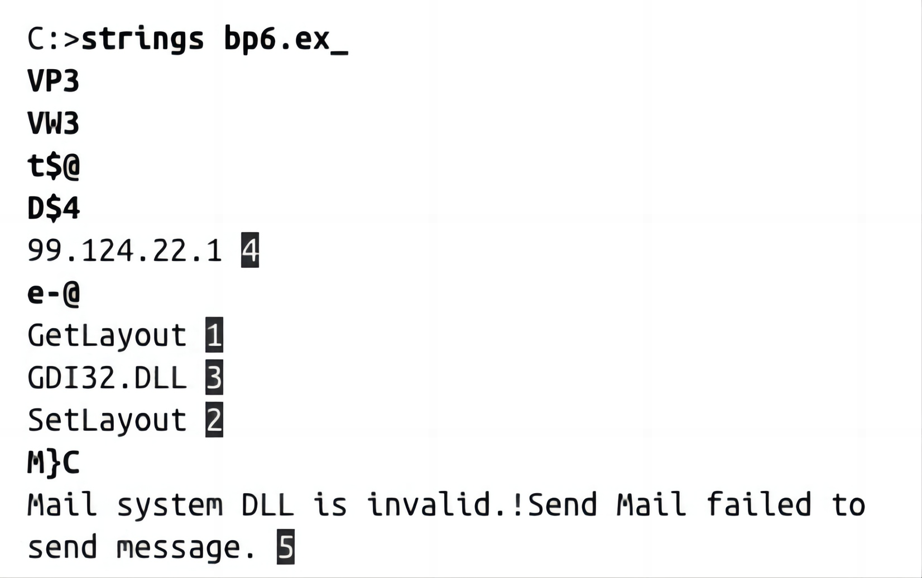
Strings Command
GetLayout and SetLayout are Windows functions.
GDI32.DLL is a Dynamic Link Library

Slide 21
Example
char *sneaky = "SOSNEAKY";
int authenticate(char *username, char *password)
{
char stored_pw[9];
stored_pw[8] = 0;
int pwfile;
// evil back d00r
if (strcmp(password, sneaky) == 0) return 1;
pwfile = open(username, O_RDONLY);
read(pwfile, stored_pw, 8);
if (strcmp(password, stored_pw) == 0) return 1;
return 0;
}
int accepted()
{
printf("Welcome to the admin console, trusted user!\n");
}
int rejected()
{
printf("Go away!");
exit(1);
}
int main(int argc, char **argv)
{
char username[9];
char password[9];
int authed;
username[8] = 0;
password[8] = 0;
printf("Username: \n");
read(0, username, 8);
read(0, &authed, 1);
printf("Password: \n");
read(0, password, 8);
read(0, &authed, 1);
authed = authenticate(username, password);
if (authed) accepted();
else rejected();
}

Slide 22
Static Features for Malware Classification
Opcode (mnemonic) n-grams – n consecutive opcodes (i.e., operational code instructions) in the assembly language source code
  Assembly instructions are composed of an operational code and operand
    E.g., for the instruction sequence: “call sub_401BCD”, “add eax 1”, “mov ebx ebx”, the 3-gram opcode is: CALL-ADD-MOV
  Malware samples from the same family often use the same opcodes
  Santos et al. (2013) selected the top 1,000 features using 1 or 2-gram opcodes and trained an SVM malware classifier
API function call – request to the OS for accessing system resources, such as networking, security, file management, etc.
  Application Programming Interfaces (API) function calls are very discriminative features, as they can provide key information to reveal the behavior of malware
  E.g., certain sequences of API function calls are often found in malware, but rarely in benign files
  Ahmadi et al. (2016) used the frequency of 794 API function calls to develop an ML system for classifying malware into families

Slide 23
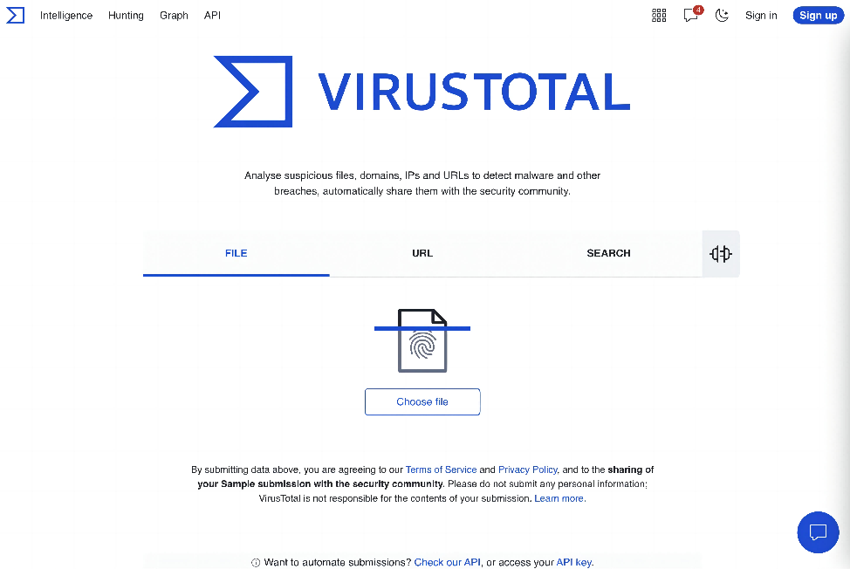
Generic Detection
VirusTotal is a free online service that allows users to scan files, URLs, and IP addresses for viruses, malware, and other security threats using more than 70 antivirus engines and other security tools.
https://www.virustotal.com/gui/home/upload

Slide 24
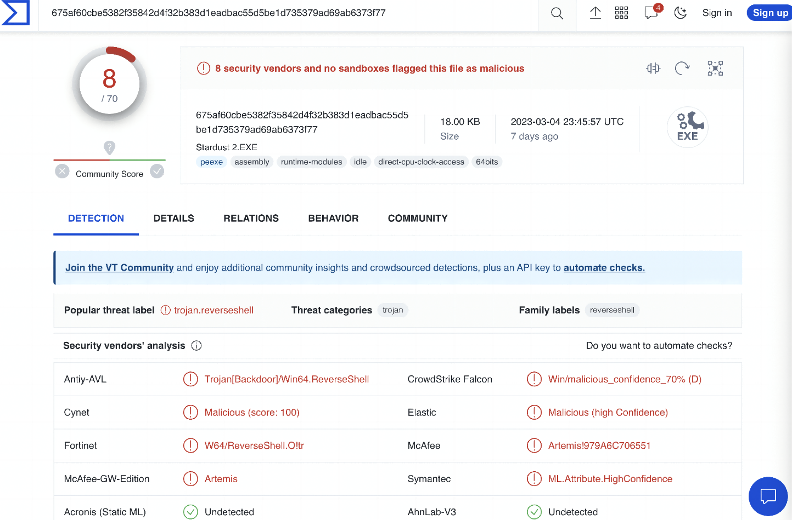
Example

Slide 25
Hashing
Static malware analysis by hashing involves calculating a cryptographic hash of a suspicious file to determine if it matches any known malware.
To perform static malware analysis by hashing, the following steps can be taken:
Obtain a suspicious file that needs to be analyzed.
Calculate the cryptographic hash of the file using a hashing algorithm such as MD5, SHA-1, or SHA-256.
Compare the calculated hash value against a database of known malicious hash values. This database could be a local repository of known malware hashes or an online database such as VirusTotal.
If the hash value matches a known malicious hash, the file is likely to be malware and should be treated accordingly. If the hash value does not match any known malicious hash, the file may still be suspicious and further analysis is needed.

Slide 26

Hashes
MD5, SHA-1 or SHA-256.
Condenses a file of any size down to a fixed-length fingerprint.
Uniquely identifies a file well in practice.
There are MD5 collisions but they are not common.
Collision: two different files with the same hash.

Slide 27
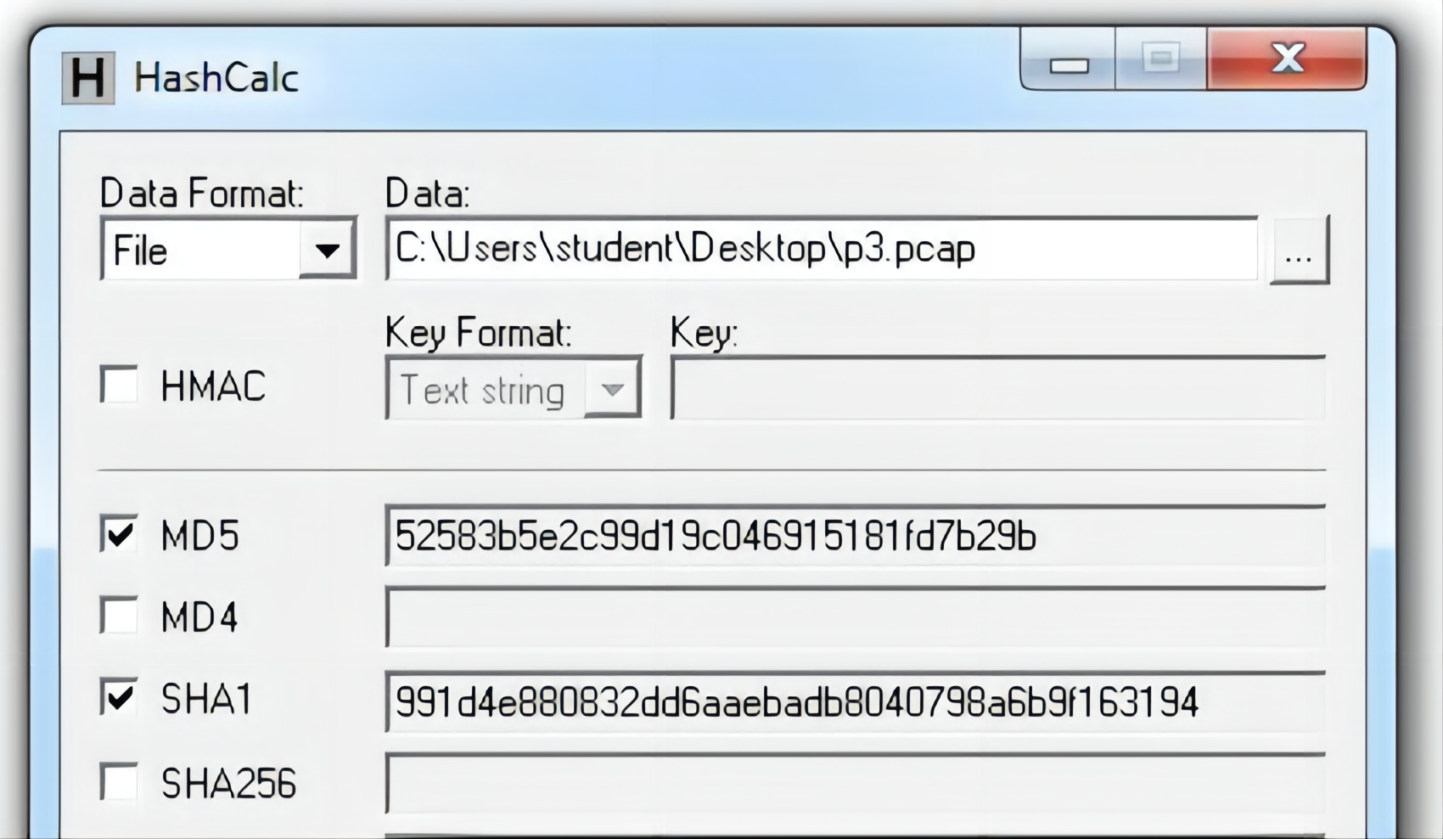
HashCalc

Slide 28

Hash Uses
Label a malware file
Share the hash with other analysts to identify malware
Search the hash online to see if someone else has already identified the file

Slide 29
Static Features for Malware Classification
Function–call graph – is a directed graph whose vertices represent the functions of a program, and the edges symbolize function calls
  Kinable et al. (2011) developed an approach for clustering malware based on the structural similarities between function-call graphs
Control–flow graph – is a directed graph in which the nodes represent basic blocks, and the edges represent control-flow paths
  A basic block is a linear sequence of program instructions having an entry point (the first instruction executed) and an exit point (the last instruction executed)
  The control-flow graph is a representation of all the paths that can be traversed during a program’s execution
  Faruki et al. (2012) used a Random Forest classifier for detecting malware using control-flow graphs of various API calls

Slide 30

THE END
Fangtian Zhong
CSCI 591
Gianforte School of Computing
Norm Asbjornson College of Engineering
E-mail: fangtian.zhong@montana.edu
2023.11.28

