Slide 1

2023.11.30
Malicious Code Analysis
Fangtian Zhong
CSCI 591
Gianforte School of Computing
Norm Asbjornson College of Engineering
E-mail: fangtian.zhong@montana.edu

Slide 2

Static Malware Analysis II
Part One
01

Slide 3


Entry-point Scanning
The entry point is the address within the file where execution begins, and malware authors may attempt to modify this address to redirect execution to their own code instead of the legitimate code. Entry-point scanning involves analyzing the code at the entry point to determine whether it is behaving as expected or contains suspicious instructions.

Slide 4

Fixed-point Scanning
Fixed-point scanning involves analyzing a specific point within the file that is known to be part of the legitimate code. This could be a function or other segment of the code. By analyzing the code at this fixed point, analysts can determine whether it has been modified or replaced with malicious code.

Slide 5
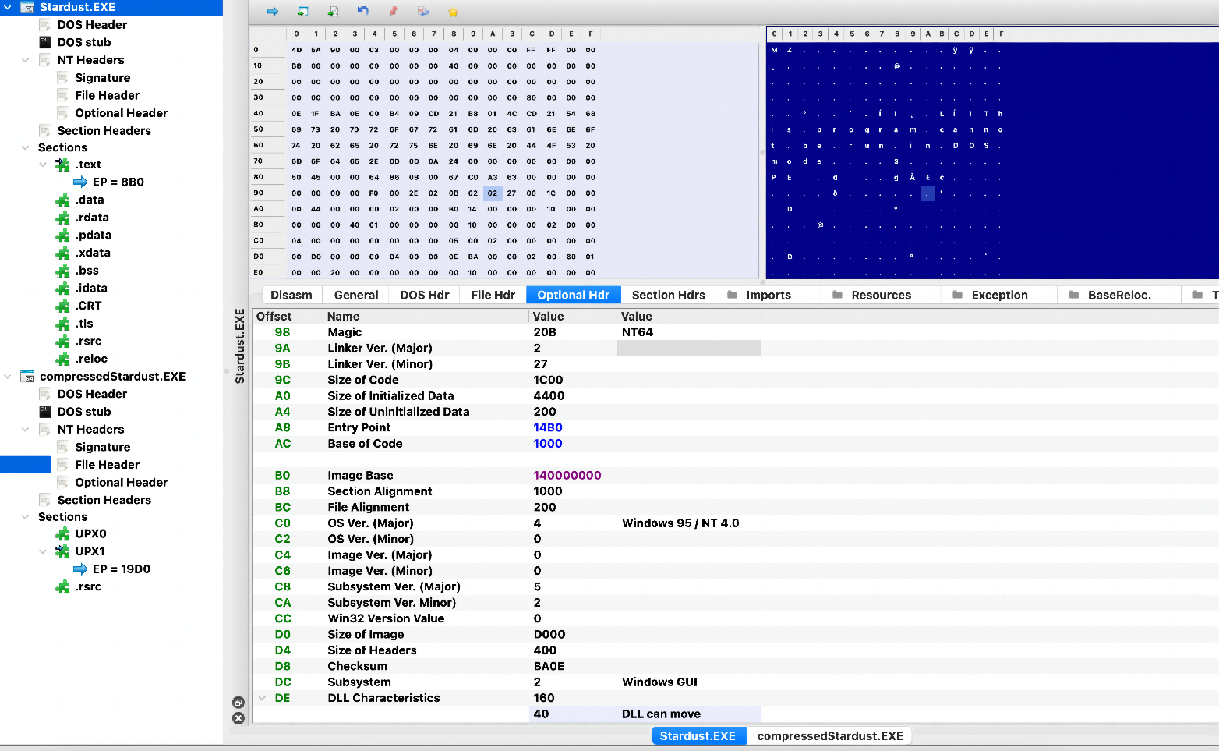
Entry-point-Stardust

Slide 6
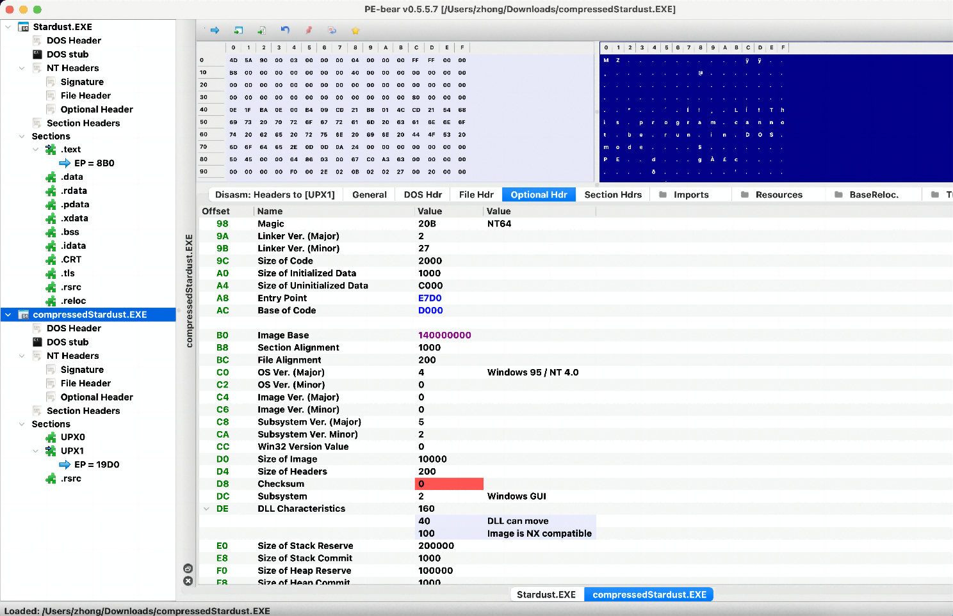
Entry-point-compressedStardust

Slide 7

Skeleton Detection
Skeleton detection is a technique that identifies the core functionality or "skeleton" of a malware sample through its static attributes, such as its code, file structure, signature generation.

Slide 8
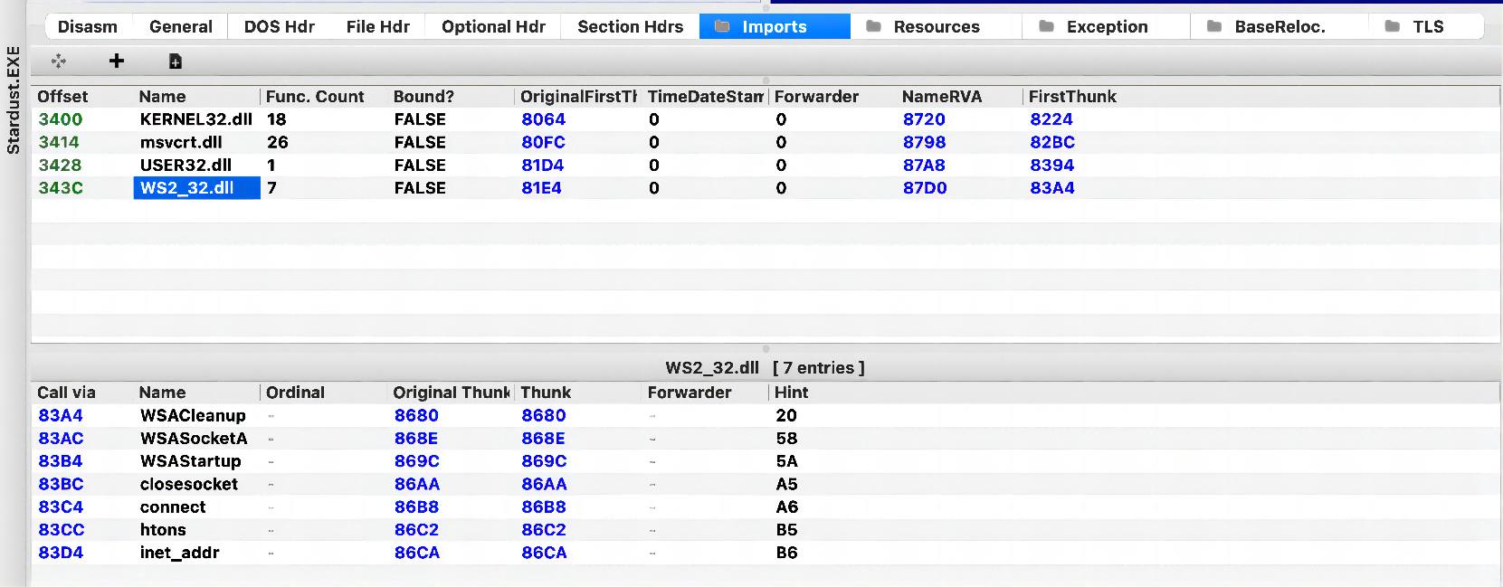
Skeleton Detection-Code analysis
It can help identify the main control flow and key functions used by the malware. This can include the identification of specific API calls or system functions used by the malware.

Slide 9

Nearly Exact Identification
Nearly exact identification is a technique that identifies a specific variant or version of a malware sample. It involves comparing two or more versions of the same malware sample to identify differences between them.

Slide 10

Nearly Exact Identification
To perform nearly exact identification, analysts typically use techniques such as binary diffing, code comparison, or file comparison.

Slide 11
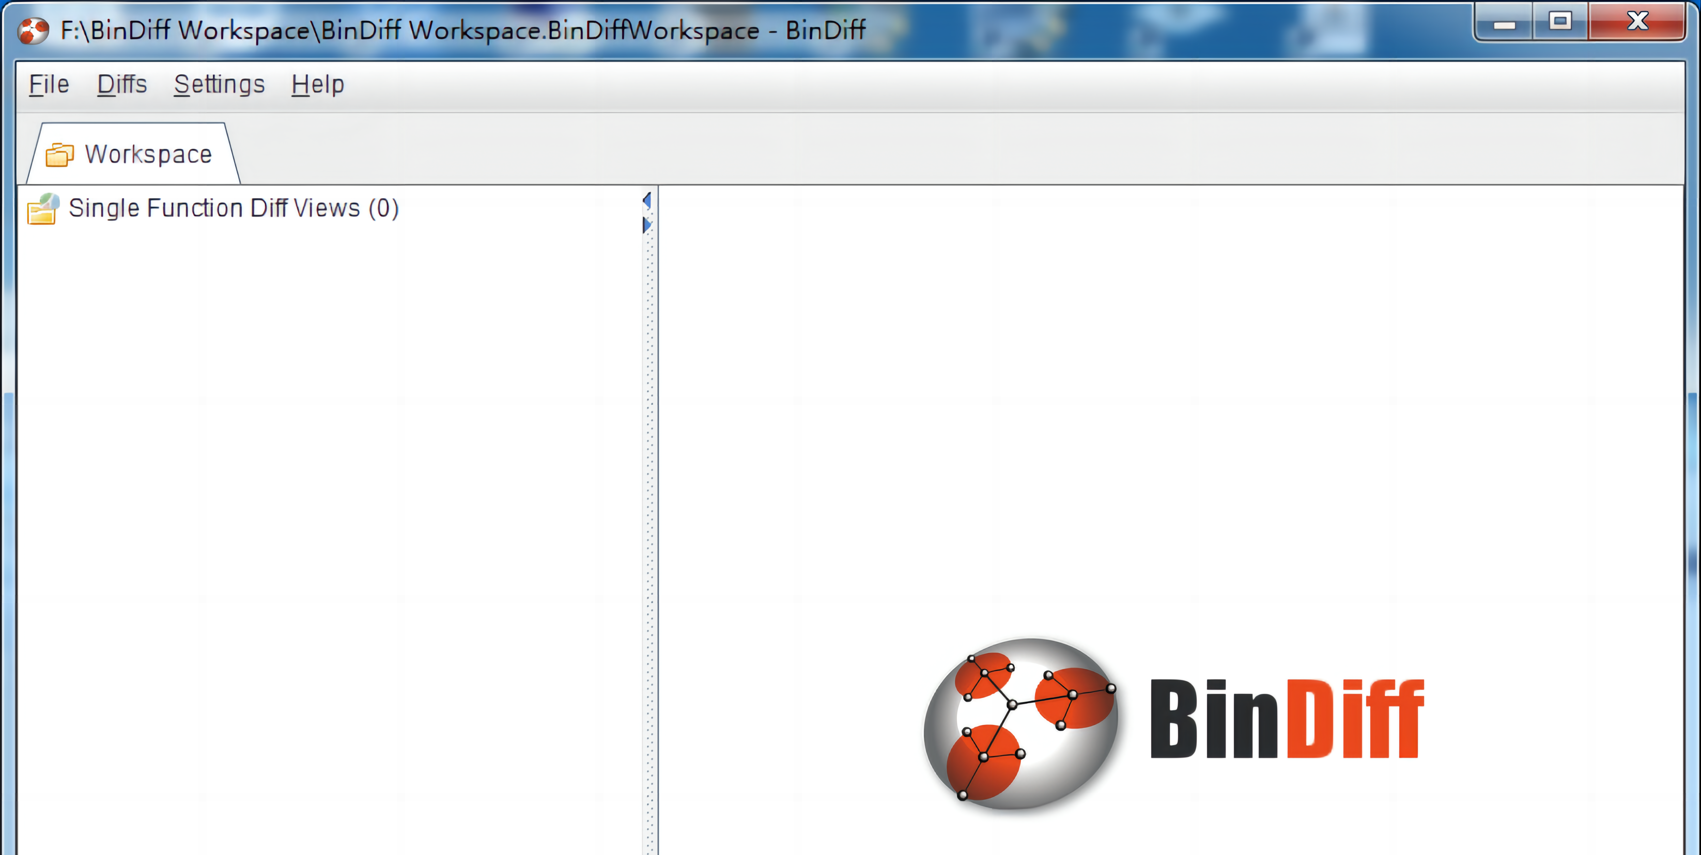
BinDiff
BinDiff uses a unique graph-theoretical approach to compare executables by identifying identical and similar functions.

Slide 12
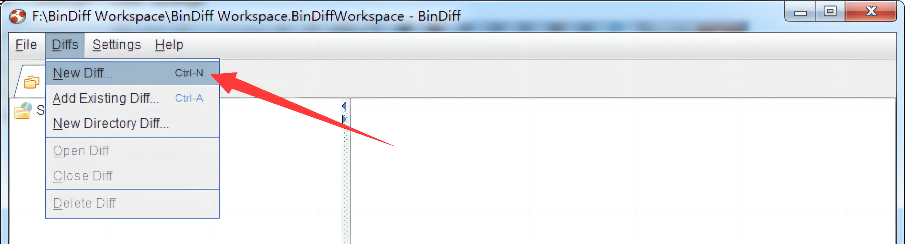
BinDiff

Slide 13
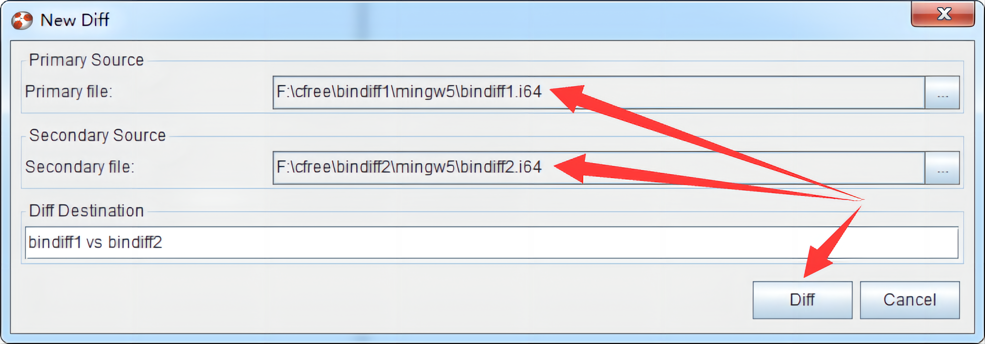
BinDiff

Slide 14
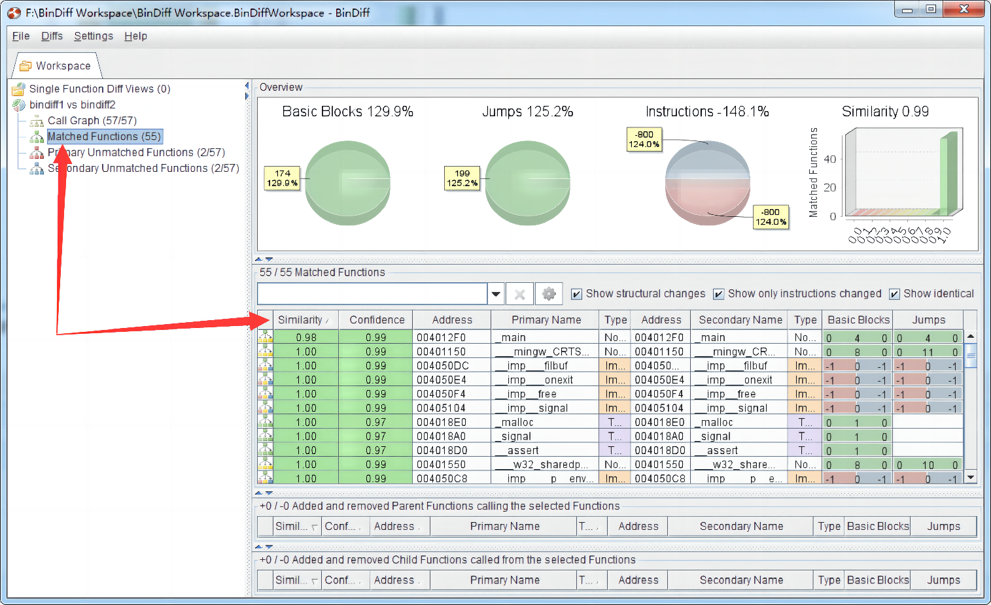
BinDiff

Slide 15
BinDiff
#include <stdio.h>
#include <stdlib.h>
#include <string.h>
int get_num();
void print_good();
void print_bad();
int main() {
int num;
while(1) {
num = get_num();
if (num == 1337 || num == 7331 || ((num*3+3321)*2 + 7331)/3 == 7333) {
print_good();
}
else {
print_bad();
}
}
return 0;
}
int get_num() {
char buf[16];
printf("Enter secret number : ");
fgets(buf, 16, stdin);
return atoi(buf);
}
void print_good() {
printf("Accepted!\n");
}
void print_bad() {
printf("Nope!\n");
}
#include <stdio.h>
#include <stdlib.h>
#include <string.h>
int get_num();
void print_bad();
int main() {
int num;
while(1) {
num = get_num();
if (num == 1337) {
printf("Accepted!\n");
}
else {
print_bad();
}
}
return 0;
}
int get_num() {
char buf[16];
printf("Enter secret number : ");
fgets(buf, 16, stdin);
return atoi(buf);
}
void print_bad() {
printf("Nope!\n");
}

Slide 16
BinDiff-function
proj = angr.Project('bindiff_a', auto_load_libs=False)
cfg = proj.analyses.CFGFast()
proj2 = angr.Project('bindiff_b', auto_load_libs=False)
cfg2 = proj2.analyses.CFGFast()
anaz = proj.analyses.BinDiff(proj2, cfg_a=cfg, cfg_b=cfg2)
for func_addrs in anaz.differing_functions:
addr1 = func_addrs[0]
addr2 = func_addrs[1]
print(cfg.kb.functions[addr1].name, cfg2.kb.functions[addr2].name)
for func_pair in anaz.identical_functions:
print(proj.kb.functions[func_pair[0]].name, proj2.kb.functions[func_pair[1]].name)

Slide 17
BinDiff-block
for blocks in anaz.differing_blocks:
block1, block2 = blocks
print(hex(block1.addr))
print(hex(block2.addr))
print(proj.factory.block(block1.addr).pp())
print(proj2.factory.block(block2.addr).pp())

Slide 18
BinDiff-block
def analyze(b, name):
for func in b.kb.functions.values():
if func.name.find(name) == 0:
plot_func_graph(b, func.transition_graph, "%s_%s_cfg" % (name, b.filename), asminst=True, vexinst=False)
analyze(proj, "main")
analyze(proj2, "main")

Slide 19
BinDiff

Slide 20
BinDiff

Slide 21
Static Decryptor Detection
Static decryptor detection analyzes the behavior of malware that uses encryption or obfuscation to conceal its functionality. This technique involves analyzing the malware sample's static attributes, such as its code or file structure, to detect the presence of encryption or obfuscation routines, and then using these routines to decrypt or deobfuscate the malware's code.
Its goal is to uncover the true behavior and capabilities of a malware sample that has been obscured through encryption or obfuscation. By identifying and understanding the decryption or deobfuscation routines used by the malware, analysts can gain insight into the malware's behavior and develop effective countermeasures to detect and mitigate its effects.

Slide 22
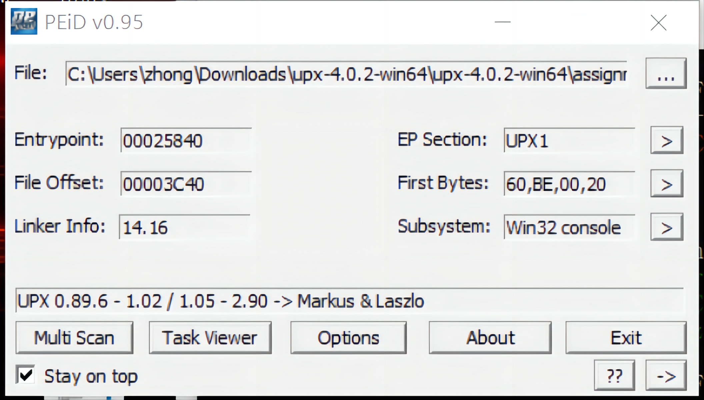
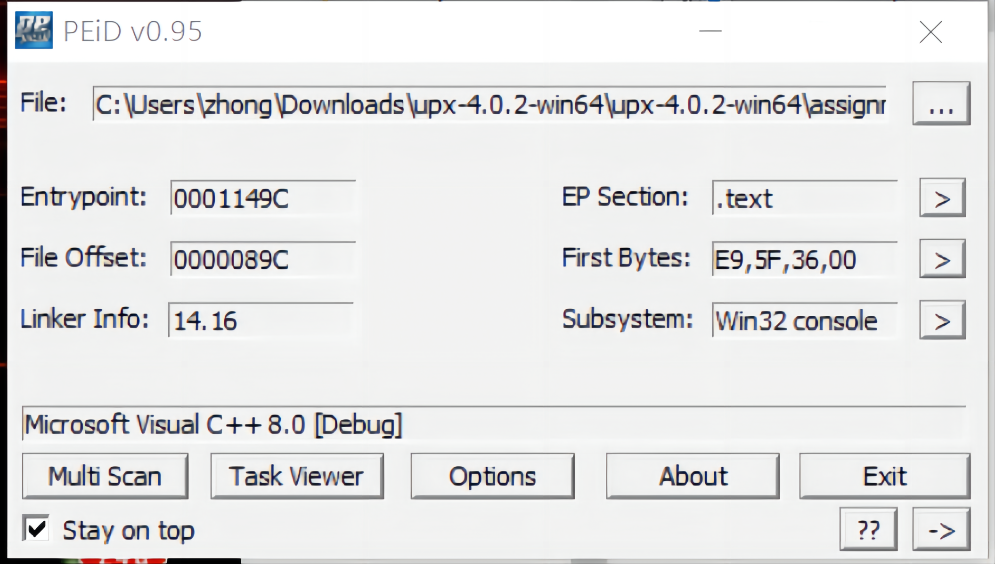
Static Decryptor Detection

Slide 23
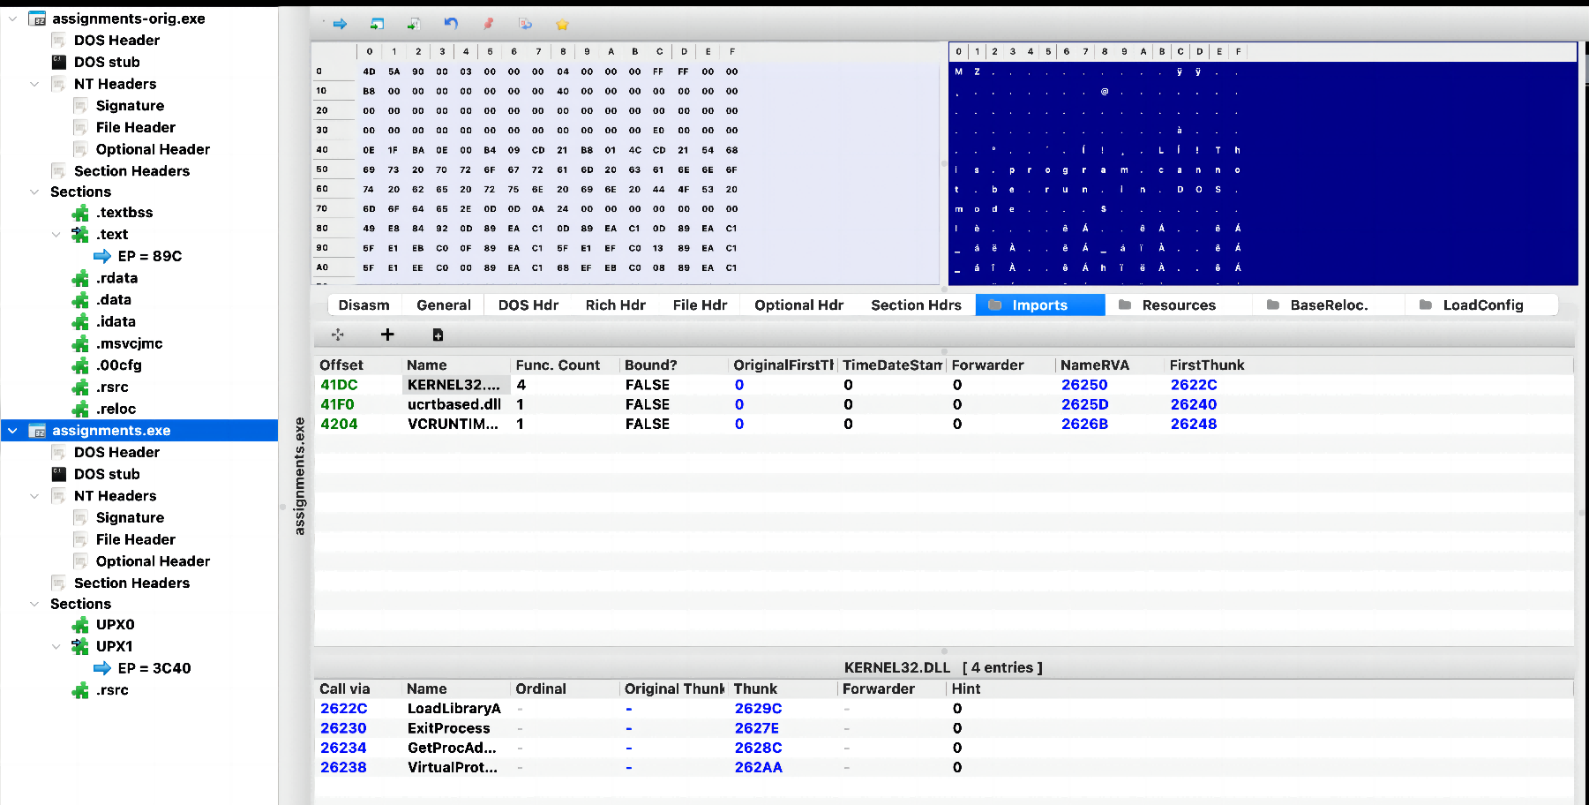
Static Decryptor Detection

Slide 24
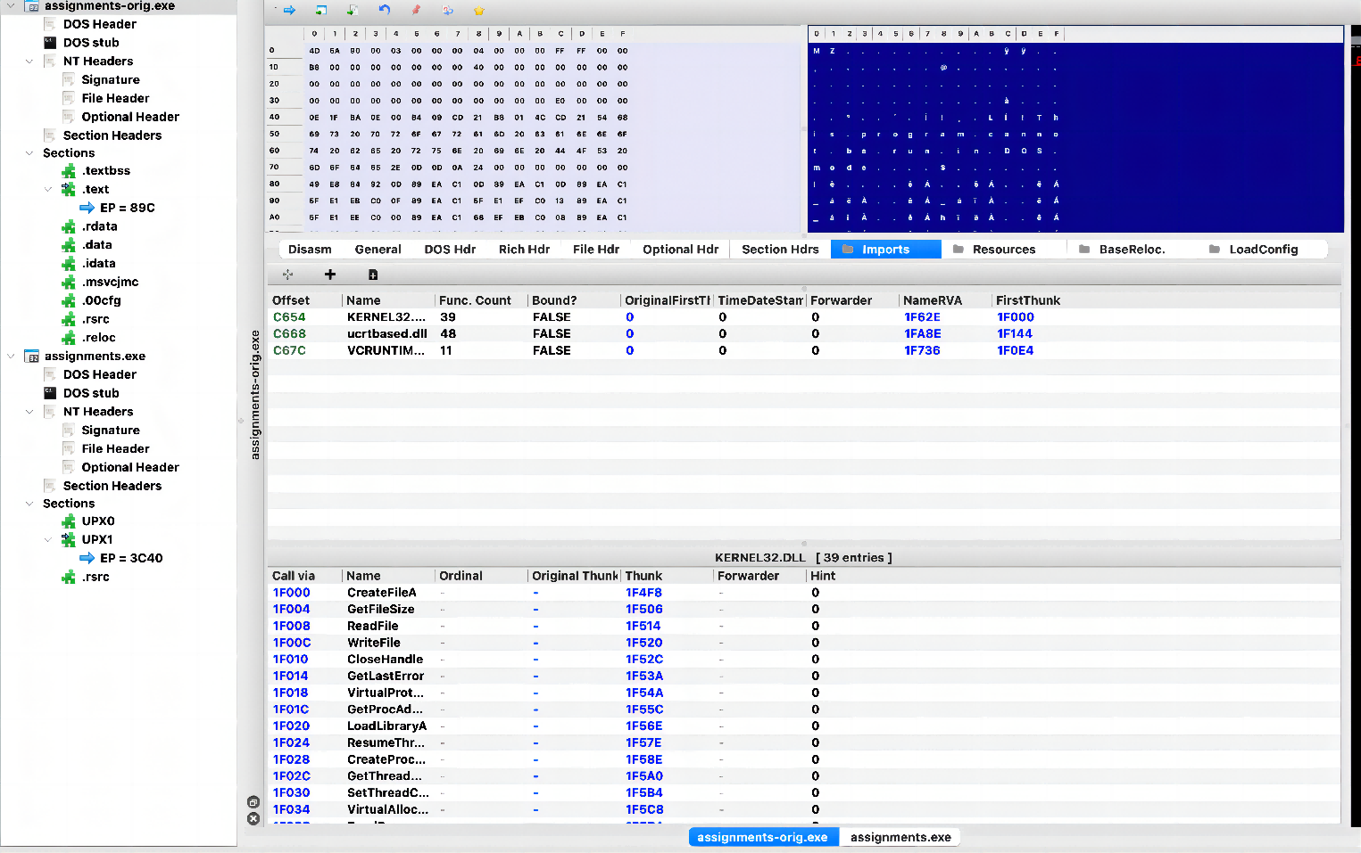
Static Decryptor Detection

Slide 25
Image Based Method
Image-based malware detection is a technique used to identify malware as an image file. This technique involves analyzing the contents of the image file to detect any embedded malicious code or hidden payloads.

Slide 26
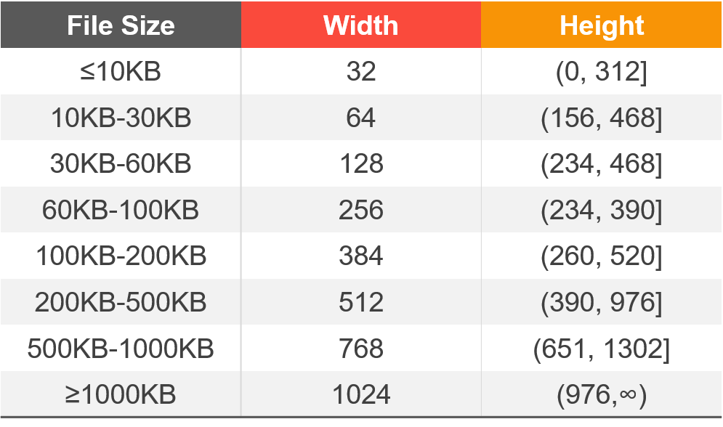
Malware Samples to Images
Correspondence between the malware sample file size and the converted imaged width
Sequentially reads the binary data in bytes and converts each byte into a number ranging in [0-255]
1
Reshape the image data by following a recommended fixed width with a variable height
2

Slide 27


AdialerC7c2-AdialerC948

Slide 28


AllapleA43ad-AllapleAf4a

Slide 29

THE END
Fangtian Zhong
CSCI 591
Gianforte School of Computing
Norm Asbjornson College of Engineering
E-mail: fangtian.zhong@montana.edu
2023.11.30

