Slide 1

2023.12.05
Malicious Code Analysis
Fangtian Zhong
CSCI 591
Gianforte School of Computing
Norm Asbjornson College of Engineering
E-mail: fangtian.zhong@montana.edu

Slide 2

Dynamic Malware Analysis
Part One
01

Slide 3



What is Dynamic Analysis?
Allow the malware to run.
Complement static analysis.
1
2
3
Help us to understand the program behavior.

Slide 4
Dynamic Analysis
Basic dynamic analysis
Advanced dynamic analysis
Executing target binary and using a debugger to analyze internal states.
Executing target binary and observing its behavior.

Slide 5

Basic Dynamic Analysis
Monitered execution of a program in order to perform analysis.
Often performed after static analysis is done.
Advantages
Efficient way to determine program functionality.
Able to check file activity, process creation, network activity, etc.
Disadvantages
Non-functional paths may be explored.

Slide 6
Executing the Malware
In most cases, you can just double-click the “exe” file.
You may want to run it from the command-line as well.
What if the extension is not “exe”?
You can change it. Verify if it is a PE file using a PE parser.
What if it is a DLL?
You can run a DLL using the rundll32 program.
Format: C:\> rundll32.exe <name>.dll

Slide 7

Dynamic Analysis Systems
Dynamic analysis is run in a safe environment on dedicated physical or virtual machines (in order not to expose the users’ system to unnecessary risks)
Physical machines are set up on isolated networks, disconnected from the Internet or any other network, to prevent malware from spreading
Virtual machines emulate the functionality of a physical computer, where the OS running on the virtual machine is isolated from the host OS
One limitation is that some malware can detect when they are running in a virtual machine, and they will execute differently than when in a physical machine
A related term is sandbox, referring to a physical or virtual environment for running malware, which isolates executables from other system resources and applications.
Although they share characteristics with physical and virtual machines, sandboxes can be more limited (e.g., they can run in the browser), while physical and virtual machines always act as a complete system
For example, online sandboxes are websites where one can submit a sample file and receive a report about its behavior

Slide 8
Dynamic Features for Malware Classification
Dynamic features are extracted from the execution of malware at runtime
Memory and registers usage - values stored in the memory and different registers during the execution can distinguish benign from malicious programs
Ghiasi et al. (2015) monitored the memory content and register values before and after each invoked API call
They used similarity scores between the benign and malicious files in a training set to train an ML model for malware detection
Instruction traces - sequence of processor instructions called during the execution of a program
Dynamic instruction traces are more robust indicators of the program’s behavior than static traces, since compression and encryption can obfuscate code instructions from static analysis
Carlin et al. (2017) analyzed traces of opcodes to detect malware by Random Forest and Hidden Markov Model classifiers

Slide 9
Dynamic Features for Malware Classification
Network traffic - monitoring the traffic entering and exiting the network can provide helpful information to detect malicious behavior
E.g., when malware infects a host machine, it may establish communication with an external server to download updates, other malware, or leak private and sensitive information from the host machine
Bekerman et al. (2015) extracted 972 features from the network traffic, and used them for developing Decision Tree and Random Forest malware classifiers
API call traces - traces for accessing file systems, devices, processes, threads and error handling, and also to access functions such as the Windows registry, manage user accounts, etc.
Uppal et al. (2014) proposed traditional ML-based classifiers using n-grams of features extracted from traces of invoked API calls.

Slide 10
Sandboxing
Sandboxing is a security technique used to isolate running applications from the rest of the system. It works by creating a virtual environment, or sandbox, in which an application or process can run without affecting other parts of the system.
The sandboxed environment provides a controlled and secure environment for testing or running potentially risky applications. If the application performs any suspicious behavior, it will be confined within the sandbox and prevented from affecting other parts of the system.

Slide 11
Sandboxing
Sandboxing can be implemented in various ways, such as virtual machines, containerization, or operating system-level sandboxes. For example, a virtual machine can be used to create a separate operating system environment within the host operating system, while containerization can be used to create isolated environments for individual applications or processes.

Slide 12


Sandboxes
All-in-one software solutions to analyze the execution of a program.
Provides security mechanisms for running untrusted programs in a safe environment.
Lets you moniter behavior/changes to the system.
The “real” system remains isolated-so, it does not get infected.

Slide 13

Sandboxes
Usually use virtual components
Simulates network services to allow program to execute as it “normally” would
Sandboxes for malware analysis
There are many free and commercial versions available
Lets you analyze a variety of file types: EXE, PDF, Office documents, URLs, etc.

Slide 14

Sandboxes-drawbacks
May run the EXE w/o command line arguments.
Execution may wait for response from C2.
Malware may find out that it is running in a sandbox .
an anti-analysis technique
in that case, the malware may change its behavior
Often the environment is not properly setup.

Slide 15
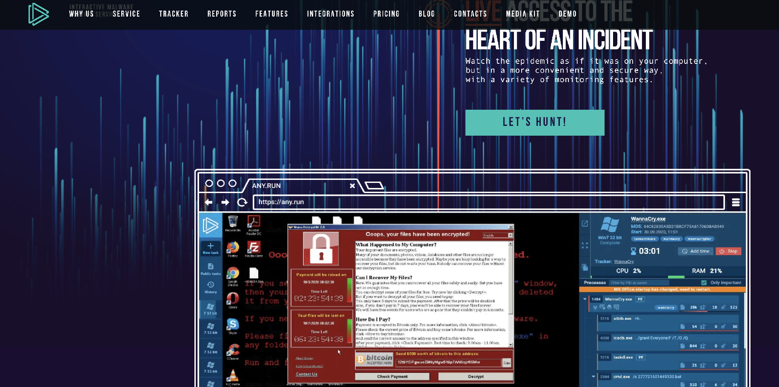
Sandbox-Example:https://any.run/

Slide 16
Moniter System Activity
Process Moniter
Allow monitering of registry, file system, network, process, and thread activities.
Moniter all system calls
Captures a lot of data (>50,000 events in a minute)
Use RAM to capture events
can easily crash a VM - so, run for a limited amount of time
Not a reliable tool for network activities
so other tools needs to be used

Slide 17
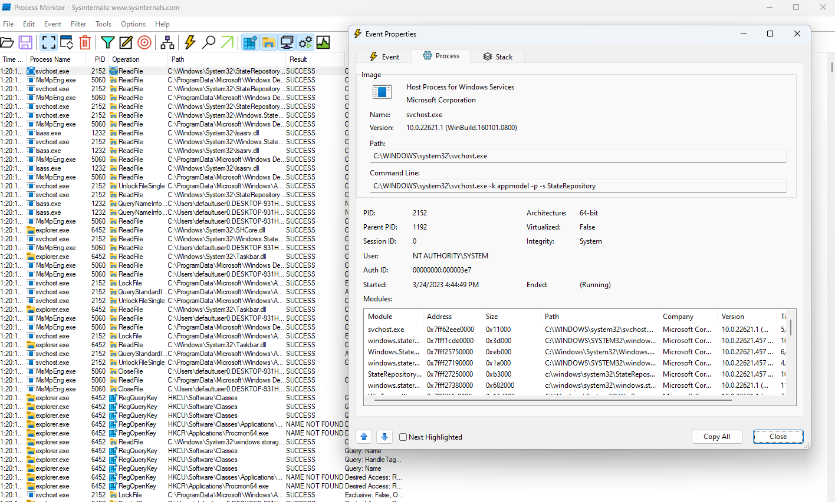
Running Malware-Process Moniter

Slide 18
Running Malware-Process Moniter
To narrow the result, use filtering
You may want to filter on:
Executables running on the system
System call (such as RegSetValue, Create File, WriteFile, etc.)
Note: Filtering does not prevent from consuming too much memory though.

Slide 19
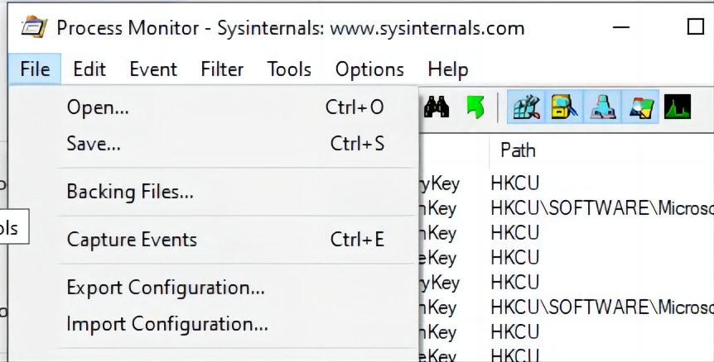
Example1-Track File and Registry Changes
Let’s say, you need to track access to the registry key HKEY_CURRENT_USER\Software\test and file c:\ps\procmon_example.txt.
When Process Monitor starts, it begins capturing all events according to the default filters.
Step 1. Stop capturing events by unchecking the option File > Capture Events (Ctrl+E).
Step 2. Clear the current ProcMon log (Edit > Clear Display).

Slide 20
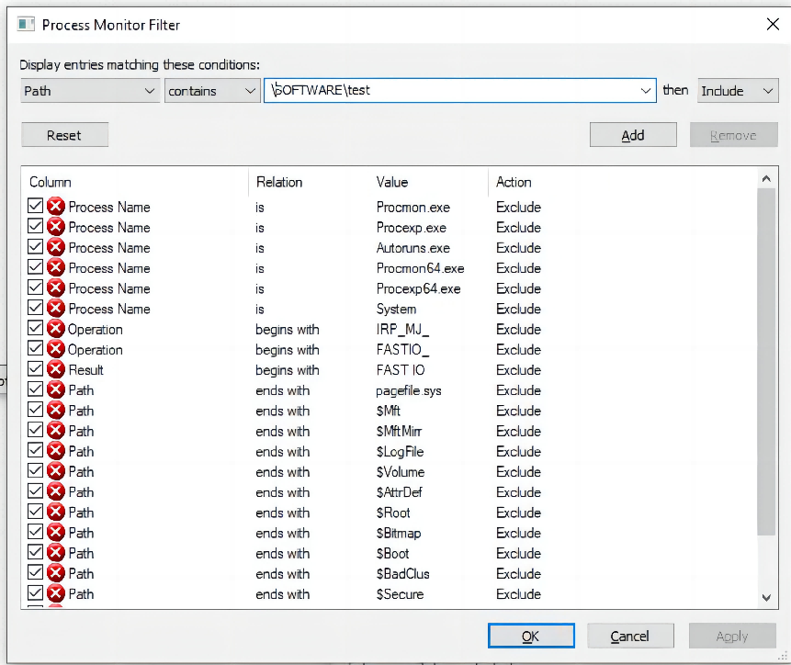
Example1-Track File and Registry Changes
Let’s say, you need to track access to the registry key HKEY_CURRENT_USER\Software\test and file c:\ps\procmon_example.txt.
Step 3. Now you need to configure the Process Monitor filters (Filter > Filter).
Step 4. Create a filter for monitoring access to the registry key: Path > contains > \SOFTWARE\test > Include.
Step 5. Click Add to add a new filter to the list

Slide 21
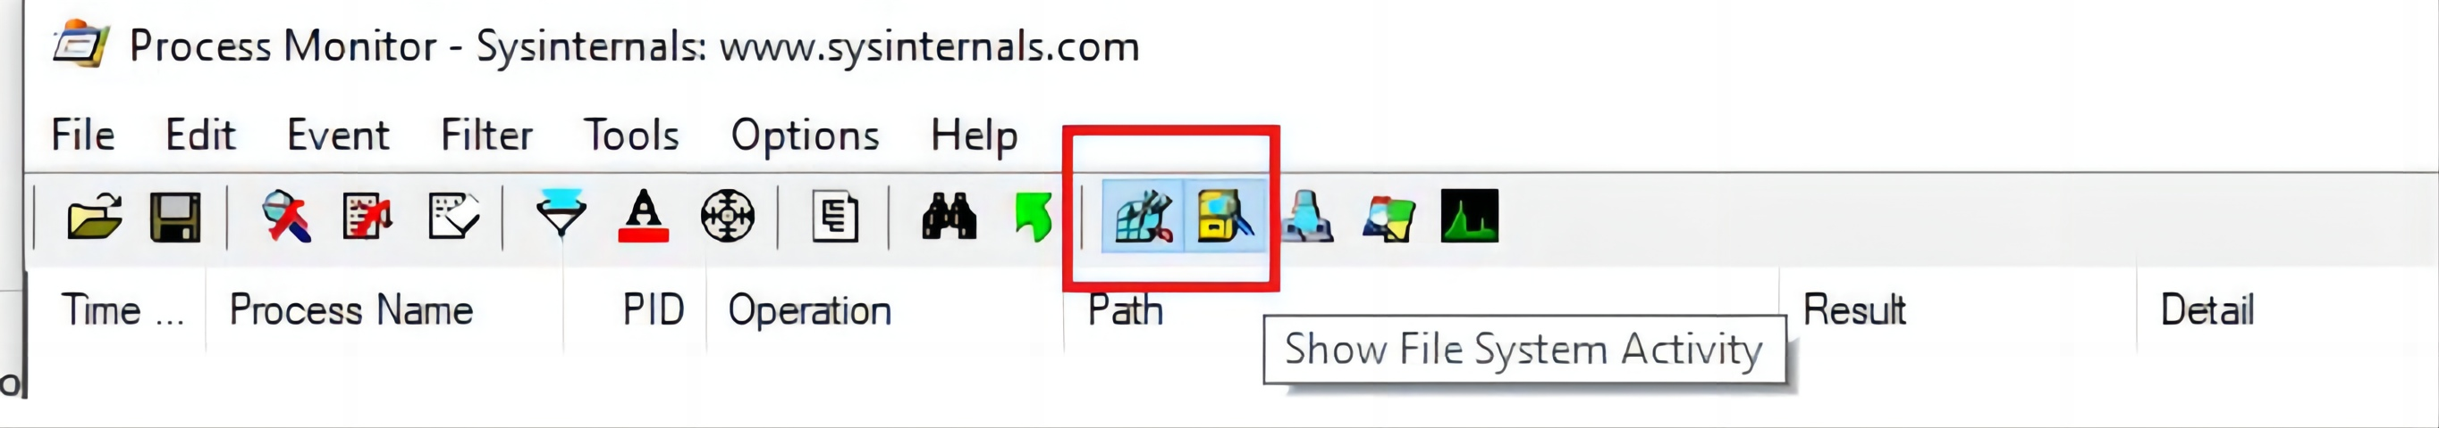
Example1-Track File and Registry Changes
Let’s say, you need to track access to the registry key HKEY_CURRENT_USER\Software\test and file c:\ps\procmon_example.txt.
Step 6. Now add a file access event filter: Path > is > c:\ps\procmon_example.txt > Include.
Step 7. Make sure the following options are enabled in the toolbar: Show Registry Activity, Show File System Activity.
The Show Network Activity and Show Process, and Threads Activity options can be disabled.

Slide 22
Example1-Track File and Registry Changes
Let’s say, you need to track access to the registry key HKEY_CURRENT_USER\Software\test and file c:\ps\procmon_example.txt.
Step 8. Start event monitoring File > Capture Event.
Step 9. Let’s create a reg parameter key in the specified registry key using the command prompt:
reg add hkcu\software\test /v Path /t REG_EXPAND_SZ /d ^%systemroot^%
Step 10. Let’s write some data into the procmon_example.txt file using the command prompt:
echo %date%>>c:\ps\procmon_example.txt
Step 11. And using PowerShell:
Get-Process|out-file C:\ps\procmon_example.txt

Slide 23
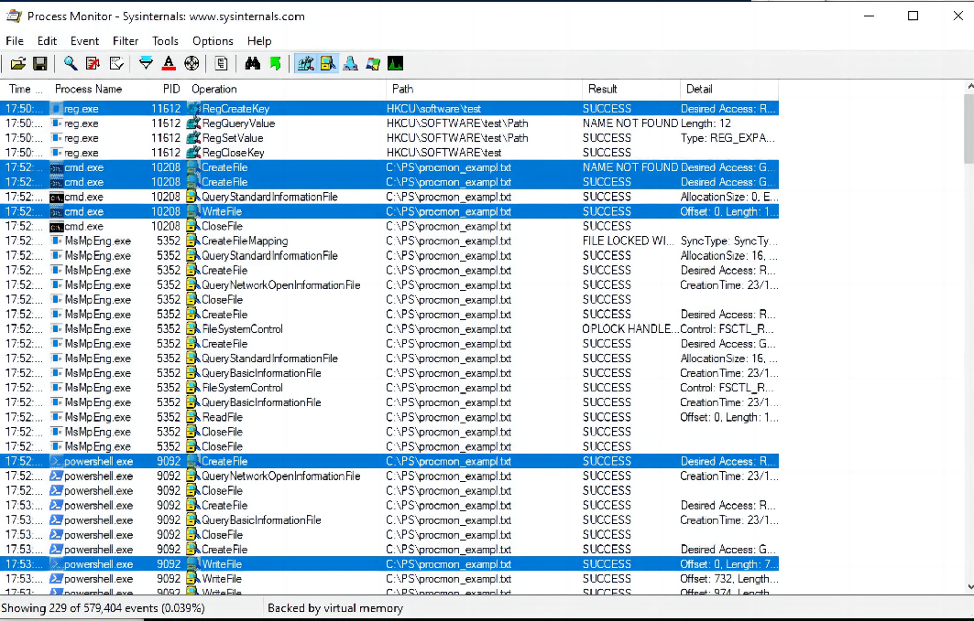
Example1-Track File and Registry Changes
Let’s say, you need to track access to the registry key HKEY_CURRENT_USER\Software\test and file c:\ps\procmon_example.txt.
It contains events for creating a registry key by the reg.exe process (Operation > RegCreateKey).
It also contains events of creation (Create File) and writing to a file (WriteFile) by the processes cmd.exe and powershell.exe.

Slide 24
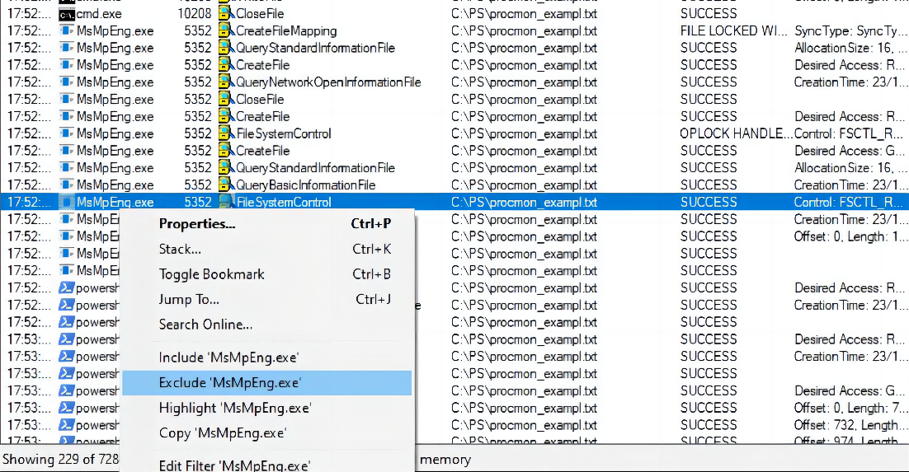
Example2-Exclude System Process
Let’s say, exclude msmpeng.exe (Antimalware Service Executable). This is the core process of the antimalware detection engine in Windows Defender.
To exclude the events of this process from the ProcMon log, right-click on the process name msmpeng.exe and select Exclude.

Slide 25
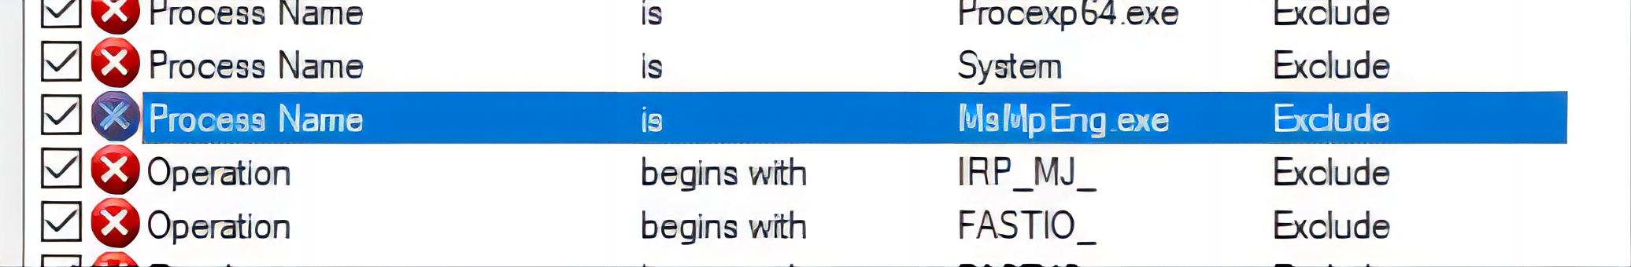
Example2-Exclude System Process
Let’s say, exclude msmpeng.exe (Antimalware Service Executable). This is the core process of the antimalware detection engine in Windows Defender.
This process will be added to the ProcMon filter with the Exclude value. It means that the ProcMon log won’t display any activity from this process.

Slide 26
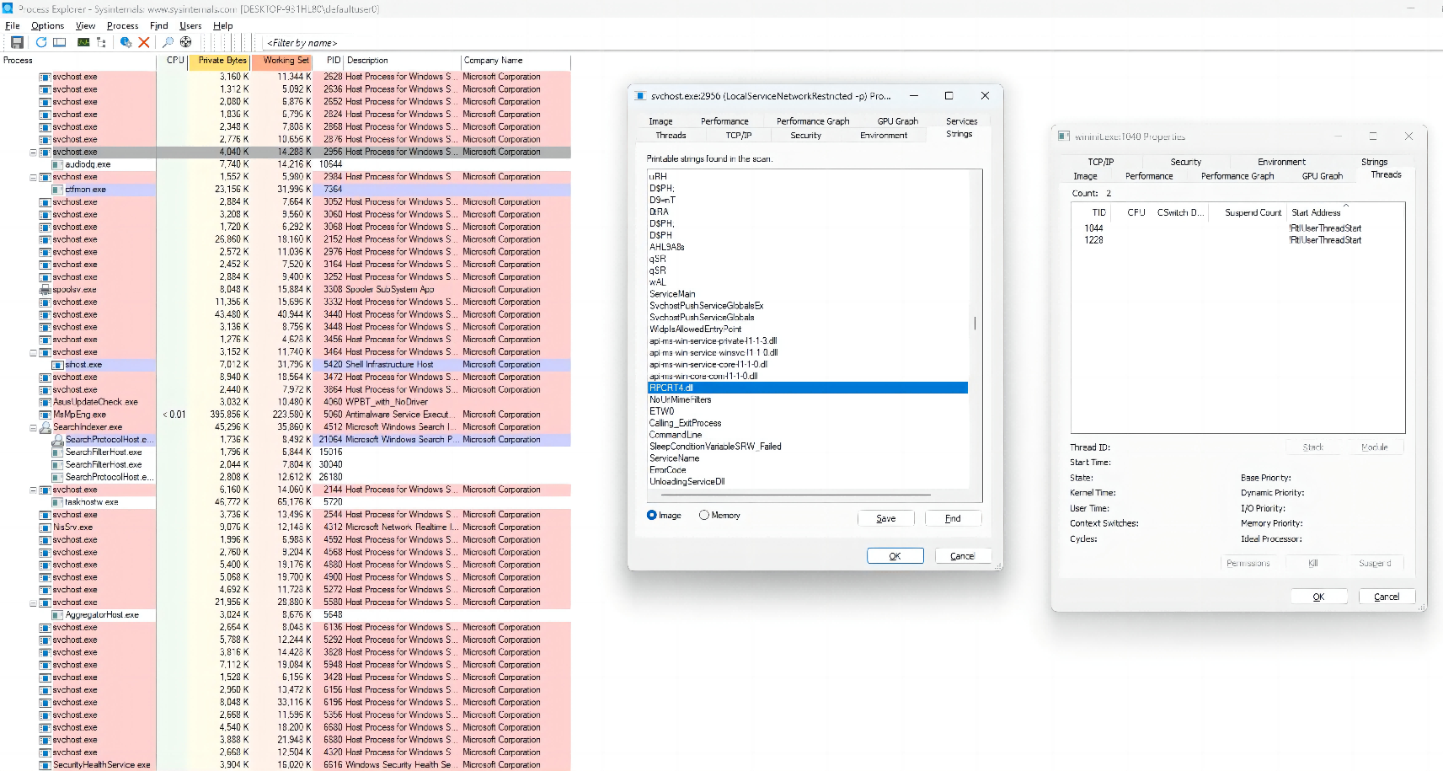
Process Explorer
Windows task manager and system monitoring tool
It moniters all running processes
Free
Shows which propram in the system has a specific file/directory open
Provides insight into the processes that are running on a system
Lists active processes, DLLs loaded by a process, process properties, system information.

Slide 27

THE END
Fangtian Zhong
CSCI 591
Gianforte School of Computing
Norm Asbjornson College of Engineering
E-mail: fangtian.zhong@montana.edu
2023.12.05

