Slide 1

2023.09.07
Malicious Code Analysis
Fangtian Zhong
CSCI 591
Gianforte School of Computing
Norm Asbjornson College of Engineering
E-mail: fangtian.zhong@montana.edu

Slide 2
Overview
Arithmetic Instructions
01
Logical Instructions
02

Slide 3

Arithmetic Instructions
Part One
01

Slide 4

The INC Instruction
The INC instruction is used for incrementing an operand by one. It works on a single operand that can be either in a register or in memory.
The INC instruction has the following syntax −
INC destination
The operand destination could be an 8-bit, 16-bit, 32-bit, or 64-bit operand.
Example
INC RBX; Increments 64-bit register
INC DL; Increments 8-bit register
INC [count] ; Increments the count variable

Slide 5
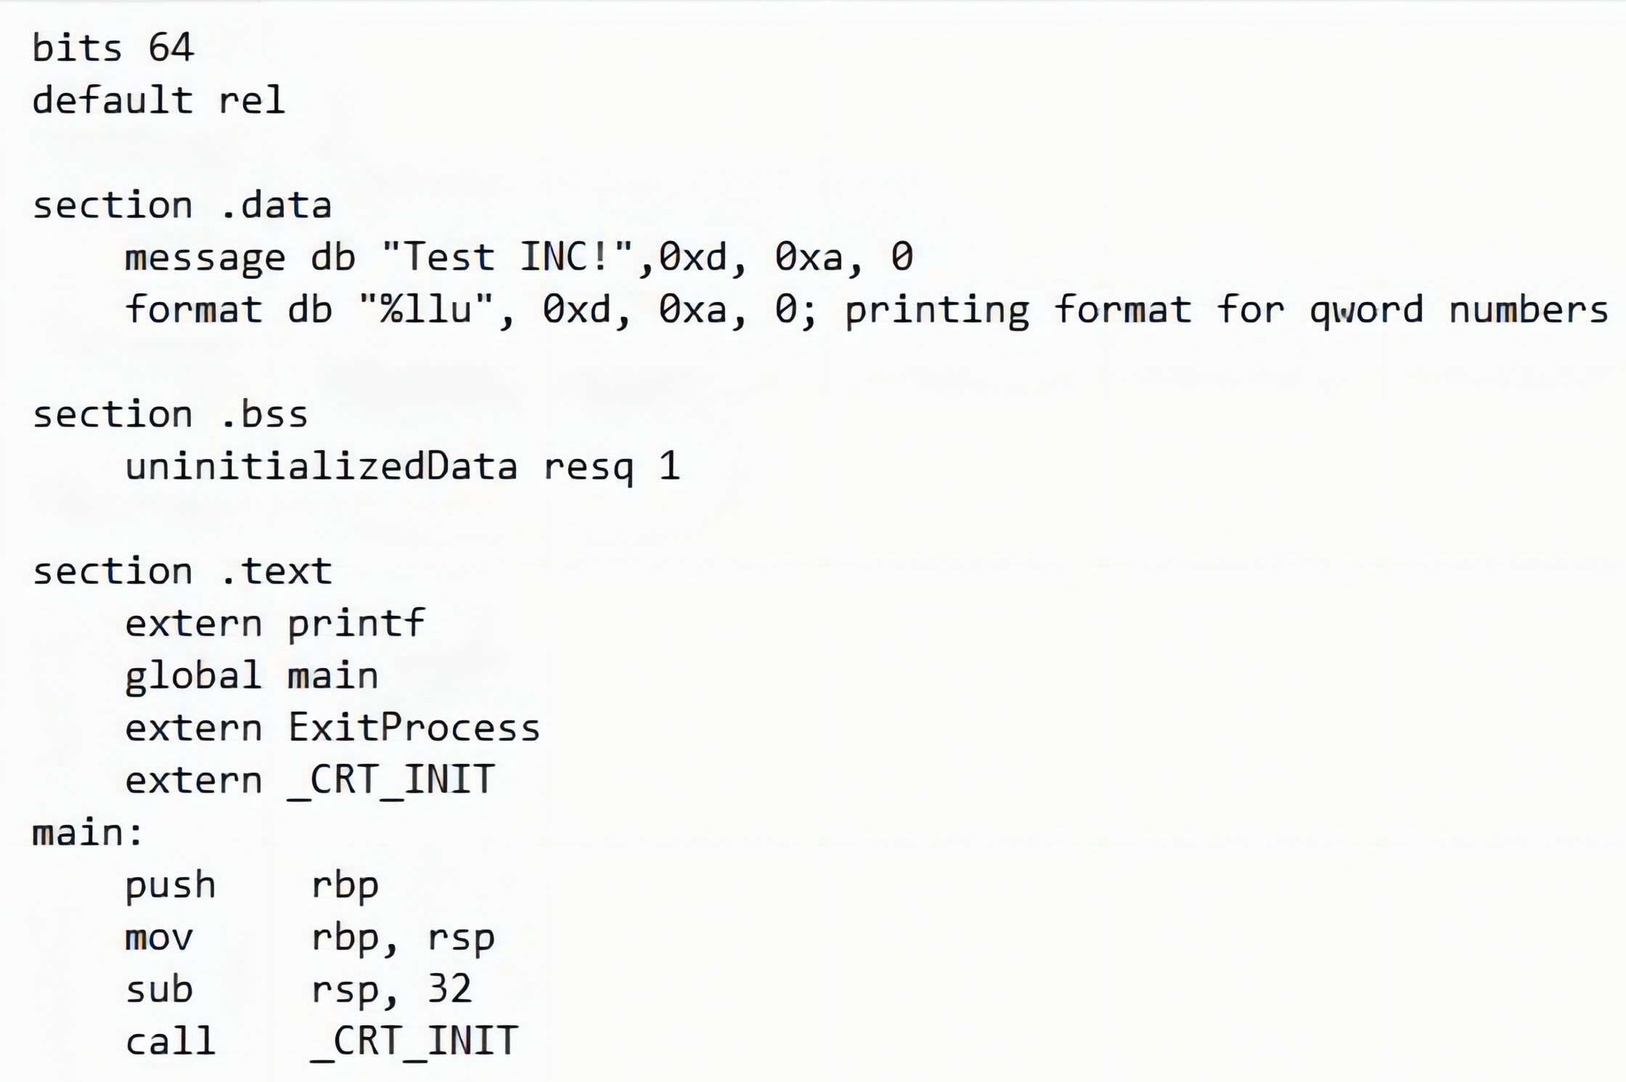
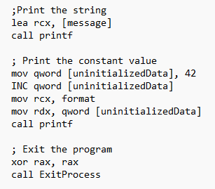
Example: INC

Slide 6
The DEC Instruction
The DEC instruction is used for decrementing an operand by one. It works on a single operand that can be either in a register or in memory.
The DEC instruction has the following syntax −
DEC destination
The operand destination could be an 8-bit, 16-bit, 32-bit or 64-bit operand.

Slide 7
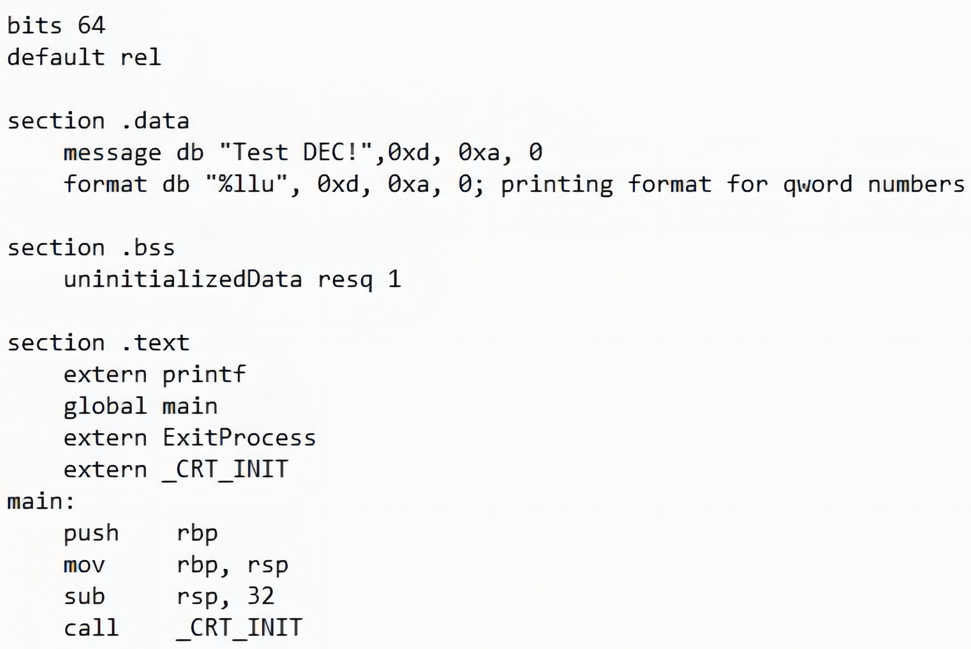
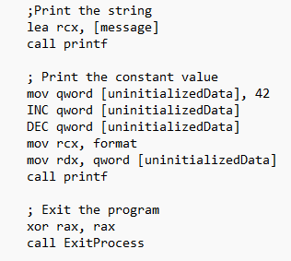
Example: DEC

Slide 8
The ADD and SUB Instructions
The ADD and SUB instructions are used for performing simple addition/subtraction of binary data in byte, word, doubleword, qword and size, i.e., for adding or subtracting 8-bit, 16-bit, 32-bit or 64-bit operands, respectively.
The ADD and SUB instructions have the following syntax −
ADD/SUB destination, source
The ADD/SUB instruction can take place between −
Register to register
Memory to register
Register to memory
Register to constant data
Memory to constant data

Slide 9
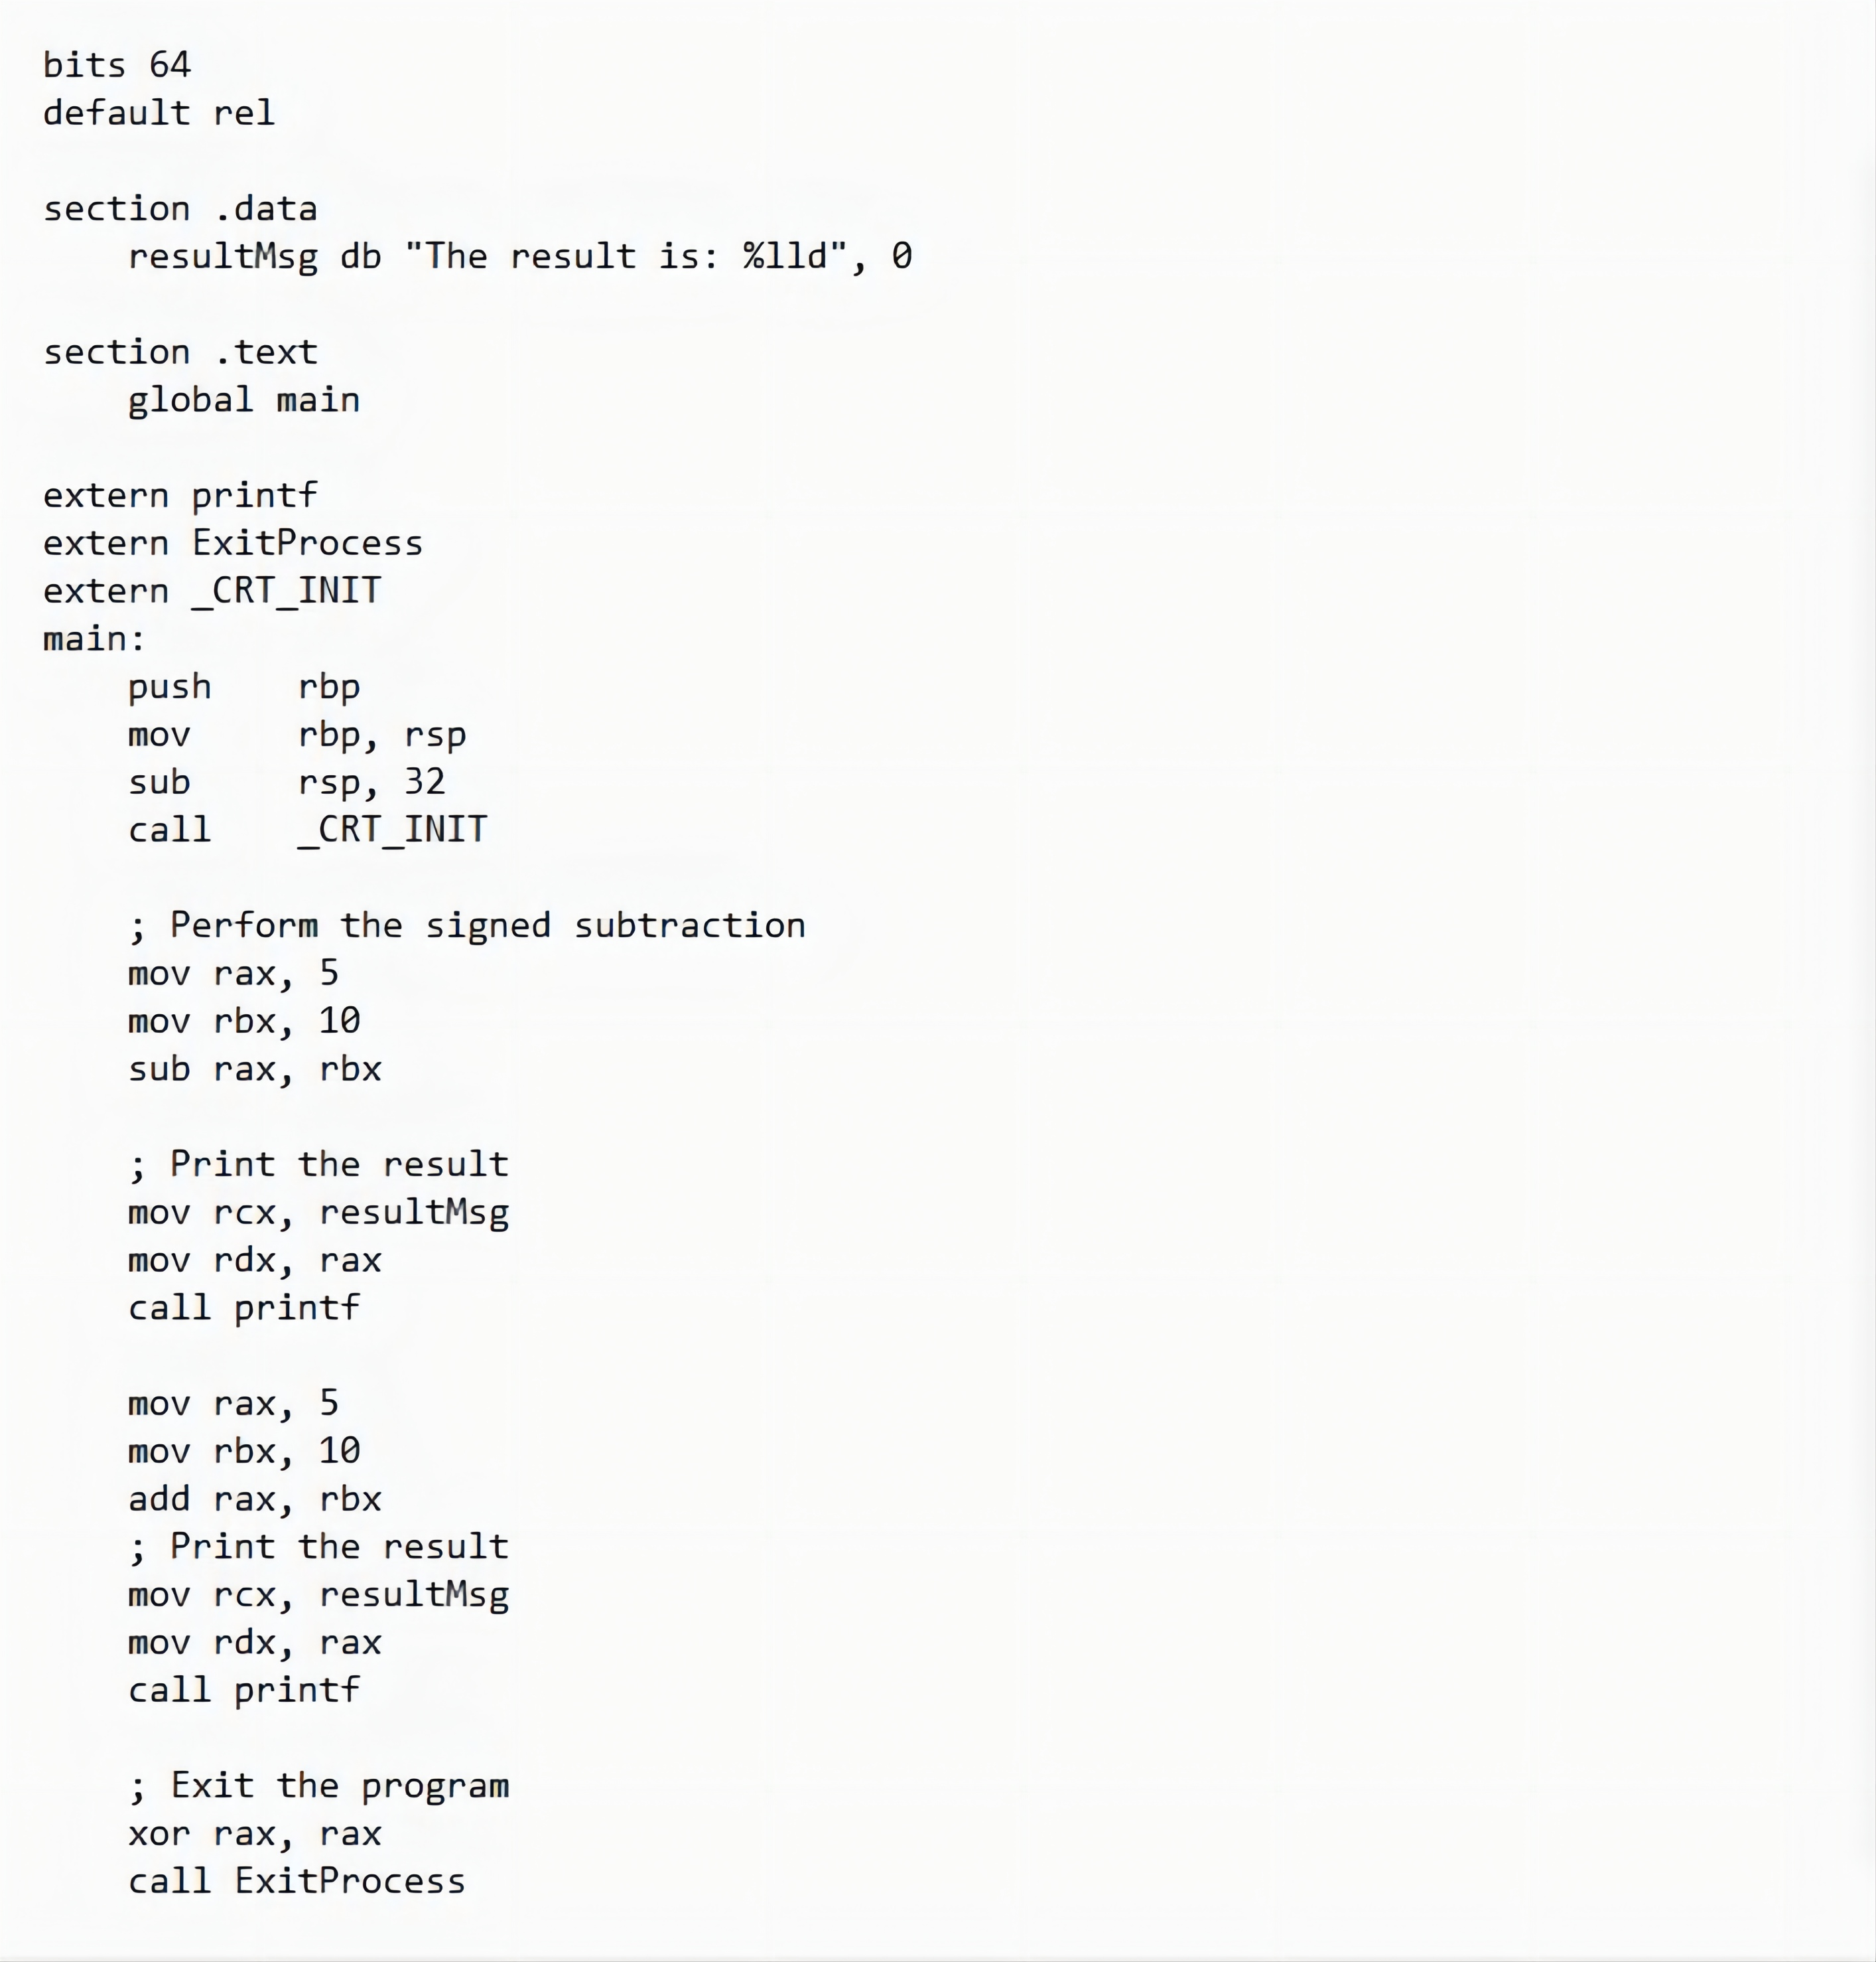
Examples

Slide 10
The MUL/IMUL Instruction
There are two instructions for multiplying binary data. The MUL (Multiply) instruction handles unsigned data and the IMUL (Integer Multiply) handles signed data. Both instructions affect the Carry and Overflow flag.
The syntax for the MUL/IMUL instructions is as follows −
MUL/IMUL multiplier
Multiplicand in both cases will be in an accumulator, depending upon the size of the multiplicand and the multiplier and the generated product is also stored in two registers depending upon the size of the operands.

Slide 11
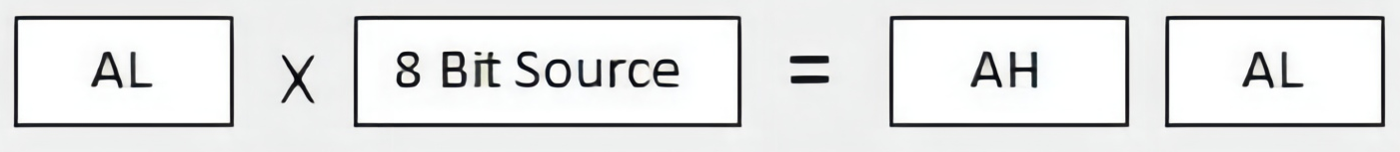
Different Cases
When two bytes are multiplied −
The multiplicand is in the AL register, and the multiplier is a byte in the memory or in another register. The product is in AX. High-order 8 bits of the product is stored in AH and the low-order 8 bits are stored in AL.

Slide 12
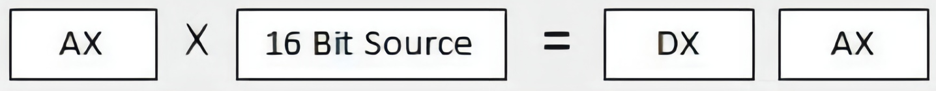
Different Cases
When two one-word values are multiplied −
The multiplicand should be in the AX register, and the multiplier is a word in memory or another register. For example, for an instruction like MUL DX, you must store the multiplier in DX and the multiplicand in AX.
The resultant product is a doubleword, which will need two registers. The high-order (leftmost) portion gets stored in DX and the lower-order (rightmost) portion gets stored in AX.

Slide 13
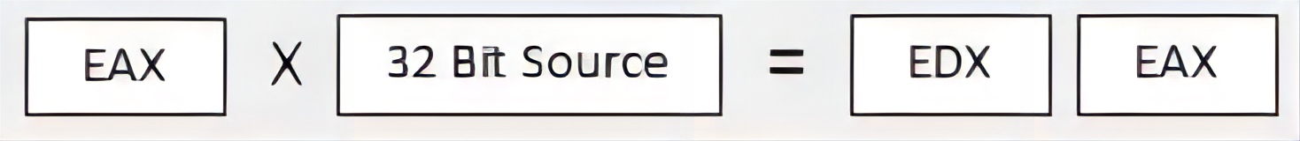
Different Cases
When two doubleword values are multiplied, the multiplicand should be in EAX and the multiplier is a doubleword value stored in memory or in another register. The product generated is stored in the EDX:EAX registers, i.e., the high order 32 bits gets stored in the EDX register and the low order 32-bits are stored in the EAX register.

Slide 14
Different Cases
When two qword values are multiplied, the multiplicand should be in RAX and the multiplier is a qword value stored in memory or in another register. The product generated is stored in the RDX:RAX registers, i.e., the high order 64 bits gets stored in the RDX register and the low order 64 bits are stored in the RAX register.
RAX
64 bit Source
RDX
RAX

Slide 15

Examples
MOV AL, 10
MOV DL, 25
MUL DL
...
MOV DL, 0FFH ; DL= -1
MOV AL, 0BEH ; AL = -66
IMUL DL

Slide 16
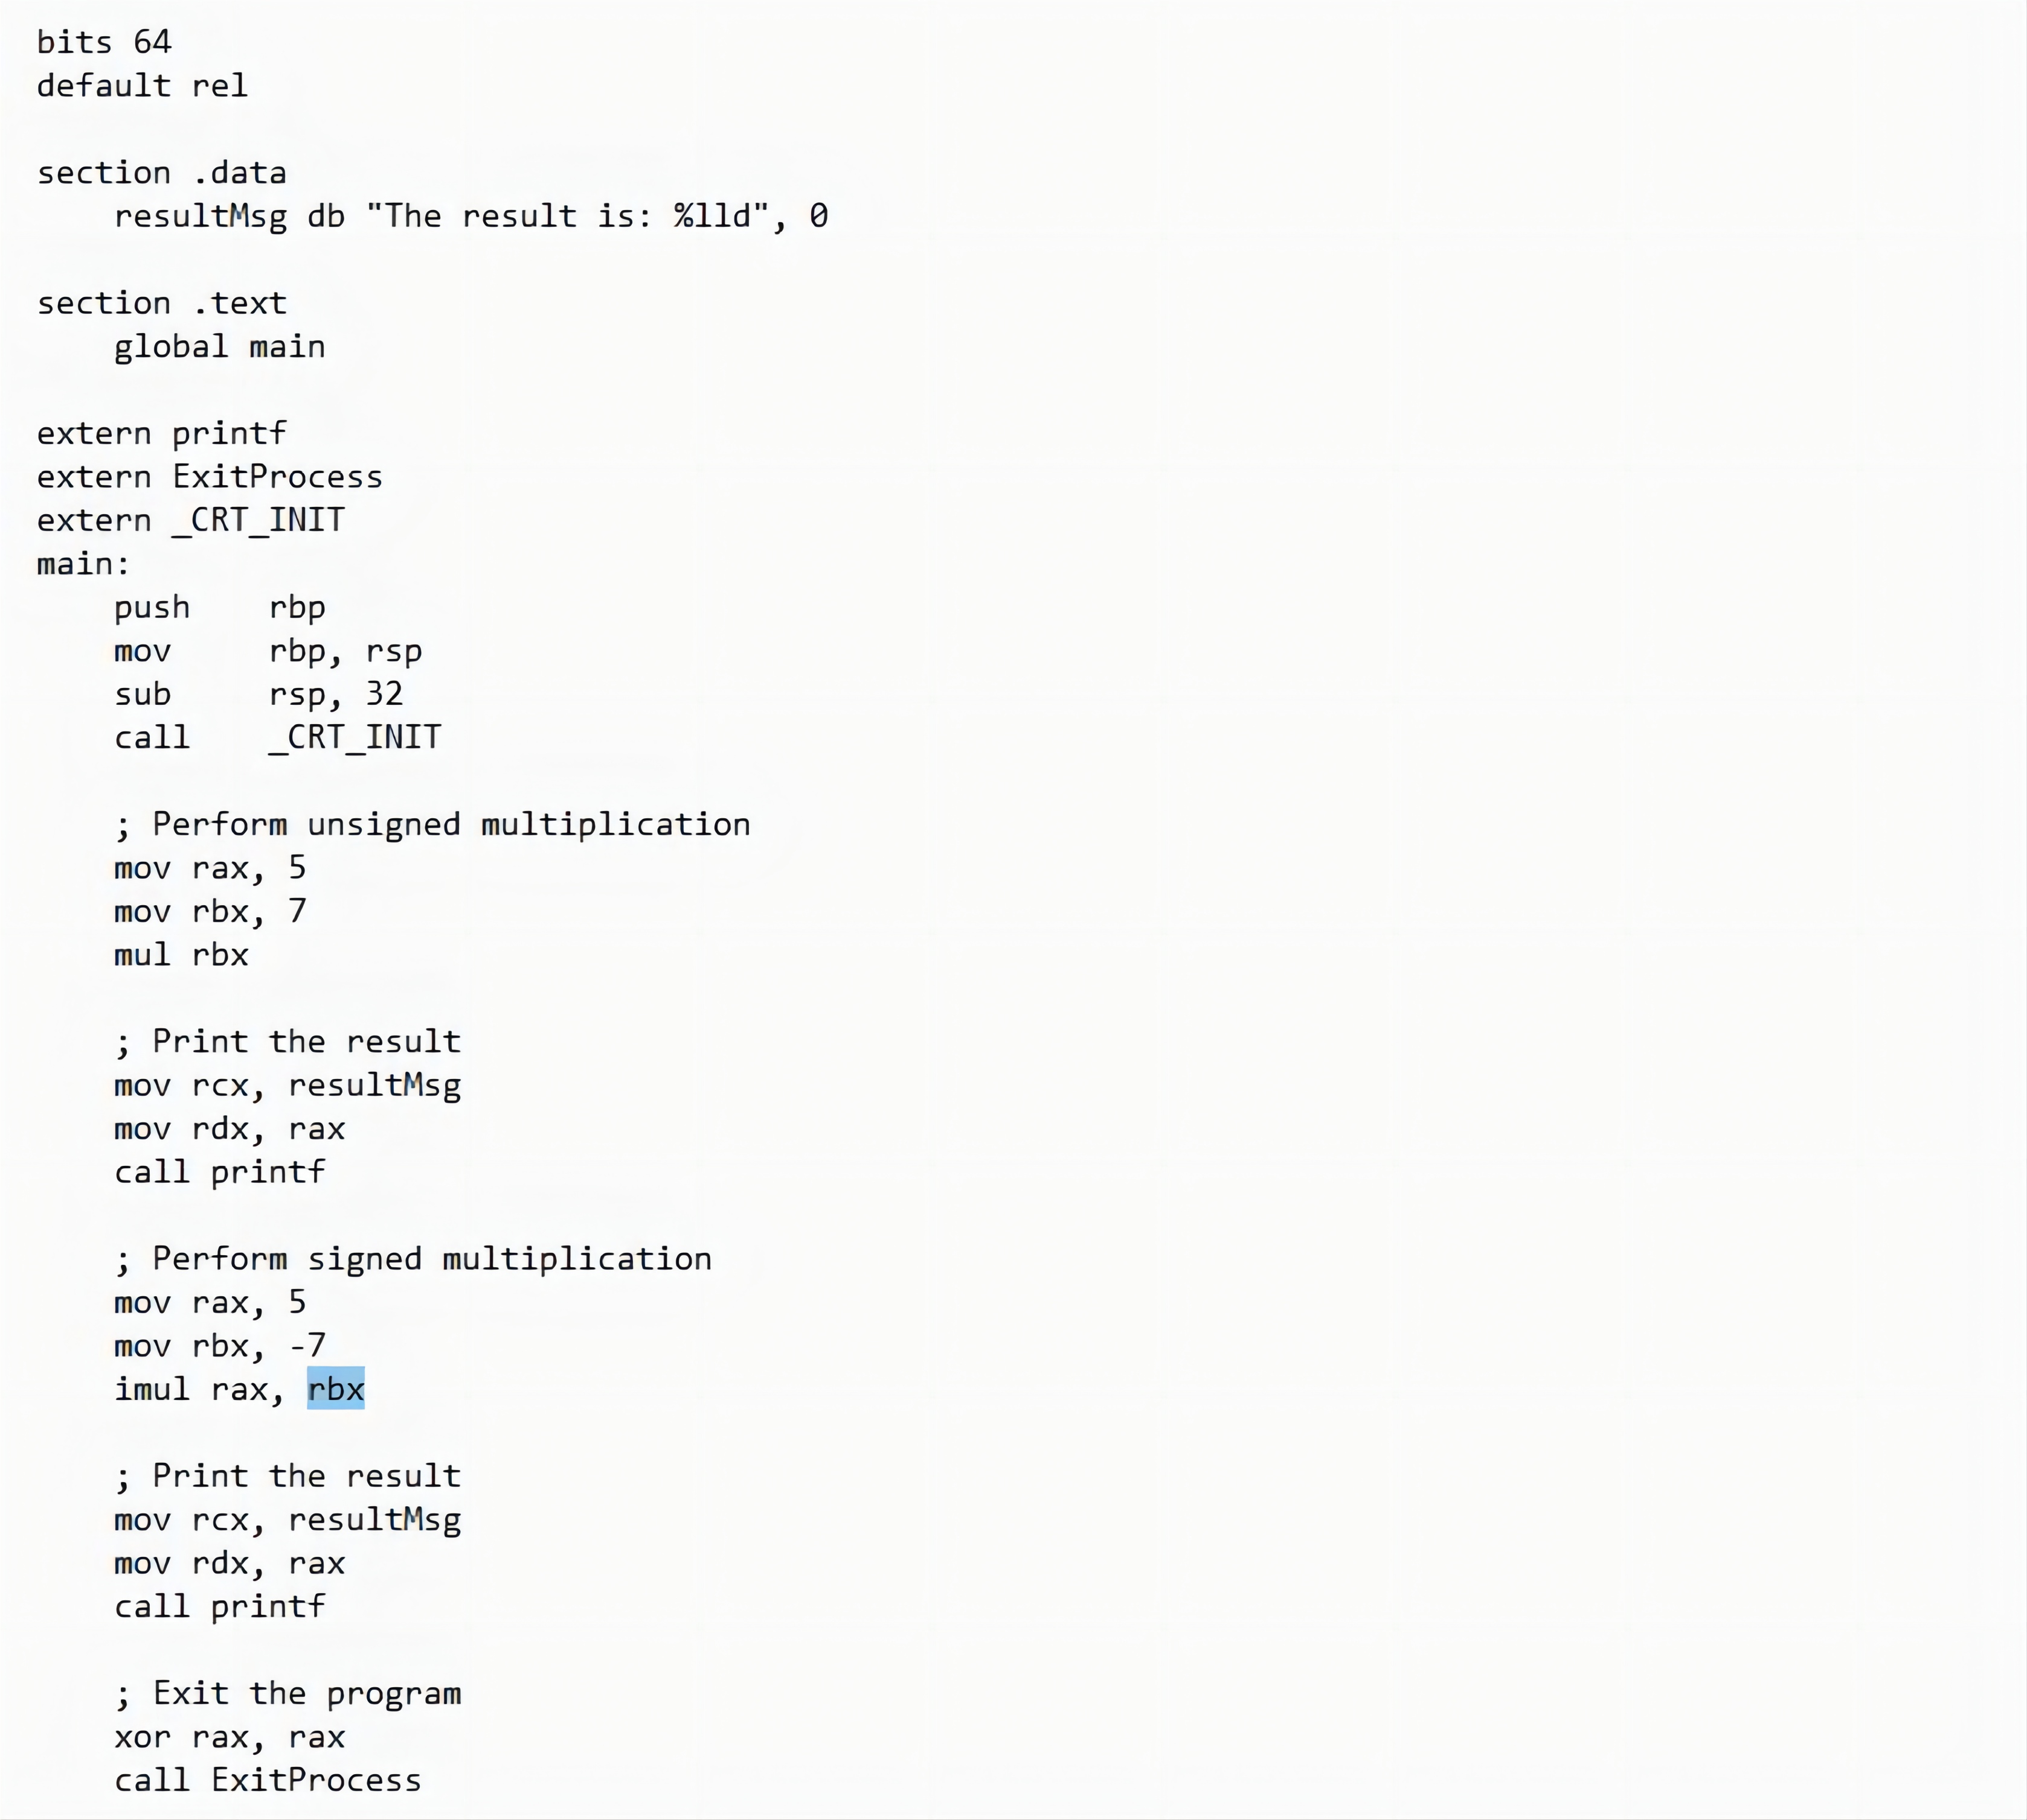
Examples

Slide 17
The DIV/IDIV Instructions
The division operation generates two elements - a quotient and a remainder. In case of multiplication, overflow does not occur because double-length registers are used to keep the product. However, in case of division, overflow may occur. The processor generates an interrupt if overflow occurs.
The DIV (Divide) instruction is used for unsigned data and the IDIV (Integer Divide) is used for signed data.
The format for the DIV/IDIV instruction −
DIV/IDIV divisor

Slide 18
The DIV/IDIV Instructions
The dividend is in an accumulator. Both the instructions can work with 8-bit, 16-bit, 32-bit, or 64 bit operands. The operation affects all six status flags. Following section explains four cases of division with different operand size −

Slide 19
Different Cases
When the divisor is 1 byte −
The dividend is assumed to be in the AX register (16 bits). After division, the quotient goes to the AL register and the remainder goes to the AH register.
16 bit divdent
AX
Quotient
Remainder
=
AL
And
AH
8 bit Divisor

Slide 20
Different Cases
When the divisor is 1 word −
The dividend is assumed to be 32 bits long and in the EAX registers. After division, the 16-bit quotient goes to the AX register and the 16-bit remainder goes to the DX register.
32 bit divdent
EAX
Quotient
Remainder
=
AX
And
DX
16 bit Divisor

Slide 21
Different Cases
When the divisor is doubleword −
The dividend is assumed to be 64 bits long and in the RAX registers. After division, the 32-bit quotient goes to the EAX register and the 32-bit remainder goes to the EDX register.
64 bit divdent
RAX
Quotient
Remainder
=
EAX
And
EDX
32 bit Divisor

Slide 22
Different Cases
When the divisor is qword −
The dividend is assumed to be 128 bits long and in the RAX registers. The high-order 64 bits are in RDX and the low-order 64 bits are in RAX. After division, the 64-bit quotient goes to the RAX register and the 64-bit remainder goes to the RDX register.
128 bit divdent
RDX
RAX
Quotient
Remainder
=
RAX
And
RDX
64 bit Divisor

Slide 23
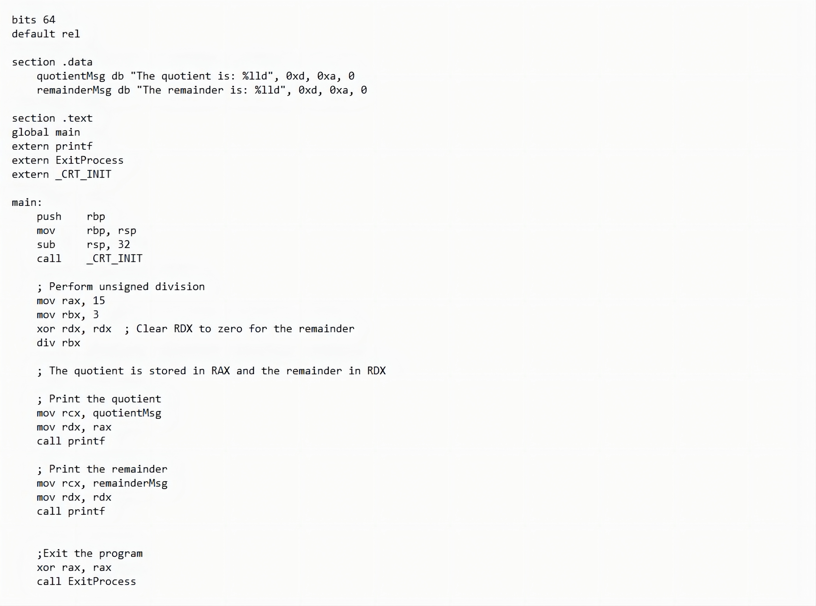
Examples

Slide 24
Part Two
Logical Instructions
02

Slide 25
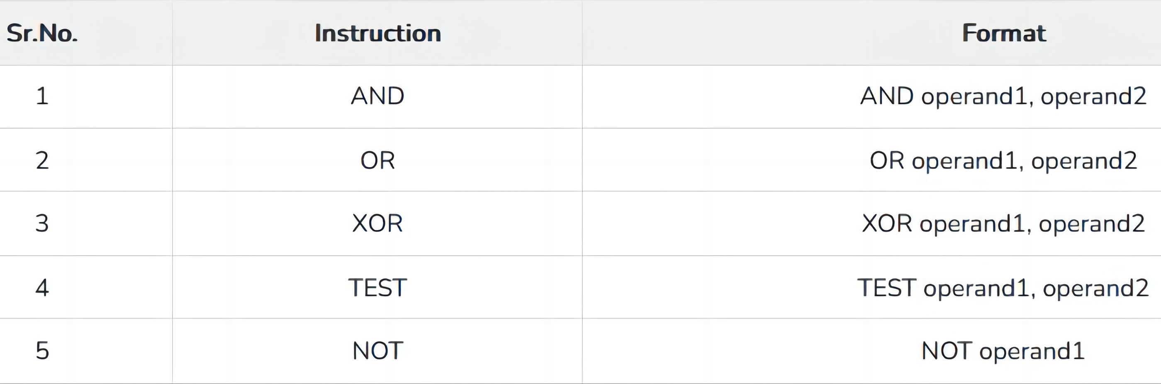

Logical Instructions
The processor instruction set provides the instructions AND, OR, XOR, TEST, and NOT Boolean logic, which tests, sets, and clears the bits according to the need of the program.
The format for these instructions −
The first operand in all the cases could be either in register or in memory. The second operand could be either in register/memory or an immediate (constant) value. However, memory-to-memory operations are not possible.
These instructions compare or match bits of the operands and set the CF, OF, PF, SF and ZF flags.

Slide 26
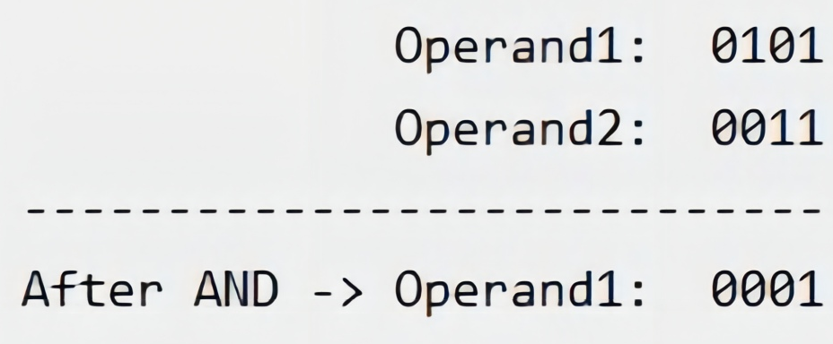
The AND Instruction
The AND instruction is used for supporting logical expressions by performing bitwise AND operation. The bitwise AND operation returns 1, if the matching bits from both the operands are 1, otherwise it returns 0. For example −
The AND operation can be used for clearing one or more bits. For example, say the BL register contains 0011 1010. If you need to clear the high-order bits to zero, you AND it with 0FH.
AND BL, 0FH ; This sets BL to 0000 1010

Slide 27
The AND Instruction
Let's take up another example. If you want to check whether a given number is odd or even, a simple test would be to check the least significant bit of the number. If this is 1, the number is odd, else the number is even.
Assuming the number is in AL register, we can write −

Slide 28
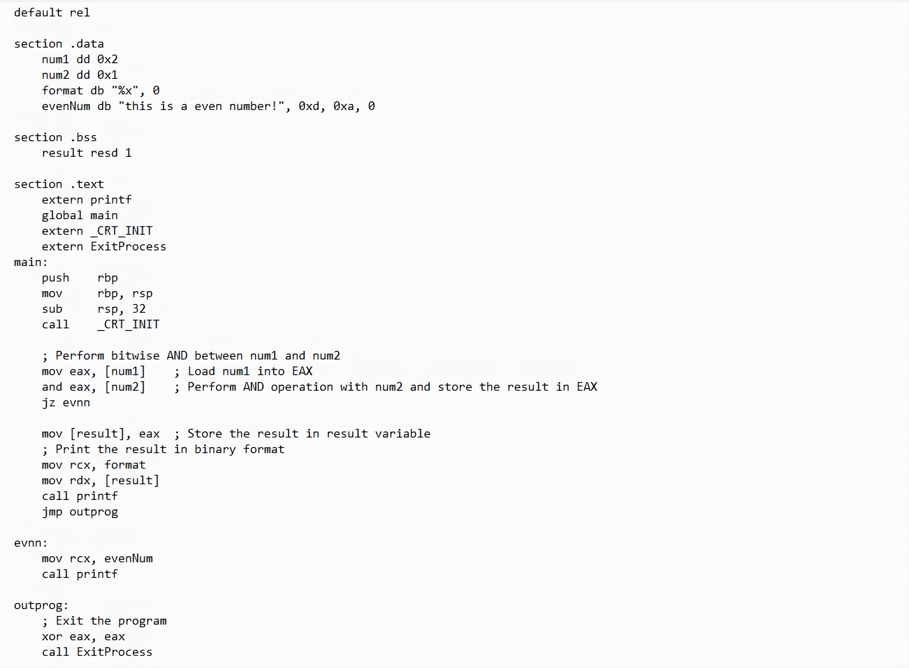
Examples

Slide 29
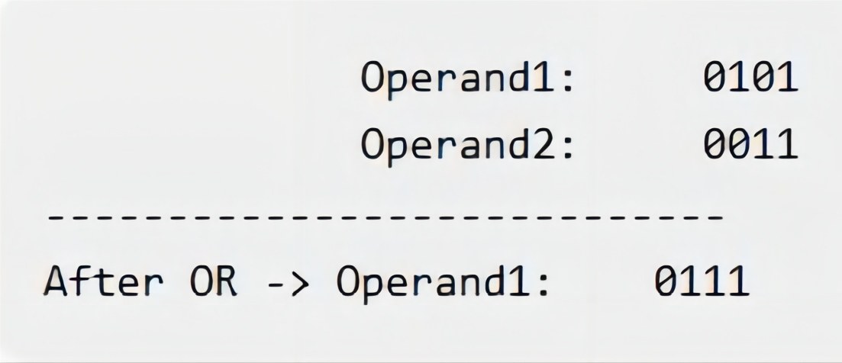
The OR Instruction
The OR instruction is used for supporting logical expression by performing bitwise OR operation. The bitwise OR operator returns 1, if the matching bits from either or both operands are one. It returns 0, if both the bits are zero. For example,
The OR operation can be used for setting one or more bits. For example, let us assume the AL register contains 0011 1010, you need to set the four low-order bits, you can OR it with a value 0000 1111, i.e., FH.

Slide 30
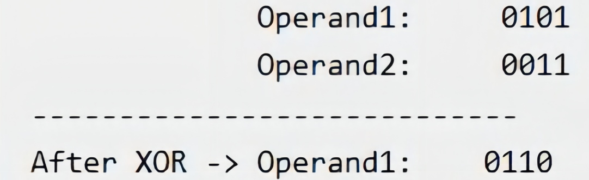
The XOR Instruction
The XOR instruction implements the bitwise XOR operation. The XOR operation sets the resultant bit to 1, if and only if the bits from the operands are different. If the bits from the operands are same (both 0 or both 1), the resultant bit is cleared to 0. For example,
XORing an operand with itself changes the operand to 0. This is used to clear a register.

Slide 31
The TEST Instruction
The TEST instruction works same as the AND operation, but unlike AND instruction, it does not change the first operand. So, if we need to check whether a number in a register is even or odd, we can also do this using the TEST instruction without changing the original number.

Slide 32
The NOT Instruction
The NOT instruction implements the bitwise NOT operation. NOT operation reverses the bits in an operand. The operand could be either in a register or in the memory.
For example,

Slide 33

THE END
Fangtian Zhong
CSCI 591
Gianforte School of Computing
Norm Asbjornson College of Engineering
E-mail: fangtian.zhong@montana.edu
2023.09.07

