Slide 1

2023.09.12
Malicious Code Analysis
Fangtian Zhong
CSCI 591
Gianforte School of Computing
Norm Asbjornson College of Engineering
E-mail: fangtian.zhong@montana.edu

Slide 2
Overview
Conditions
01
Loops
02
Numbers, Strings, Array
03

Slide 3

Part One
Conditions
01

Slide 4

Condition Execution
Conditional execution in assembly language is accomplished by several looping and branching instructions. These instructions can change the flow of control in a program. Conditional execution is observed in two scenarios −
Unconditional jump
This is performed by the JMP instruction. Unconditional execution often involves a transfer of control to the address of an instruction that does not follow the currently executing instruction. Transfer of control may be forward, to execute a new set of instructions or backward, to re-execute the same steps.
Conditional jump
This is performed by a set of jump instructions j<condition> depending upon the condition. The conditional instructions transfer the control by breaking the sequential flow and they do it by changing the offset value in IP.

Slide 5
CMP Instruction
The CMP instruction compares two operands. It is generally used in conditional execution. This instruction basically subtracts one operand from the other for comparing whether the operands are equal or not. It does not disturb the destination or source operands. It is used along with the conditional jump instruction for decision making.
Syntax
CMP destination, source
CMP compares two numeric data fields. The destination operand could be either in register or in memory. The source operand could be a constant (immediate) data, register or memory.
Example
CMP RAX, 00 ; Compare the DX value with zero
JE L7 ; If yes, then jump to label L7
.
.
L7: ...

Slide 6
CMP Instruction
CMP is often used for comparing whether a counter value has reached the number of times a loop needs to be run.
Consider the following typical condition −
Example
LP1:
INC RDX
CMP RDX, 10 ; Compares whether the counter has reached 10
JLE LP1 ; If it is less than or equal to 10, then jump to LP1

Slide 7
Unconditional Jump
The JMP instruction provides a label name where the flow of control is transferred immediately. The syntax of the JMP instruction is −
JMP label

Slide 8
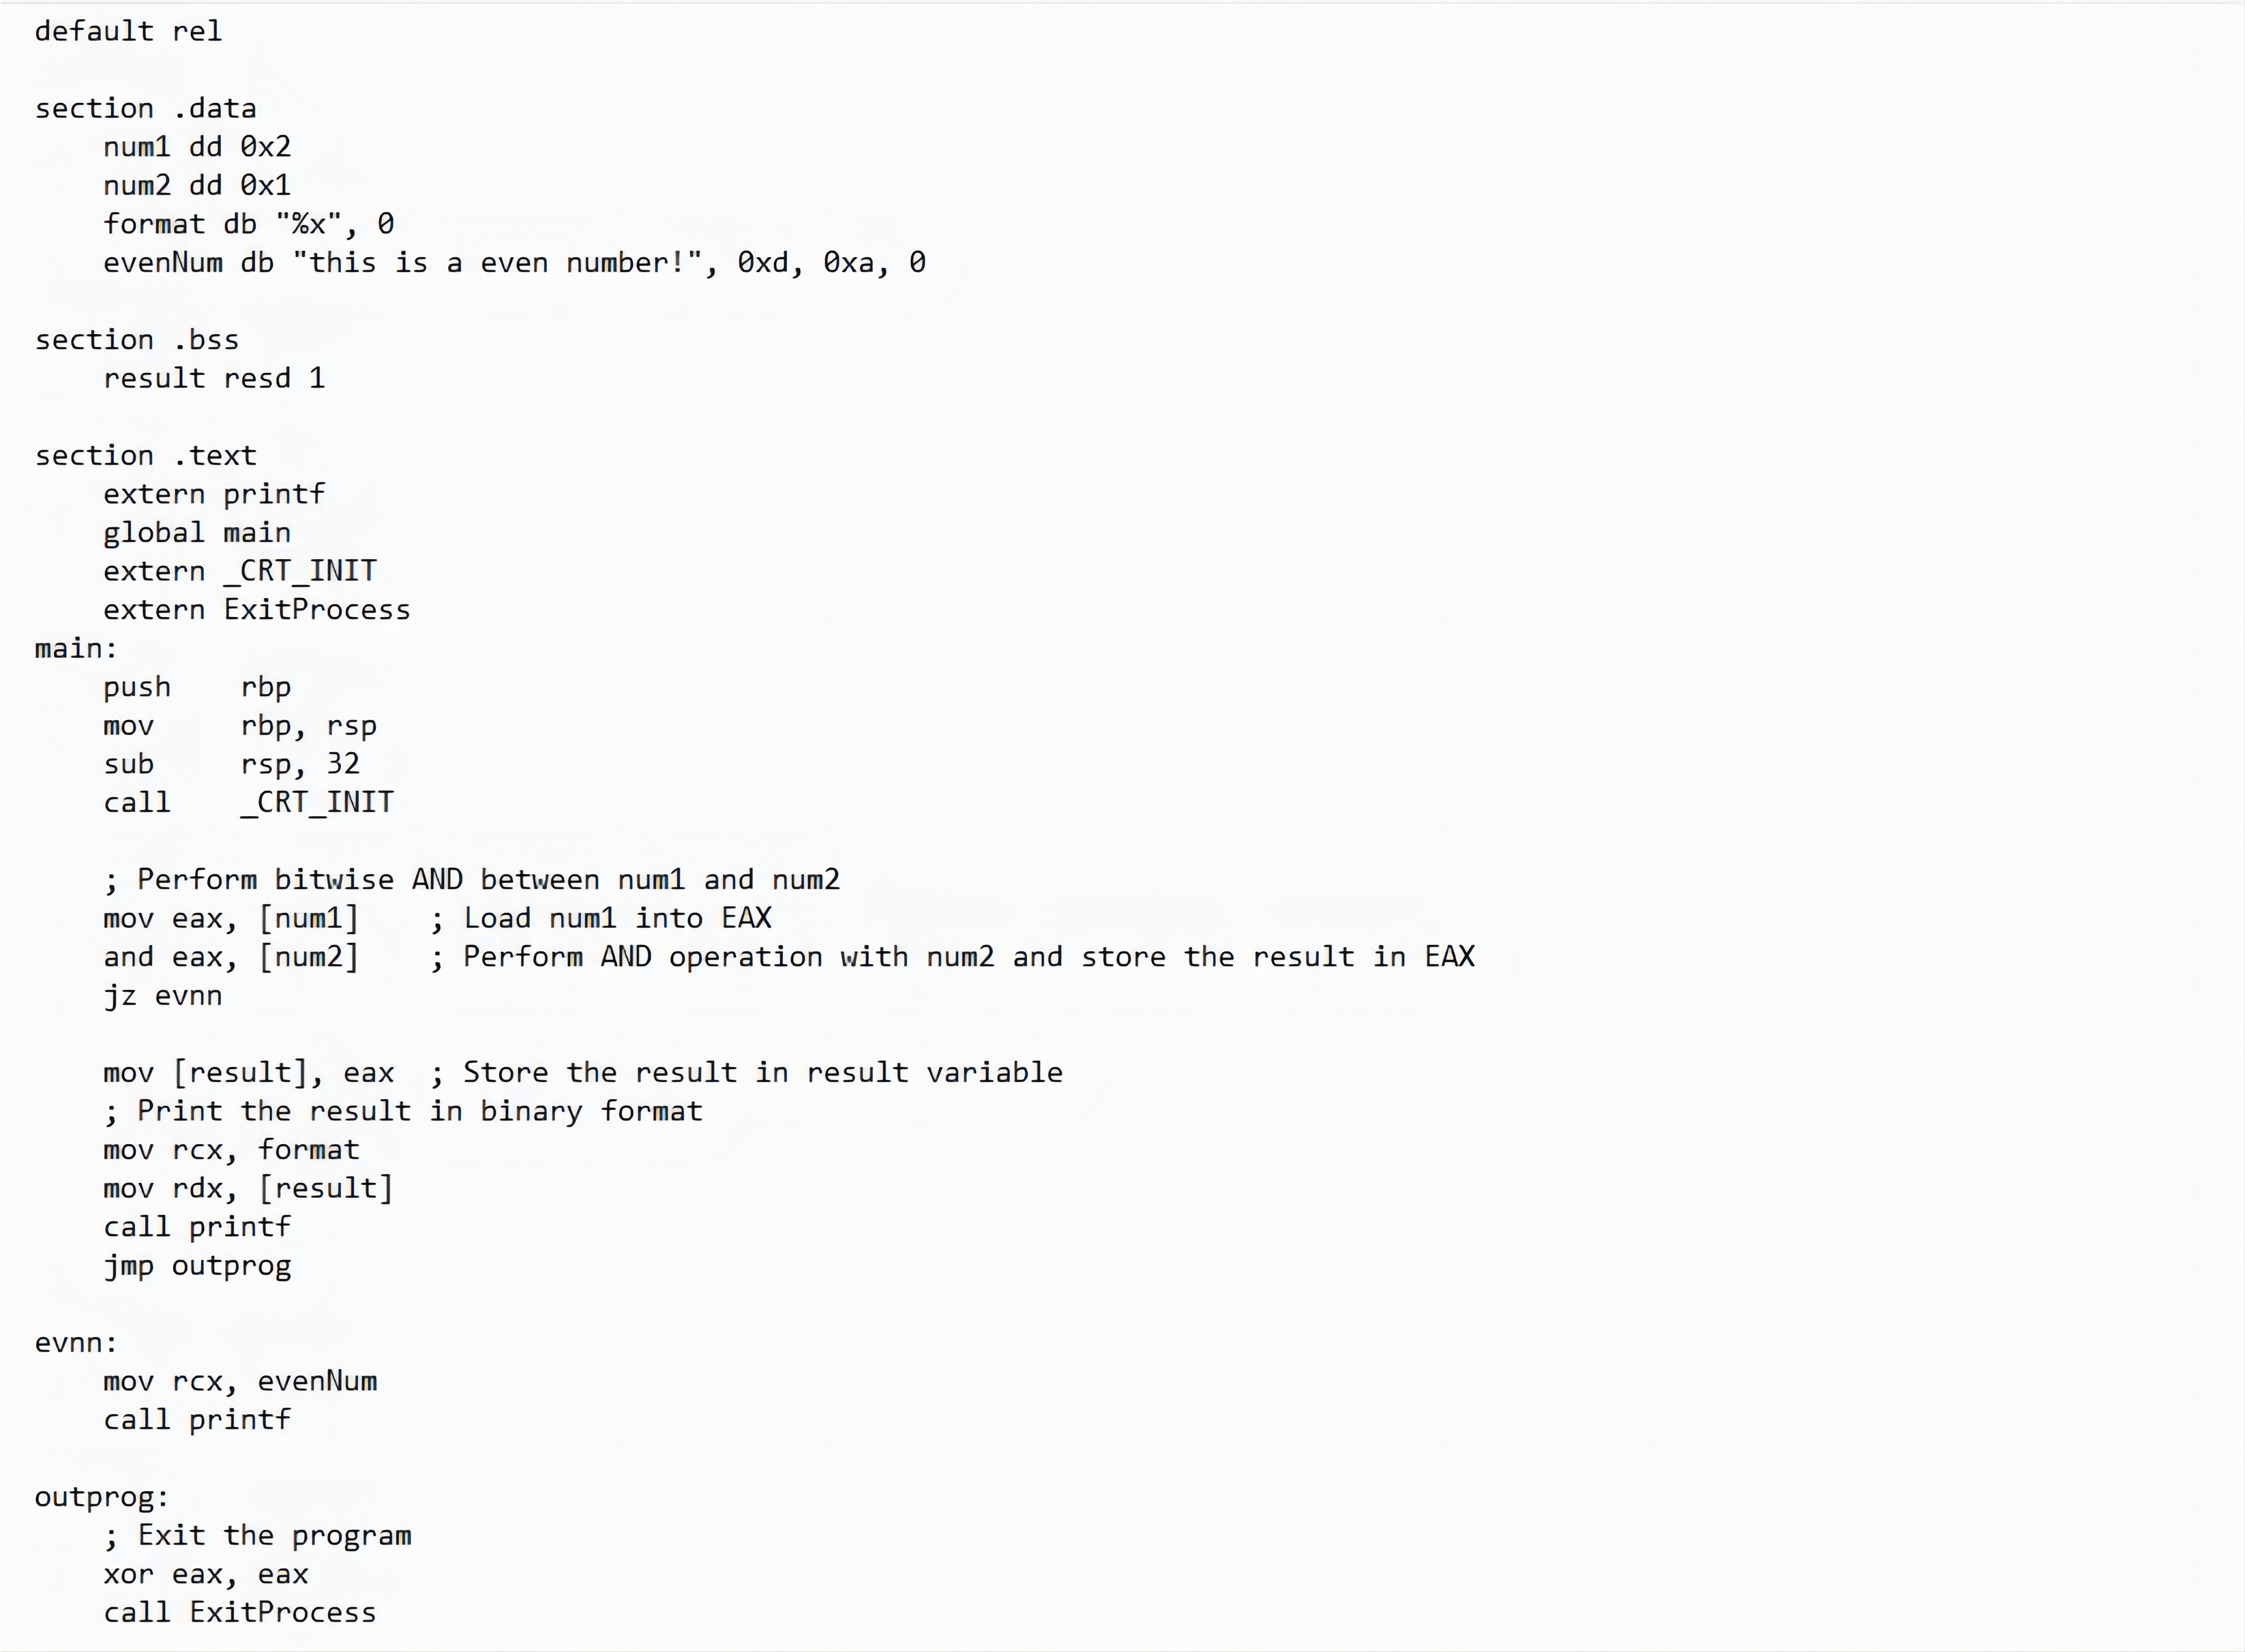
Examples

Slide 9
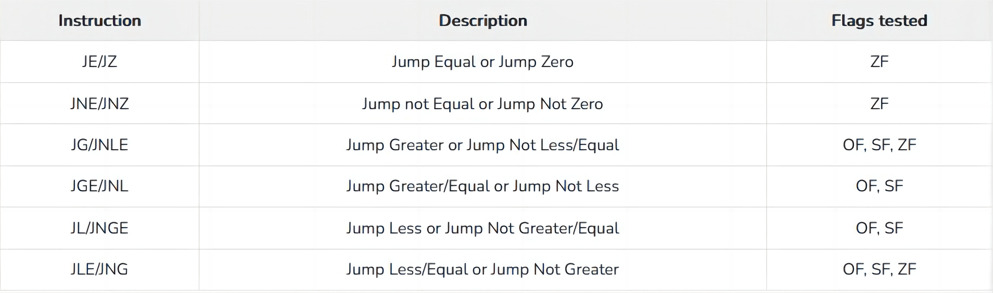
Conditional Jump
If some specified condition is satisfied in conditional jump, the control flow is transferred to a target instruction. There are numerous conditional jump instructions depending upon the condition and data.
Following are the conditional jump instructions used on signed data used for arithmetic operations −

Slide 10
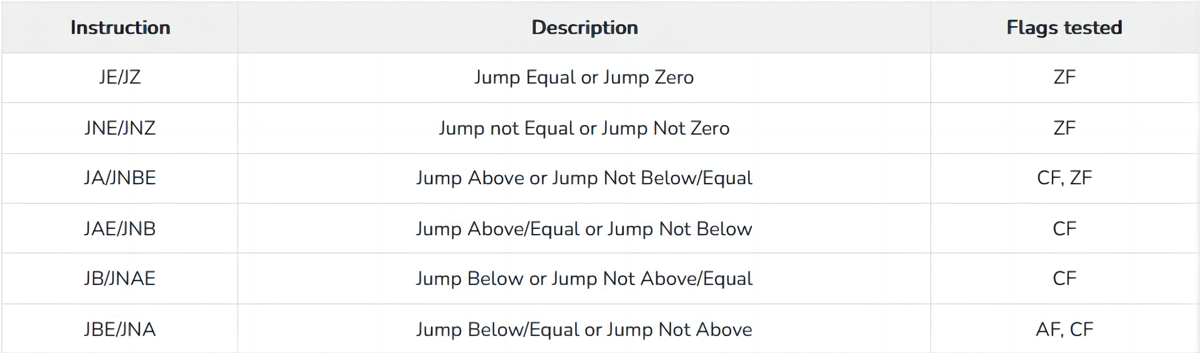
Conditional Jump
Following are the conditional jump instructions used on unsigned data used for logical operations −

Slide 11
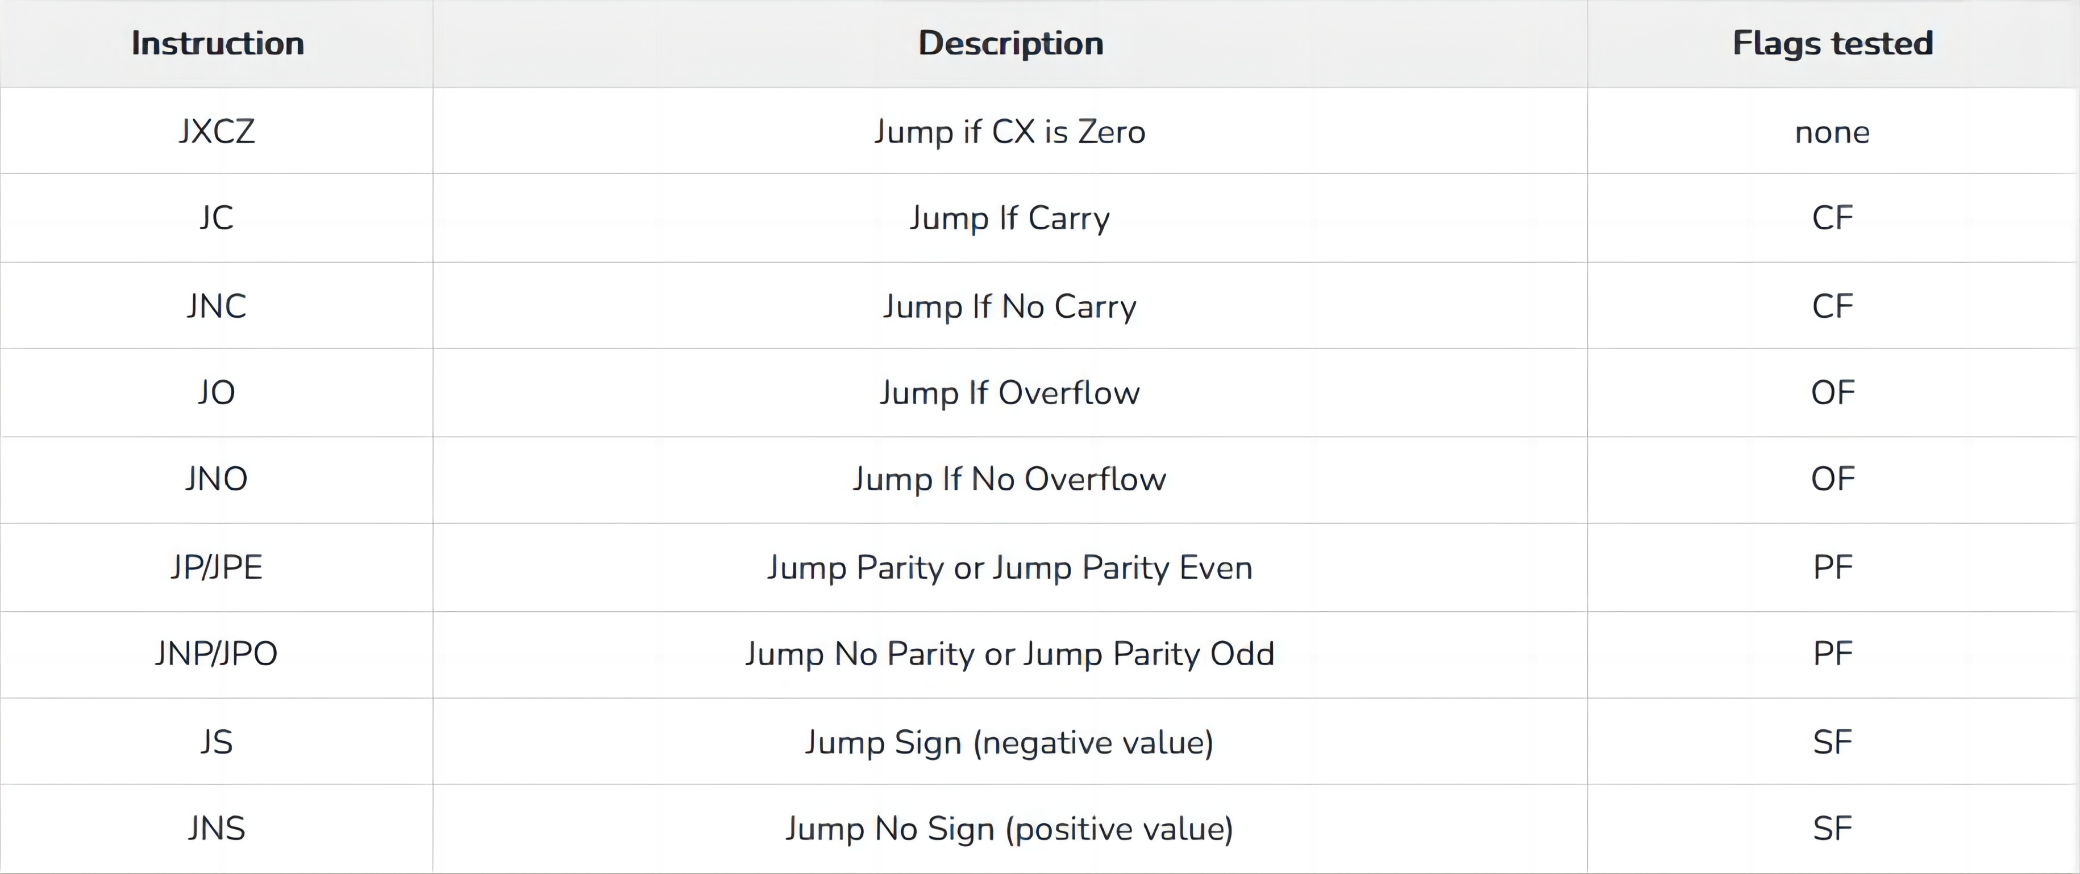
Conditional Jump
The following conditional jump instructions have special uses and check the value of flags −

Slide 12
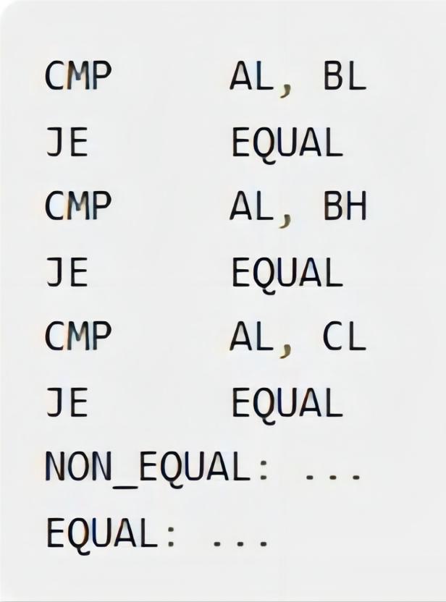
Syntax
The syntax for the J<condition> set of instructions −
Example,

Slide 13
Loops
Part Two
02

Slide 14

Loops
The JMP instruction can be used for implementing loops. For example, the following code snippet can be used for executing the loop-body 10 times.
MOV CX, 10
L1:
<LOOP-BODY>
DEC CX
JNZ L1

Slide 15
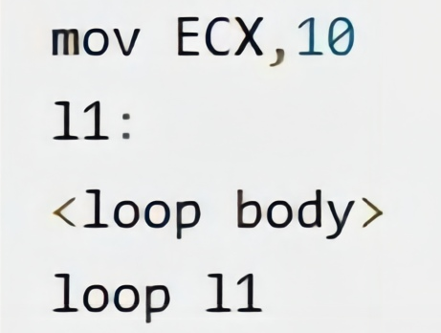
Loops
The processor instruction set, however, includes a group of loop instructions for implementing iteration.
The basic LOOP instruction has the following syntax −
LOOP label
Where, label is the target label that identifies the target instruction as in the jump instructions. The LOOP instruction assumes that the ECX register contains the loop count. When the loop instruction is executed, the ECX register is decremented and the control jumps to the target label, until the ECX register value, i.e., the counter reaches the value zero.
The above code snippet could be written as −

Slide 16
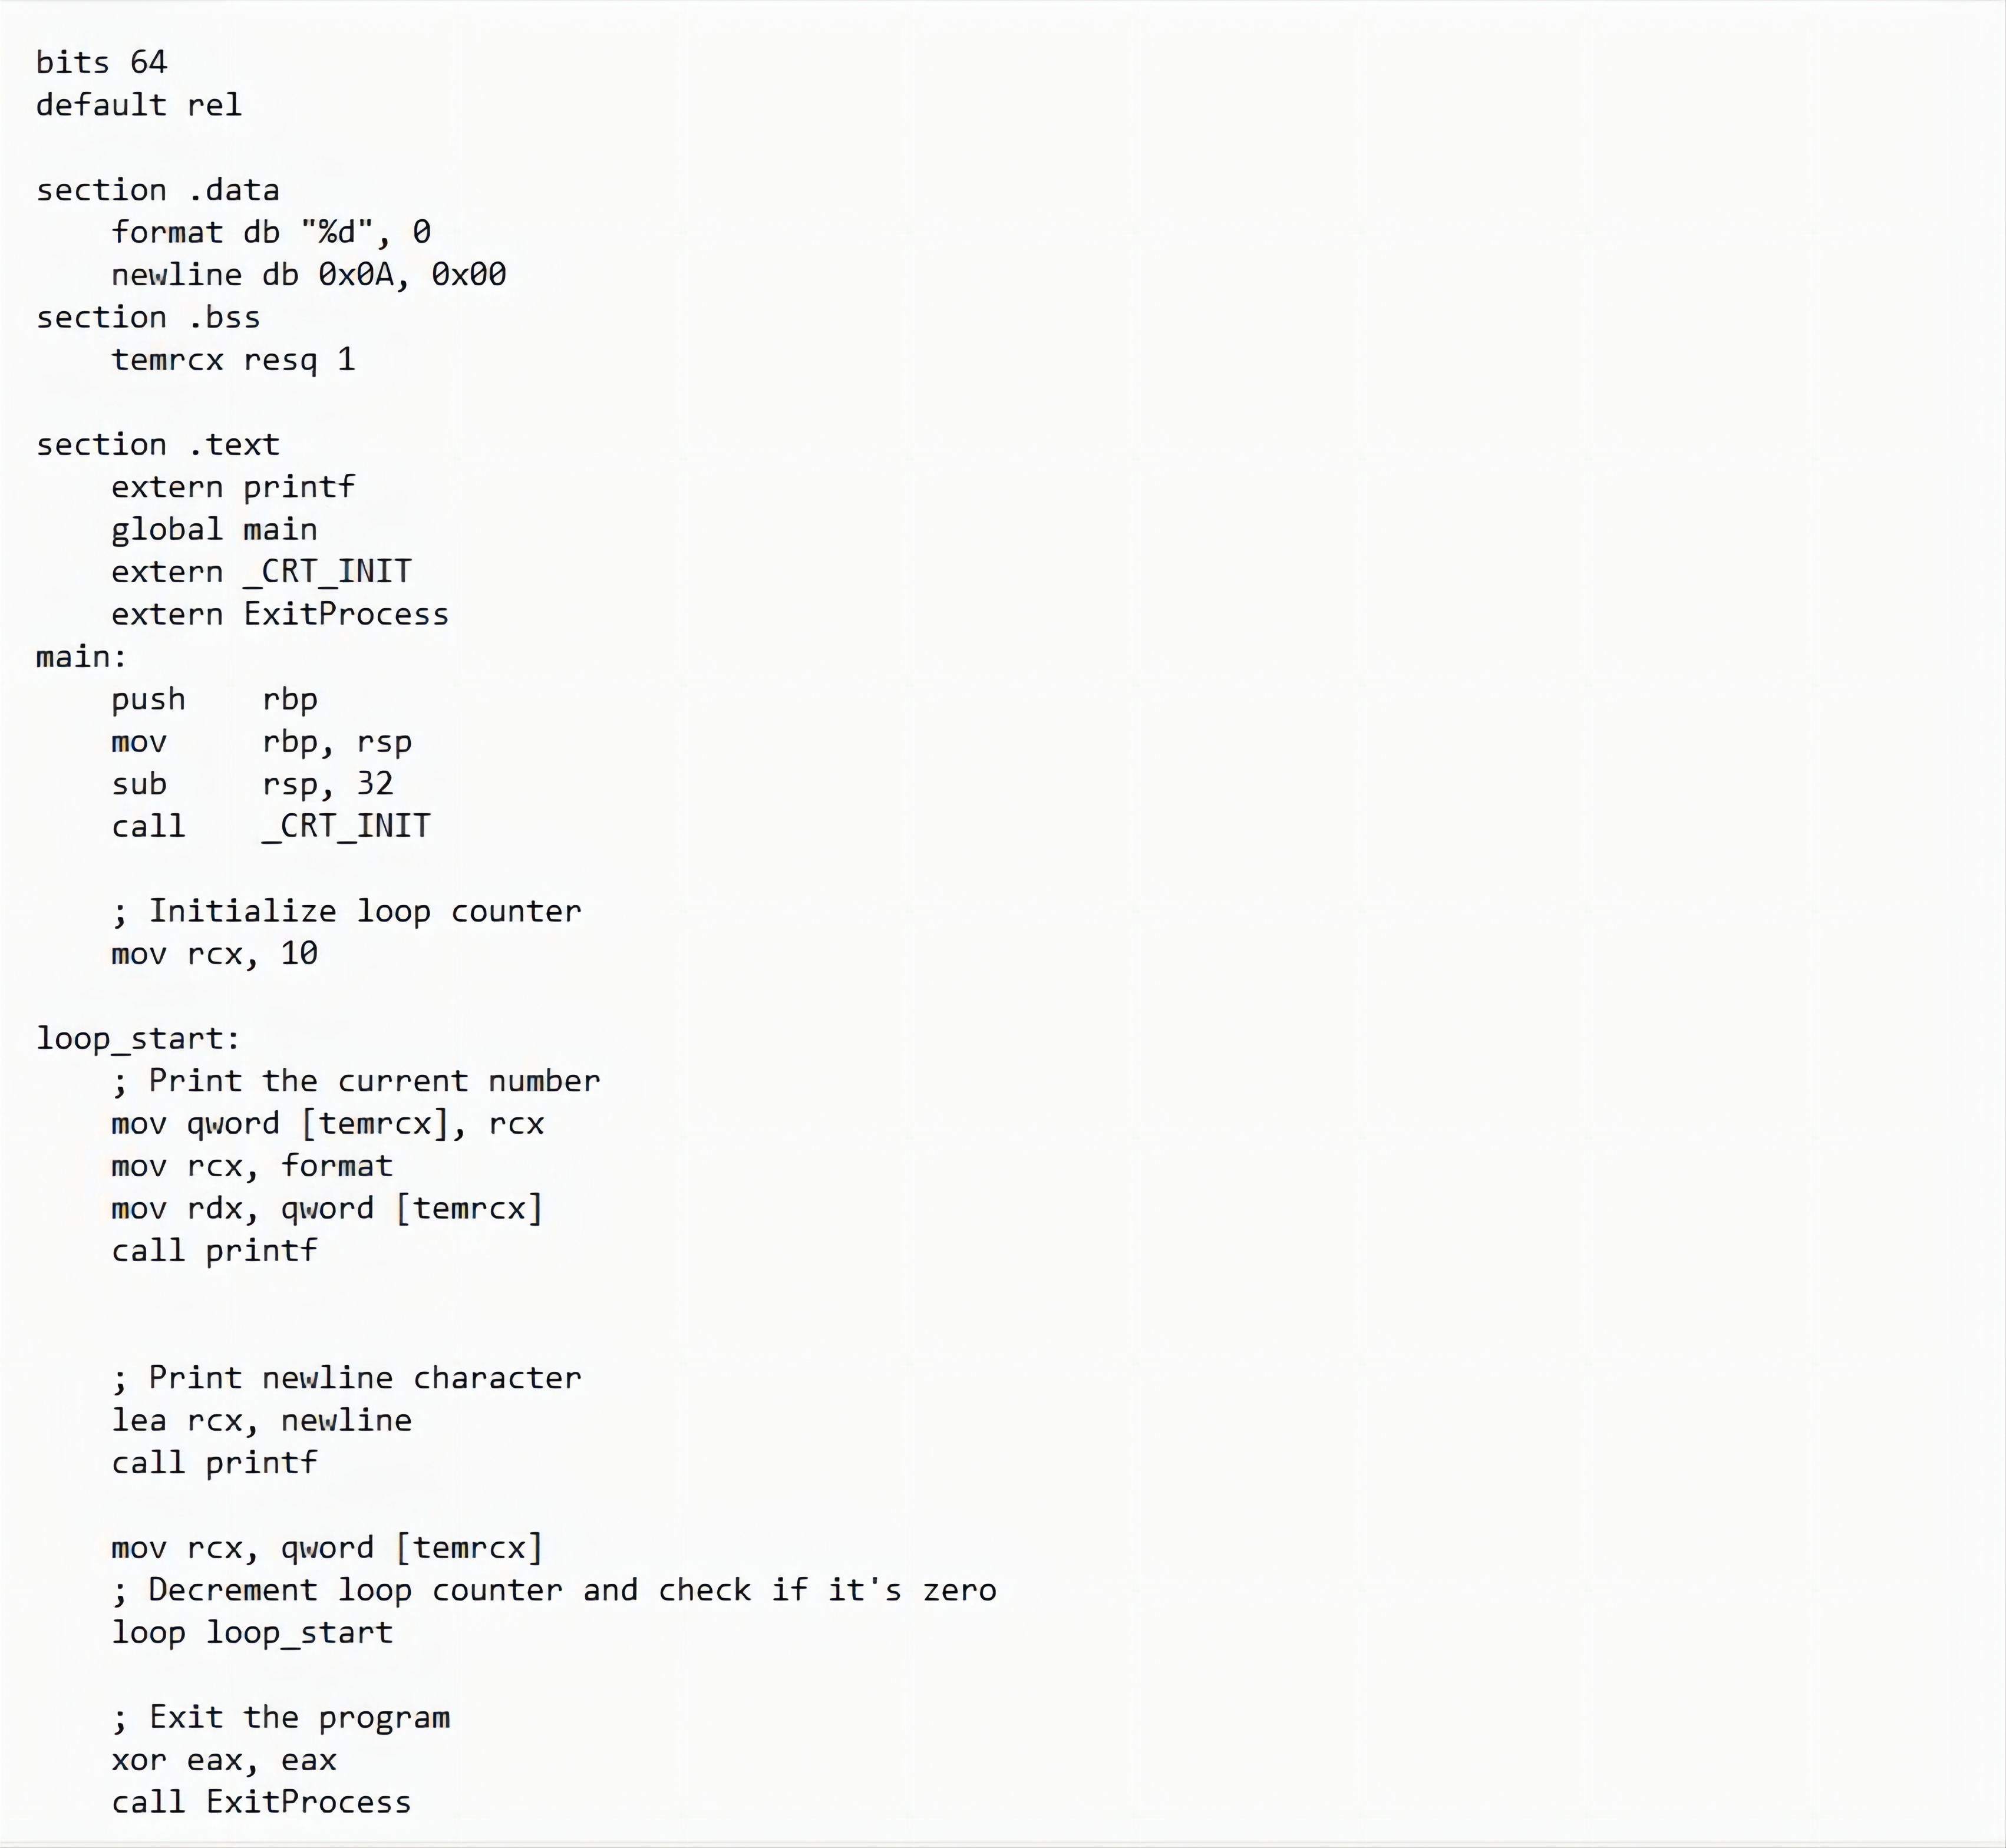
Examples

Slide 17
Numbers, Strings, Arrays
Part Three
03

Slide 18
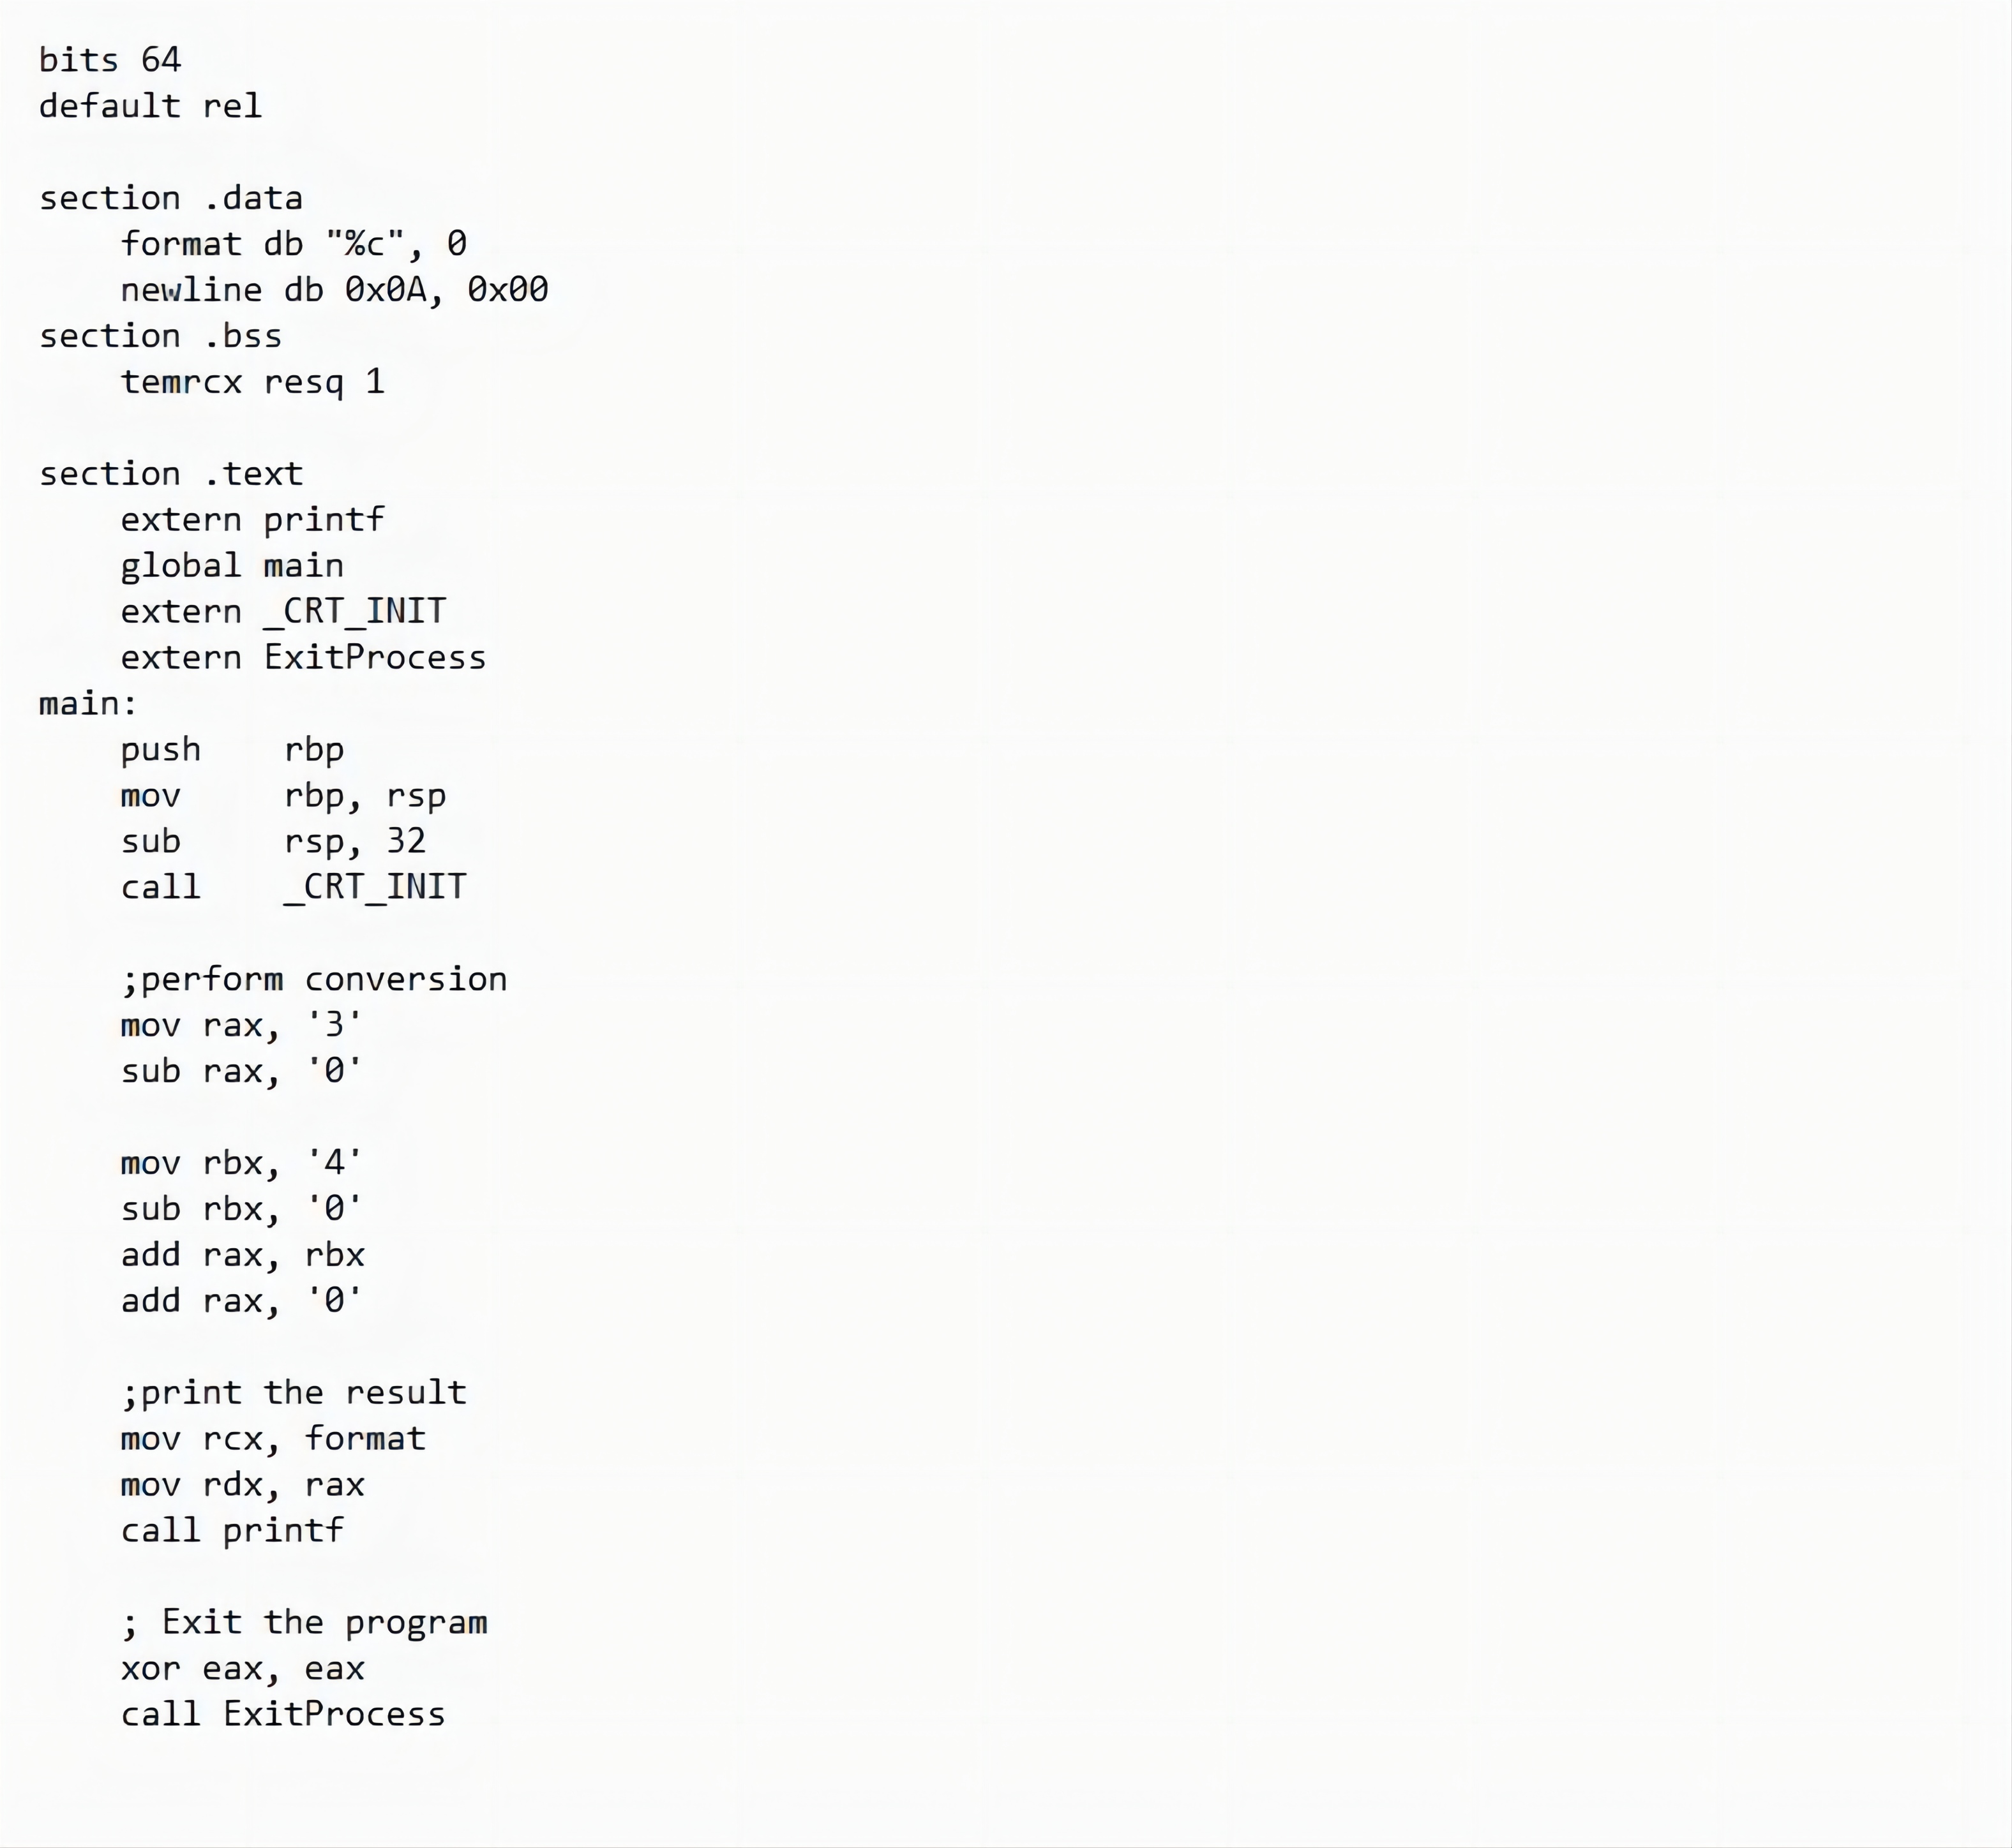

Numbers
Numerical data is generally represented in binary system. Arithmetic instructions operate on binary data.
When numbers are displayed on screen or entered from keyboard, they are in ASCII form.
We have converted this input data in ASCII form to binary for arithmetic calculations and converted the result back to binary.

Slide 19
The ADD and SUB Instructions
The ADD and SUB instructions are used for performing simple addition/subtraction of binary data in byte, word and doubleword size, i.e., for adding or subtracting 8-bit, 16-bit, 32-bit or 64-bit operands, respectively.
The ADD and SUB instructions have the following syntax −
ADD/SUB destination, source
The ADD/SUB instruction can take place between −
Register to register
Memory to register
Register to memory
Register to constant data
Memory to constant data

Slide 20
Weakness
Such conversions, however, have an overhead, and assembly language programming allows processing numbers in a more efficient way, in the binary form. Decimal numbers can be represented in two forms −
ASCII form
BCD or Binary Coded Decimal form
ASCII Representation
In ASCII representation, decimal numbers are stored as string of ASCII characters.
For example, the decimal value 1234 is stored as −
31 32 33 34H
Where, 31H is ASCII value for 1, 32H is ASCII value for 2, and so on. There are four instructions for processing numbers in ASCII representation −
AAA − ASCII Adjust After Addition
AAS − ASCII Adjust After Subtraction
AAM − ASCII Adjust After Multiplication
AAD − ASCII Adjust Before Division
These instructions do not take any operands and assume the required operand to be in the AL register. However, they are no longer supported in Windows x64.

Slide 21
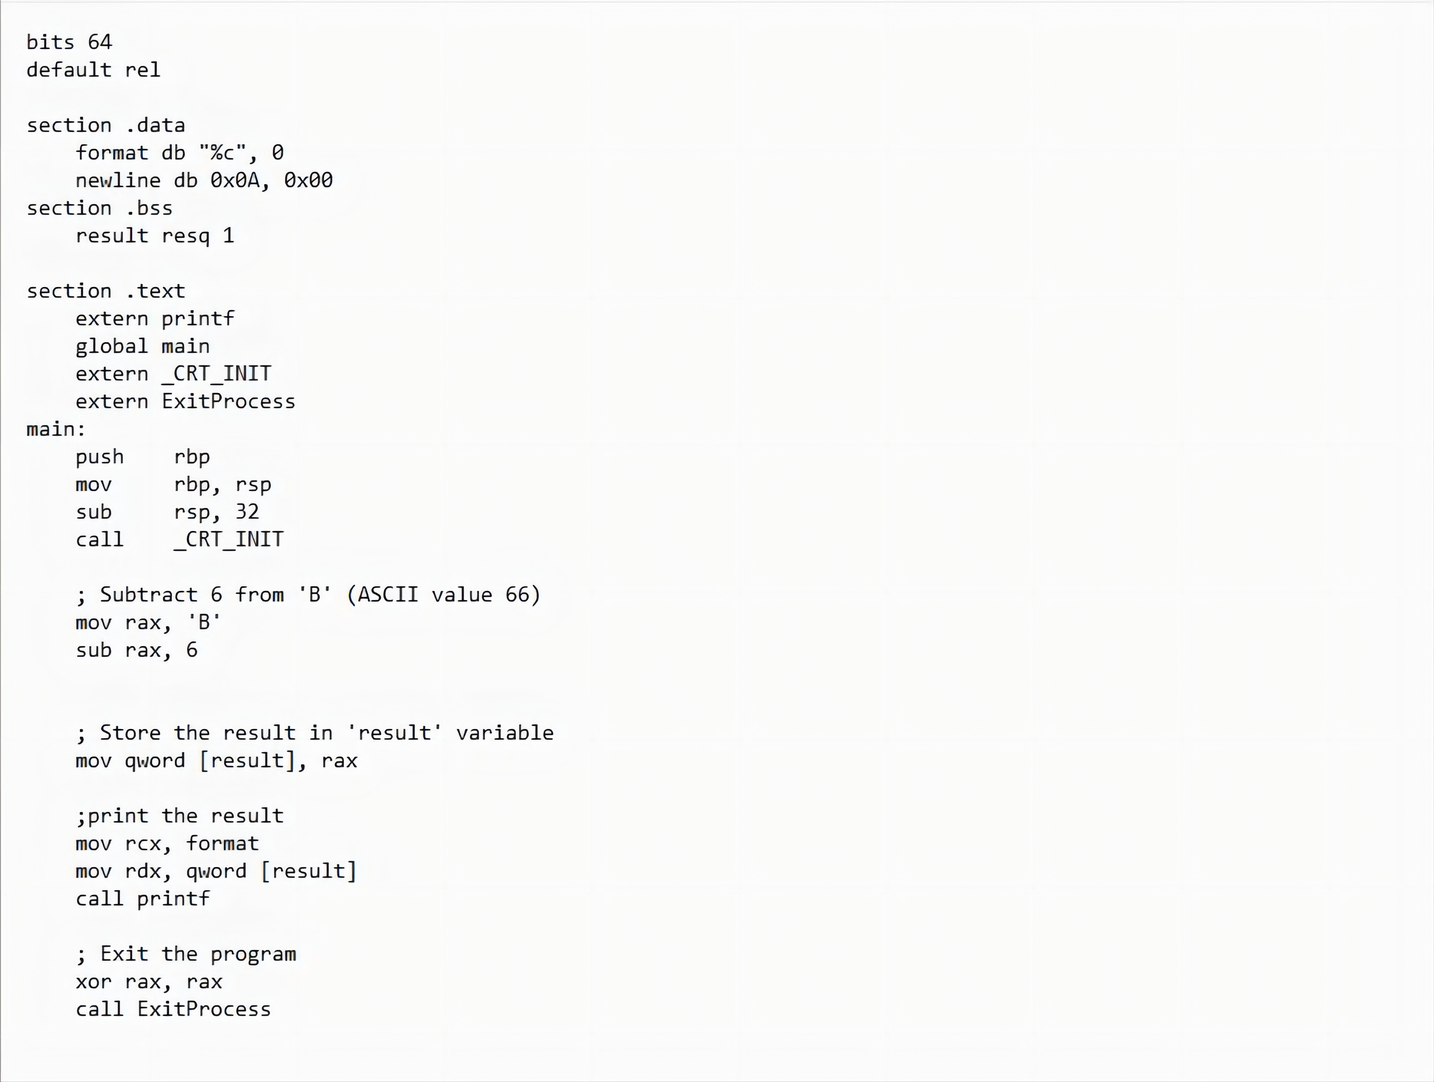
Solution

Slide 22
BCD Representation
There are two types of BCD representation −
Unpacked BCD representation
Packed BCD representation
In unpacked BCD representation, each byte stores the binary equivalent of a decimal digit. For example, the number 1234 is stored as −
01 02 03 04H

Slide 23
BCD Representation
There are two instructions for processing these numbers −
AAM − ASCII Adjust After Multiplication
AAD − ASCII Adjust Before Division
The four ASCII adjust instructions, AAA, AAS, AAM, and AAD, can also be used with unpacked BCD representation. In packed BCD representation, each digit is stored using four bits. Two decimal digits are packed into a byte. For example, the number 1234p is stored as −
12 34H
There are two instructions for processing these numbers −
DAA − Decimal Adjust After Addition
DAS − decimal Adjust After Subtraction
These instructions are no longer supported in Windows x64, only in x86.

Slide 24
Strings
We have already used variable length strings in our previous examples. The variable length strings can have as many characters as required. Generally, we specify the length of the string by either of the two ways −
Explicitly storing string length
Using a sentinel character
We can store the string length explicitly by using the $ location counter symbol that represents the current value of the location counter. In the following example −
msg db 'Hello, world!',0xa ;our dear string
len equ $ - msg ;length of our dear string
$ points to the byte after the last character of the string variable msg. Therefore, $-msg gives the length of the string. We can also write
msg db 'Hello, world!',0xa ;our dear string
len equ 13 ;length of our dear string

Slide 25
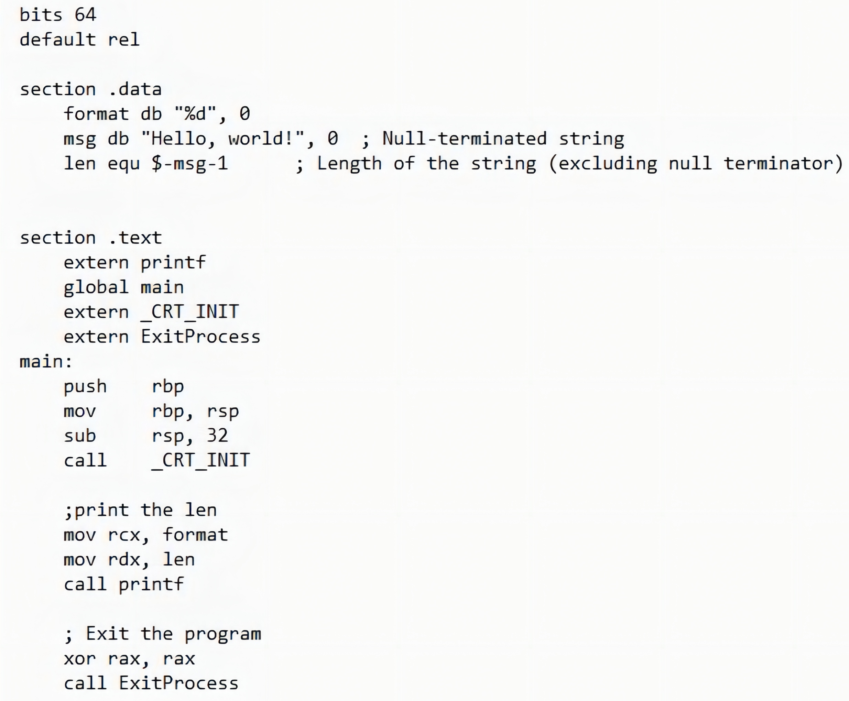
Strings
Alternatively, you can store strings with a trailing sentinel character to delimit a string instead of storing the string length explicitly. The sentinel character should be a special character that does not appear within a string.
For example −
message db 'Hello, world!', 0

Slide 26
String Instructions
Each string instruction may require a source operand, a destination operand or both. For 64-bit segments, string instructions use RSI and RDI registers to point to the source and destination operands, respectively.
For 32-bit segments, however, the ESI and the EDI registers are used to point to the source and destination, respectively.

Slide 27
String Instructions
There are five basic instructions for processing strings. They are −
MOVS − This instruction moves 1 Byte, Word or Doubleword of data from memory location to another.
LODS − This instruction loads from memory. If the operand is of one byte, it is loaded into the AL register, if the operand is one word, it is loaded into the AX register and a doubleword is loaded into the EAX register.
STOS − This instruction stores data from register (AL, AX, or EAX) to memory.
CMPS − This instruction compares two data items in memory. Data could be of a byte size, word or doubleword.
SCAS − This instruction compares the contents of a register (AL, AX or EAX) with the contents of an item in memory.

Slide 28
Examples
Each of the above instruction has a byte, word, doubleword, and quadword version, and string instructions can be repeated by using a repetition prefix.
These instructions use the ES:RDI and DS:RSI pair of registers, where RDI and RSI registers contain valid offset addresses that refers to bytes stored in memory. RSI is normally associated with DS (data segment) and RDI is always associated with ES (extra segment).

Slide 29
Versions of String Instructions
Byte Operation | Word Operation | Double word Operation | Quad word Operation
MOVSB | MOVSW | MOVSD | MOVSQ
LODSB | LODSW | LODSD | LODSQ
STOSB | STOSW | STOSD | STOSQ
CMPSB | CMPSW | CMPSD | CMPSQ
SCASB | SCASW | SCASD | SCASQ

Slide 30
Repetition Prefixes
The REP prefix, when set before a string instruction, for example - REP MOVSB, causes repetition of the instruction based on a counter placed at the RCX register. REP executes the instruction, decreases RCX by 1, and checks whether RCX is zero. It repeats the instruction processing until RCX is zero.
The Direction Flag (DF) determines the direction of the operation.
Use CLD (Clear Direction Flag, DF = 0) to make the operation left to right.
Use STD (Set Direction Flag, DF = 1) to make the operation right to left.

Slide 31
REP Prefix Variants
The REP prefix also has the following variations:
REP: It is the unconditional repeat. It repeats the operation until CX is zero.
REPE or REPZ: It is conditional repeat. It repeats the operation while the zero flag indicates equal/zero. It stops when the ZF indicates not equal/zero or when CX is zero.
REPNE or REPNZ: It is also conditional repeat. It repeats the operation while the zero flag indicates not equal/zero. It stops when the ZF indicates equal/zero or when CX is decremented to zero.

Slide 32
Arrays
We have already discussed that the data definition directives to the assembler are used for allocating storage for variables. The variable could also be initialized with some specific value. The initialized value could be specified in hexadecimal, decimal or binary form.
For example, we can define a word variable 'months' in either of the following way −
MONTHS DW 12
MONTHS DW 0CH
MONTHS DW 0110B
The data definition directives can also be used for defining a one-dimensional array. Let us define a one-dimensional array of numbers.
NUMBERS DW 34, 45, 56, 67, 75, 89
The above definition declares an array of six words each initialized with the numbers 34, 45, 56, 67, 75, 89. This allocates 2x6 = 12 bytes of consecutive memory space. The symbolic address of the first number will be NUMBERS and that of the second number will be NUMBERS + 2 and so on.

Slide 33
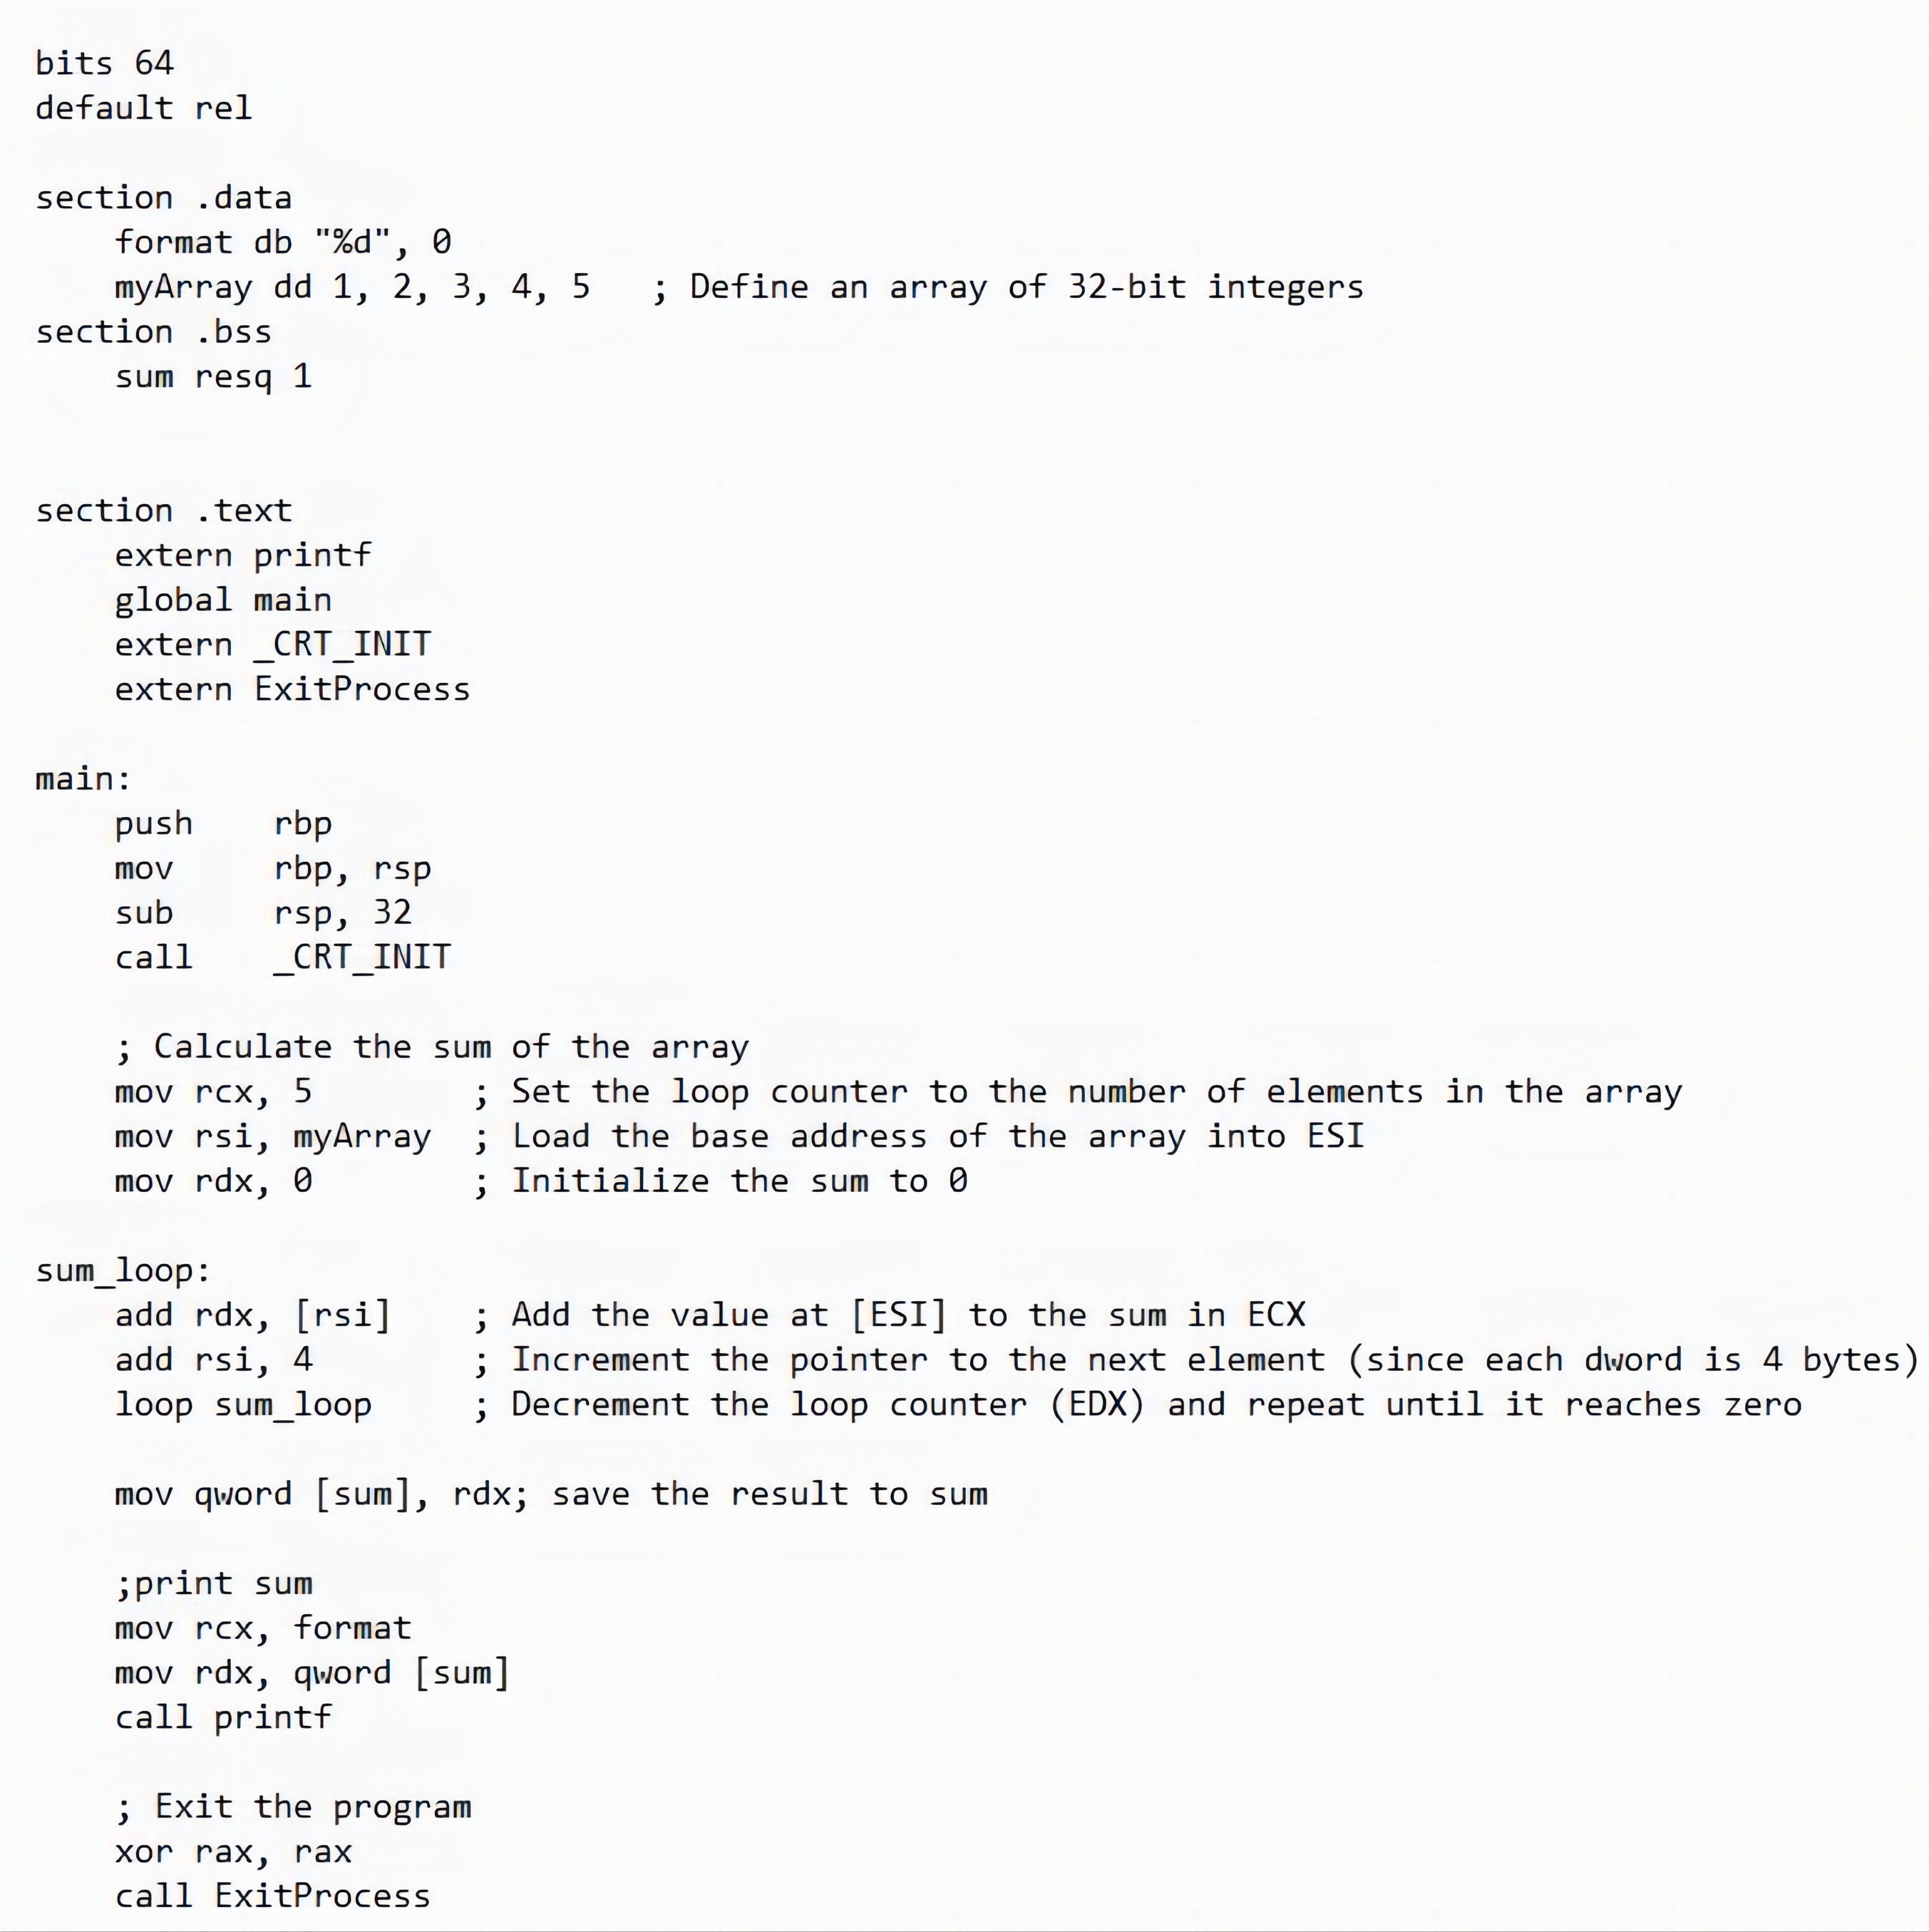
Examples
The times directive can also be used for multiple initializations to the same value. Using times, the inventory array can be defined as:
inventory times 8 dw 0

Slide 34

THE END
Fangtian Zhong
CSCI 591
Gianforte School of Computing
Norm Asbjornson College of Engineering
E-mail: fangtian.zhong@montana.edu
2023.09.12

