Slide 1

2023.09.14
Malicious Code Analysis
Fangtian Zhong
CSCI 591
Gianforte School of Computing
Norm Asbjornson College of Engineering
E-mail: fangtian.zhong@montana.edu

Slide 2
Overview
Procedures, Recursion, Macro
01
File Management
02
Memory Management
03

Slide 3

Procedures, Recursion, Macro
Part One
01
2023/8/20

Slide 4

Procedures
Procedures or subroutines are very important in assembly language, as the assembly language programs tend to be large in size. Procedures are identified by a name. Following this name, the body of the procedure is described which performs a well-defined job. End of the procedure is indicated by a return statement.
Following is the syntax to define a procedure −
proc_name:
procedure body
...
ret

Slide 5
call instruction
The procedure is called from another function by using the call instruction. The call instruction should have the name of the called procedure as an argument as shown below −
call proc_name
elow −The called procedure returns the control to the calling procedure by using the ret instruction.

Slide 6
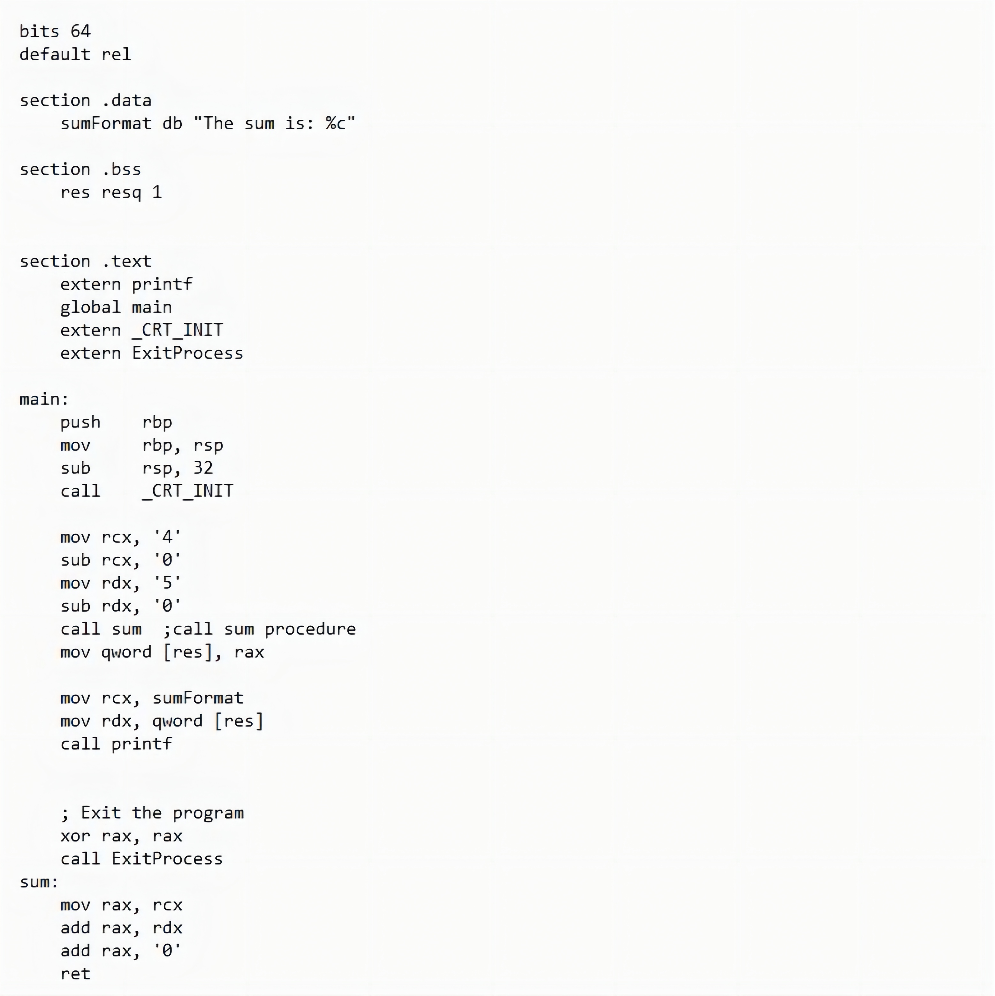
Examples

Slide 7
Stacks Data Structure
A stack is an array-like data structure in the memory in which data can be stored and removed from a location called the 'top' of the stack. The data that needs to be stored is 'pushed' into the stack and data to be retrieved is 'popped' out from the stack. Stack is a LIFO data structure, i.e., the data stored first is retrieved last.
Assembly language provides two instructions for stack operations: PUSH and POP. These instructions have syntaxes like −
PUSH operand
POP address/register
The memory space reserved in the stack segment is used for implementing stack. The registers SS and RSP (ESP or SP) are used for implementing the stack. The top of the stack, which oints to the last data item inserted into the stack is pointed to by the SS:RSP register, where the SS register points to the beginning of the stack segment and the RSP (ESP or SP) gives the offset into the stack segment.

Slide 8
Stack Characteristics
The stack implementation has the following characteristics −
Only words or doublewords could be saved into the stack, not a byte.
The stack grows in the reverse direction, i.e., toward the lower memory address.
The top of the stack points to the last item inserted in the stack; it points to the lower byte of the last word inserted.
As we discussed about storing the values of the registers in the stack before using them for some use; it can be done in following way −
; Save the AX and BX registers in the stack
PUSH RAX
PUSH RBX
; Use the registers for other purpose
MOV RAX, VALUE1
MOV RBX, VALUE2
...
MOV VALUE1, RAX
MOV VALUE2, RBX
; Restore the original values
POP RBX
POP RAX

Slide 9
Recursion
A recursive procedure is one that calls itself. There are two kind of recursion: direct and indirect. In direct recursion, the procedure calls itself and in indirect recursion, the first procedure calls a second procedure, which in turn calls the first procedure.
Recursion could be observed in numerous mathematical algorithms. For example, consider the case of calculating the factorial of a number. Factorial of a number is given by the equation −
Recursion could be observed in numerous mathematical algorithms. For example, consider the case of calculating the factorial of a number. Factorial of a number is given by the equation −
Fact (n) = n * fact (n-1) for n > 0
For example: factorial of 5 is 1 x 2 x 3 x 4 x 5 = 5 x factorial of 4 and this can be a good example of showing a recursive procedure. Every recursive algorithm must have an ending condition, i.e., the recursive calling of the program should be stopped when a condition is fulfilled. In the case of factorial algorithm, the end condition is reached when n is 0.

Slide 10
Other Conventions
Writing a macro is another way of ensuring modular programming in assembly language.
A macro is a sequence of instructions, assigned by a name and could be used anywhere in the program.
In NASM, macros are defined with %macro and %endmacro directives.
The macro begins with the %macro directive and ends with the %endmacro directive.
The Syntax for macro definition −
%macro macro_name number_of_params
<macro body>
%endmacro
Where, number_of_params specifies the number parameters, macro_name specifies the name of the macro.
The macro is invoked by using the macro name along with the necessary parameters. When you need to use some sequence of instructions many times in a program, you can put those instructions in a macro and use it instead of writing the instructions all the time.

Slide 11
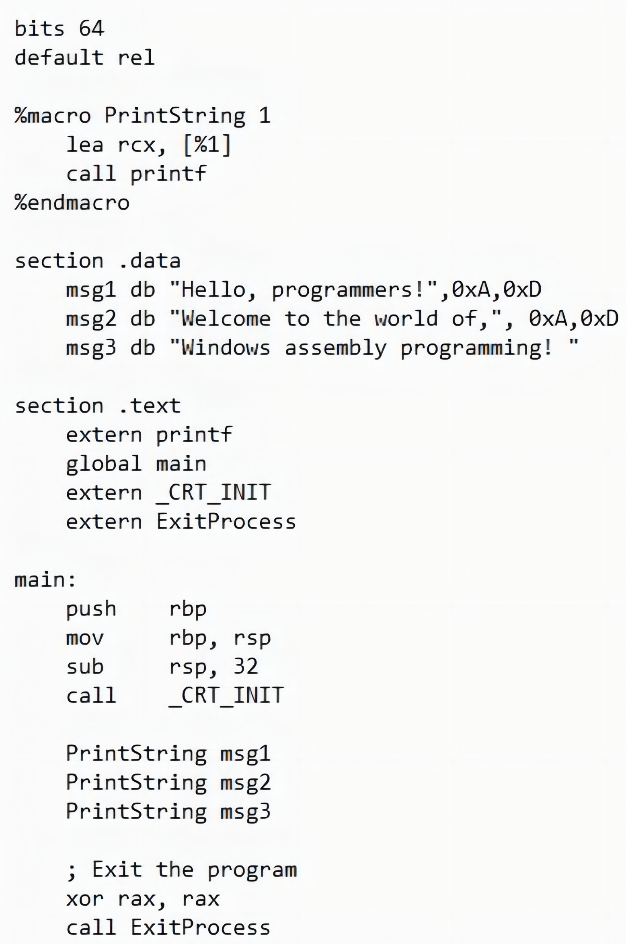
Macros
For example, a very common need for programs is to write a string of characters in the screen.
For displaying a string of characters, you need the following sequence of instructions −
lea rcx, [msg]
call printf

Slide 12
Part Two
File Management
02
2023/8/20

Slide 13

File Management System
In Windows x64 assembly, file management can be accomplished using the WinAPI functions provided by the operating system. These functions allow you to perform various operations such as creating, opening, reading, writing, and closing files.There are three standard file streams −
Standard input (stdin),
Standard output (stdout), and
Standard error (stderr).

Slide 14
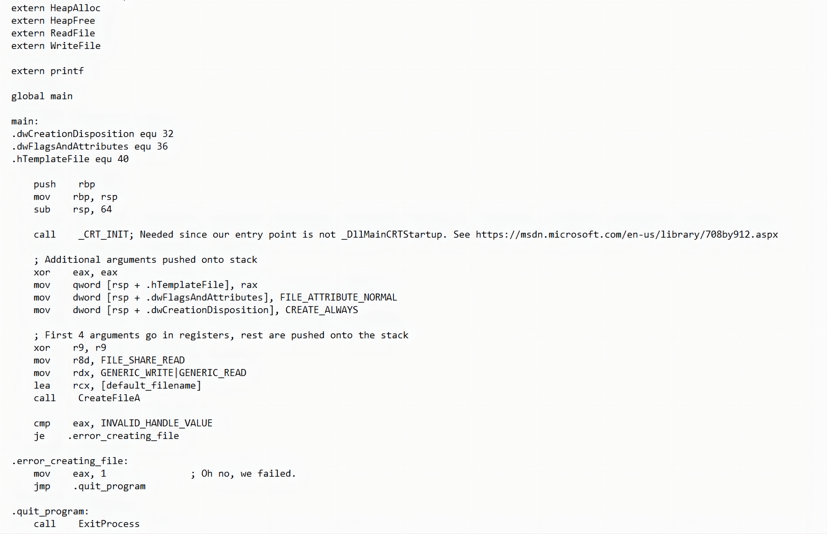
Create or Open a File:
To create a new file or open an existing file, you can use the CreateFile function. This function allows you to specify the file name, desired access mode, file attributes, and other parameters. It returns a handle to the file that you can use for subsequent operations.
HANDLE CreateFileA(
[in] LPCSTR lpFileName,
[in] DWORD dwDesiredAccess,
[in] DWORD dwShareMode,
[in, optional] LPSECURITY_ATTRIBUTES lpSecurityAttributes,
[in] DWORD dwCreationDisposition,
[in] DWORD dwFlagsAndAttributes,
[in, optional] HANDLE hTemplateFile
);

Slide 15
Create or Open a File:

Slide 16
Write
To write data to a file, you can use the WriteFile function. Similar to ReadFile, you need to provide the file handle, a buffer containing the data to write, the number of bytes to write, and other required parameters. The function writes the specified number of bytes from the buffer to the file.
BOOL WriteFile(
[in] HANDLE hFile,
[in] LPCVOID lpBuffer,
[in] DWORD nNumberOfBytesToWrite,
[out, optional] LPDWORD lpNumberOfBytesWritten,
[in, out, optional] LPOVERLAPPED lpOverlapped
);

Slide 17
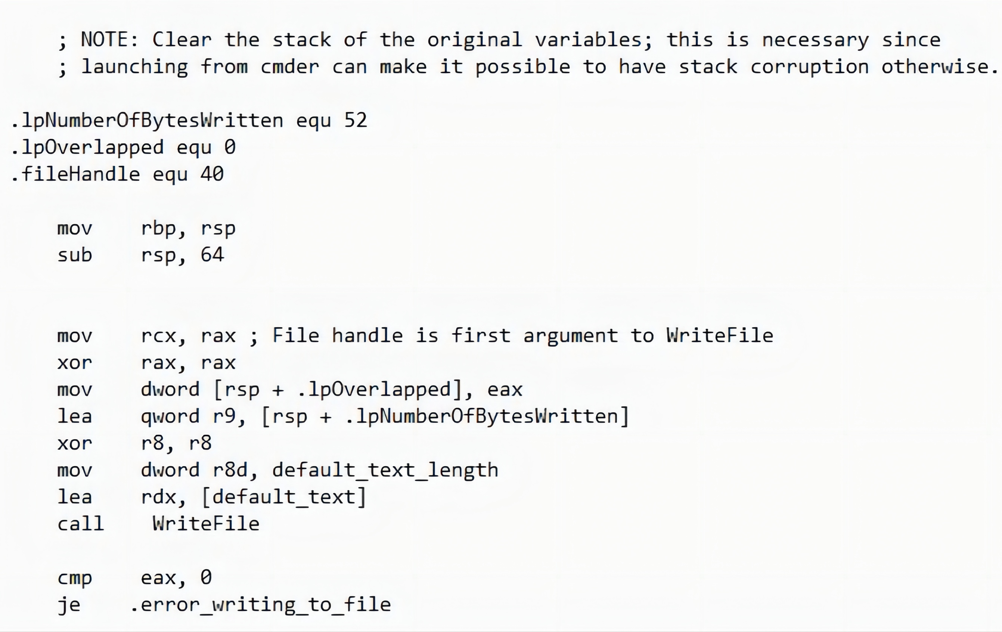
Write

Slide 18
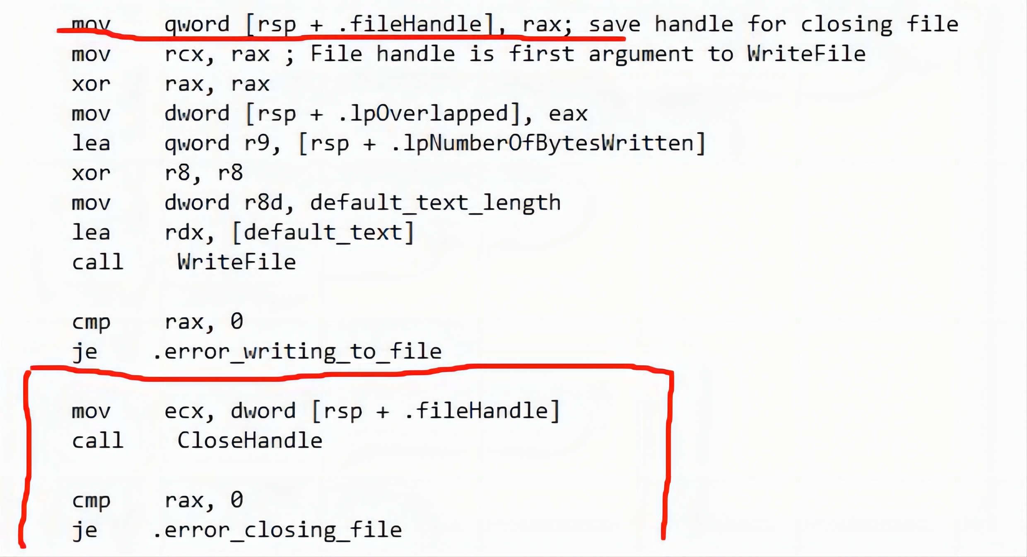
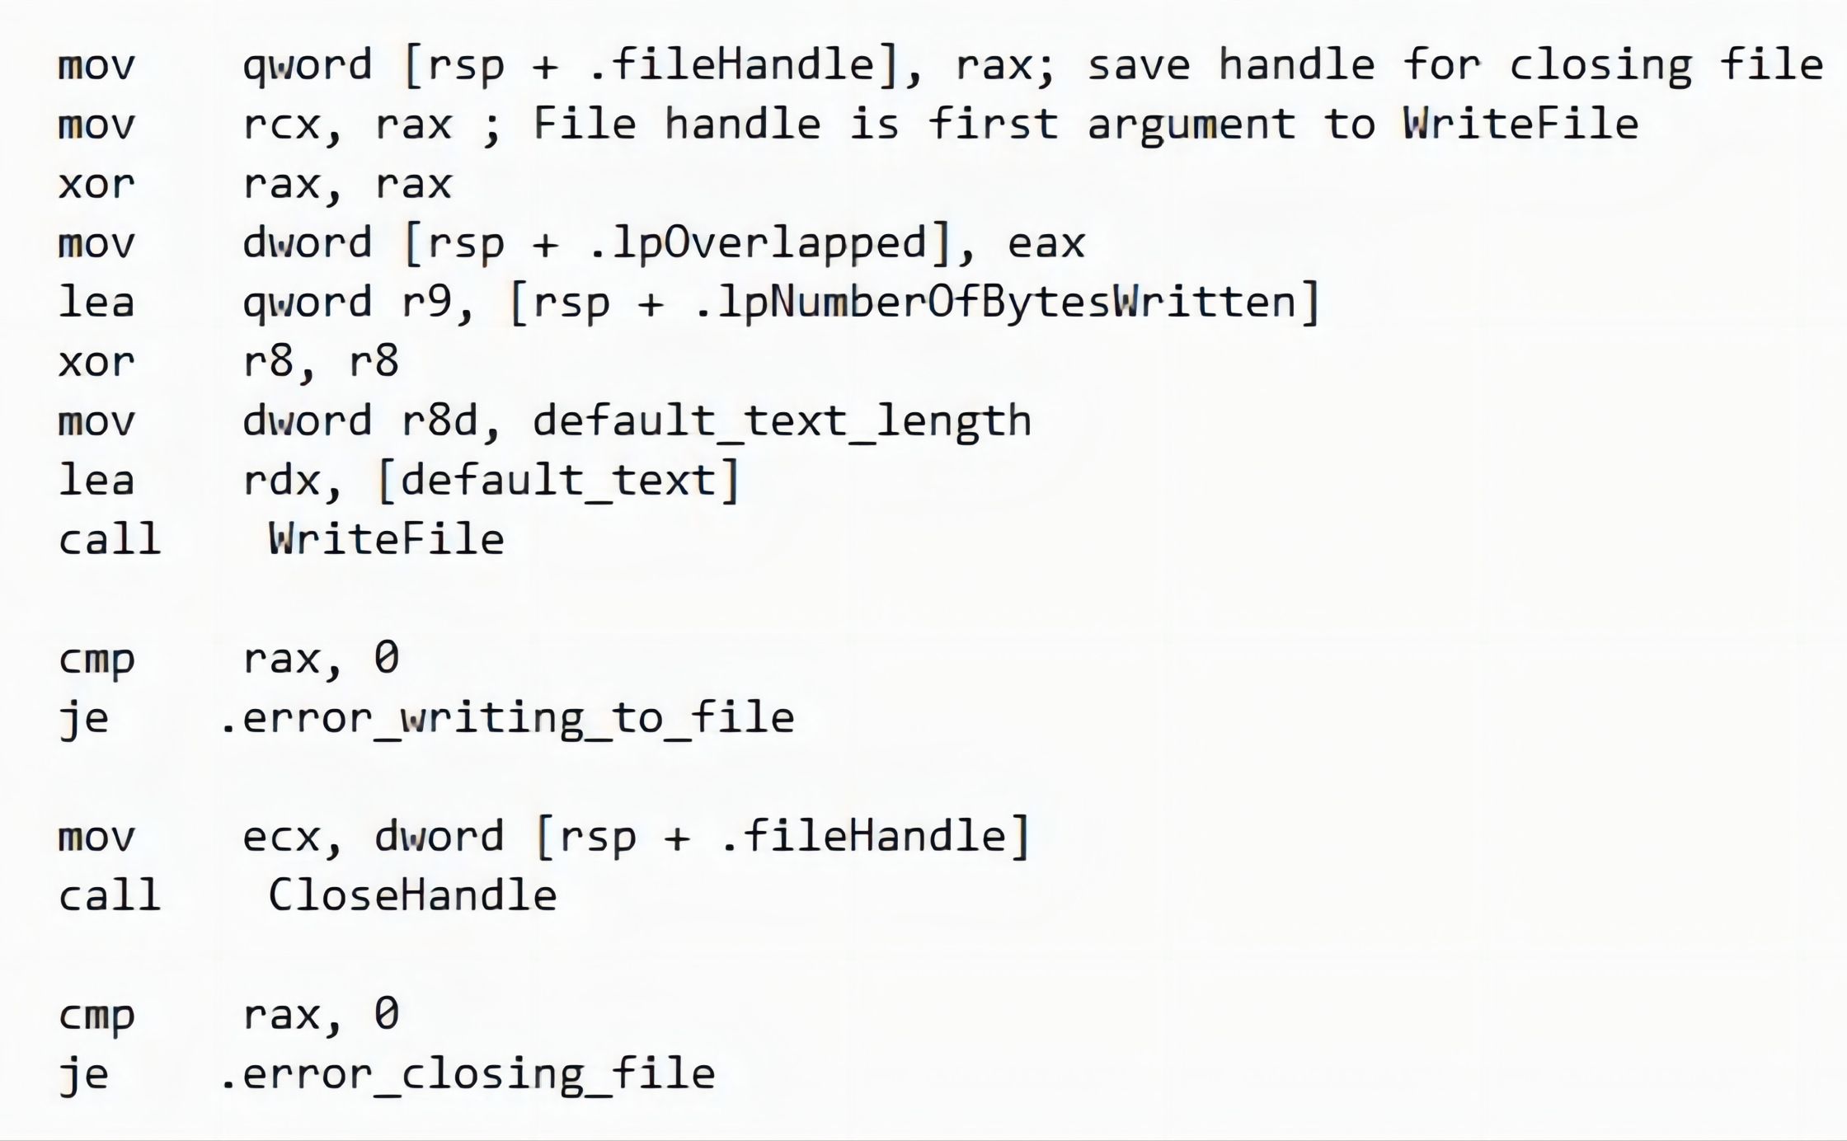
Close
After you finish working with a file, it's important to close it using the CloseHandle function. This function takes the file handle as a parameter and releases any resources associated with the file.

Slide 19
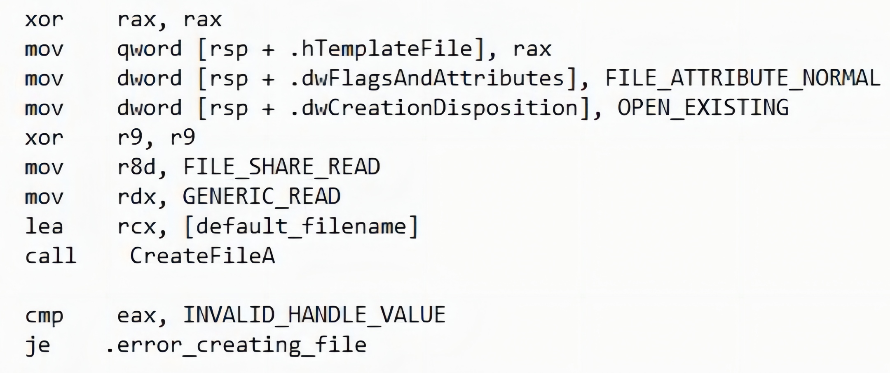
Read
To read data from a file, you can use the ReadFile function. You need to provide the file handle, a buffer to store the read data, the number of bytes to read, and other necessary parameters. The function reads the specified number of bytes from the file and stores them in the provided buffer.

Slide 20
Memory Management
Part Three
03

Slide 21

Memory Management System
In Windows x64 assembly, memory management is primarily handled by the operating system. However, as a developer, you can interact with the memory management system using various WinAPI functions to allocate, deallocate, and manipulate memory.
It's important to note that memory management in Windows x64 assembly involves a combination of assembly instructions and WinAPI function calls. The assembly instructions are used to perform low-level memory operations, while the WinAPI functions provide a higher-level interface to interact with the memory management system.

Slide 22

Allocate Memory
To allocate memory dynamically, you can use the HeapAlloc function. This function allows you to specify the size of the memory block, the desired allocation type, and other parameters. It returns a pointer to the allocated memory block.
DECLSPEC_ALLOCATOR LPVOID HeapAlloc(
[in] HANDLE hHeap,
[in] DWORD dwFlags,
[in] SIZE_T dwBytes
);

Slide 23
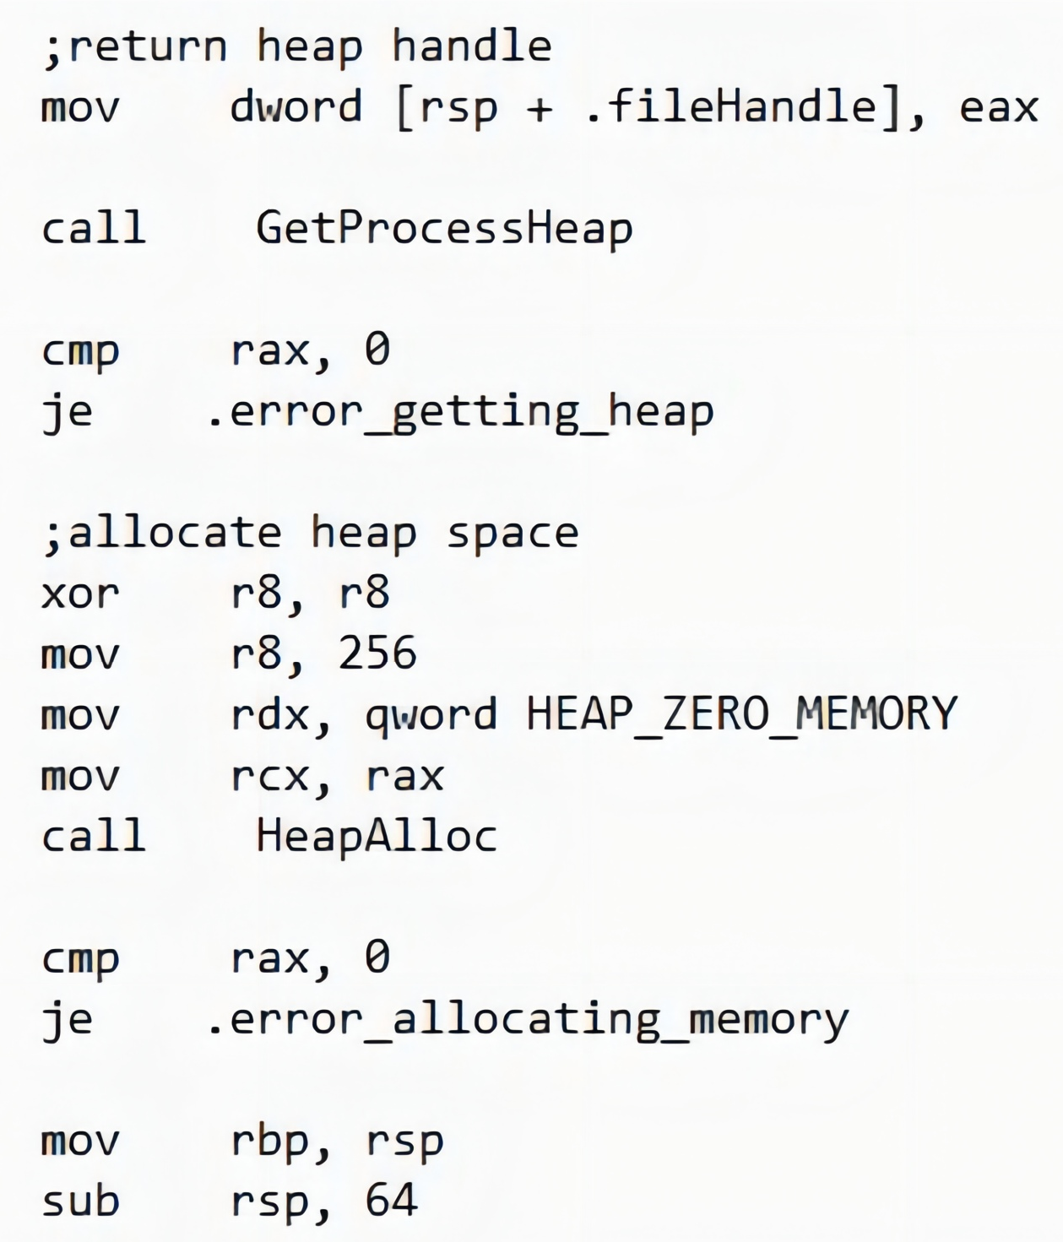
Allocate Memory

Slide 24
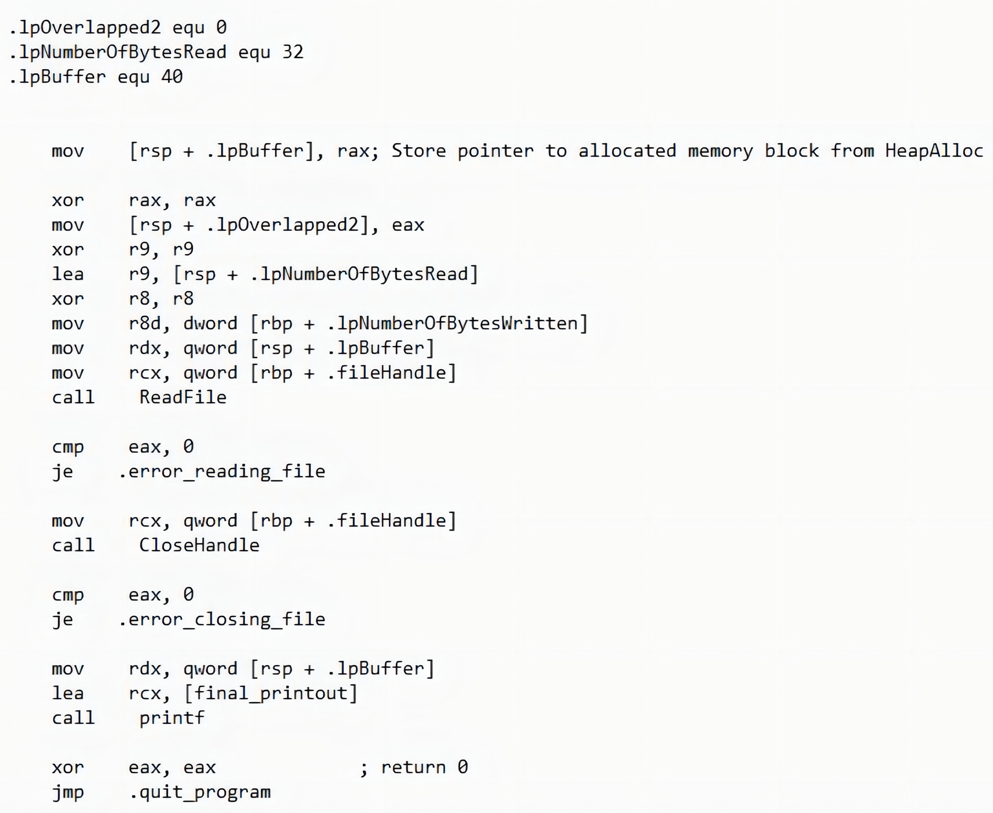
Read or Write Memory
Once you have allocated memory, you can read from or write to it using standard memory access instructions in assembly, such as mov, add, sub, etc.

Slide 25

Deallocate Memory
To release the previously allocated memory, you can use the HeapFreefunction. This function takes the pointer to the memory block and frees the associated memory. It also allows you to specify the desired release type and other parameters.

Slide 26

THE END
Fangtian Zhong
CSCI 591
Gianforte School of Computing
Norm Asbjornson College of Engineering
E-mail: fangtian.zhong@montana.edu
2023.09.14

