Slide 1

2023.09.19
Malicious Code Analysis
Fangtian Zhong
CSCI 591
Gianforte School of Computing
Norm Asbjornson College of Engineering
E-mail: fangtian.zhong@montana.edu

Slide 2
Overview
Taxonomy
01
Analyze
02
Virus
03

Slide 3

Part One
Taxonomy
01

Slide 4


Definition
A malware is a simple or self-replicating program, which discreetly installs itself in a system, without users knowledge or consent, with a view to either endangering data confidentiality, data integrity and system availability or making sure that users to be framed for computer crime.

Slide 5

Attacks
To gain unauthorized access to confidential data.
To modify data integrity.
To attack the availability of the system.
To remove all traces of their intrusions from the system.

Slide 6
Malware
Taxonomy of Malware
Malware
Simple
Self-Reproducing
Logical bombs
Trojan horses
Rootkits
Backdoors
Viruses
Worms
Bots
Botnets

Slide 7
Part Two
Analyze
02

Slide 8


Tools You Might Need
A disassembler (such as Angr, IDA Pro or Relyze)
Knowledge of assembly language
Experience in reverse engineering and malware analysis

Slide 9

Steps
To identify the malicious behaviors, it might include some of the following steps.
Obtain the Suspicious Binary
Set up a Controlled Environment
Diassemble the Binary
Identify Suspicious Code Patterns
Follow Execution Flow
Check for Known indicators
Examine File System and Registry Activity
Analyze Network Activity
Review Function Calls and API Calls
Document Findings:
Report and Take Action

Slide 10
Critical System APIs
Malware commonly use to achieve their goals:
File System Functions:
CreateFile: Used to create or open files on the file system
ReadFile and WriteFile: Used for reading from and writing to files
DeleteFile: Used to delete files from the file system
FindFirstFile and FindNextFile: Used for searching files and directories
Registry Functions:
RegOpenKeyEx, RegCreateKeyEx: Used to open or create registry keys
RegSetValueEx: Used to write data to registry keys
RegQueryValueEx: Used to read data from registry keys
RegDeleteKey: Used to delete registry keys

Slide 11
Critical System APIs
Malware commonly use to achieve their goals:
Process and Thread Functions:
CreateProcess: Used to create new processes, often for launching additional malware or payloads
OpenProcess: Used to obtain a handle to an existing process
CreateThread: Used to create threads within a process, which can be used for injecting code or executing malicious functions
Network Functions:
Socket: Used to create network sockets for communication with remote servers or peers
Connect, Bind, Listen, Accept: Functions related to network communication
HttpOpenRequest, HttpSendRequest: Used for making HTTP requests
DNS functions: Used for domain resolution and communication with specific IP address

Slide 12
Critical System APIs
Malware commonly use to achieve their goals:
API Hooking Functions:
GetProcAddress, LoadLibrary: Used to dynamically load DLLs and hook API functions, allowing the malware to intercept and manipulate system calls
Encryption and Decryption Functions:
CryptEncrypt, CryptDecrypt: Used for encrypting and decrypting data, often to protect communication or hide malicious payloads
System Service Functions:
Service Control Manager Functions: Used to interact with Windows services, which may be targeted for disruption or manipulation
ControlService: Used to send control commands to services

Slide 13
Critical System APIs
Malware commonly use to achieve their goals:
Memory Manipulation Functions:
VirtualAlloc: Used to allocate memory within a process
WriteProcessMemory, ReadProcessMemory: Used to read and write data within the memory space of another process
System Information Functions:
GetSystemInfo, GetNativeSystemInfo: Used to obtain information about the system, such as processor architecture and memory layout
GetComputerName: Used to display messages to the user, often as part of social engineering tactics
User Interaction Functions:
MessageBox: Used to display messages to the user, often as part of social engineering tactics

Slide 14
Virus
Part Three
03

Slide 15
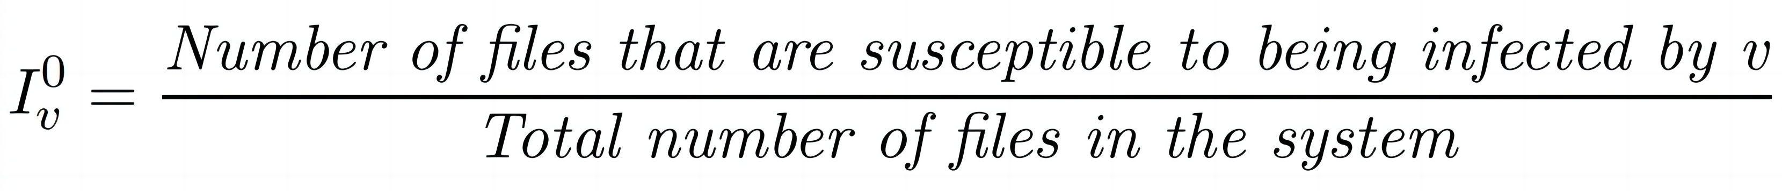

Definition I_{v}⁰
The infectious index Iv0 for a virus v is a measure of the a priori risk. It is defined by

Slide 16
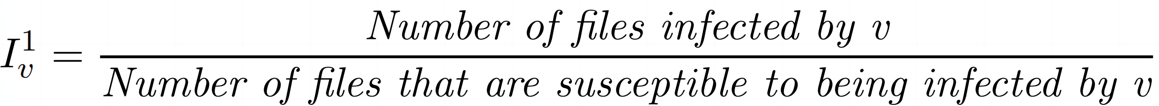


Definition I_{v}¹
The infection index Iv1 for a virus v is a measure of the a posteriori risk. It is defined by

Slide 17
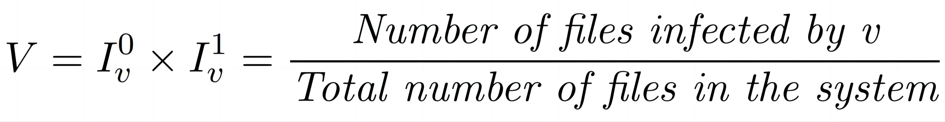
Definition 37 (Virulence)
The virulence V_{v} of a virus v is then given by

Slide 18
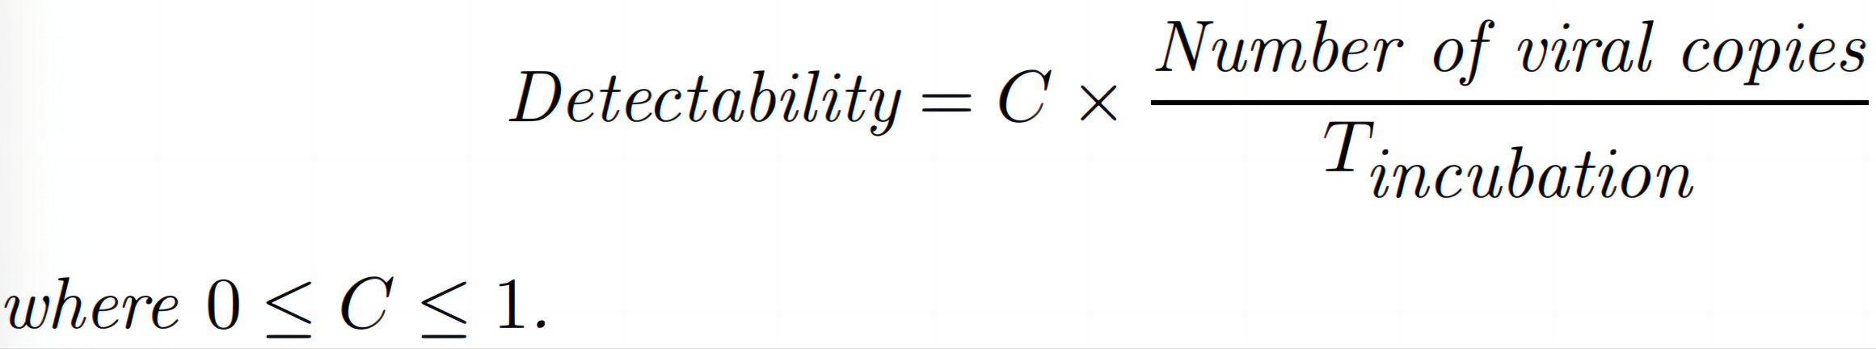
Proposition 14
Proposition 14 The level of detectability of a computer infection program is inversely proportional to the length of the incubation period and proportional to the number of infections which occur in a system.
Proposition 14

Slide 19


Biological Viruses VS Computer Viruses
DNA
Source code

Slide 20


Biological Viruses VS Computer Viruses
RNA
Binary code

Slide 21

Biological Viruses VS Computer Viruses
Attack on specific cells | Attack on specific file formats
Including liver cells, cells in the immune system, and endothelial cells, which lie the inside of blood vessels | PE, ELF, DEX, Mach-O
travel through the cell membrane. takes advantage of a non-specific engulfing process called macropinocytosis, which allows the virus to be“eaten” by a wave-like motion of the cell membrane. | typically spreads through phishing emails, infected software downloads.

Slide 22
Biological Viruses VS Computer Viruses
Infected cells produce new viral offsprings | Infected programs produce new viral codes
After all of the pieces for a new virus have been assembled, the viral pieces “bud”, use the cell’s own membrane to make a capsule for its safe travel to new cells nearby. | Once the infected application is executed, the virus will replicate itself and spread to other uninfected applications.

Slide 23
Biological Viruses VS Computer Viruses
Modification of cell’s genome | Modification of program’s functions
hijacks the cell’s own machinery to create more copies of itself. | modifies the application and add one more section in the application to attach it.

Slide 24
Biological Viruses VS Computer Viruses
Viruses use cell’s structures to replicate | Viruses use format structures for copy mechanisms
The cell’s replication machinery comes at the expense of the cell being able to make all of its own needed machinery. | A virus might infect an executable file, allowing it to spread when the infected file is opened on another system. The virus can then use the file format structure to replicate itself and infect other files on the same system.

Slide 25
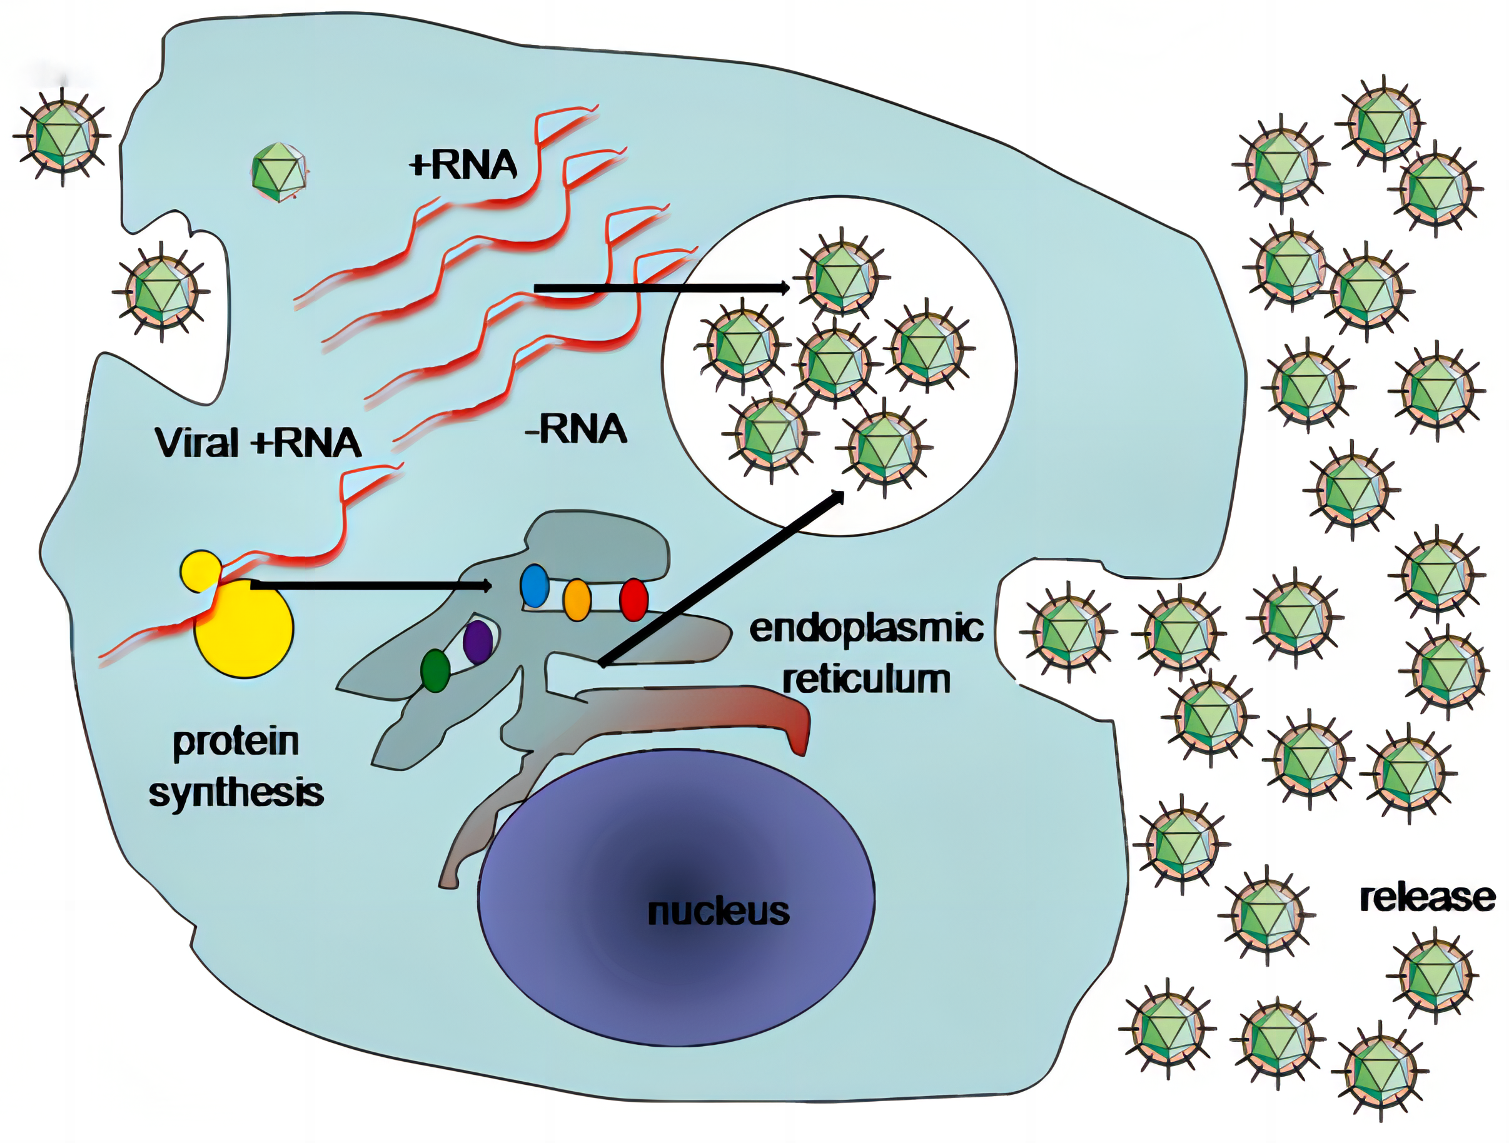

Biological Viruses VS Computer Viruses
Viruses replicates only in living cells | Execution is required to spread
Execution
Living cell

Slide 26
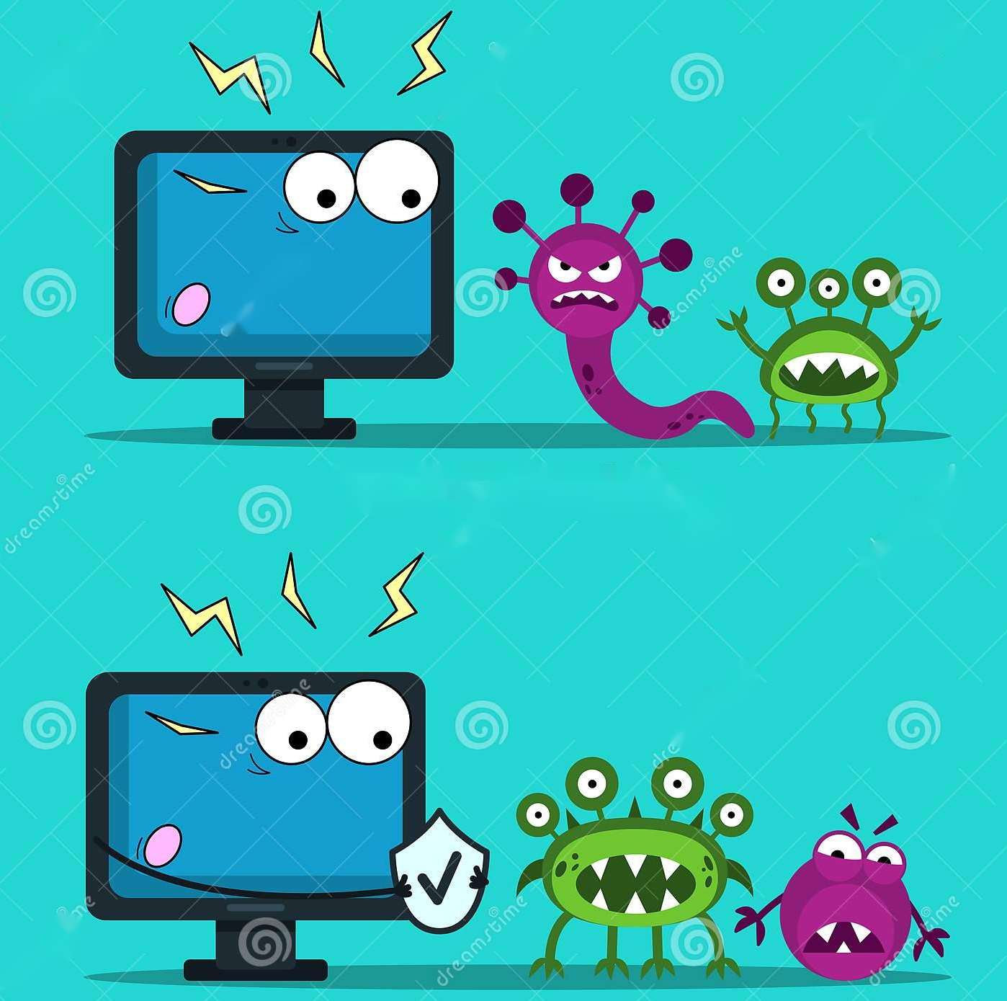

Biological Viruses VS Computer Viruses
Already infected cells are not reinfected | Virus use infection marker to prevent overinfection
Infection marker

Slide 27
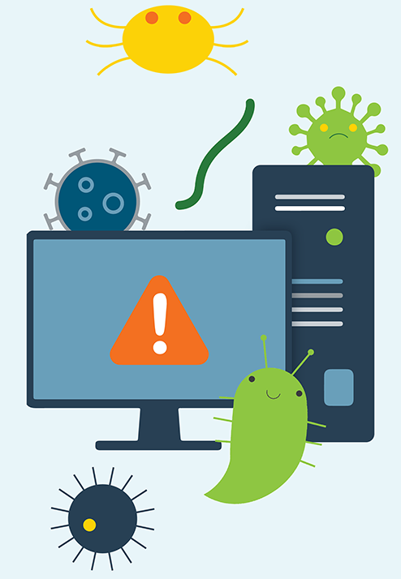
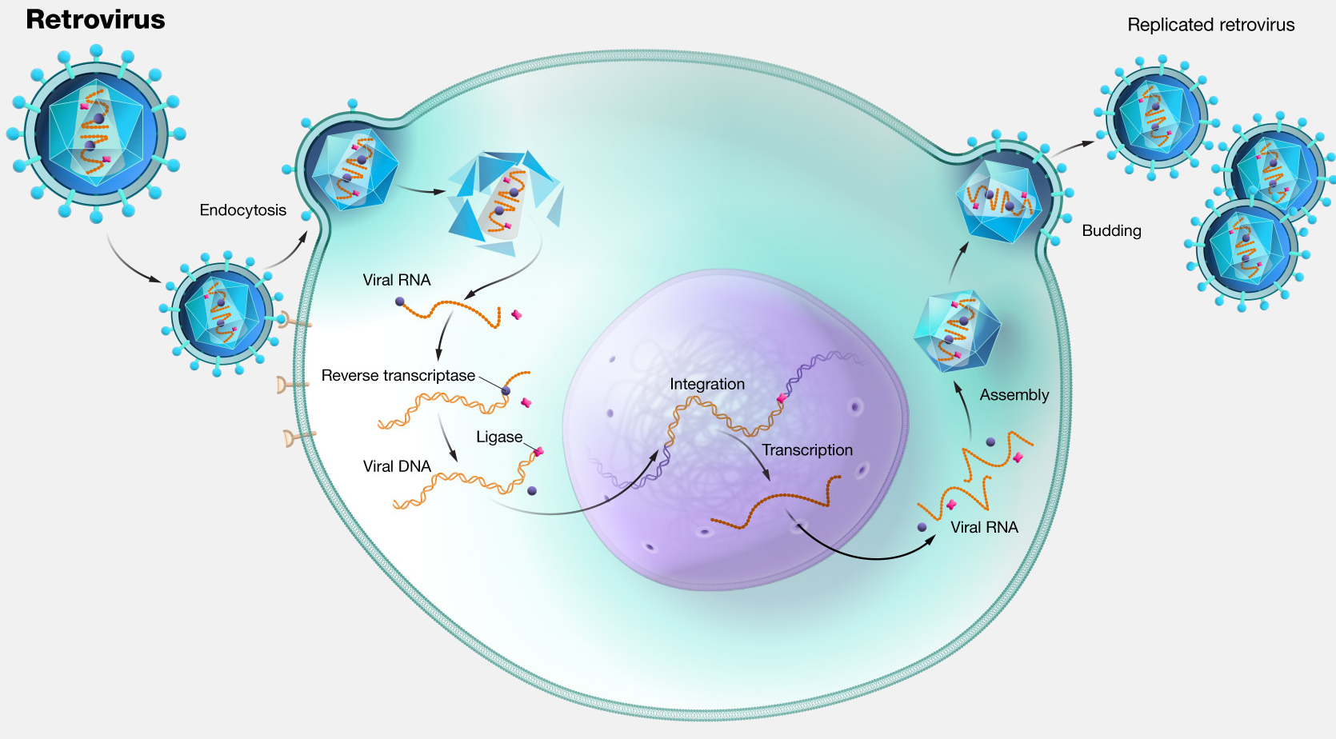
Biological Viruses VS Computer Viruses
Retrovirus | Virus specifically bypassing a given antivirus software-Source code viruses

Slide 28



Biological Viruses VS Computer Viruses
Healthy virus carriers | Latent or dormant viruses

Slide 29
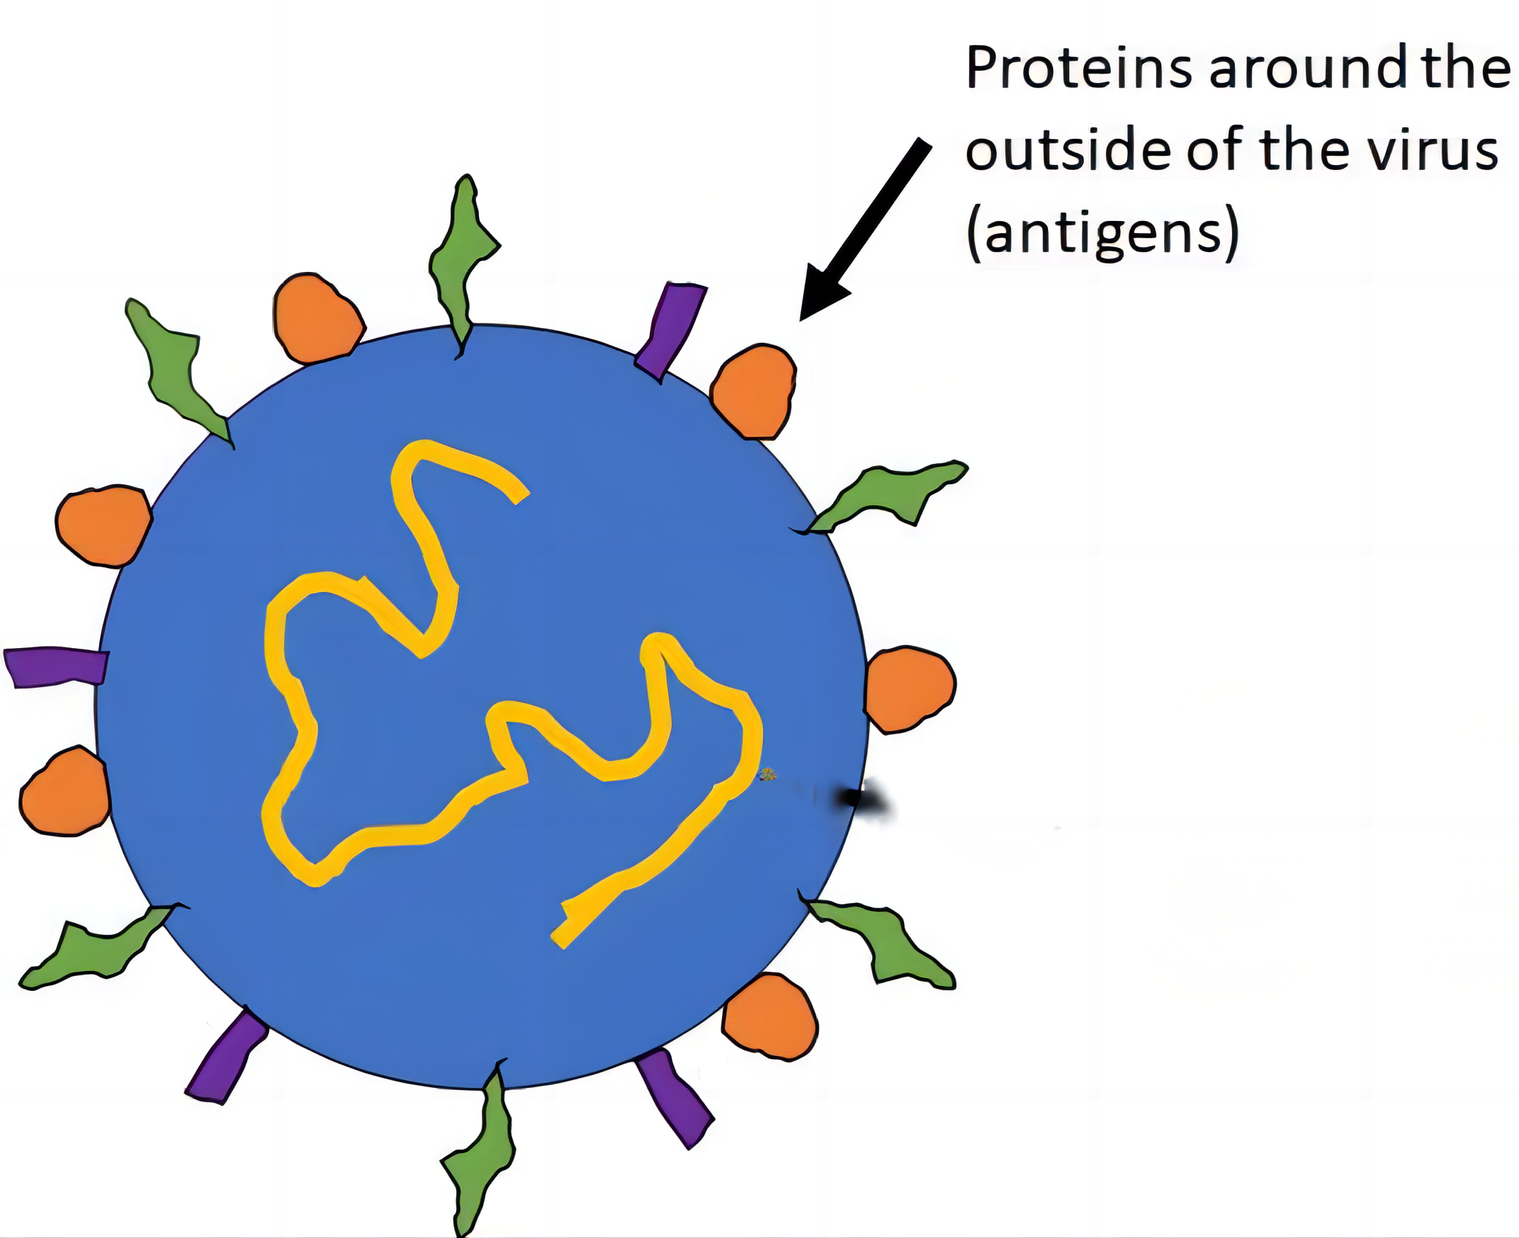
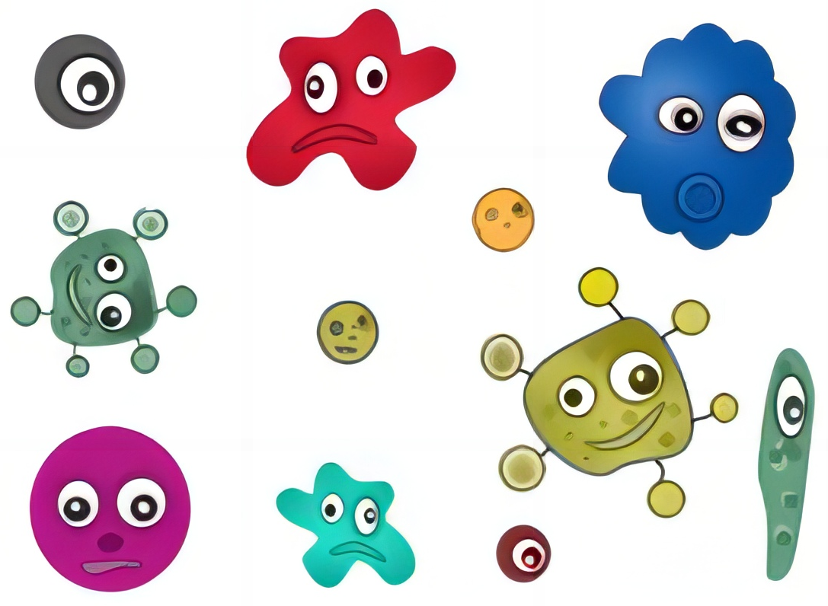
Biological Viruses VS Computer Viruses
Antigens | Infection markers-signature

Slide 30
Virus spread and operate
The infecting program is carried by an host program (called an infected program);The term of “dropper” is used to launch the very first infection.
Whenever the dropper is executed:
The infecting program takes control and acts according to its own operation mode. The host program is temporarily dormant;
Then the infecting program returns control to the host program. The latter is executed normally without betraying the presence of the infecting program.

Slide 31

Dropper
The dropper always takes an innocuous, mostly attractive appearance (such as games, flash animations, illegal copies of software, eyecatching emails) to convince users to activate it thus allowing the installation or spreading of the infection.

Slide 32
Conditions
A mass memory (mass storage devices) in which the infected program remains in an inactive form (dormant state).
A random access memory (RAM) to which a possibly infected program is mapped (creation of a process) whenever it is executed.
A processing unit or a microcontroller unit designed to execute the program binary code.
An operating system or any equivalent system.

Slide 33
Action Chart of Viruses or Worms
A search routine designed to find target programs or files to infect.
The search routine directly determines the scope and the efficiency of action of the virus.
A copy routine. The job of this routine is to copy its own code into a target program or file.
An anti-detection routine. Its purpose is to prevent antivirus programs from acting so that the given virus survives.

Slide 34

Viruses Life Cycle
The starting point of the life of a virus, once it has been inserted in an apparently innocuous program called the dropper, is precisely its release “in the wild” (diffusion phase).
As for target attacks (a small group of victims), the virus writer will have to gather some information beforehand (intelligence phase) about this group’s habits, desires and so on.
Allowing the virus to be executed along with the dropper and then to operate.

Slide 35

The infection phase
Passive infection:The virus will spread throughout the target environment in a passive way: the dropper is put at intended victims’ disposal.Victims then may copy it into their own environments, before executing it.
Active infection：The virus will spread in the target environment actively. The user or the system executes either the dropper (the system is infected for the first time, in other words, it is referred as the primary infection) or an infected file.

Slide 36

The incubation phase
This phase represents the longest one in the life of a virus.
The main purpose here is the virus’s survival in the infected system. Accordingly, it must escape detection by either:
The user himself. While writing an virus, a virus writer will try hard to avoid any execution error (bugs) which could alert the user.
Or antivirus programs. The virus will use various techniques designed to evade detection.

Slide 37
The disease phase
The final payload is activated at this stage.
The way it is triggered depends on various factors and especially on the location where the offensive function was inserted in the code:
If the offensive routine is located at the very beginning of the virus code, it means that as soon as the virus infects a new host or system, the payload will be executed immediately before any further spreading of the infection occurs.
If the offensive routine is located at the end of the virus code, the payload will be triggered only after the infection process.
If the offensive routine is inserted in the middle of the code, the payload will be triggered depending on whether the infection was successful or not.

Slide 38
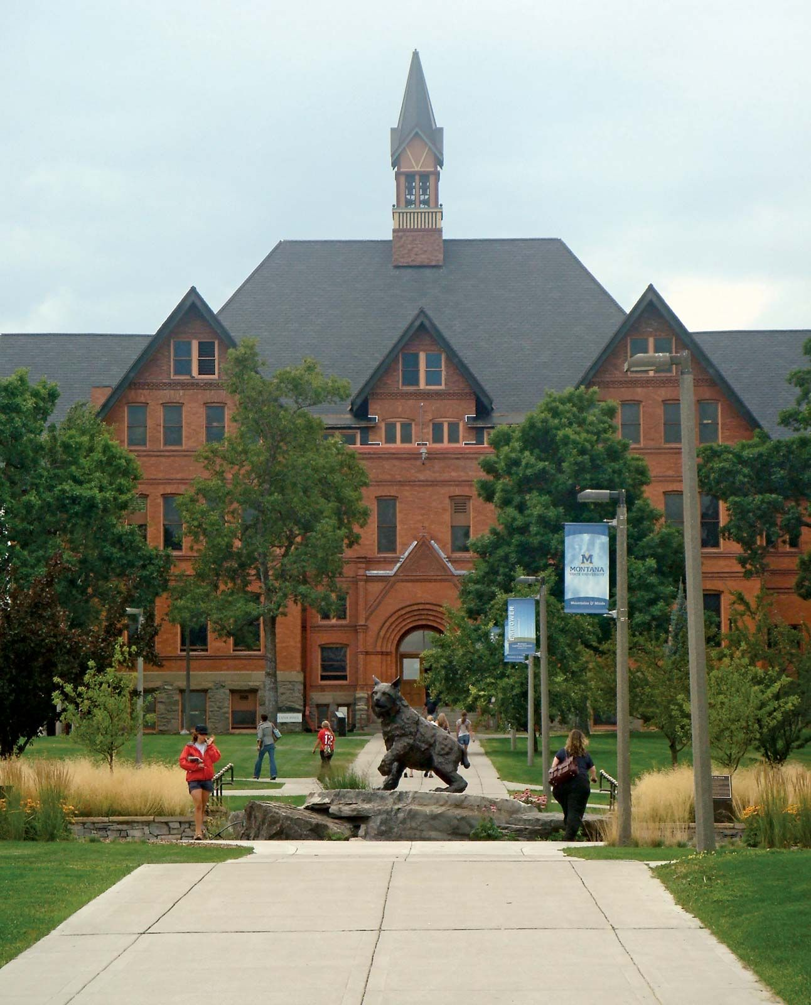
THE END
Fangtian Zhong
CSCI 591
Gianforte School of Computing
Norm Asbjornson College of Engineering
E-mail: fangtian.zhong@montana.edu
2023.09.19

